Slide 1
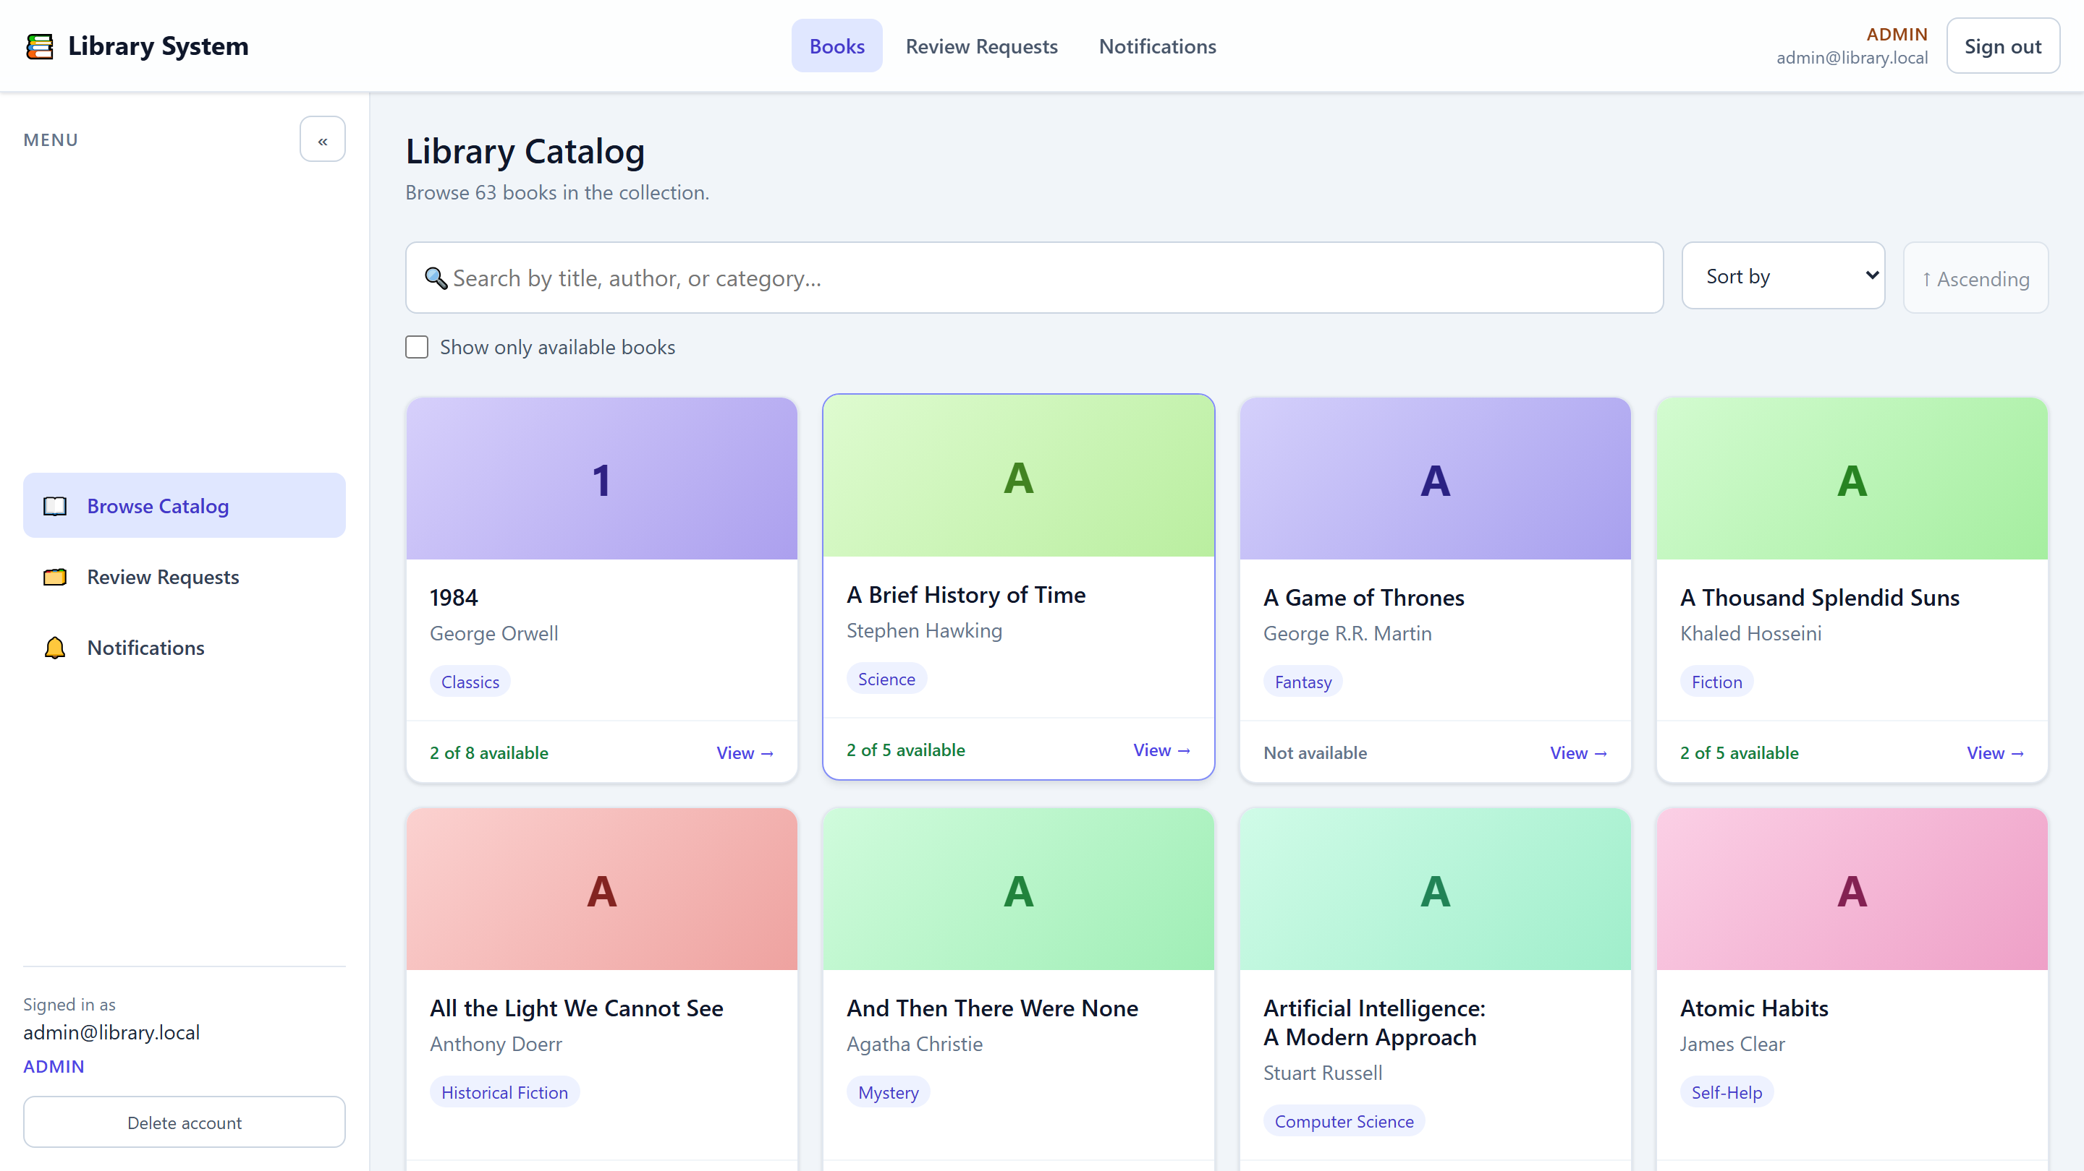
Library System
Full-Stack Library Management Platform
Angular 21 · .NET 10 · SQL Server RabbitMQ · SignalR · JWT Security
The actual application - live catalog with search, filters and pagination
1 / 20
Notes:
Welcome. This is our full-stack Library System: an Angular single-page application backed by a .NET Web API and SQL Server. On the right is the real application - a live catalog with search, sorting and availability filtering. Everything shown today is implemented and working, not mockups.

Slide 2
AGENDA
What We Will Cover
01
Project Overview
04
Security
Problem, objectives and user roles
JWT authentication and role authorization
02
Technology Stack
05
Integration
Angular 21, .NET 10, SQL Server, RabbitMQ
How the SPA talks to the API in real time
03
System Architecture
06
Screens & Conclusions
Frontend, backend and database design
Live UI, challenges, testing, roadmap
2 / 20
Notes:
Quick roadmap: we start with the problem and objectives, look at roles and features, then the technology stack and the architecture of all three tiers, followed by security, integration, real screens, the challenges we solved, and finally testing and future work.

Slide 3
MOTIVATION
Problem Statement & Objectives
The Problem
Objectives
Paper-based borrowing is slow and untraceable
No shared source of truth for request status
Librarians get no real-time awareness of new requests
No automatic reminders before due dates
Decisions lack an audit trail
Digitalize the borrow → review → return lifecycle
Enforce rules on client and server (1-30 days, reason required)
Decouple submission from processing with RabbitMQ
Deliver real-time + persisted notifications (SignalR)
Protect every endpoint with JWT and roles
Full audit trail: requestedAt / reviewedAt / reviewedBy
3 / 20
Notes:
The problem: manual borrowing workflows are slow, easy to lose track of, and give librarians no live view. Our objectives map one-to-one to features: digitalize the lifecycle with an audit trail, enforce rules on both tiers, decouple processing through a message queue, and notify people in real time.

Slide 4
ACTORS
Target Users & Roles
User - library member
Admin - librarian
Register and sign in with email / password
Browse, search, filter and sort the catalog
Request to borrow a book for 1-30 days
Track own borrowing history and statuses
Receive real-time notifications and reminders
Review the full borrowing-request queue
Approve requests (optional approval note)
Deny requests - reason is mandatory
Get notified the moment a request arrives
Monitor upcoming due dates (expiration job)
Roles live on User.Role, are embedded in the JWT role claim, and are enforced with [Authorize(Roles=...)] on the API plus route guards in Angular.
4 / 20
Notes:
Two roles only - deliberately simple. A User browses and borrows; an Admin reviews and decides. The key point: roles are not UI cosmetics. They are stored in the database, embedded in the JWT, enforced with Authorize attributes on the API, and mirrored by Angular route guards for UX.

Slide 5
SCOPE
Implemented Features
User features
Admin features
Account registration with instant sign-in
Email + password login (JWT)
Password reset via single-use emailed token
Catalog search, sorting, availability filter, paging
Borrow requests (1-30 days) via RabbitMQ
My Requests history with status badges
Notifications inbox - mark as read, unread badge
Self-service account deletion (password-confirmed)
Review queue with status filtering and paging
Approve with optional audit note
Deny with required reason (shown to the user)
Real-time alert on every new borrow request
Due-date reminders for users and admins
Role-scoped data: users only ever see their own rows
5 / 20
Notes:
Every feature listed is implemented and verified. Highlight the engineering depth: password reset with single-use hashed tokens, borrow requests flowing through RabbitMQ, notifications merged from two sources (REST history plus real-time pushes), and password-confirmed account deletion that cleans up all user data transactionally.

Slide 6
STACK
Technology Stack
Frontend
Backend
Data & Infrastructure
Angular 21 (standalone, zoneless)
TypeScript 5.9 strict
Signals state management
RxJS + @microsoft/signalr
Reactive forms + validators
SCSS design tokens
Vitest tests, Vite dev server
.NET 10 ASP.NET Core Web API
Entity Framework Core 10
JWT Bearer authentication
RabbitMQ.Client 7.2 messaging
SignalR real-time hub
Swashbuckle (Swagger) docs
MSTest + Moq unit tests
SQL Server - code-first migrations
5 entities, seeded dev data
RabbitMQ broker (async queue)
SMTP email delivery
Angular dev proxy
Git version control
6 / 20
Notes:
Stack choices: Angular 21 with standalone components and signals for state; .NET 10 with EF Core and JWT; SQL Server code-first; RabbitMQ for async; SignalR for real-time. The frontend never touches the database directly - everything goes through the REST API contract.

Slide 7
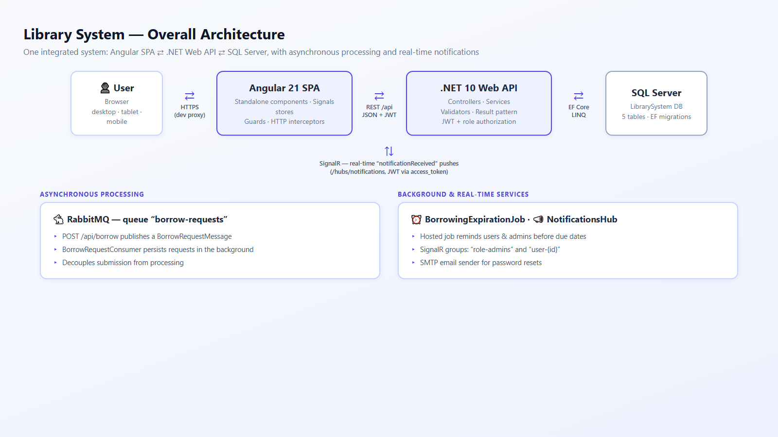
ARCHITECTURE
System Architecture - One Integrated System
7 / 20
Notes:
The big picture. Top row: browser, Angular SPA, .NET API, SQL Server. Below: two supporting systems. RabbitMQ decouples submission from processing - the API acknowledges immediately and a consumer persists the request. The expiration job and the SignalR hub handle reminders and real-time delivery.

Slide 8
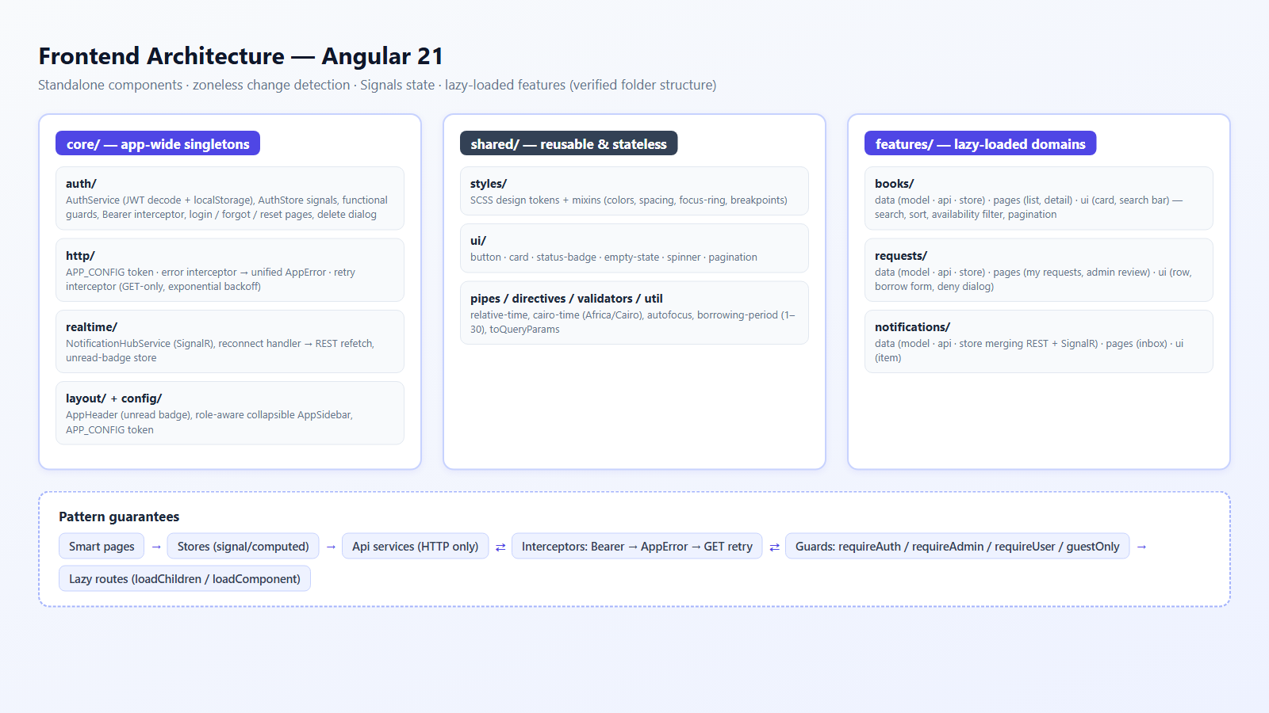
FRONTEND
Frontend Architecture (Angular 21)
8 / 20
Notes:
Frontend architecture: Core contains singletons (auth store, interceptors, SignalR client, layout). Shared contains stateless reusable pieces - the UI kit, pipes, validators. Features are lazy-loaded domains, each owning its data stores, API services and pages. State is signals-based; the retry interceptor only ever retries GETs, so a borrow or an approval can never be duplicated by a network blip.

Slide 9
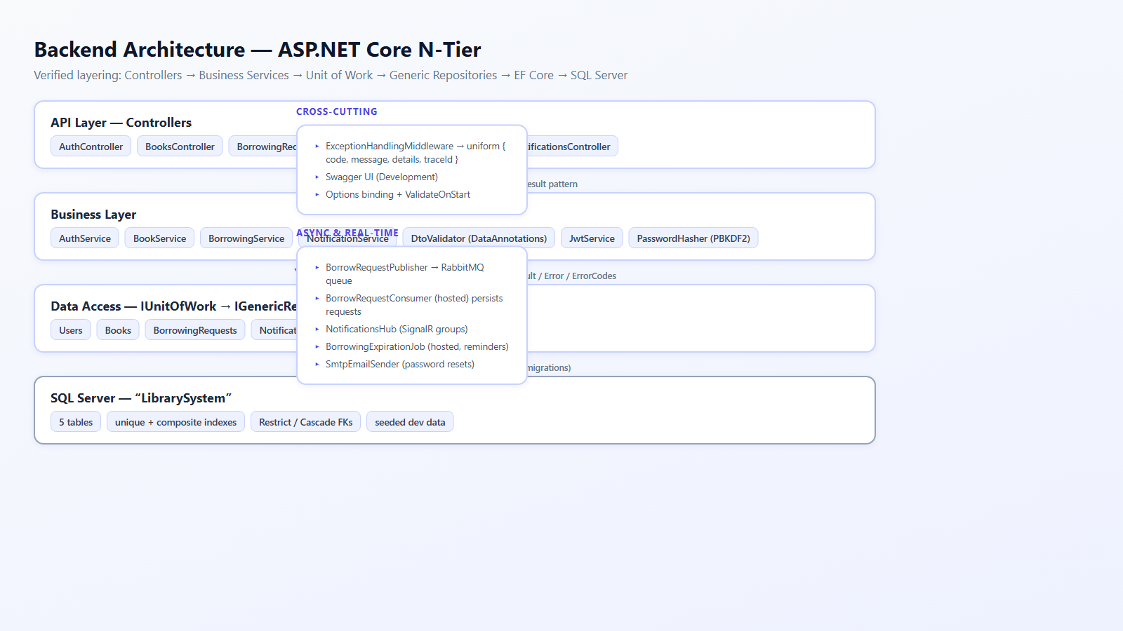
BACKEND
Backend Architecture (.NET 10 N-Tier)
9 / 20
Notes:
Backend: a strict N-tier. Controllers receive DTOs and return the Result pattern; business services contain the rules; the unit of work coordinates generic repositories; EF Core talks to SQL Server. Cross-cutting: exception middleware returns one uniform error envelope, and the messaging, notification and job services sit beside the layers without polluting them.

Slide 10
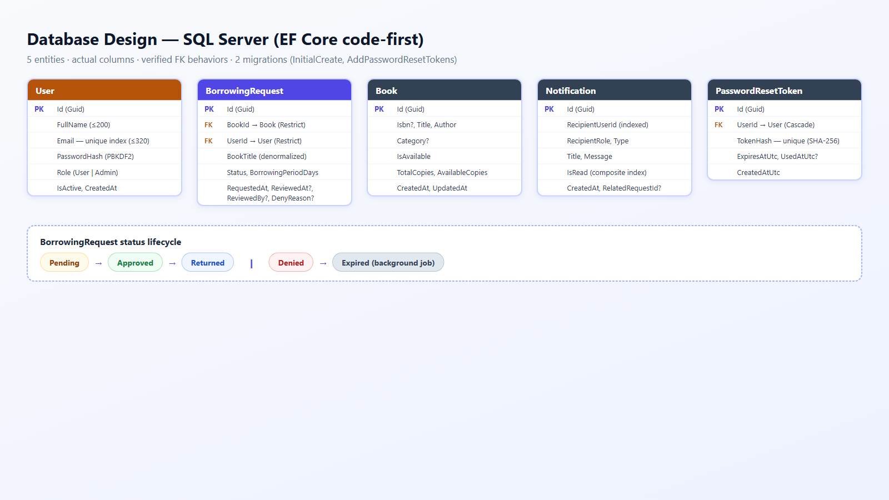
DATABASE
Database Design - 5 Entities
10 / 20
Notes:
Database: five entities. User and Book both have Restrict FKs to borrowing requests - history cannot be orphaned. Reset tokens cascade with their user. The status lifecycle is enforced by an enum, and the Expired transition is driven by the background job. Note the unique indexes on email and reset-token hash, and composite indexes for inbox queries.

Slide 11
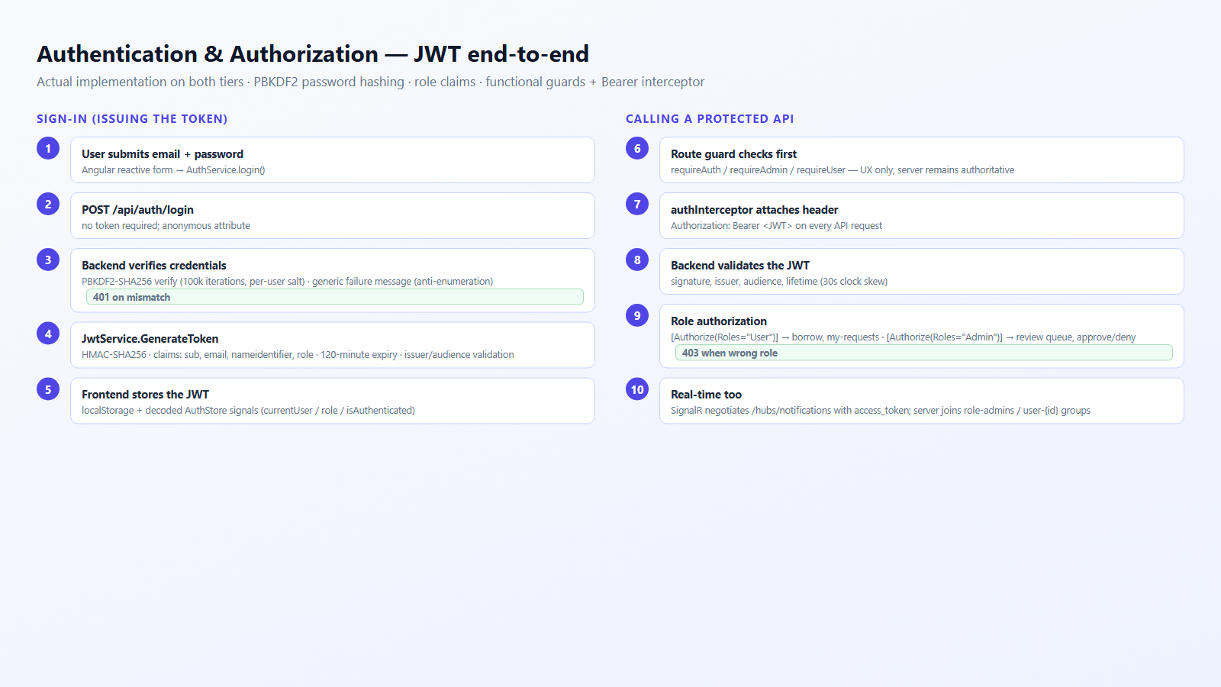
SECURITY FLOW
Authentication & Authorization - JWT
11 / 20
Notes:
Security flow. Left: sign-in verifies the password against its PBKDF2 hash and issues a signed 120-minute JWT containing the role claim; unknown users and wrong passwords get the same message so attackers cannot enumerate accounts. Right: every request carries the Bearer token; the API validates it and checks role attributes. SignalR accepts the same token via the access_token handshake.

Slide 12
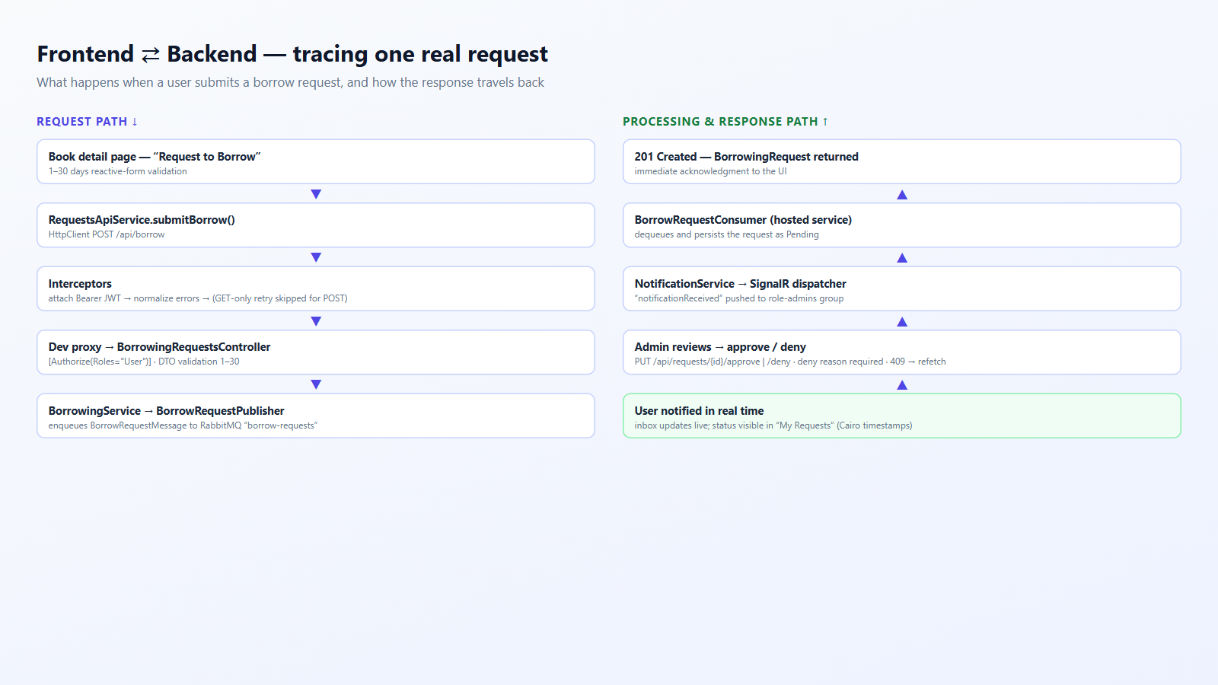
INTEGRATION
Frontend and Backend - a Real Request Trace
12 / 20
Notes:
Integration trace of one real request - the borrow. Down the left: form validation, API service, interceptors, proxy, controller, RabbitMQ publisher. Up the right: the consumer persists the request as Pending, admins get a live push, the decision endpoints update the row, and the user is notified. All endpoints shown are the real ones from the API contract.

Slide 13
GATEWAY
WSO2 + ngrok - One Secured Entry Point
Angular 21
SPA + in-memory token cache
ngrok
TLS tunnel (free tier)
WSO2 API Manager
OAuth2 + CORS + policies
.NET 10 API
JWT + role checks
API BASE
https://cohesive-roundup-demeanor.ngrok-free.dev/api/1.0.0/api - every REST call goes through here
TOKEN ENDPOINT
POST /token-api/1.0.0/oauth2/token - OAuth2 client_credentials grant, 1-hour access tokens
GATEWAY POLICIES
OAuth2 on secured resources, CORS allow-list, user-header swap policy (InjectionToken2)
Verified end-to-end: login, register and role checks (200 / 401 / 403) - all traffic flows ngrok -> WSO2 -> API, never direct
13 / 20
Notes:
All traffic now flows through one secured entry point: the Angular app calls the ngrok domain, which tunnels to WSO2 API Manager, which fronts the .NET API. Walk through the base URL and token endpoint; mention OAuth2-secured resources, the CORS allow-list and the user-header swap policy. Stress that the backend is never called directly.

Slide 14
GATEWAY
Two Tokens, One Request - How Auth Travels
1.
A client_credentials POST fetches a WSO2 access token - cached in memory, refreshed before expiry
POST /api/1.0.0/api/requests
Authorization: Bearer eyJraWQi... <- WSO2 token
user: Bearer eyJhbGci... <- backend JWT
ngrok-skip-browser-warning: true
HTTP/1.1 200 OK (401 / 403 on failure)
2.
Every request carries the WSO2 token in Authorization and the backend JWT in user
3.
WSO2 validates the gateway token; the InjectionToken2 policy swaps user -> Authorization toward the API
4.
The backend enforces [Authorize] + roles; 401 / 403 surface as friendly in-app errors
14 / 20
Notes:
Explain the dual-token scheme: WSO2 consumes the Authorization header for its own OAuth2 check, so the backend JWT travels in the user header; a WSO2 mediation policy rewrites it into Authorization on the way to the API. Mention in-memory token caching with pre-expiry refresh and the single environment config. Close with the verified end-to-end results: login, register and role checks all pass through the gateway.

Slide 15
GATEWAY
Inside API Manager - Resources & Token Policy
RESOURCES IN API MANAGER
TOKEN POLICY AT THE GATEWAY
REST resources mirrored from the backend contract - exposed through one managed gateway.
INTEGRATION TOKEN
Authentication
POST /api/auth/login - register - forgot/reset
Controls client access through WSO2. Issued via the client_credentials grant and sent as Authorization: Bearer on every request - validated at the gateway before anything reaches the API.
Books
GET /api/books - GET /api/books/:id
Borrowing requests
POST /api/borrow - GET /api/requests/my
BACKEND TOKEN
Secures communication toward the .NET API. The backend JWT travels in the user header, and a gateway policy swaps it into Authorization on the way to the backend - no backend code changes.
Admin actions
PUT /api/requests/:id/approve - deny
Notifications
GET /api/notifications - unread count
Policies standardize handling at the gateway - the backend stays untouched.
15 / 20
Notes:
Created the REST resources in WSO2 API Manager from the backend contract - each pairing an HTTP method and URI (GET /api/books, POST /api/borrow, PUT approval/denial) - so all functionality is exposed through one managed gateway: authentication, books, borrowing requests, admin actions and notifications. Then the token policy: the integration token controls client access through WSO2, while the backend token secures communication toward the API. Policies apply these rules and standardize request/response handling without changing backend code.

Slide 16
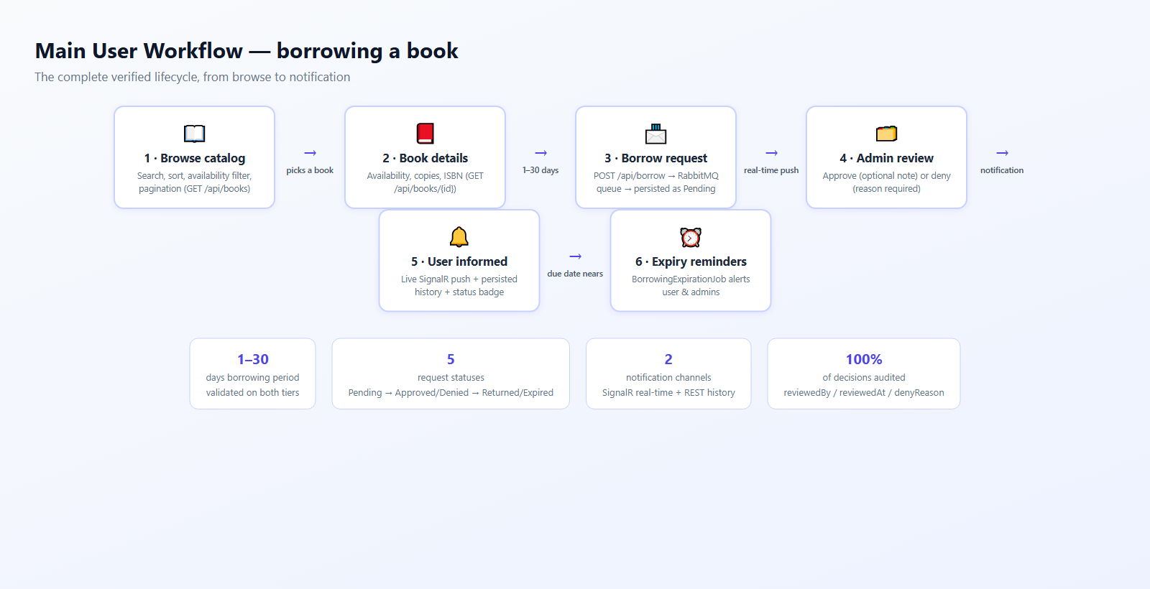
MAIN WORKFLOW
Borrowing a Book - End to End
16 / 20
Notes:
The end-to-end user journey with the enforced rules summarized at the bottom: period validated 1-30 on both tiers, five statuses, two notification channels, and every decision audited with reviewer, timestamp and denial reason.

Slide 17
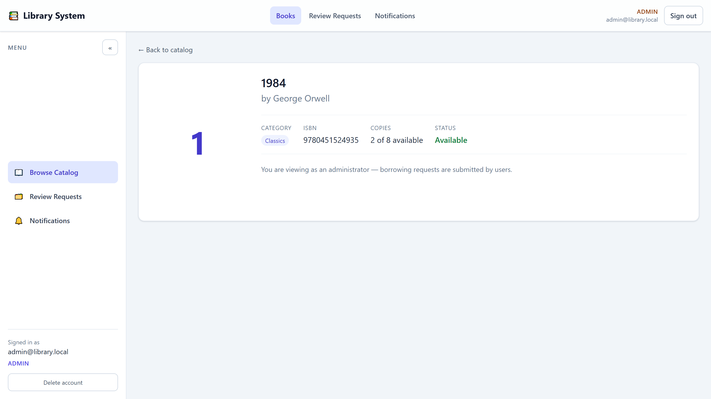
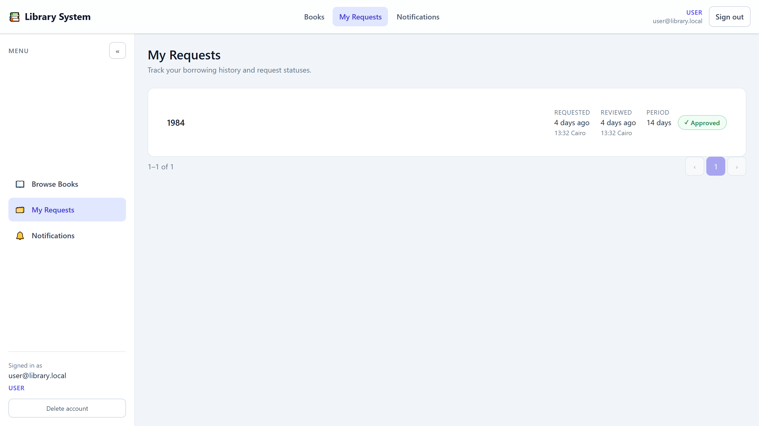
USER EXPERIENCE
Key Screens - User Journey
Catalog - live search, sort by title/author/date, availability filter, deep-linkable filters
Book details - copies, ISBN, availability and the 1-30 day borrow form
My Requests - history with status badges and Cairo timestamps
Registration and password reset are fully implemented: signing up issues a session immediately, and a forgotten password is recovered with a single-use emailed token that expires after 30 minutes. Users can also delete their account - it requires the current password and removes all their data in one transaction.
17 / 20
Notes:
User journey screens - real captures from the running app. The catalog supports deep-linkable filters (they survive refresh and sharing), the detail page exposes the borrow form with inline validation, and My Requests shows each status with a color-plus-icon badge and Cairo-local timestamps.

Slide 18
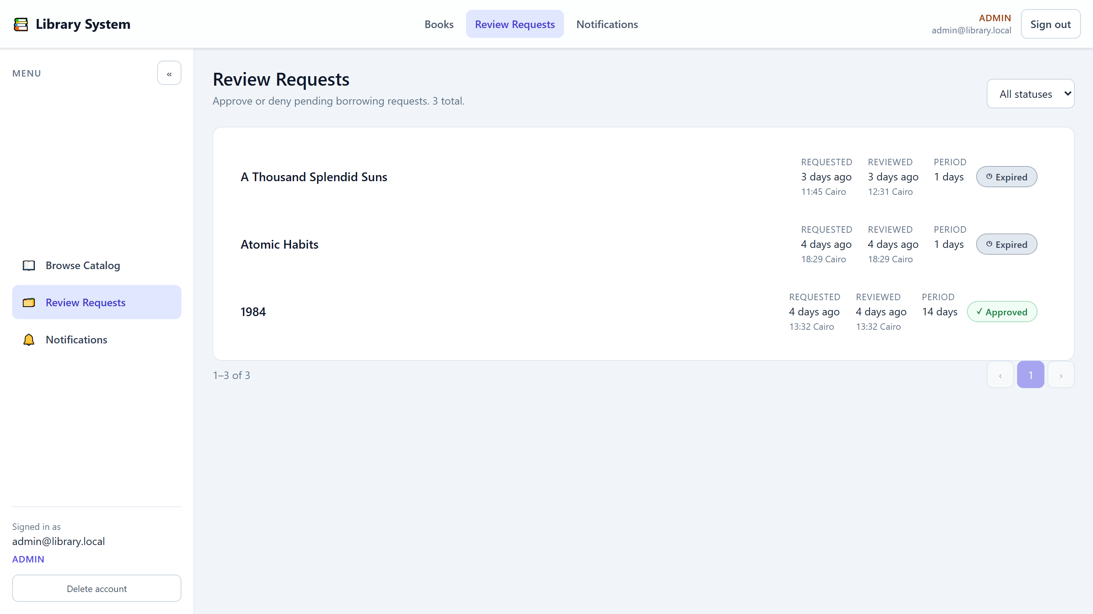
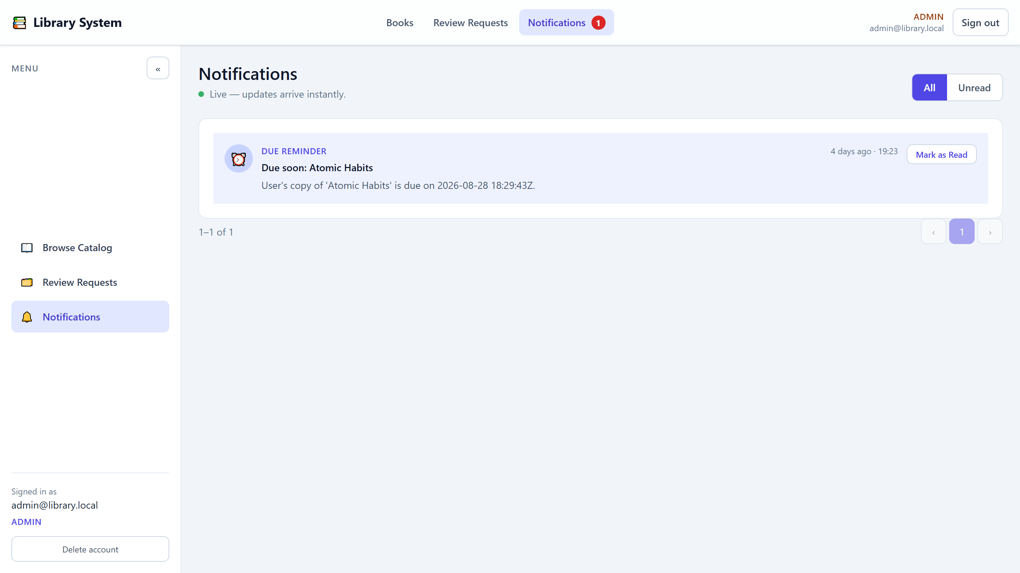
ADMIN EXPERIENCE
Key Screens - Review & Notifications
Review queue - approve or deny; denial requires a written reason; 409 conflicts refetch live state
Notification inbox - real-time SignalR pushes merged with REST history, unread badge in the header
18 / 20
Notes:
Admin side: the review queue with status filtering, approve with an optional audit note, deny with a mandatory written reason that the user later sees. The notifications inbox merges live SignalR pushes with the REST history and keeps the unread badge in sync. Conflicts - for example two admins deciding simultaneously - surface a 409 and the list refreshes to authoritative state.

Slide 19
QUALITY
Security & Validation
Security
Validation
PBKDF2-SHA256 hashing - 100k iterations, per-user salt
JWT HMAC-SHA256, 120-min expiry, issuer/audience checks
Role claims + [Authorize(Roles=...)] on every endpoint
Reset tokens: SHA-256 stored, single-use, 30-min expiry
Anti-enumeration: generic login / forgot-password replies
Secrets from configuration - never committed to Git
Server: DataAnnotations gate on every request DTO
Server: 1-30 day period, deny reason 3+ chars
Server: unique email = 409 CONFLICT
Client: reactive forms mirror the same rules
Client: normalized AppError = friendly inline messages
Uniform error envelope: code, message, details, traceId
19 / 20
Notes:
Security and validation form defense in depth. Server-side: PBKDF2 hashing, signed JWTs, role attributes, DTO validation gates and business rules. Client-side: the same rules mirrored in reactive forms for fast feedback, and a normalized error model so users only ever see friendly messages. The uniform error envelope keeps the contract consistent.

Slide 20
CLOSING
Testing, Future Work & Conclusion
Testing
Future work
Conclusion
Backend unit tests (MSTest + Moq):
BorrowingService create rules
BorrowingService approve/deny
NotificationService behavior
Frontend: Vitest component tests
Flows verified end-to-end in a browser
Admin CRUD for books
Refresh tokens / sliding sessions
Dedicated return-workflow endpoint
Email notifications for all events
Playwright E2E suite
Docker Compose for the full stack
A production-style, contract-driven system: layered .NET API, modern Angular SPA, asynchronous messaging, real-time notifications and hardened security - all verified working end-to-end. Thank you - questions welcome!
20 / 20
Notes:
Testing: unit tests cover the borrowing create rules, the approve/deny decisions and notification behavior on the backend; the frontend has component tests; all major flows were verified end-to-end in automated browser sessions. Future work is scoping, not missing foundations. Close by inviting questions and offering a live demo.

