Slide 1
zakat.icclmd.org - website map
Home
Forgot Password
Create Account
public security roles
Login
non-public security roles
Zakat Portal
Change Password
Zakat Inbox
Admin
Console
Review Zakat Application Status
Maintain Profile Data
Submit Zakat Application
one-time submission
Review Zakat Application
Organization Admin
Console
User Admin
Console
Security Admin Roles:
Role | Description
Administrator | This role enables a user with it to administer organizations, users, and roles
Applicant | This role is given to public users enabling them the ability to maintain a profile, submit zakat applications, and review status
Validator | This role enables a user with it to review a zakat form to ensure that the data entered is complete and not artificial
Investigator | This role enables a user with it to leverage the data on the zakat form to perform an investigation on the zakat case
Qualifier Step 1 | This role enables a user with it to leverage the data on the zakat form to make an eligibility ruling on the zakat case (qualifier step 1)
Qualifier Step 2 | This role enables a user with it to leverage the data on the zakat form to make an eligibility ruling on the zakat case (qualifier step 2)
Financier | This role provides a user the ability to be notified about an approved zakat application so that funds can be dispersed

Slide 2
zakat.icclmd.org - home page
$$$ Change Password Create Account Forgot Password Login
$$$

Slide 3
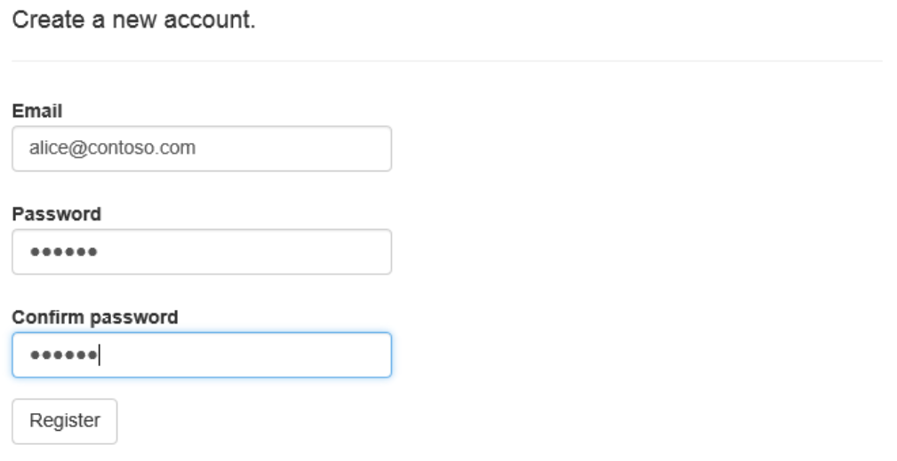
zakat.icclmd.org – create account
$$$ Change Password Forgot Password Login

Slide 4
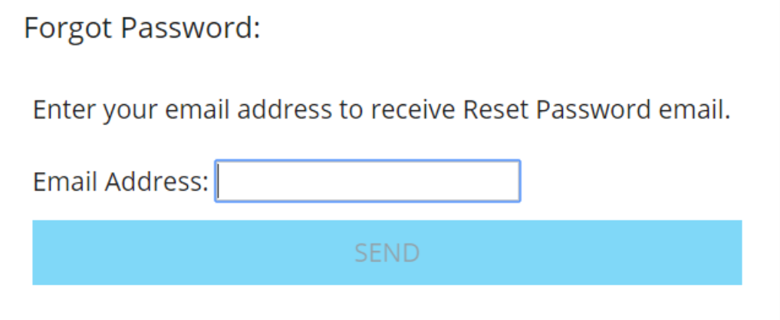
zakat.icclmd.org – forgot password
$$$ Change Password Create Account Login

Slide 5
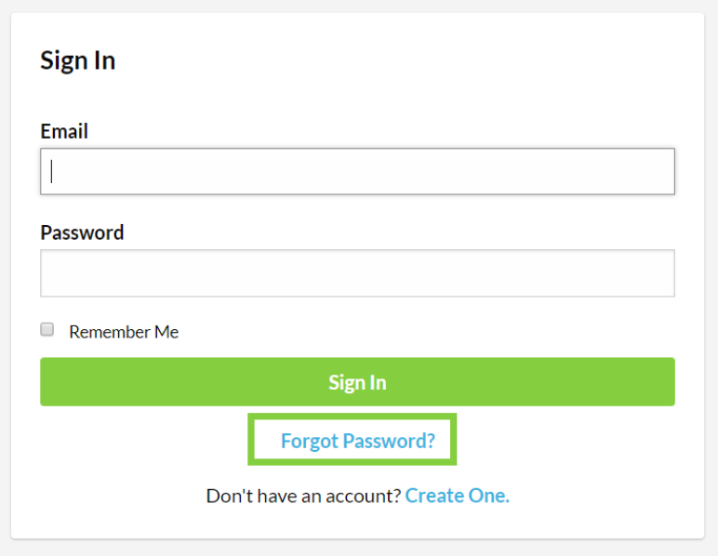
zakat.icclmd.org – login
$$$ Change Password Create Account Forgot Password

Slide 6
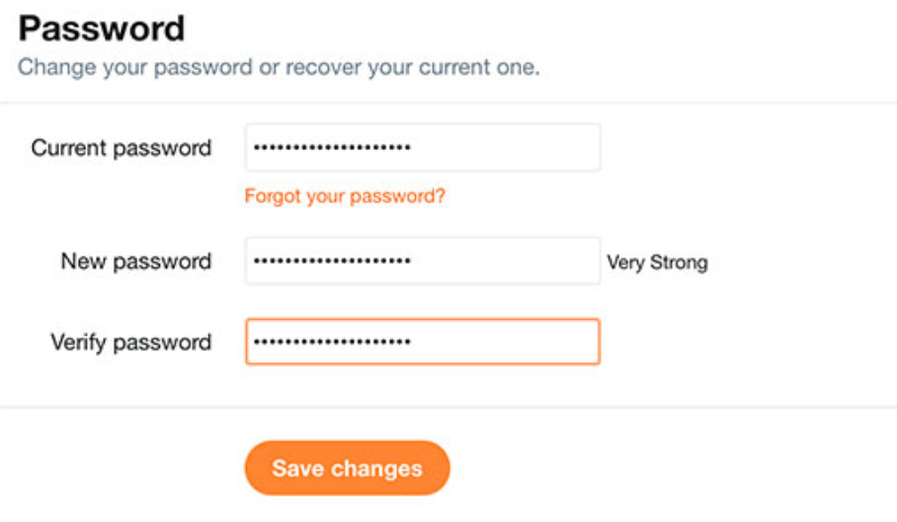
zakat.icclmd.org – change password
$$$ Logout

Slide 7
zakat.icclmd.org – zakat portal
$$$ Change Password Review Status Maintain Profile Submit Application Logout
$$$

Slide 8
zakat.icclmd.org – review zakat application status
$$$ Change Password Zakat Portal Logout
$$$

Slide 9
zakat.icclmd.org – maintain profile data
$$$ Change Password Zakat Portal Logout
$$$
Submit Application

Slide 10
zakat.icclmd.org – submit zakat application
$$$ Change Password Zakat Portal Logout
$$$

Slide 11
zakat.icclmd.org – zakat inbox
$$$ Change Password Logout
$$$

Slide 12
zakat.icclmd.org – review zakat application
$$$ Change Password Zakat Inbox Logout
$$$

Slide 13
zakat.icclmd.org – administration console
$$$ Users Organizations Logout
$$$

Slide 14

zakat.icclmd.org – user role administration
$$$ Users Organizations Logout
Users:
Assigned Roles:
Eiad Sayyad
Muna Sayyad
Aleena Sayyad
Ziad Sayyad
Aminnah Sayyad
Ayah Sayyad
Zayd Sayyad
Administrator
Applicant
Validator
Investigator
Assigned Roles:
Administrator
Applicant
Validator
Investigator
Qualifier

Slide 15
zakat.icclmd.org – organization administration
$$$ Users Organizations Logout
$$$

Slide 16
zakat.icclmd.org – user role administration
$$$ Users Organizations Logout
Artifact Type:
Choose File
Upload Artifact
Photo Identification
Lease/Mortgage Document
Utility Bill
Medical Bill
Tuition Bill
Eviction Notice
Other
Your Current List of Artifacts For This Application Are Shown Below:
# | Artifact Type | Filename | Content Type | Delete
0006 | Photo Identification | Eiad.jpg | Image/jpg | X
0007 | Medical Bill | Doctors Hospital Bill.pdf | Document/pdf | X

Slide 17
