Slide 1
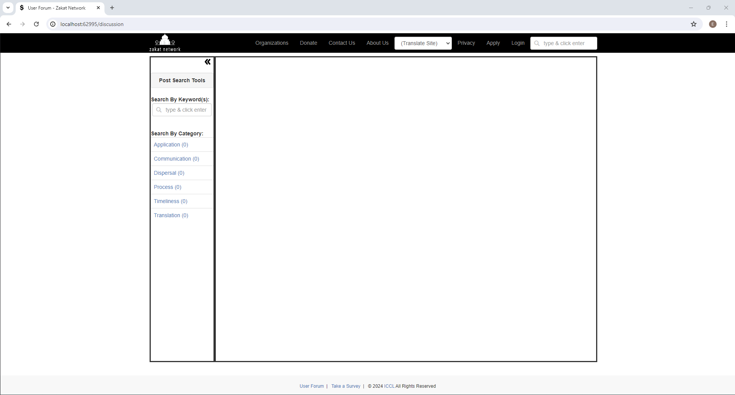
URL Parameters:
?mode=s&id=0&term=process
mode
id
term
BODY
A
C
List of Search Results
E
Post
pnlSearchResults
visible=false
D
B
List of Specific Post Categories
pnlPostCategories
visible=false
PANE
pnlPost
visible=false

