Slide 1
Mini-Project
Sound localization with spiking neural networks (SNN)
Volker Bormuth
Maitre de Conférence
Laboratoire Jean Perrin
Campus Jussieu, Tour 32-33, bureau 416
volker.bormuth@sorbonne-universite.fr

Slide 2
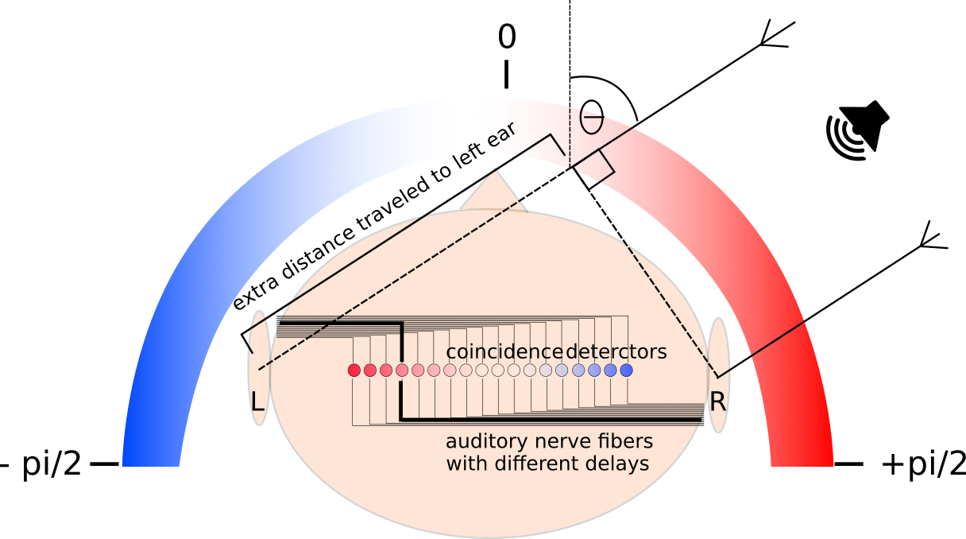
Sound localization task
Humans:
Can detect interaural time-of-arrival differences (ITDs) of as small as 10-20 microseconds
This corresponds to directional differences of sound sources in the horizontal plane as small as 1-2 degrees (azimuth).
ITDs = zero for sounds coming from in front
IDT = 700 microseconds for sounds coming from the side.
ITD = inter time-of-arrival differences
IPD = inter phase difference
https://comob-project.github.io/snn-sound-localization/

Slide 3
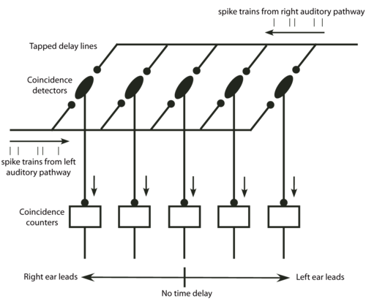
Jeffress model
Jeffrey in 1948 proposed the existence of coincident detection neurons in the brain to solve the task
See here for more details: http://www.scholarpedia.org/article/Jeffress_model

Slide 4
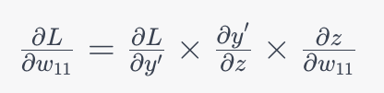
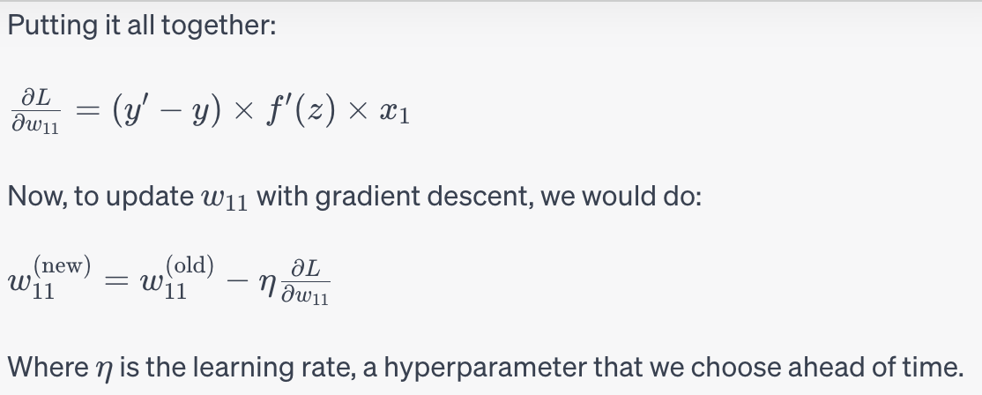
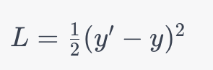
Artificial Neural Networks (ANN):
Inputs
Weights
Summation
Activation
Output
Linear
Non-linear:
Sigmoidal
Softmax
…
x₁
w₁₁
f(z₁)
z₁ = w₁₁ x₁ + w₂₁ x₂
y’ = f(z₁) : prediction
y : true value
x₂
w₂₁
Weights update
Backpropagation
Loss function,
e.g. root mean squared
Gradient
Loss
score
η = learning rate

Slide 5
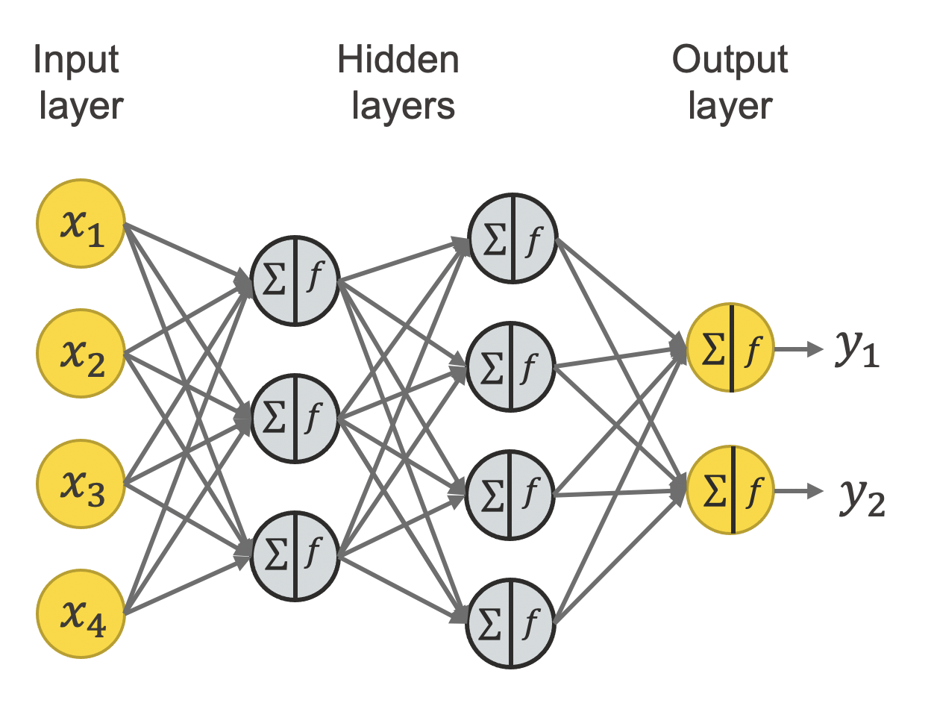
Artificial Neural Networks (ANN):
A neuronal networks combines linear layers with a non-linear activation function, f, and uses stack of multiple layers.
=> This allows the approximation of complex non-linear functions and thus to model complex patterns in data

Slide 6
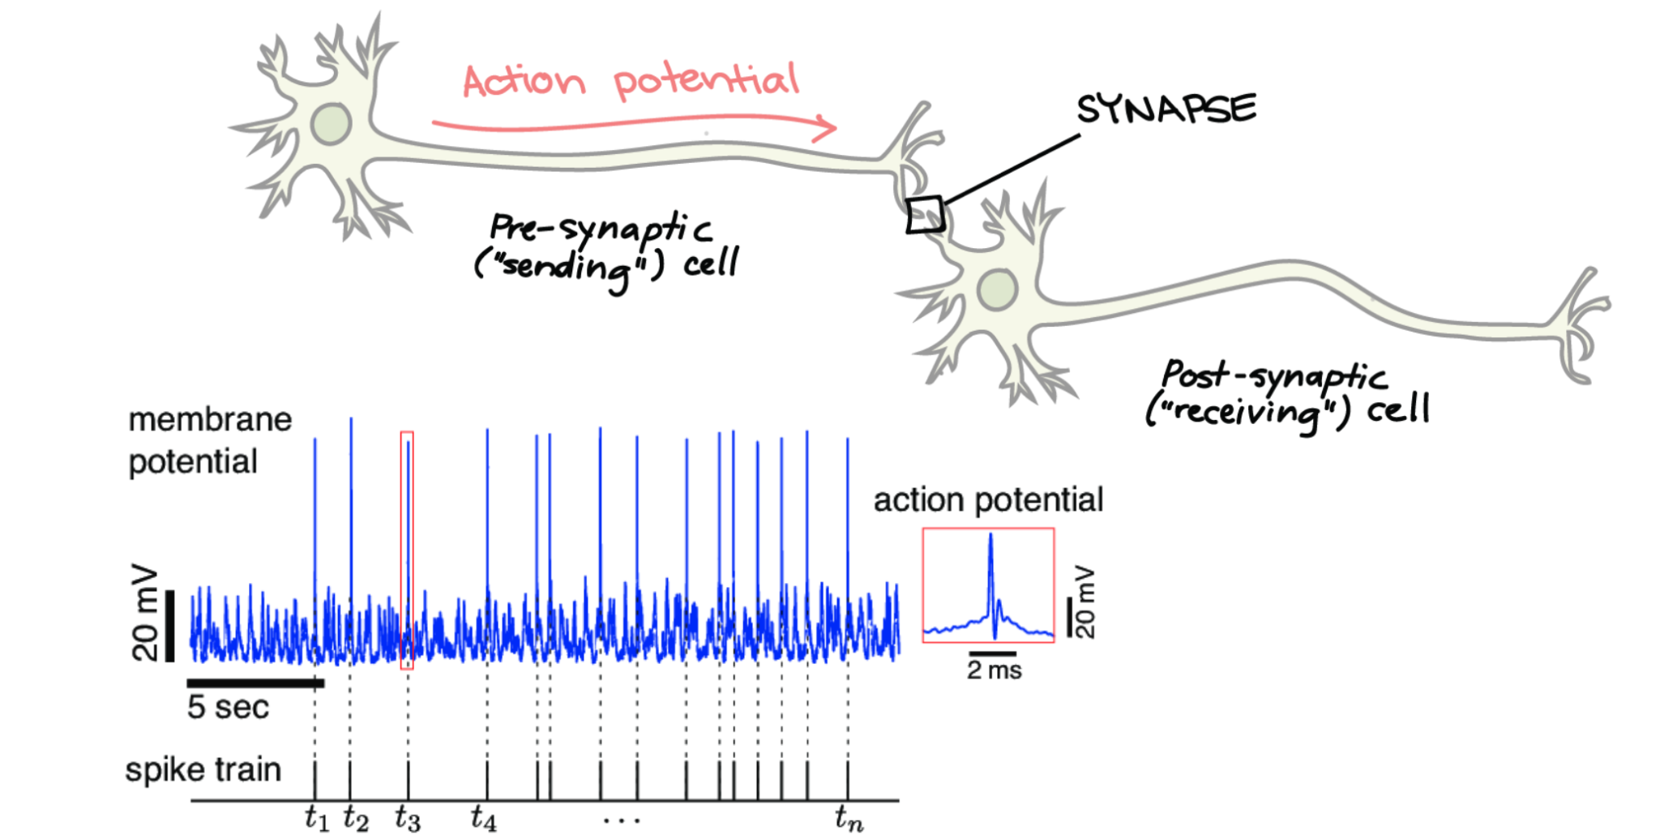
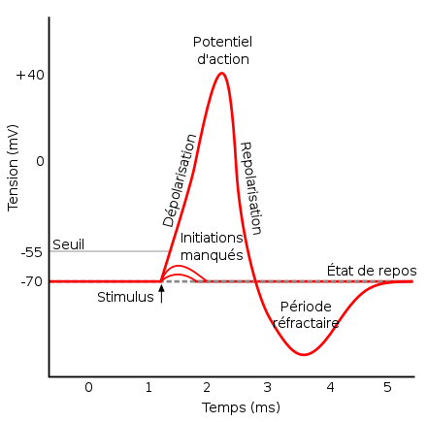
Real neurons

Slide 7
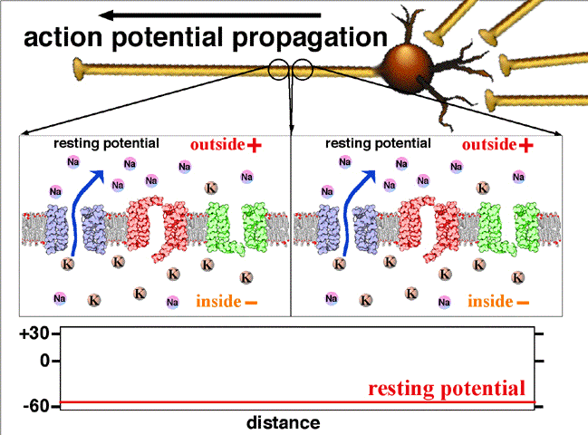
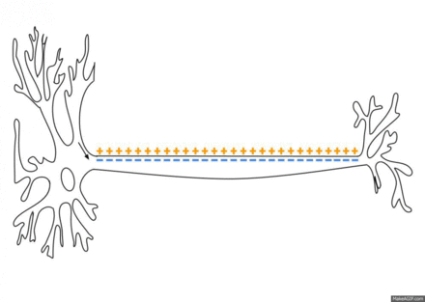
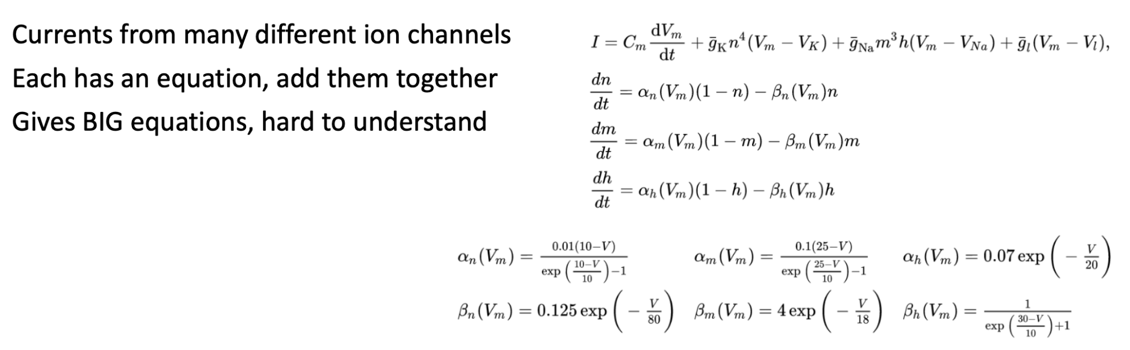
Hodgkin-Huxley and other biophysically detailed models

Slide 8
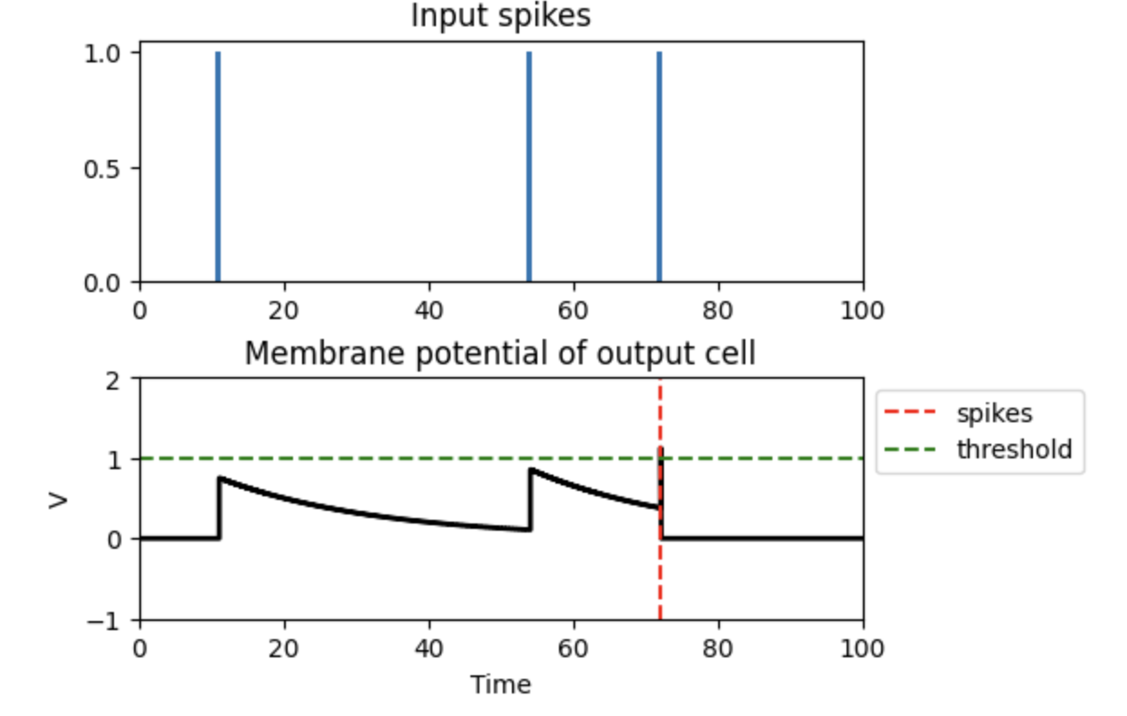
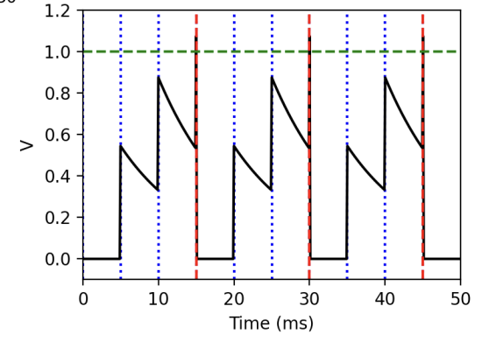
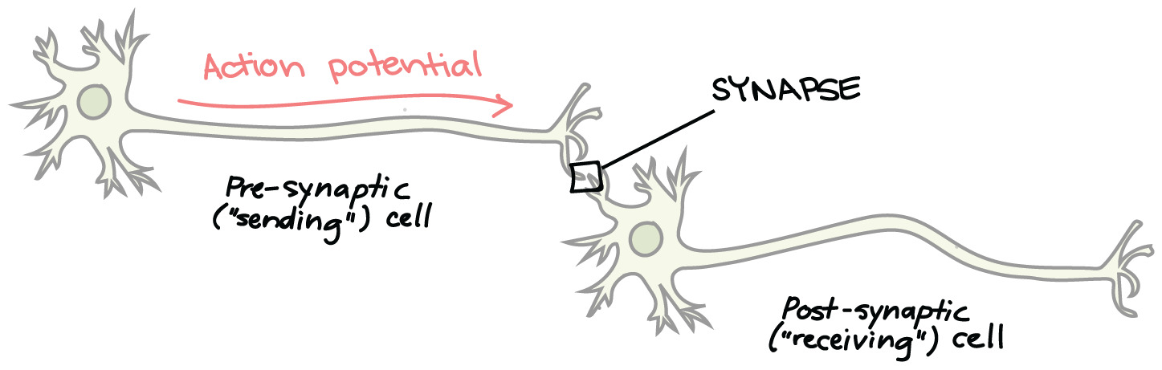
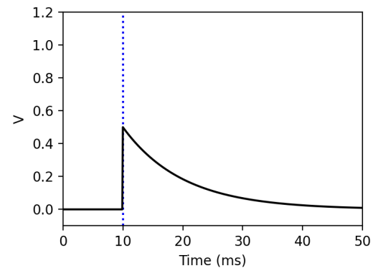
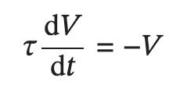



Leaky integrate and fire model (LIF)
V
Kahn Academdy
In the absence of any input, the variable evolves over time according to the differential equation
Every input spike increases the membrane potential by a constant
The solution is:
If V exceeds a threshold the neuron spikes and V is reset to its resting potential
with 𝜏 the time constant controlling how quickly V relaxis back to its resting state.

Slide 9
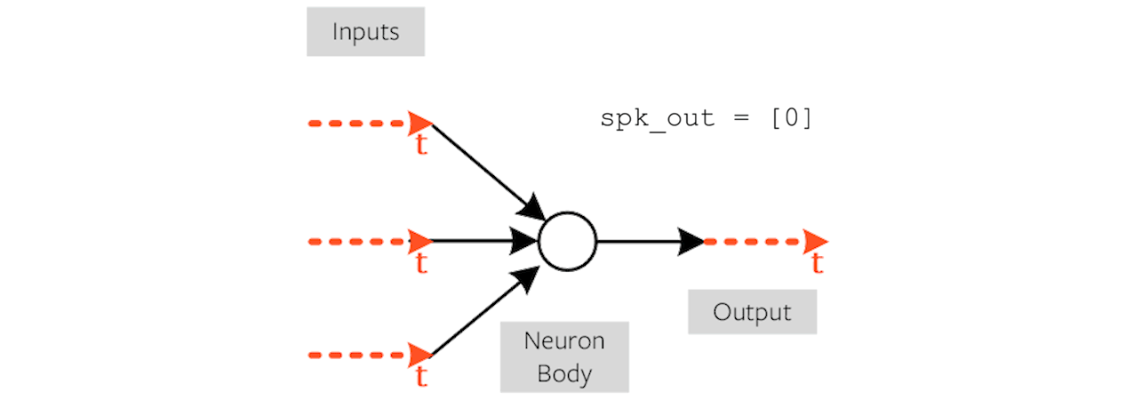

Slide 10
Spiking Neural Networks (SNN):
=> surrogate gradient descent for training
Inputs
Weights
Summation
Activation
Output
Linear
Non-linear:
Heavy side
x₁
w₁₁
f(z₁)
z₁ = w₁₁ x₁ + w₂₁ x₂
y’ = f(z₁) : prediction
y : true value
x₂
w₂₁
Weights update
Backpropagation
Loss function,
e.g. root mean squared
Gradient
Loss
score
η = learning rate

Slide 11
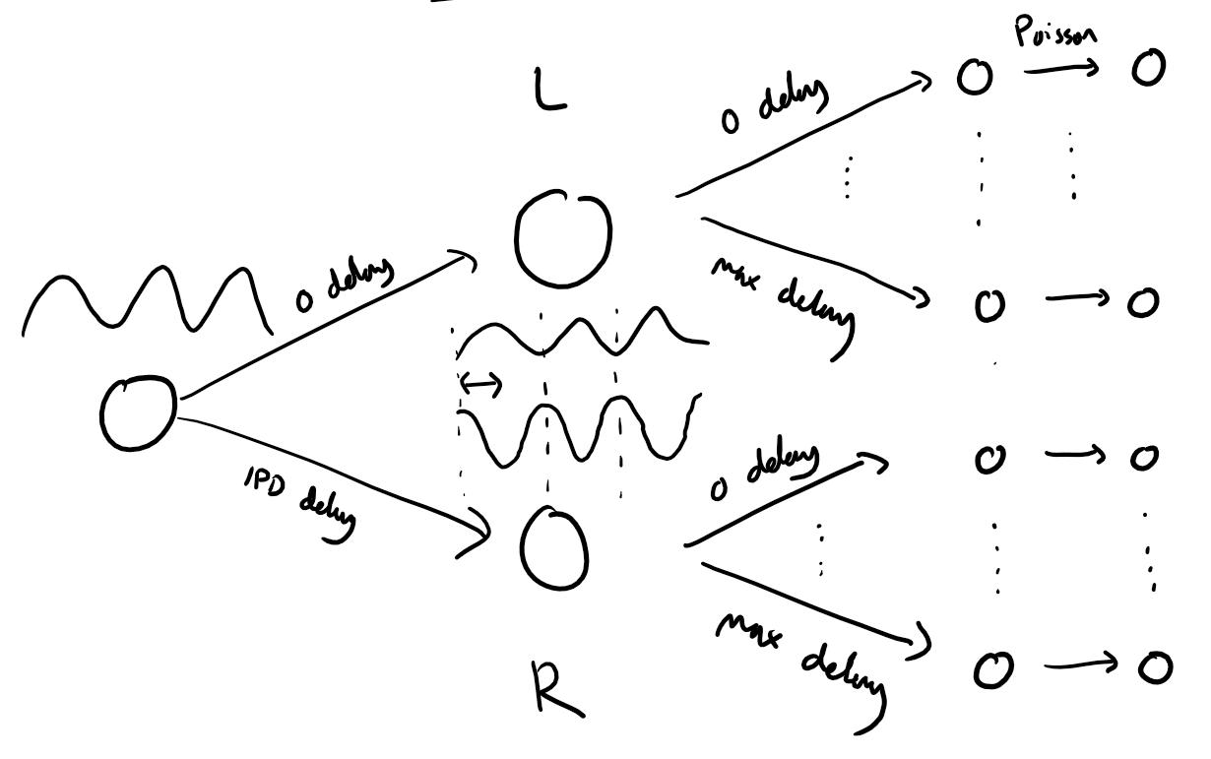
Setting up our network

Slide 13
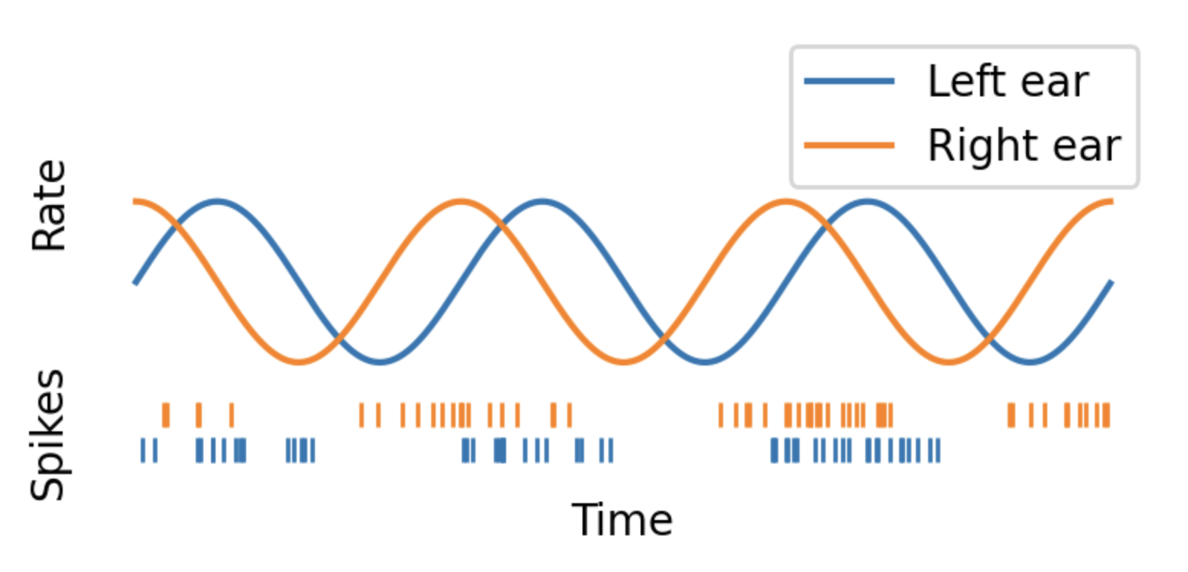
Transforming auditory input signals into spike trains
At time t, the spiking probability of the neuron, represented as p(t), is proportional to the auditory stimulus waveform, stim(t), that is modulated by the envelope power, k :
p(t) = rate_max × dt × stim(t)**k,
where rate_max is the maximum possible firing rate of the neuron.
During each time step, a random number is generated and compared to p(t). If this number is less than p(t), the neuron releases a spike.
spikes = np.random.rand(number_of_time_points) < rate_max *(0.5*(1+np.sin(theta)))**envelope_power * dt
rate * dt
Spiking probability in time interval dt
Poisson process: the emission of a spike is independent of the event in the previous time step

Slide 14
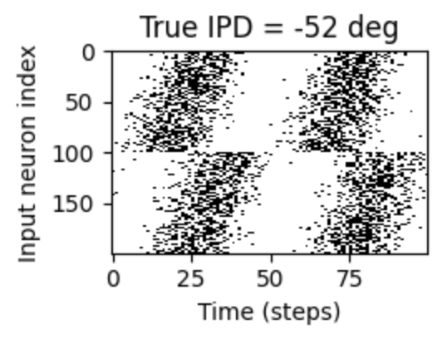

Setting up our network
IDP

Slide 15
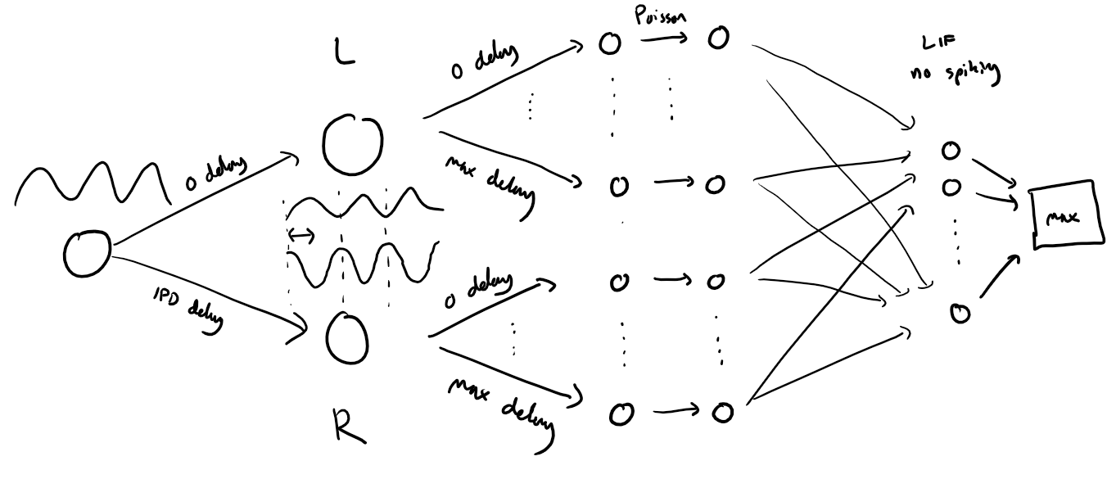
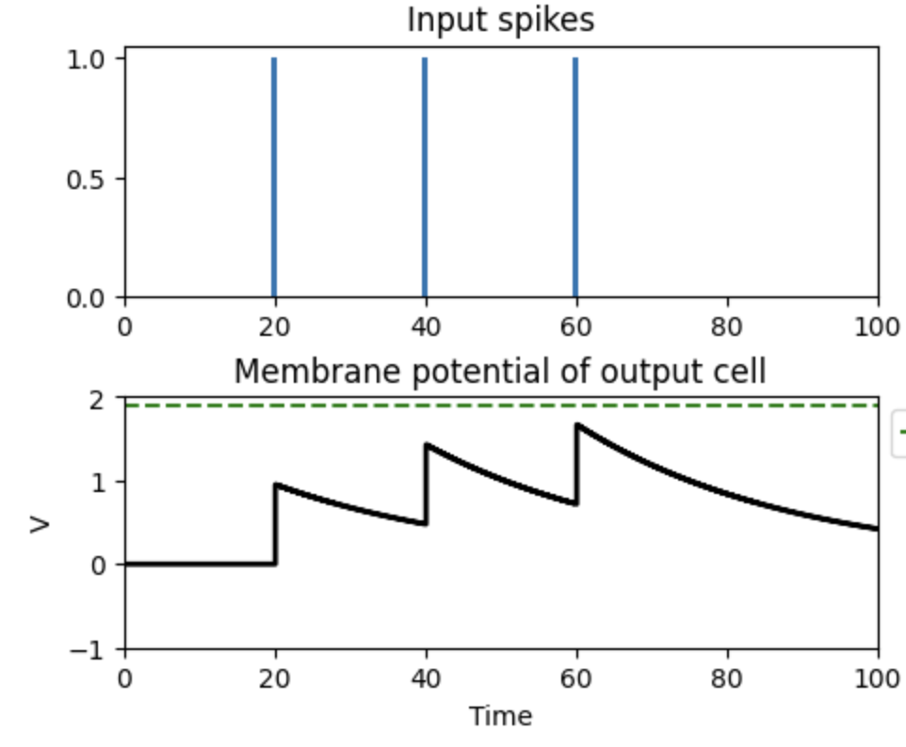
Note, computation layer inputs converge directly on output layer neurons that vary only in membrane potential (no spiking neurons)
weights
mean
Notes:
If we add non-spiking hidden layers, will the network do the job as good as the spiking neural network

Slide 16
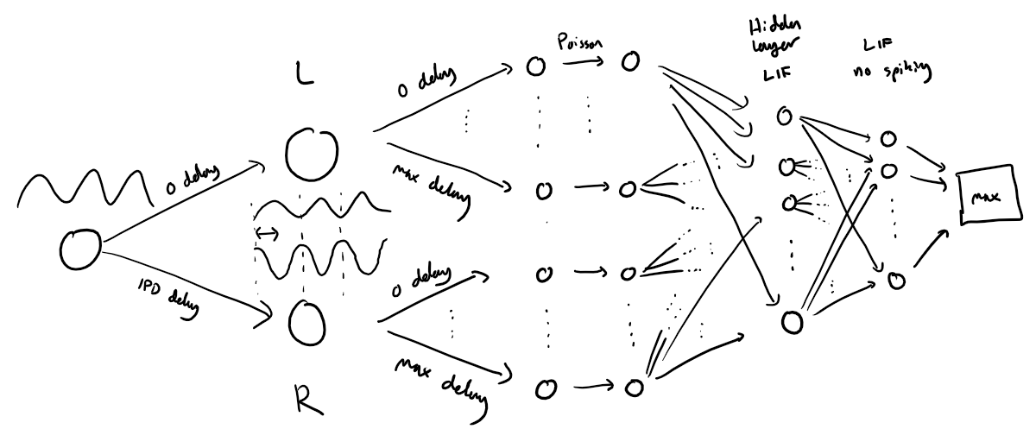
Model with computation in hidden layer formed by spiking neurons

Slide 17
Up to you to play with the model
How to improve the performance of the network?
Time constant
Mean or max of output neurons membrane potential
Heterogeneous time constants
Change number of hidden units
Only positive weights
Adaptive thresholds
Inhomogeneous time constants
What is better, to use the mean or the max of the output neurons membrane potential time variation?
…
Can we understand what the network is doing?
Ablate neurons after training and see how this affects the test performance
…

Slide 18
Some notes:
In PyTorch, variables are encapsulated within the framework, requiring the use of PyTorch's built-in methods for any operations, including calculations like summations. For instance, to compute the sum across elements, you would use:
m = torch.sum(output, 1)
However, if your workflow involves numpy, there's an additional step required. You must first detach the variable from the computation graph to prevent gradient tracking, which is irrelevant to numpy operations. Once detached, you can then convert the tensor to a numpy array. Here's how you do it:
W.detach().numpy()

