Slide 1

Economic Viability Analysis for a 400MW Windfarm
Mohamad Mostafa Hareb Karim Hamawi
Samir Wadih

Slide 2
Project Description
Number of MW produced by the entire farm | 400
Number of MW produced by a single turbine | 2
Number of Turbines Needed for the Project | 200
Average Price for a single turbine | 3000000
Price for all Turbines | 600000000
Wind Capacity factor in Marjayoun (Where project will take place) | 0.49
KWh Produced | 1716960000
Per capita KWh consumed | 2292
Per household KWh consumed | 8709.6
Households covered by our project | 197134.197
Number of Households in lebanon | 1266000
Coverage of local electric demand by single wind farm | 15.571%

Slide 3
Cost of Land
Land Cost Estimation
Area Needed per turbine (acres) | 1.5
Area Needed per turbine (m^2) | 6070.3089
Total Area needed for turbines(m^2) | 1214061.8
Total Area neededfor turbines(km^2) | 1.2140618
Total area for facilities needed | 10000
Price of 1 m^2 land in Marjayoun | 40
Total areas including facilities | 1224061.8
Price of all the land needed | 48962471

Slide 4
Total Initial Costs
Construction Costs
Price of Turbines with the installation | 600000000
Price of Transportation of Material | 3000000
Facility Building and Miscellaneous costs | 2000000
Powerplant Infrastructure | 2000000
Cost of Labor | 1500000
Planning and Permits | 2000000
Cost Basis (including Land) | 659462471

Slide 5
Annual O&M Costs
Annual Costs
Average O&M costs per turbine | 48000
Average O&M costs for all turbines | 9600000
Labor costs per employee | 20000
Facility running and services | 100000
Labor costs for 200 employees | 4000000
Annual Insurance and Property Taxes(5%) | 2448123.566
Total O & M Annual Costs | 16148123.57

Slide 6
Bank Loan Details
Total Principal Amount | 459462471.3
K | 12
M | 12
C | 1
N (years) | 25
N (months) | 300

Slide 7
Bank Loan Details
Years | Monthly Interest | APR
Years 1-5 | 0.250% | 3%
Year 6-10 | 0.292% | 3.50%
Year 11-15 | 0.308% | 3.70%
Year 16-25 | 0.330% | 3.960%

Slide 8
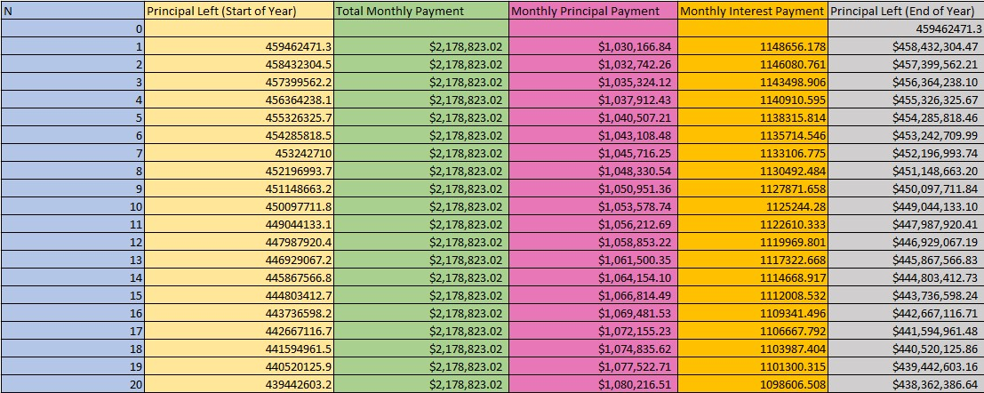
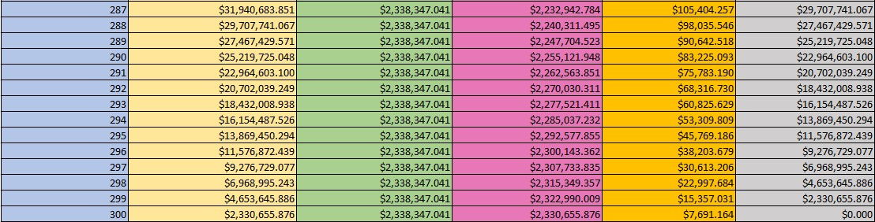
Loan Payment Details
v

Slide 9
Principal Balance Left to Pay
Months

Slide 10
Depreciation (Straight Line)
Depreciation (Standard Line Method)
Cost Basis | $659,462,471.32
Total Salvage Value | $99,754,965.58
Depreciable Life in years | 25
Total Annual Depreciation | $22,388,300.23

Slide 11
Total Depreciation Graph

Slide 12
Capital Recovery
MARR= | 10%
Salvage Value for Land(20% increase)= | $ 58,754,965.58
Salvage Value for single turbine= | $ 200,000.00
Salvage Value for all turbines= | $ 40,000,000.00
Facility Salvage Value= | $ 1,000,000.00
Total Salvage Value= | $ 99,754,965.58
Cost Basis Total= | $ 659,462,471.32
CR(MARR=10%)= | $ 71,637,393.46

Slide 13
Equivalent Annual and Per Unit Costs

Slide 14
Annual Revenues
Charge per KWH= | $0.08
N | Annual Revenues
0 | 137356800
1 | 137356800
2 | 137356800
3 | 137356800
4 | 137356800
5 | 137356800
6 | 137356800
7 | 137356800
8 | 137356800
9 | 137356800
10 | 137356800

Slide 15
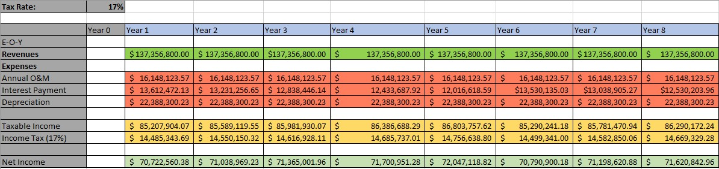
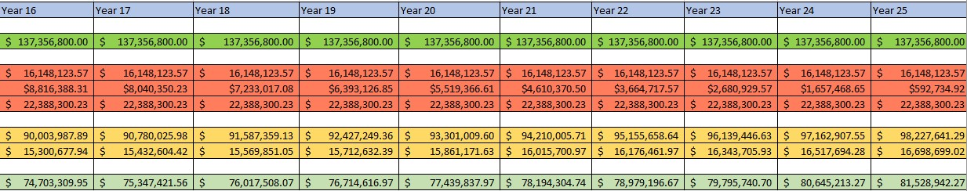
Net Income Statement

Slide 16
Cash Flow Statement

Slide 17
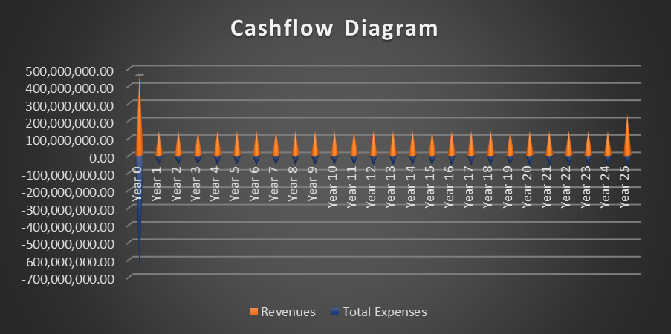
Cashflow Diagram (Revenues and Expenses)

Slide 18
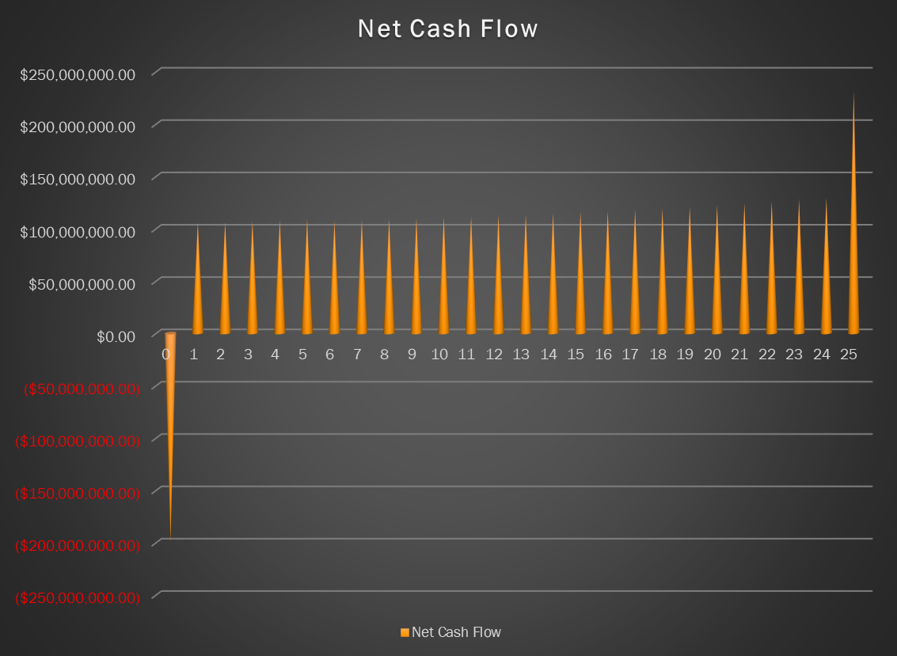
Net Cash Flow Diagram

Slide 19
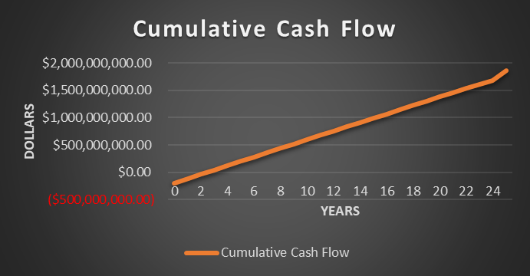
Break-even Point
2.48 years

Slide 20
Decision Analysis Based on Several Criteria
Criterion | Value | Case | Decision
ROR | 40.09% | ROR>MARR (10%) | Accept
NPV | $480,838,364.07 | NPV>0 | Accept
AEW | $52,973,035.60 | AEW>0 | Accept
Break Even Point | 2.48 Years≈ 2.5 Years | BEP<25 Years | Accept

