Slide 1
Pervasive Computing
Lab 4

Slide 2
Agenda
Importance of Fragments and its definition
Difference between Fragment and Intents
Fragment LifeCycle
Fragment Usage
Floating Context menu

Slide 3
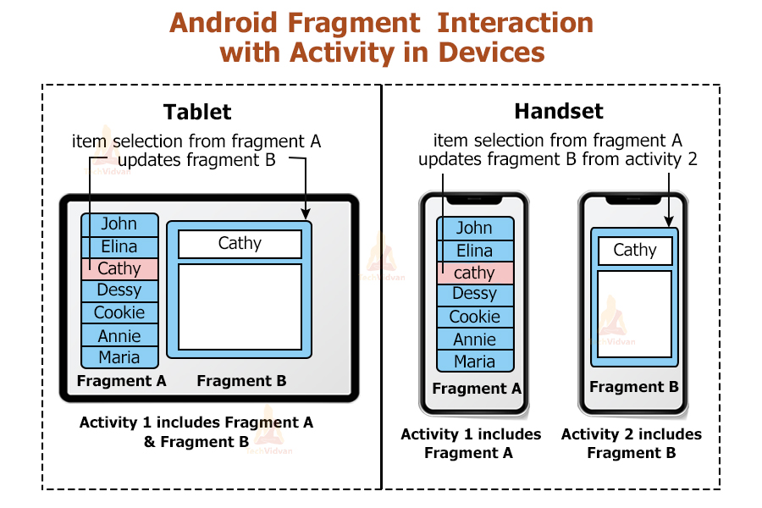
Definition and usage of fragments
A Fragment is a reusable UI component embedded within an Activity.
Why Use Fragments?
- Dynamic and flexible UI.
- Efficient navigation and UI changes.
- Ideal for multi-screen apps within a single Activity.

Slide 4
Difference between Fragment and Intents
Feature | Intent | Fragment
Purpose | To communicate between Activities or apps | To create reusable UI components within an Activity
Use for Navigation | Primarily used for navigation between Activities | Used for navigation within a single Activity
Lifecycle | Follows the Activity lifecycle | Has its own lifecycle but depends on the Activity’s lifecycle
Data Passing | Can pass data between Activities using putExtra() | Passes data through Bundle arguments during creation
Reusability | Intents are not reusable in the same way | Fragments are reusable components that can be placed in different Activities
UI Flexibility | Limited; each Activity generally represents a separate screen | High; allows for more dynamic UI updates within an Activity
Device Configuration | Suitable for single screen or independent UI flows | Designed for adaptable layouts (e.g., multi-pane layouts on tablets)

Slide 5
E-commerce app Example
Activity 1: Login
Activity 2: Home
Inside Home (one Activity):
Fragment 1: Categories
Fragment 2: Product Details
Fragment 3: Cart

Slide 6
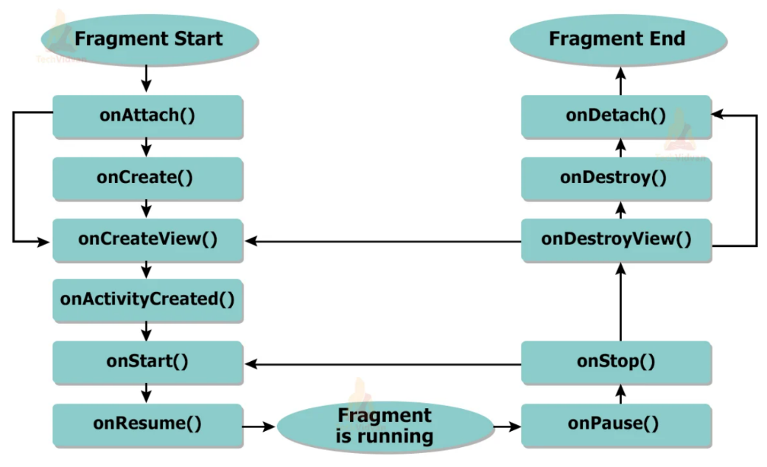
Fragments Lifecycle
Notes:
1. onAttach()
To initialize a fragment with the respective activity, we use the above method. Using this method, the fragment gets fully initialized. It is called once the fragment is associated with its activity, allowing the fragment to interact with the activity context and access its properties.
2. onCreate()
This method is used to create a fragment and initialize the necessary components. We may want to retain these essential components even if the fragment is paused or stopped and then resumed. It is called to perform the initial setup, such as inflating views and setting up resources.
3. onCreateView()
This method is used to return the UI layout of the fragment to the user. This method is invoked at the time when the fragment is created. If you don’t have any design with your fragment then just return null.
4. onActivityCreated()
This method is invoked after the onCreateView(). This method signifies that the activity is ready to host your fragment. After this method is invoked, we can access the fragment view by using findViewById().
5. onStart()
This method is invoked immediately after the fragment is visible on the user’s device. It marks the point where the fragment becomes visible and interactive to the user, often used to initialize components that require user input.
6. onResume()
This method is invoked immediately when the fragment comes back into focus. It signifies that the fragment is now active and the user can interact with it. This method is typically used to resume any paused tasks or animations.
7. onPause()
This method is invoked whenever the fragment goes out of focus or is inactive for some duration. It allows you to save any state changes or pause ongoing tasks that should not continue while the fragment is not in the foreground.
8. onStop()
This method is invoked when the fragment is not visible to the user anymore.
9. onDestroyView()
This method is invoked to clear up the resources used by the fragment. It is called just before the fragment is going to be destroyed. It allows you to clean up resources related to the fragment’s view, such as bitmap recycling or stopping services.
10. onDestroy()
This method is invoked to destroy the fragment and clean up its state. It is the final cleanup call before the fragment is completely removed from memory. Use this method to release resources and save any persistent state.
11. onDetach()
This method is invoked to detach a fragment from host activity. It marks the end of the fragment’s association with its activity and provides an opportunity to perform final cleanup before the fragment is destroyed.

Slide 7
Fragments Usage
Bottom Navigation: Apps like Instagram, YouTube, Facebook.
ViewPager + Tabs (Swipe Left/Right) : Apps like WhatsApp (Chats – Status – Calls)
Master-Detail Layout (Tablet / Landscape): Example: Email app
DialogFragment (Custom Dialogs): Instead of using AlertDialog, we create a DialogFragment.

Slide 8
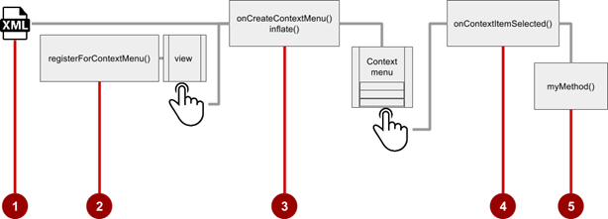
Floating Context Menu Steps
Create XML menu resource file and assign appearance and position attributes
Register View using registerForContextMenu()
Implement onCreateContextMenu() in Activity to inflate menu
Implement onContextItemSelected() to handle menu item clicks
Create method to perform action for each context menu item

Slide 9
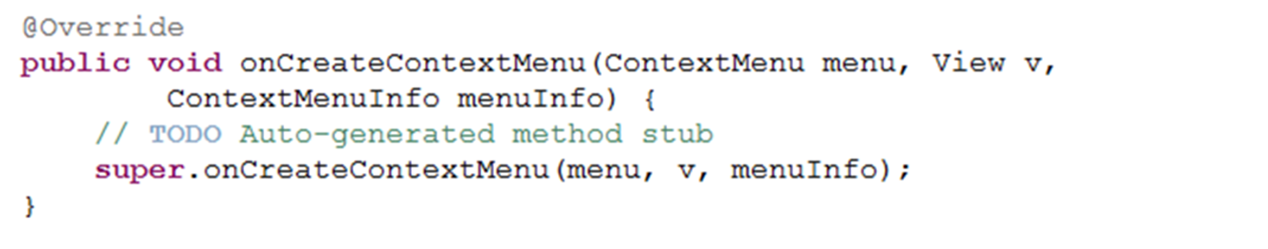
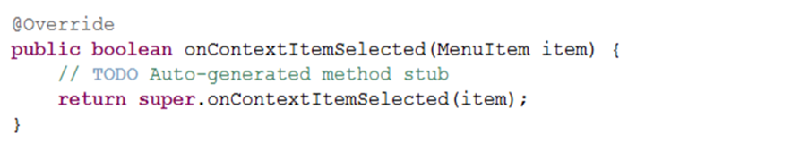
Floating Context Menu Steps
To Show context menu when long-pressing TextView, Override the “onCreateContextMenu” method
To handle event of selecting a certain context menu item, Override the “onContextItemSelected” method

Slide 10
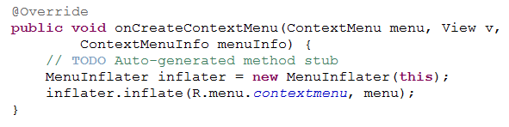
How to bind menu defined in xml file to the context menu to be shown
On the “onCreateContextMenu” method create object from “MenuInflater” Class and then call inflate method

Slide 11
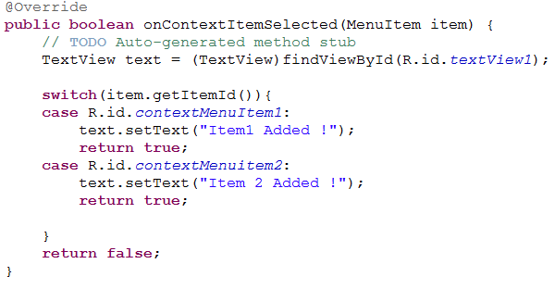
How to update TextView text when selecting any menu item from Context menu?!

Slide 12
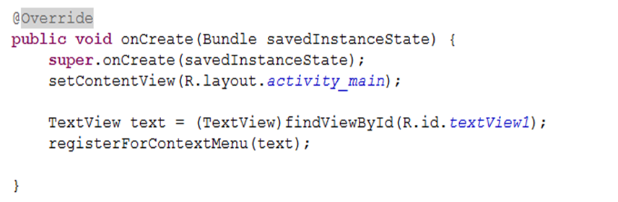
How to bind context menu with TextView ?!
In the OnCreate Method of the activity

Slide 13
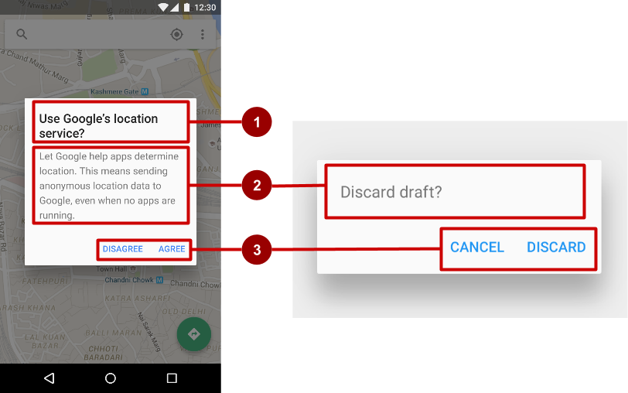
AlertDialog
Title (optional)
Content area
Action buttons

Slide 14
Build the AlertDialog
Use AlertDialog.Builder to build alert dialog and set attributes:
public void onClickShowAlert(View view) {
AlertDialog.Builder alertDialog = new
AlertDialog.Builder(MainActivity.this);
alertDialog.setTitle("Connect to Provider");
alertDialog.setMessage(R.string.alert_message);
// ... Code to set buttons goes here.

Slide 15
Set the button actions
alertDialog.setPositiveButton(
"OK", newDialogInterface.OnClickListener() {
public void onClick(DialogInterface dialog, int which) {
// User clicked OK button.
}
});
Same pattern for setNegativeButton() and setNeutralButton()

Slide 16
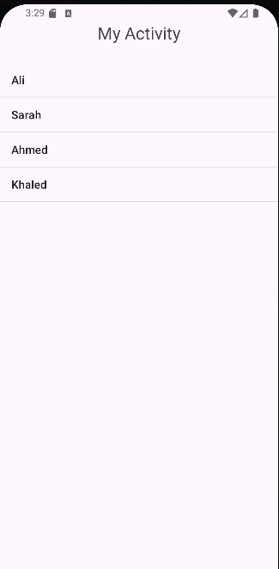
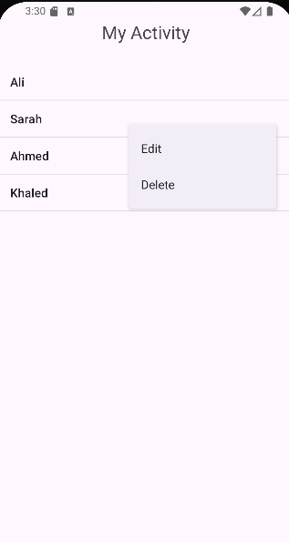
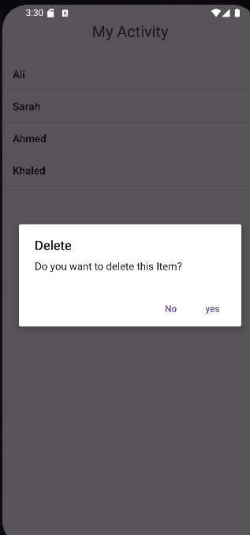
Example 1

Slide 17
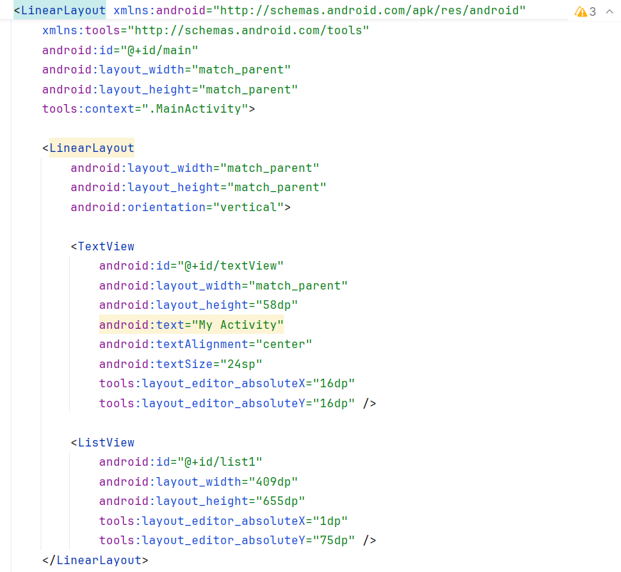
.xml

Slide 18
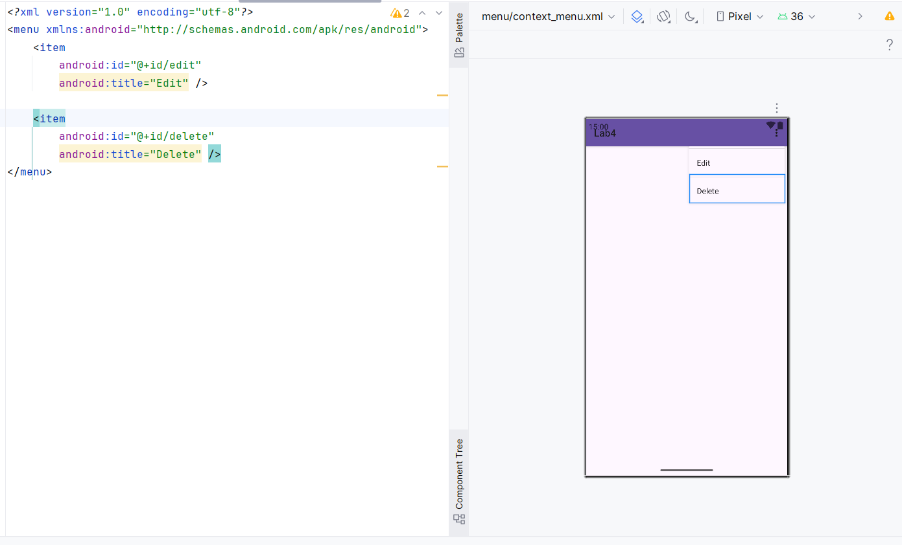
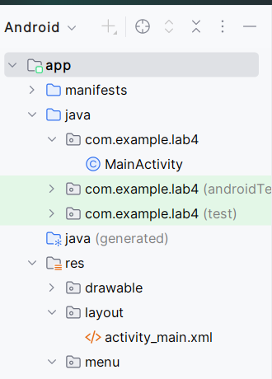
Context_menu.xml
Open res folder.
Right Click on menu folder.
New → Menu Resource file
Name file “context_menu”
Click OK.

Slide 19
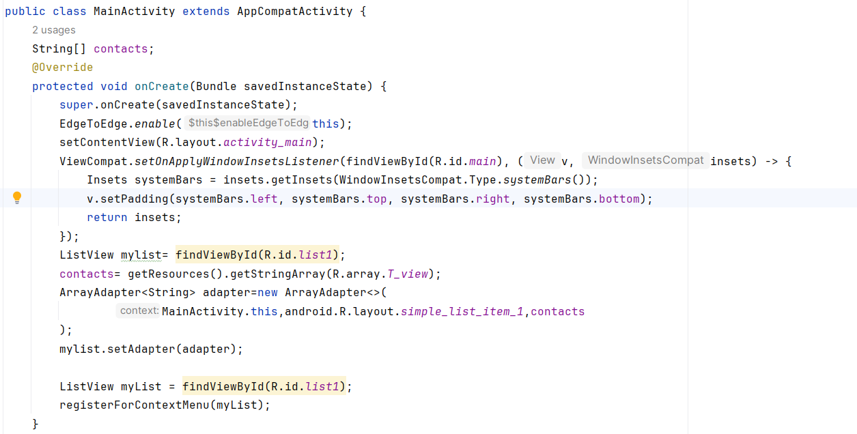
.Java

Slide 20
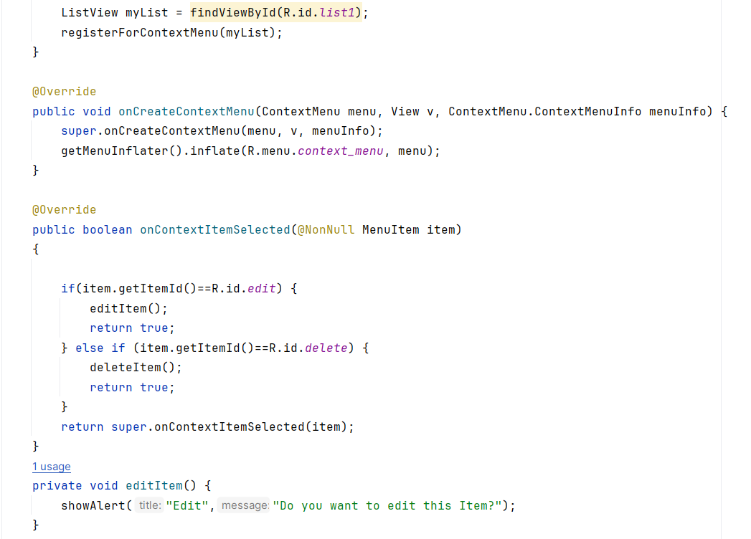
.Java

Slide 21
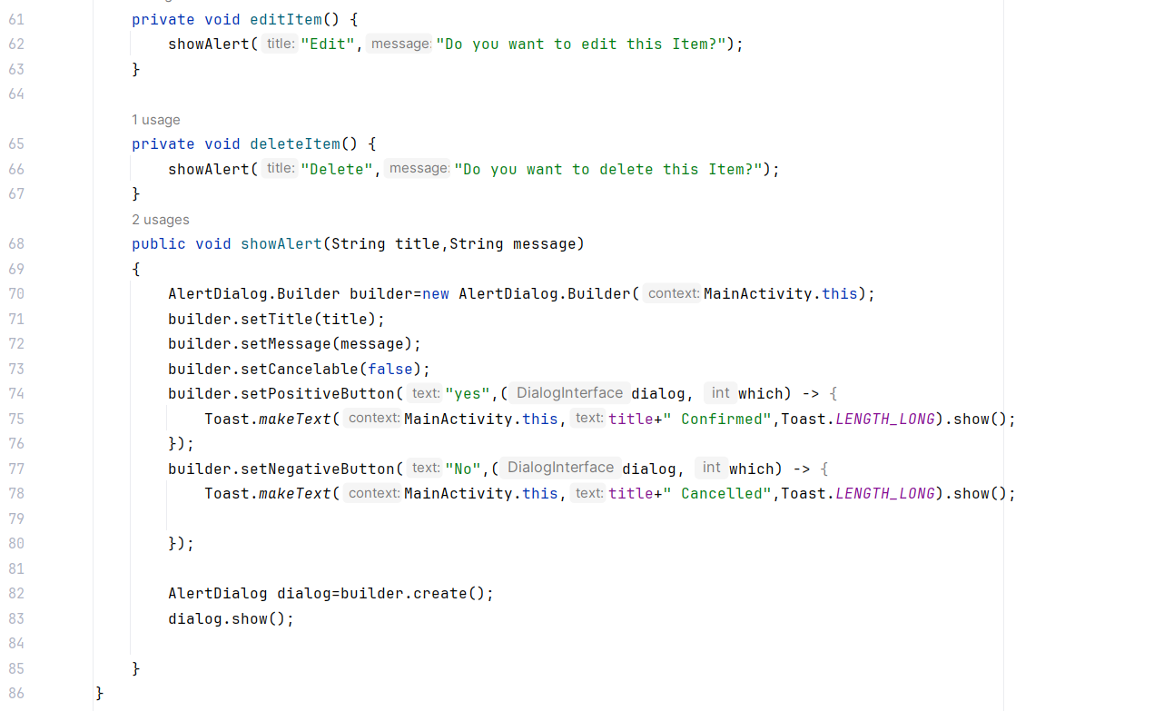
.Java

Slide 22
HANDS ON
Add a new fragment on Example 1 in which you can edit the Name of the Contacts.

Slide 23
Thank you!

