Slide 1
CS Department Orientation Class Project
Karim Shoorbajee

Slide 2
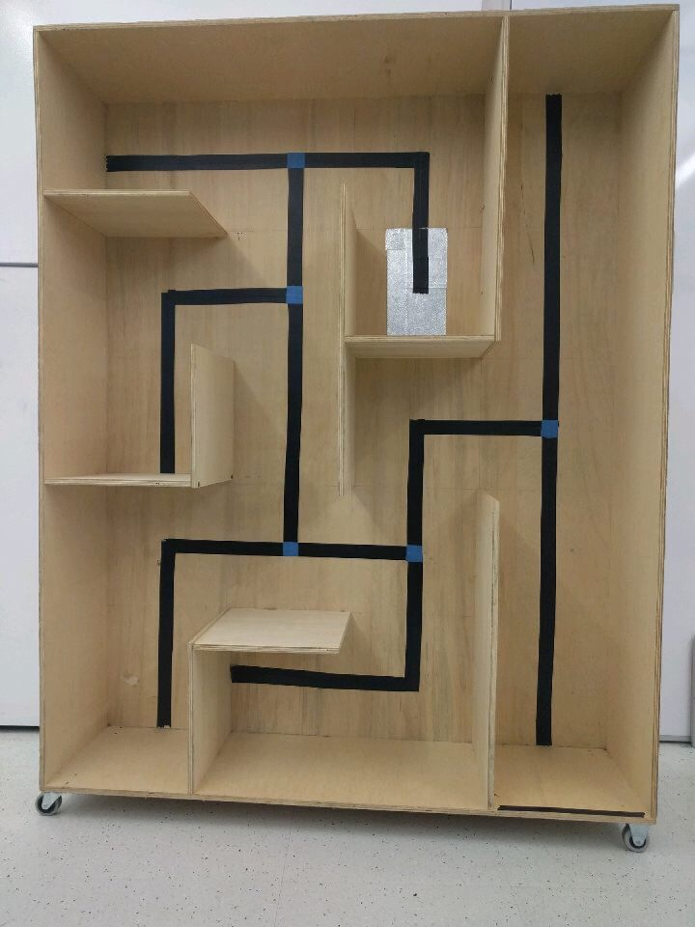
Objective
The Objective of this project was to build a Lego Mindstorms robot and direct it through a maze that our instructor, Roxana, designed.
The robot had to be programmed using the Lejos EV3 API

Slide 3
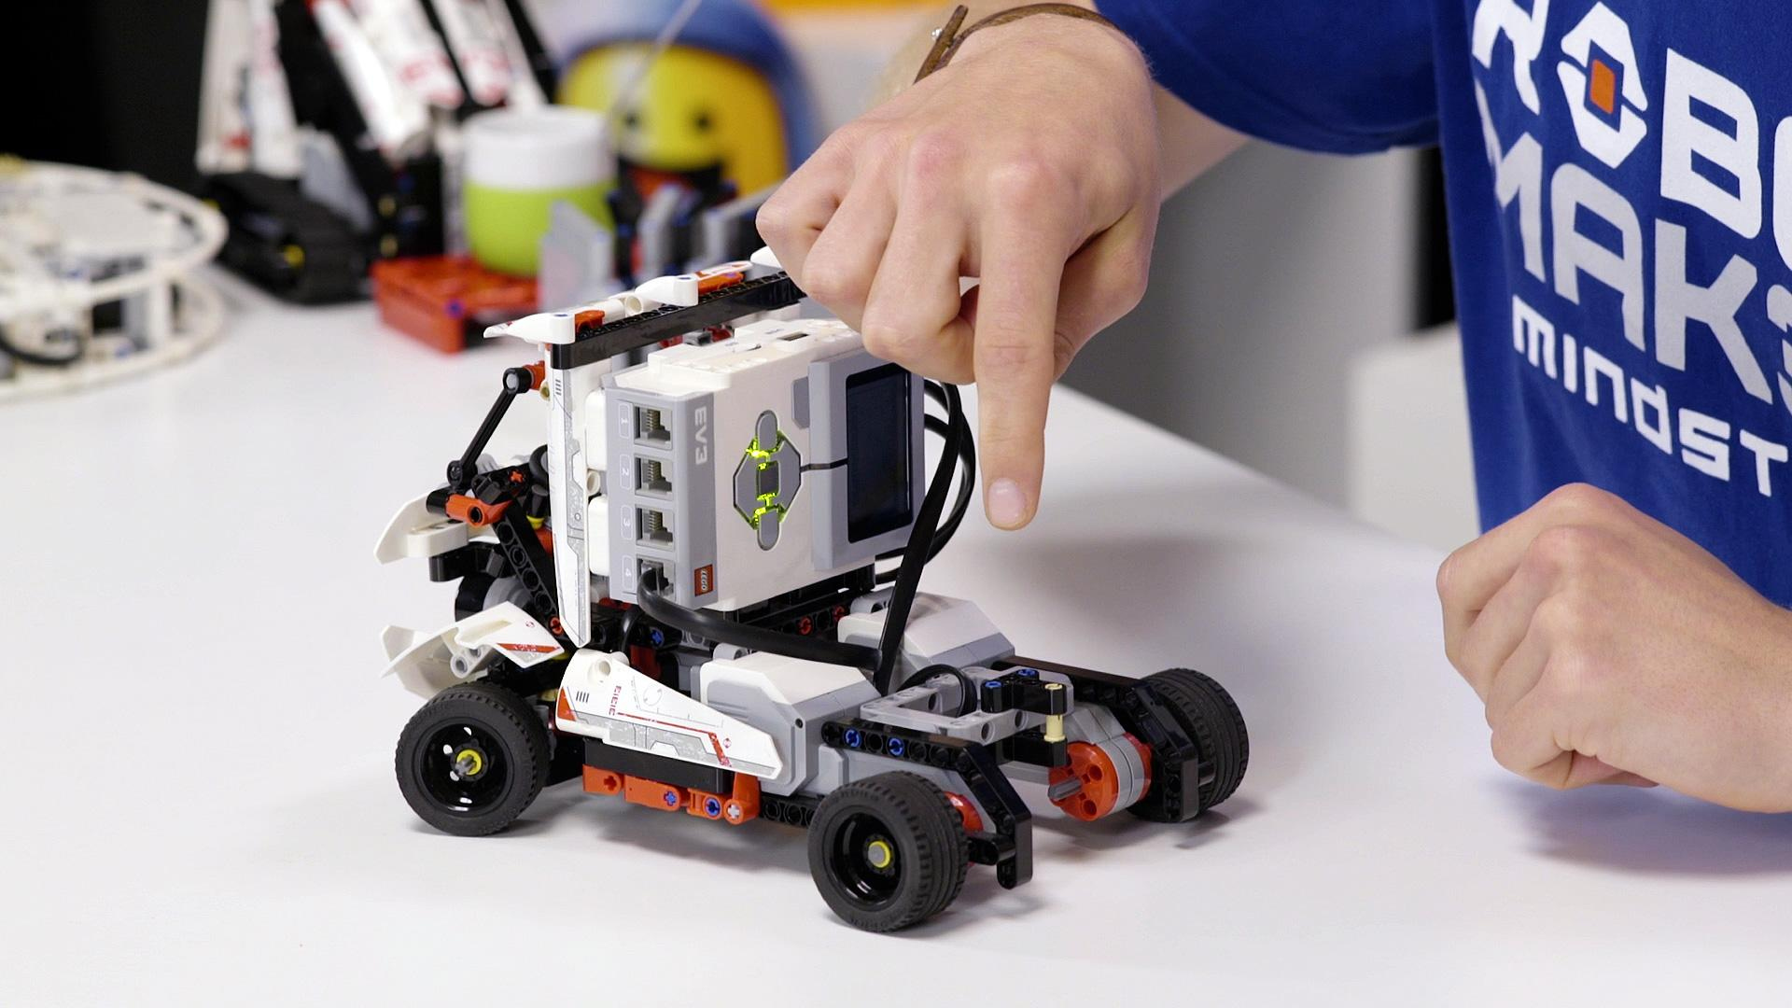
Strategy
In order to solve the maze we used a “hug the right wall” method
If the robot had the opportunity to turn right at an intersection it would. Otherwise it would keep moving.
On running into a dead end it would rotate 180 degrees and then continue moving forward
This would eventually lead the robot to the end (tin foil)

Slide 4
Strategy Cont
The second phase of the project was to navigate back to the start of the maze taking the fastest possible route.
This involved pushing (then potentially popping) certain commands to a stack
The algorithm would require “blocking” all paths that were eventually dead ends and only leave commands that would lead directly to the start of the maze.
Our group failed in developing an algorithm to do this so we were only capable of solving the maze outright.

Slide 5
What I learned
How to use git and github
Collaborate on projects and safely store my code in a repository
How to read documentation
Teaching myself how to code in an environment I’m not familiar with
Had my first experience with robotics

