Slide 1
Master Machine
Static Design
Microcontroller | Microcontroller
User_Input
LED_CTRL
Bluetooth CTRL
ROM CTRL
APP
BIT_Manipulate
Keypad
LED
Bluetooth
EEPROM
FreeRTOS
ECUAL
STD_Types
DIO
PWM
UART
I2C
Service
MCAL
LIB

Slide 2
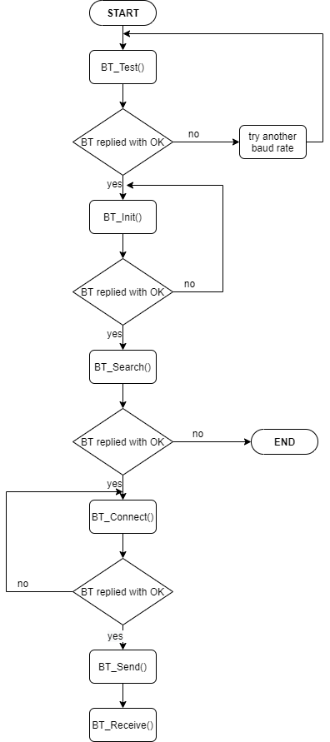
- Master Machine
Dynamic design
Bluetooth Task

Slide 3
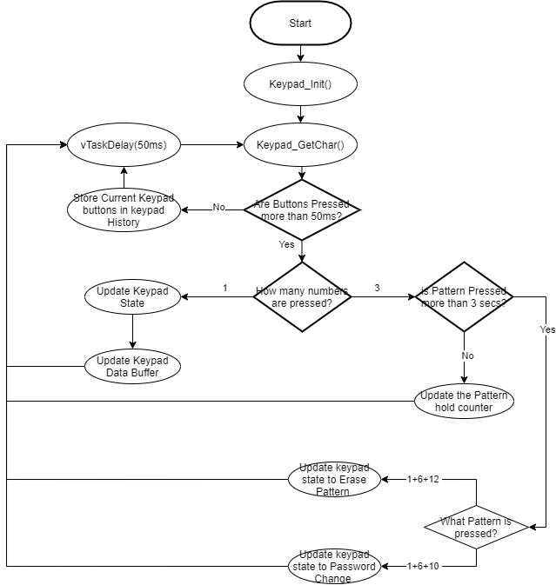
- Master Machine
Dynamic design
Keypad Task
Flowchart

Slide 4
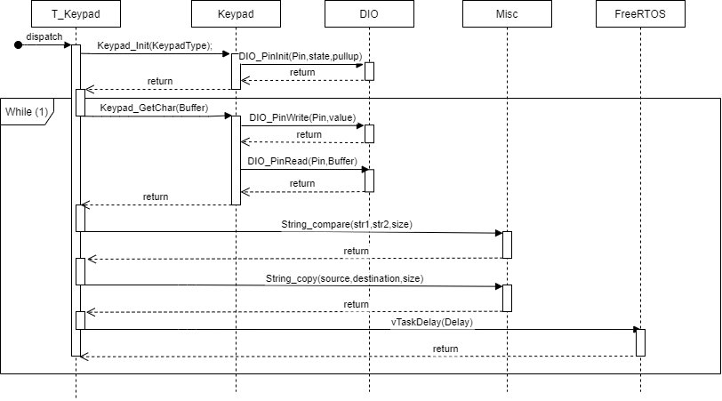
- Master Machine
Dynamic design
Keypad Task
Sequence Diagram

Slide 5
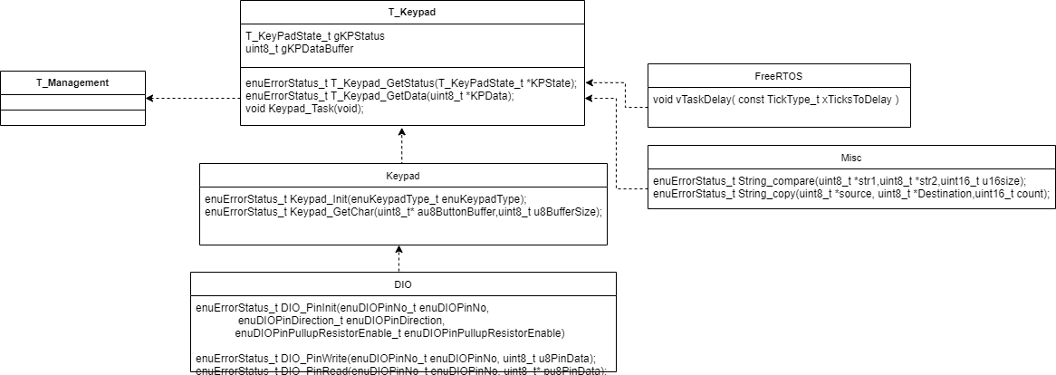
- Master Machine
Dynamic design
Keypad Task
Class Diagram

Slide 6
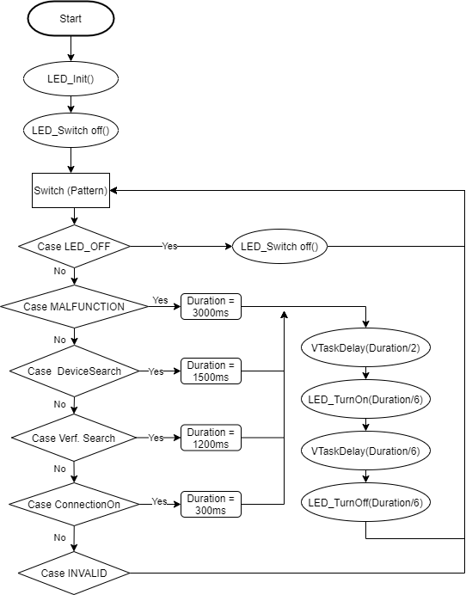
- Master Machine
Dynamic design
LED Task
Flowchart

Slide 7
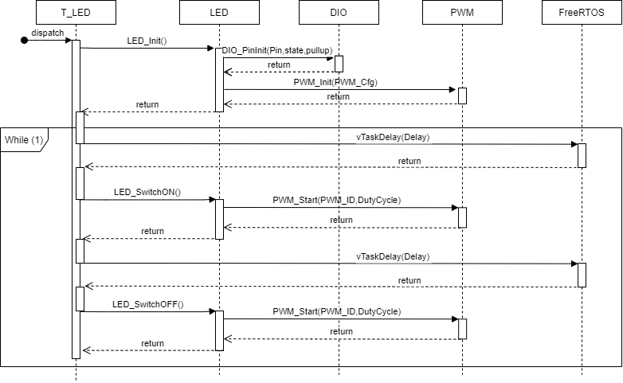
- Master Machine
Dynamic design
LED Task
Sequence Diagram

Slide 8
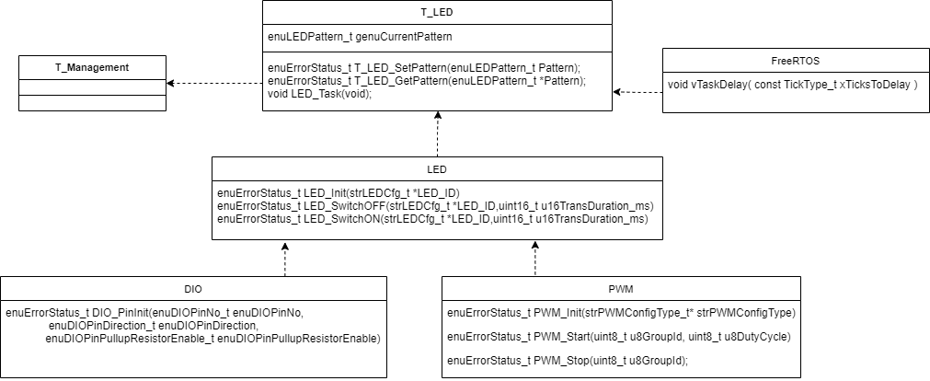
- Master Machine
Dynamic design
LED Task
Class Diagram

Slide 9
SLAVE Machine
Static Design
Microcontroller | Microcontroller
Display CTRL
LED_CTRL
Bluetooth CTRL
APP
BIT_Manipulate
7 Seg
LCD
LED
Bluetooth
FreeRTOS
ECUAL
STD_Types
DIO
PWM
UART
Service
MCAL
LIB

Slide 10
- SLAVE Machine
Dynamic design
Bluetooth Task

Slide 11
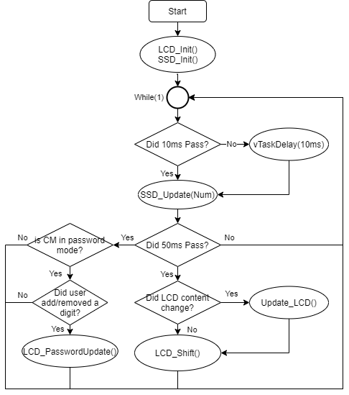
- SLAVE Machine
Dynamic design
Display Task
Flowchart

Slide 12
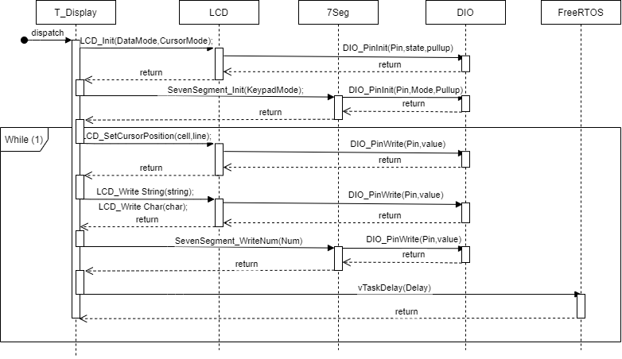
- SLAVE Machine
Dynamic design
Display Task
Sequence Diagram

Slide 13
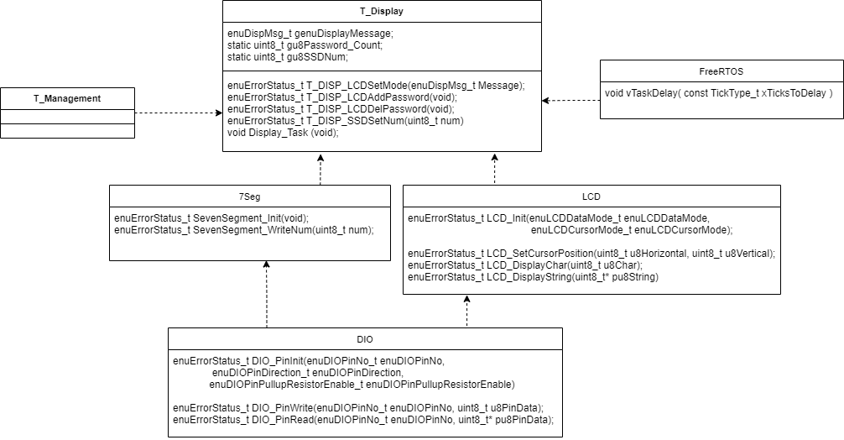
- SLAVE Machine
Dynamic design
Display Task
Class Diagram

Slide 14
- SLAVE Machine
Dynamic design
LED Task
Flowchart

Slide 15
- SLAVE Machine
Dynamic design
LED Task
Sequence Diagram

Slide 16
- SLAVE Machine
Dynamic design
LED Task
Class Diagram

