Slide 1

Aviation Analysis Business Presentation
Faith Karimi Muthoni
DSF-FT12-HYBRID

Slide 2
Overview:
Understanding aviation risks and safety challenges
Analysis of historical aviation accident data
Key insights and business recommendations
Next steps for improving aviation safety

Slide 3

Business Understanding

Slide 4
Problem Statement
Our company is expanding into commercial and private aviation to diversify its portfolio.
We lack insight into potential aircraft risks and need to determine the safest options for purchase.
Objective: Identify the lowest-risk aircraft to help the new aviation division make informed purchasing decisions.

Slide 5
Why This Matters to the Business.
Aviation accidents and incidents result in financial loss, reputational damage, and safety concerns.
Understanding risk factors helps airlines, regulatory bodies, and insurers make data-driven decisions.
The goal: Identify key risk factors and suggest strategies to reduce aviation accidents.

Slide 6

Data Understanding

Slide 7
Data Used
Source: National Transportation Safety Board (NTSB)
Timeframe: 1962 - 2023
Key Variables:
Accident severity (fatal, non-fatal, incident)
Aircraft type
Weather conditions
Mechanical failures
Data Limitations
Some missing values in older records
Possible reporting inconsistencies across years

Slide 8

Data Analysis Key Findings & Visualizations

Slide 9


1. Accident Trends Over Time
Insight: There is a decline in total accidents over the years, but the severity of incidents remains high.
Business Implication: Aviation safety improvements are effective, but critical incidents still require focused interventions.

Slide 10
2. Leading Causes of Aviation Accidents
Your ability to communicate effectively will leave a lasting impact on your audience
Effectively communicating involves not only delivering a message but also resonating with the experiences, values, and emotions of those listening

Slide 11
3. Lowest-Risk Aircraft Types
Insight: Certain aircraft models have significantly lower accident rates than others.
Business Implication: The company should prioritize purchasing aircraft with strong safety records and advanced safety features.

Slide 12

Business Actions Based on Findings

Slide 13
1. Invest in Safer Aircraft Models
Prioritize models with low historical accident rates.
Assess manufacturers with strong safety protocols.
Supporting Visual: Comparison Chart on aircraft safety ratings.

Slide 14
2. Enhance Predictive Maintenance Strategies
Use machine learning to detect early signs of mechanical failures.
Implement real-time aircraft monitoring systems.
Supporting Visual: Line Chart on mechanical failures over time.

Slide 15
3. Improve Pilot Training & Safety Protocols
Focus on mitigating human error through enhanced simulation-based training.
Implement AI-driven decision-support systems in cockpits.
Supporting Visual: Bar Chart on human error contribution to accidents.

Slide 16

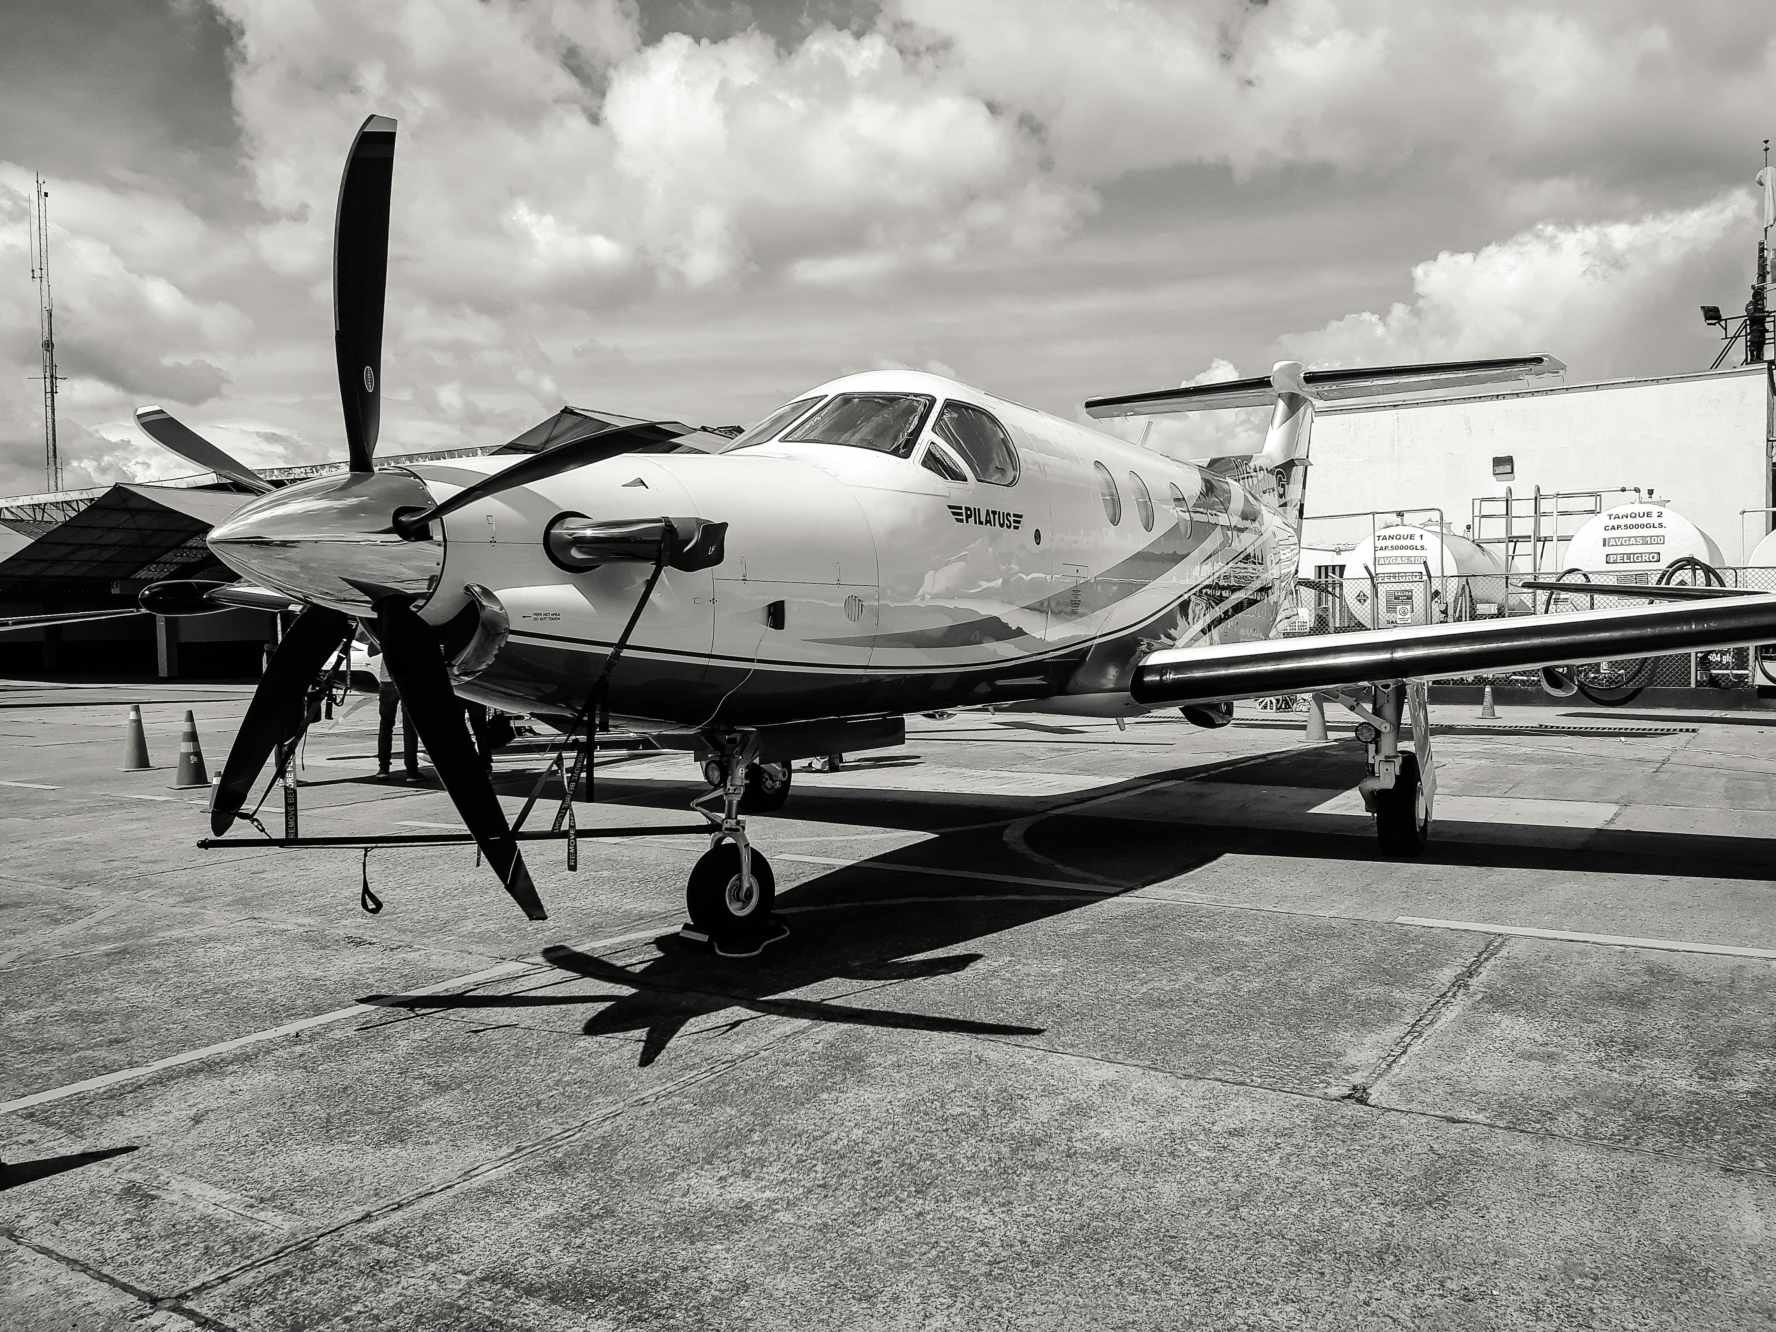
Future Actions & Considerations
Conduct deeper analysis on specific aircraft manufacturers and models.
Collaborate with aviation safety organizations for policy improvements.
Implement automated risk assessment dashboards for real-time monitoring.

Slide 17

GitHub Repository
faith.karimi@student.moringaschool.com

