Slide 1

Hacking
Presentation Topic
Presented by:
Aayush bhandari
Shadbhav regmi

Slide 2
INDEX
INTRODUCTION
DRIVERS LEADING TO HACKING
TYPES OF HACKER / HACKING
BLACK HAT HACKERS/ HACKING
WHITE HAT HACKERS/ HACKING
GREY HAY HACKERS/ HACKING
EFFECTS AND IMPACTS OF HACKERS/ HACKING
DEVICES MOST VULNERABLE TO HACKERS
CAUSE OF DEVICE VULNERABILITIES
PREVENTIVE MEASURES FROM HACKING

Slide 3
Introduction
Hacking is using unconventional or illicit means to gain unauthorized access to a digital device, computer system, or computer network.
It is a multibillion-dollar industry with extremely sophisticated and successful techniques.
Hacking first appeared as a term in the 1970s but became more popular through the next decade.
After a group of teenagers cracked major organizations' computer systems, Congress passed several bills around computer crimes.

Slide 4


Drivers leading to Hacking
Financial Gain
Gain competitive advantage
Gain Notoriety or respect for their hacking talents
State sponsored- aims to steal business info. And national intelligence or those who aim to raise public awareness by leaking sensitive information.
Security improvements

Slide 5
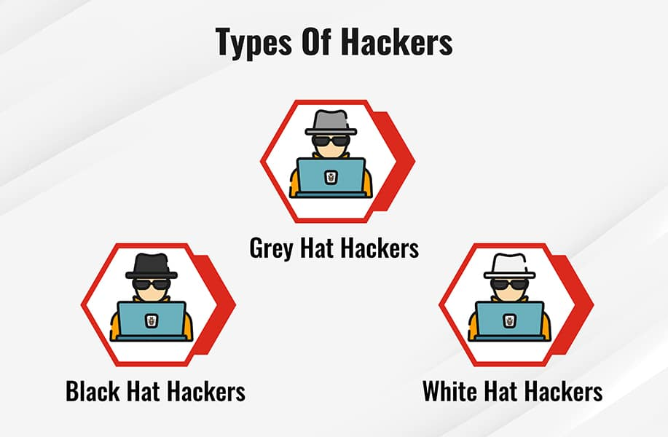

Slide 6
Black Hat Hackers / Hacking
A black hat hacker is a computer hacker who violates laws or ethical standards for nefarious purposes, such as cybercrime, cyberwarfare, or malice.
A hacker may exploit security vulnerabilities for monetary gain; steal or destroy private data; or alter, disrupt, or shut down websites and networks.
Some of the main black hat hacking methods and cyber-attacks include:
Ransomeware Attacks
Phising Scams
Data Breaches
And many more.

Slide 7
White Hat Hackers / Hacking
A cybersecurity professional who uses their skills and knowledge in hacking to identify vulnerabilities and weaknesses in computer systems, networks, or applications are known as white hat hackers.
White hat hackers have permission from the organization to conduct security testing and they work within the boundaries of legal and ethical frameworks.
Some of the techniques and tools of white hat hacking are:
Vulnerability Scanning
Penetration testing
Social Engineering
Web application testing
Reverse Engineering
And many more.

Slide 8
Grey Hat Hackers / Hacking
An individual who engages in hacking activities without explicit owner’s permission but with non-malicious intent is known as a grey hat hacker.
They represent the middle ground between white hat hackers, who operate on behalf of those maintaining secure systems, and black hat hackers who act maliciously to exploit vulnerabilities in systems.
They use the same techniques used by white and black hat hackers.
They are motivated by a combination of factors:
The thrill of breaking into secure systems and proving their skills.
Aim to improve cybersecurity.

Slide 9
Effects and Impacts of Hackers/ Hacking
Financial Loss
Identity Theft
Data Breaches
Disruption of Services
Cyber Espionage
Spread of Malware

Slide 10
Devices Most Vulnerable to Hackers
Computers
Mobile Devices
IoT Devices
Network Routers
ATM Machines
Webcams / Video Cameras / CCTV
And so on.

Slide 11
Cause of Device Vulnerabilities
Lack of encryption
Insecure passwords
Ignorance of intrusion
Outdated components
Poor device management
Insecure networks
Hardware Limitations
Limited computational power of IoT
And many more.

Slide 12
Preventive Measures from Hacking
Use strong passwords
Use multi-factor authorization
Managing digital footprint
Keeping devices and software up to date
Avoiding questionable websites
Not accessing personal or financial data with public Wi-Fi
Using a good quality antivirus
Being vigilant against phishing

Slide 13


