Slide 1
K-Means Clustering Session 20
Course : COMP6065001 Artificial Intelligence
Effective Period : September 2023

Slide 2
Learning Outcomes
At the end of this session, students will be able to:
LO 4: Apply various learning algorithms to solve the problems

Slide 3
Outline
What is Clustering?
Types of Clustering
K-Means Clustering
Simple example of K-Means Clustering implementation
Exercise

Slide 4
What is Clustering?
Organizing data into clusters such that there is
high intra-cluster similarity
low inter-cluster similarity
Informally, finding natural groupings among objects.
Clustering:
Unsupervised learning
Requires data, but no labels
Detect patterns, for example:
Group emails or search results
Customer shopping patterns
Regions of images

Slide 5
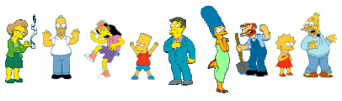
What is natural grouping among these objects?

Slide 6
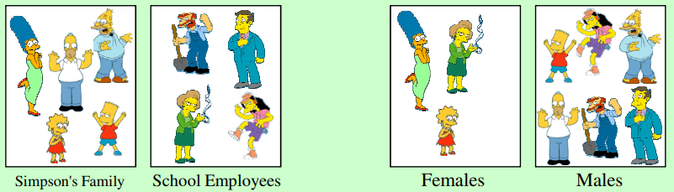
What is natural grouping among these objects?
Clustering is SUBJECTIVE

Slide 7
What is similarity?
According to Webster Dictionary, similarity is the quality or state of being similar; likeness; resemblance; as, a similarity of features.
Similarity is hard to define, but… “we know it when we see it”

Slide 8
Common Distance Measures
Distance measure will determine how the similarity of two elements is calculated and it will influence the shape of the clusters.

Slide 9

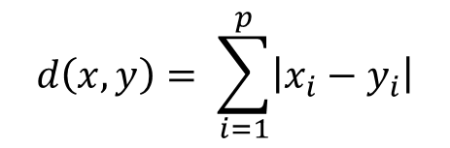
Common Distance Measures
The two most common distance measures:
The Euclidean Distance (also called 2-norm distance) is given by:
The Manhattan Distance (also called taxicab norm or 1-norm) is given by:
$$d\left(x,y\right)= \sqrt[2]{\sum_{i=1}^{p}{{\left|x_{i}−y_{i}\right|}^{2}}}$$
$$d\left(x,y\right)= \sum_{i=1}^{p}{\left|x_{i}−y_{i}\right|}$$

Slide 10
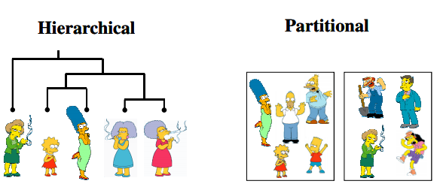
Types of Clustering
Partitional algorithms: Construct various partitions and then evaluate them by some criterion
Hierarchical algorithms: Create a hierarchical decomposition of the set of objects using some criterion

Slide 11
K-Means Clustering
K-Means Clustering is a type of partitional clustering
The k-means algorithm is an algorithm to cluster n objects based on attributes into k partitions, where k < n.
It assumes that the object attributes form a vector space.

Slide 12
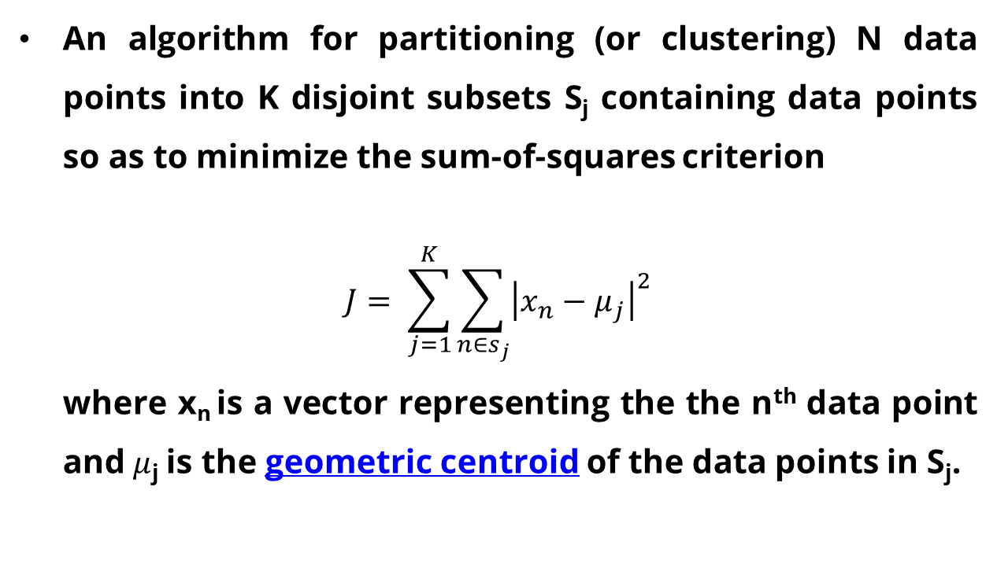
K-Means Clustering
An algorithm for partitioning (or clustering) N data points into K disjoint subsets S_{j} containing data points so as to minimize the sum-of-squares criterion
$$J= \sum_{j=1}^{K}{\sum_{n∈s_{j}}{{\left|x_{n}−μ_{j}\right|}^{2}}}$$
where x_{n} is a vector representing the the n^{th} data point and$μ$_{j} is the geometric centroid of the data points in S_{j}.

Slide 13
K-Means Clustering
Simply speaking k-means clustering is an algorithm to classify or to group the objects based on attributes/features into K number of group.
K is positive integer number.
The grouping is done by minimizing the sum of squares of distances between data and the corresponding cluster centroid.

Slide 14
How the K-Means Algorithm Works?

Slide 15
K-Means Clustering Algorithm
Step 1: Begin with a decision on the value of k = number of clusters.
Step 2: Put any initial partition that classifies the data into k-clusters. You may assign the training samples randomly, or systematically as the following:
Take the first k training sample as single-element clusters
Assign each of the remaining (N-k) sample to the cluster with the nearest centroid. After each assignment, re-compute the centroid of the gaining cluster.

Slide 16
K-Means Clustering Algorithm
Step 3: Take each sample in sequence and compute its distance from the centroid of each of the clusters. If a sample is not currently in the cluster with the closest centroid, switch this sample to that cluster and update the centroid of the cluster gaining the new sample and the cluster losing the sample.
Step 4: Repeat step 3 until convergence is achieved, that is until a pass through the training sample causes no new assignments.

Slide 17
A Simple example showing the implementation of k-means algorithm (using K=2)

Slide 18
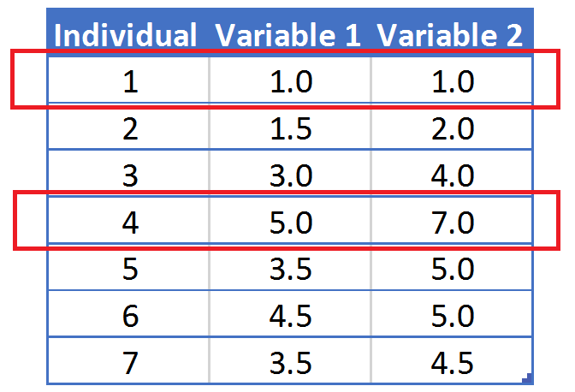
Step 1:
Initialization: Randomly we choose following two centroids (k=2) for two clusters.
In this case the 2 centroid are: m1=(1.0,1.0) and m2=(5.0,7.0).

Slide 19



Step 2:
Thus, we obtain two clusters containing:
{1,2,3} and {4,5,6,7}.
Their new centroids are:

Slide 20
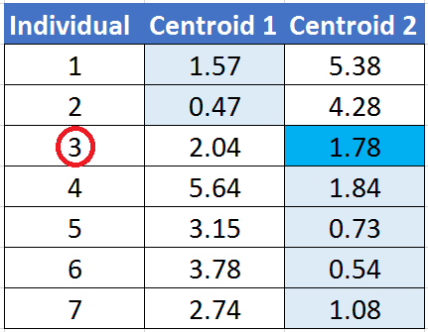
Step 3:
Now using these centroids we compute the Euclidean distance of each object, as shown in table.
Therefore, the new clusters are:
{1,2} and {3,4,5,6,7}
Next centroids are: m1=(1.25,1.5) and m2 = (3.9,5.1)

Slide 21
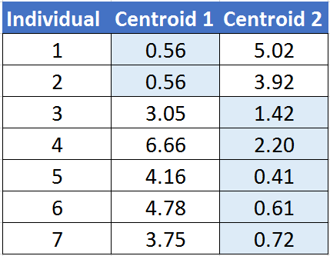
Step 4 :
The clusters obtained are: {1,2} and {3,4,5,6,7}
Therefore, there is no change in the cluster.
Thus, the algorithm comes to a halt here and final result consist of 2 clusters {1,2} and {3,4,5,6,7}.

Slide 22
PLOT

Slide 23
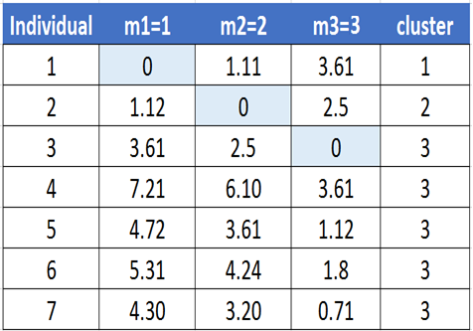
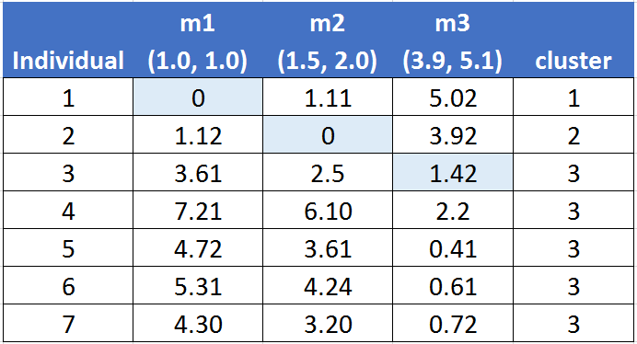
(with K = 3)
Step 1
Step 2

Slide 24
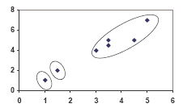
PLOT

Slide 25
Exercise

Slide 26
Exercise
A department store in Jakarta area, would want to make sure that their sale campaigns are right on target. In order to do that, they have to cluster their customers based on: age, total spending, and shopping frequency in a year. The department store has collected all the data. You are asked to help them clusters these data into 3 clusters.
Customer | Age | Total Spend (in million rupiah) | Shopping Frequency
Customer 1 | 25 | 18,000 | 20
Customer 2 | 30 | 15,000 | 10
Customer 3 | 20 | 8,000 | 8
Customer 4 | 35 | 22,000 | 5
Customer 5 | 40 | 40,000 | 14
Customer 6 | 50 | 32,000 | 15
Customer 7 | 43 | 9,000 | 6
Customer 8 | 42 | 12,000 | 16

Slide 27
References
David L. Poole, Alan K. Mackworth. 2017. Artificial Intelligence: Foundations of Computational Agents. Second Edition. Cambridge University Press. ISBN: 9781107195394
http://www.cs.cmu.edu/afs/andrew/course/15/381-f08/www/lectures/clustering.pdf
https://kjambi.kau.edu.sa/GetFile.aspx?id=187901&Lng=AR&fn=k-mean-clustering.ppt
https://artint.info/2e/html/ArtInt2e.Ch10.S2.SS1.html#p1

