Slide 1
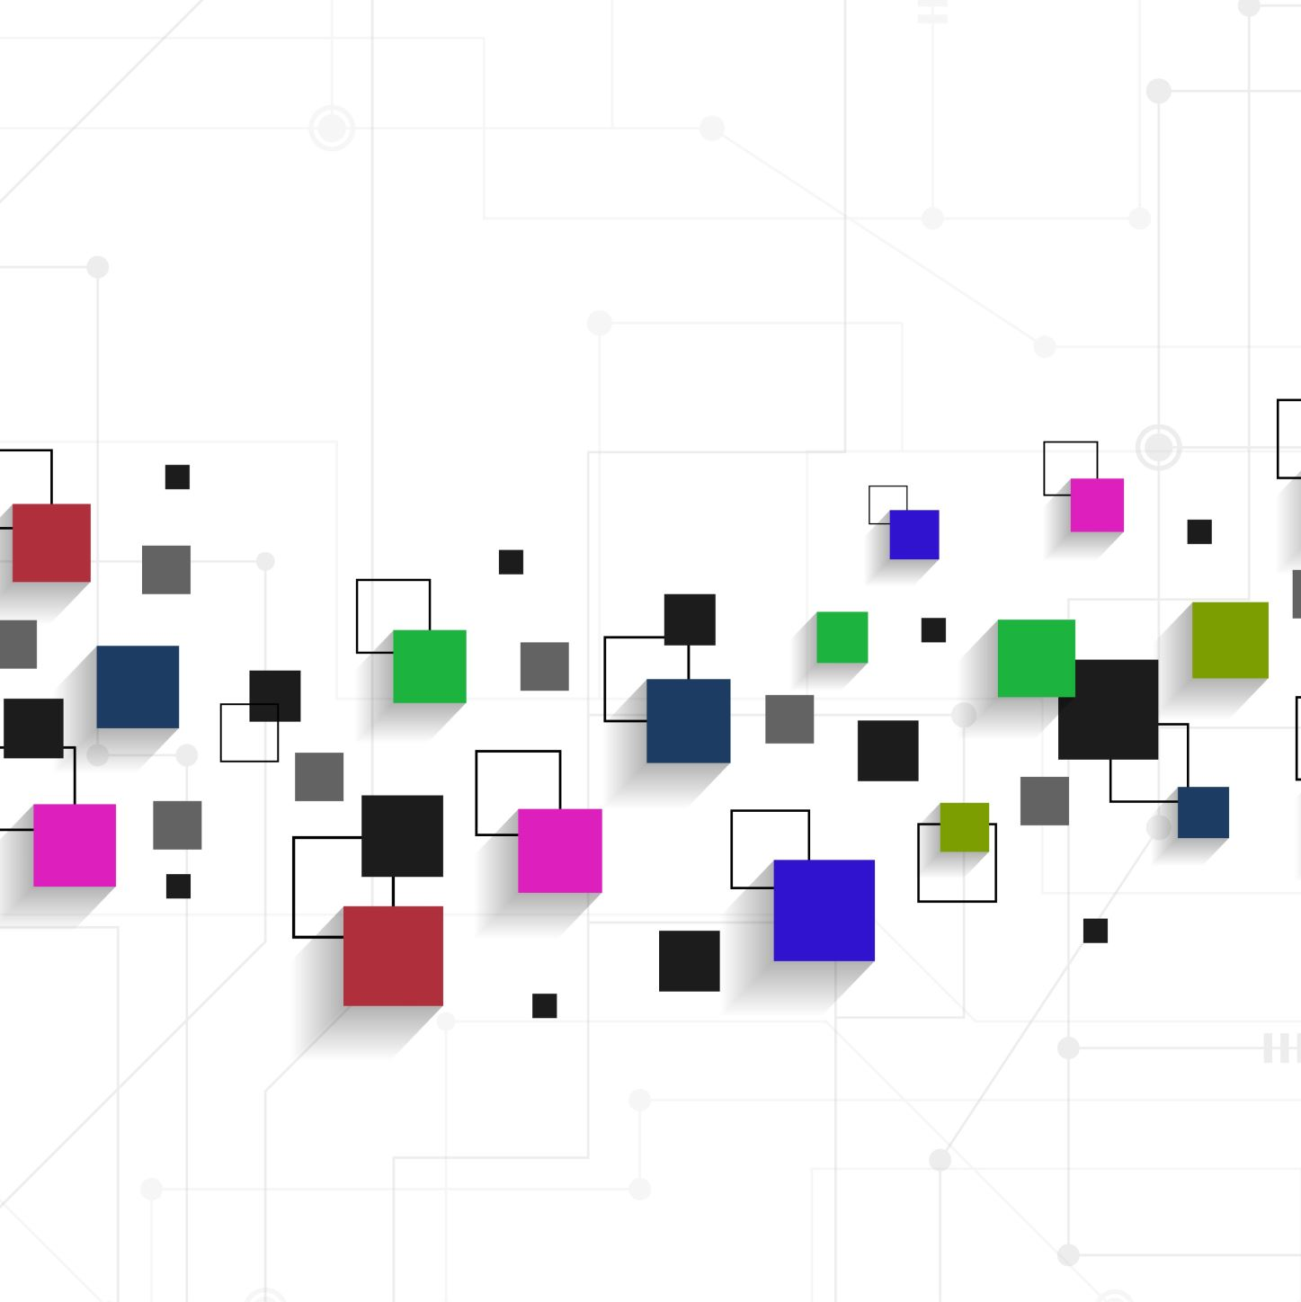
Week 1

Slide 2
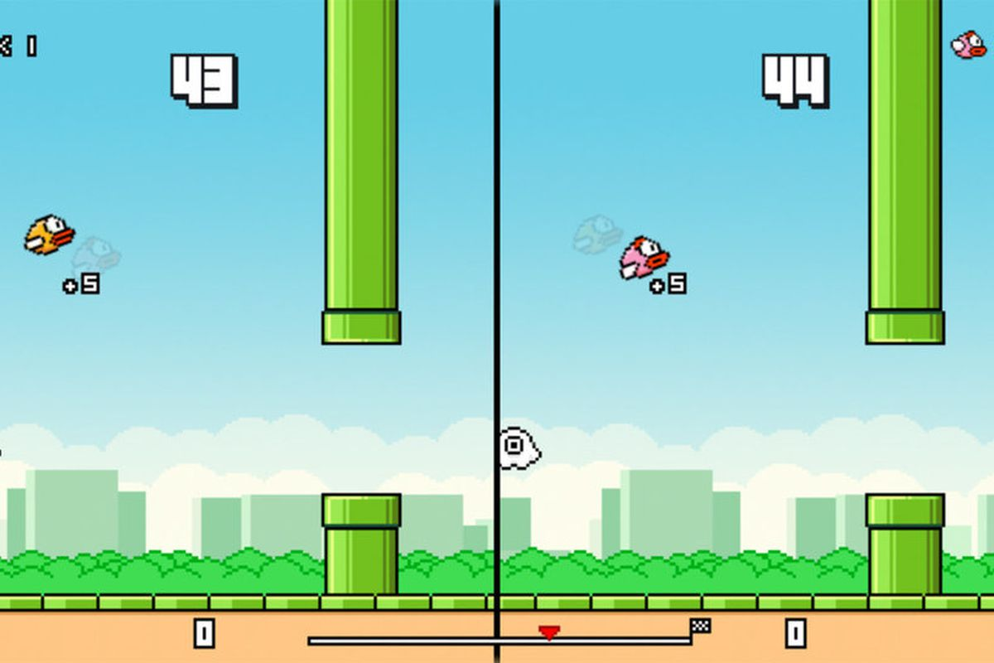

Slide 3
What is Python?
A programming language that can be used to build websites and software, automate tasks, and conduct data analysis
Cool software ideas: chatbot, spam email detector, 2D games

Slide 4
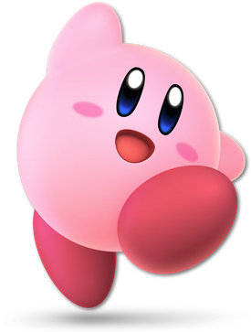
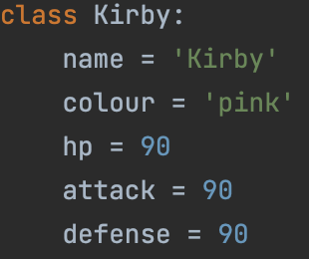
Characteristics (Variables):
Name: Kirby
Colour: pink
HP: 90
Attack: 90
Defense: 90

Slide 5
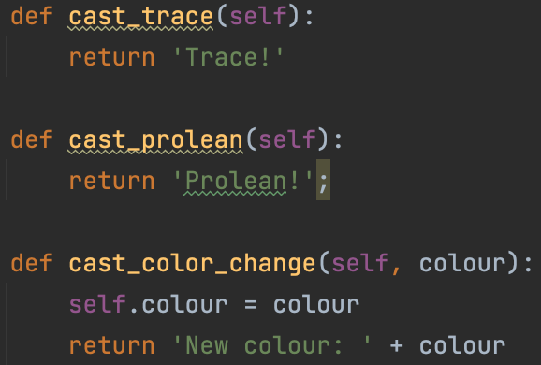
Behaviour (Methods/Functions):
Ability: Trace
Ability: Protean
Ability: Color Change

Slide 6
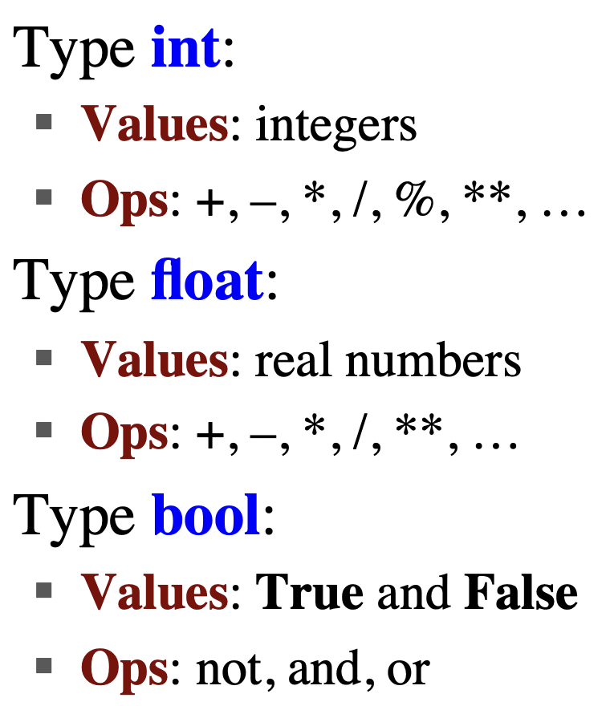
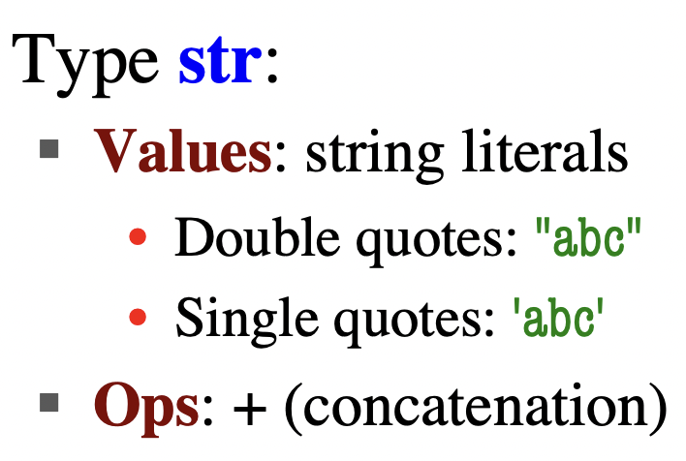
Variable Type

Slide 7
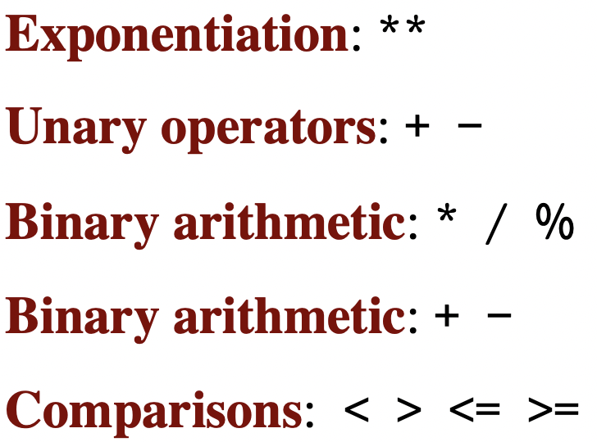
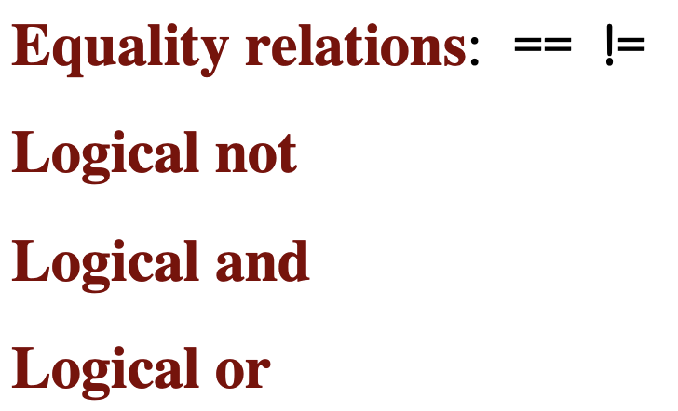
Operator Precedence

Slide 8

Variable
Has a name that begins with a letter or _
Contains a value
Can be used in expressions
Can obtain the variable type from the value

Slide 9
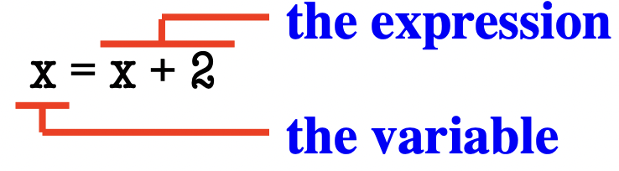
Assignment Statements
Variables are created by assignment statements
x = 5 is a statement
Assignment statements can have expressions in them

Slide 10

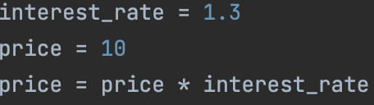
Practice

Slide 11
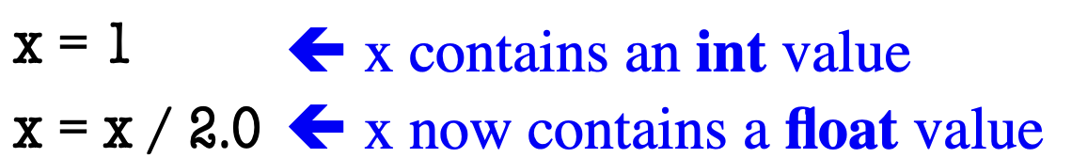
Dynamic Typing
Python is a dynamically typed language
variables can hold any type of value
can use type(x) to find out the type of the value in x

Slide 12
String
Strings are quoted characters
Python prefers quoting with ‘abc d’, while other languages prefer quoting with “abc d”

Slide 13
Escape Characters
We may want to write quotes inside quotes
‘ ‘ ‘ will result in an error in Python

Slide 14
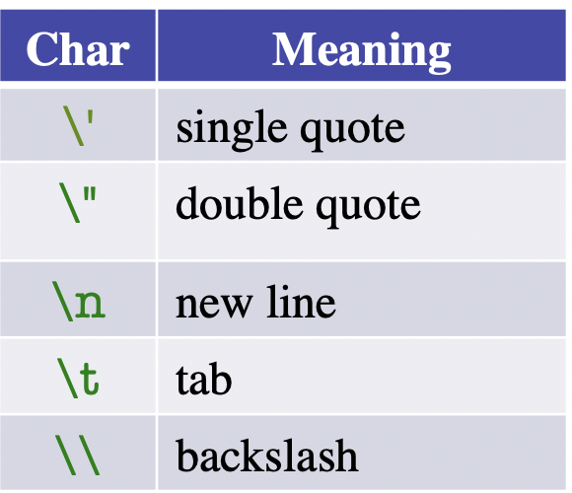
Escape Characters
Format: \ + letter

Slide 15
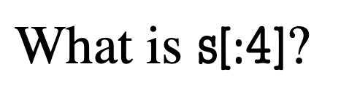
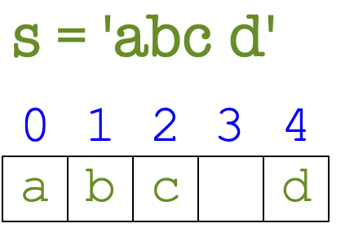
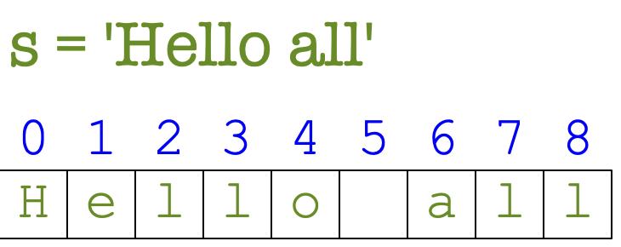
Strings are Indexed
Access characters with [], also called string slicing
s[0] = ’a’ s[5] = ERROR!
s[4] = ‘d’ s[0:2] = ‘ab’ (from index 0 to index 2-1)
s[2:] = ‘c d’ (from index 2 all the way to the end)

Slide 16
Other Power of Strings
s = ’abracadabra’
’a’ in s == True
‘cad’ in s == True
‘foo’ in s == False
s.index(‘a’) == 0
s.index(‘rac’) == 2

Slide 17
Other Power of Strings
s = ’abracadabra’
s.count(‘a’) == 5
len(s) == 11
s.strip(‘a’) == ’bracadabra’
‘ Ilikepython ‘.strip() == ‘Ilikepython’

Slide 18
Homework
Install PyCharm
Create a project using PyCharm
Create a Python file and write codes about your favourite character, add characteristics(variables) and behaviour(functions/methods) to it, like the Kirby example

