Slide 1
Week 6

Slide 2
Problems and Subproblems
We can often describe a problem as a function
fib(n): the n’th Fibonacci number
Substituting a number for n, we get an instance of the problem
fib(5): the 5’th Fibonacci number
For every instance of the problem, we can find a solution for it, or declare that none exists
fib(5) = fib(4) + fib(3) = … = 5

Slide 3
Problems and Subproblems
For some instance of fib(n), we can reduce it to smaller subproblems (another smaller instance of the same problem)
fib(n) = 0 when n = 0
fib(n) = 1 when n = 1
fib(n-1) + fib(n-2) when n > 1
In this case, fib(3) and fib(4) are smaller subproblems we need to solve to get fib(5)

Slide 4
Problems and Subproblems
For our instance of fib(n), we first decompose it into two subproblems fib(n-1) and fib(n-2)
Given the solution to these subproblems
A := fib(n-1) and
B := fib(n-2)
We can combine them to generate our solution to fib(n)
fib(n) = A + B

Slide 5
Recursion
A problem is recursive if we can decompose it into smaller subproblems, solve the subproblems, then combine their solutions to obtain the final solution
Need a base case and a recursive case

Slide 6
Dynamic Programming
An algorithmic paradigm that solves a given complex problem by breaking it into subproblems using recursion AND storing the results of subproblems to avoid computing the same results again

Slide 7
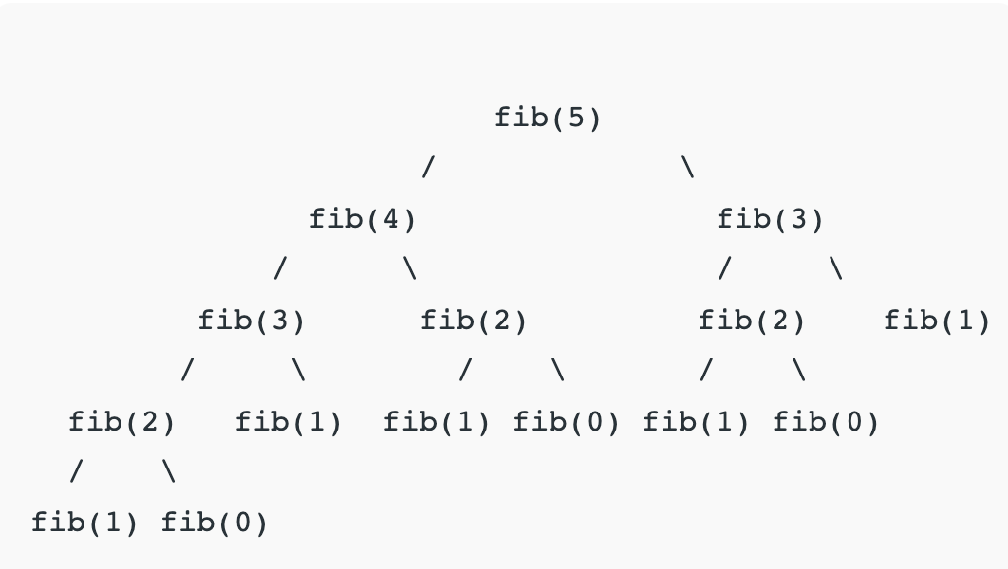

Slide 8
Memoization (Top Down)
Whenever we need a solution to a subproblem, look into a lookup table first
If the precomputed value is in the lookup table, then we return the value; otherwise, we calculate the value and save the result in the lookup table so it can be reused later

Slide 9
Tabulation (Bottom Up)
Builds a table in a bottom-up fashion and returns the last entry from the table
For the same Fibonacci number, we first calculate fib(0), then fib(1), then fib(2), and so on

Slide 10
Factorial
n! = 1 x 2 x … x n
5! = 120
How to reduce the above problem into subproblems?

Slide 11
Integer Exponentiation
a^{b} = a multiplied b times, assume a is fixed
If a = 2, a⁵ = 32
How to reduce the above problem into subproblems?

Slide 12
Longest Common Subsequence
Problem: Given two sequences, find the length of the longest subsequence present in both of them.
A subsequence is a sequence that appears in the same relative order, but not necessarily contiguous

Slide 13
Longest Common Subsequence
Example: ”abc”, “abg”, “bdf” are subsequences of “abcdefg”
LCS for input Sequences “ABCDGH” and “AEDFHR” is “ADH” of length 3
LCS for input Sequences “AGGTAB” and “GXTXAYB” is “GTAB” of length 4

Slide 14
Longest Common Subsequence
Naïve solution: generate all subsequences of both given sequences and find the longest matching subsequence

Slide 15
Longest Common Subsequence
Let the input sequences be X[0..m-1] and Y[0..n-1]
Define function LCS(X, Y) to return the length of the LCS of the two sequences X and Y
If X[m-1] == Y[n-1], last characters of both sequences match, then LCS(X[0..m-1], Y[0..n-1]) = 1 + LCS(X[0..m-2], Y[0..n-2])
If X[m-1] != Y[n-1], last characters of both sequences do not match, then LCS(X[0..m-1], Y[0..n-1]) = max(LCS(X[0..m-2], Y[0..n-1]), LCS(X[0..m-1], Y[0..n-2]))

Slide 16
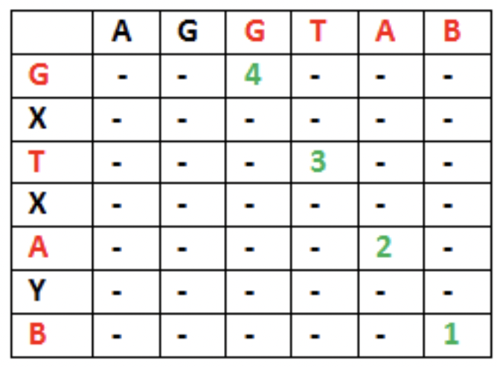
Longest Common Subsequence
Let X = “AGGTAB”, Y = “GXTXAYB”
LCS(“AGGTAB”, “GXTXAYB”) = 1 + LCS(“AGGTA”, “GXTXAY”)

Slide 17
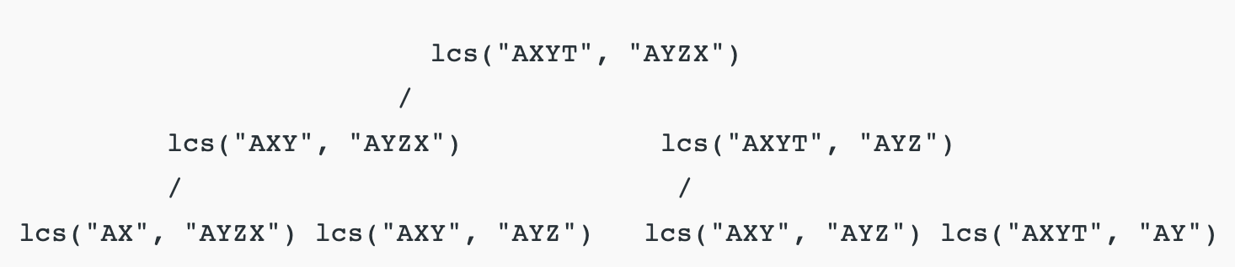

Slide 18
Longest Increasing Subsequence
Example: [10, 11, 1, 5, 3, 9, -1, 7, 25]
[1, 10, 11] is not a subsequence
[10, 11] is an increasing subsequence
[1, 3, 25] is the increasing subsequence
Longest increasing sequence(LIS)?
How to decompose LIS(A) into smaller subproblems?

Slide 19
Longest Increasing Subsequence
Example: A = [10, 11, 1, 5, 3, 9, -1, 7, 25]
If a₀ = 10
(keep 10) [10 LIS([11, 1, …])]
(don’t keep 10) LIS([11, 1, …])

Slide 20
Longest Increasing Subsequence
We can define the problem recursively as:
L(i) = 1 + max(L(j)) where 0 < j < i and A[j] < A[i]
Or L(i) = 1 if no such j exists
The length of the longest increasing subsequence ending at index i will be 1 greater than the maximum of lengths of all longest increasing subsequences ending at indices before i, if A[j] < A[i] for j < i

Slide 21
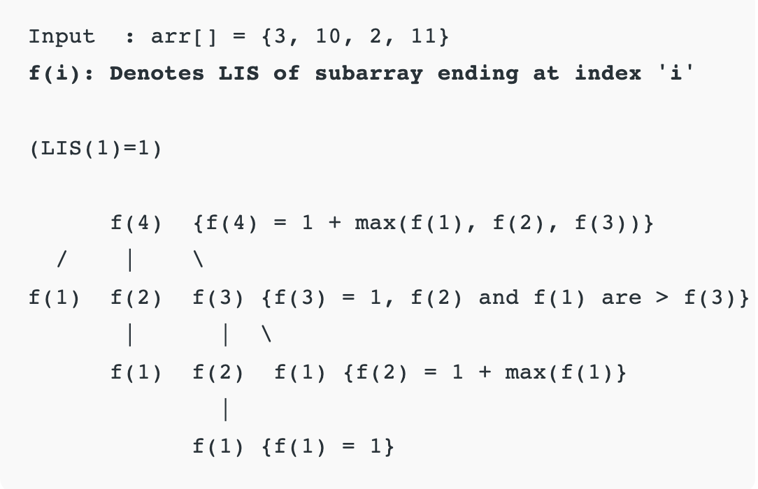

Slide 22
Time Complexity
Exponential, because there is a case of overlapping subproblems as shown in the recursive tree diagram

Slide 23
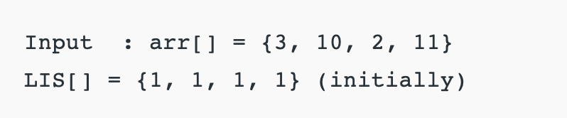
Tabulation
arr[2] > arr[1] {LIS[2] = max(LIS [2], LIS[1]+1)=2}
arr[3] < arr[1] {No change}
arr[3] < arr[2] {No change}
arr[4] > arr[1] {LIS[4] = max(LIS [4], LIS[1]+1)=2}
arr[4] > arr[2] {LIS[4] = max(LIS [4], LIS[2]+1)=3}
arr[4] > arr[3] {LIS[4] = max(LIS [4], LIS[3]+1)=3}

Slide 24
Big-O Complexity
Time: O(n^2), nested loop is used
Space: O(n), array for storing LIS values at each index

Slide 25
Converting LIS to LCS
First create another array A_sorted of unique elements of the original array A and sort it
The LIS of A must be present as a subsequence in A_sorted

Slide 26
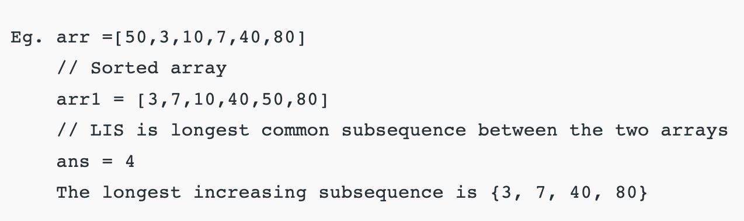
Converting LIS to LCS

Slide 27
Maximum 1D Independent Set
The maximum sum of chosen integers, such that no two chosen values are adjacent in the array
Example: [4, 5, 4, 1, 1, 8, 3, 5]
4 + 4 + 8 + 5 = 21
4 + 5 + 8 + 5 = 22 (is not valid because 4 and 5 are adjacent)

Slide 28
Homework
https://leetcode.com/problems/maximum-subarray/
https://leetcode.com/problems/longest-palindromic-substring/
https://leetcode.com/problems/longest-valid-parentheses/
For more practice, search for DP problems on LeetCode

