Slide 1

JavaFX

Slide 2
What is JavaFX?
A Java Library/GUI framework used to develop Desktop applications as well as Rich Internet Applications (RIA)
The applications built in JavaFX can run on multiple platforms including Web, Mobile, and Desktops

Slide 3
JavaFX Application
Contains three components: Stage, Scene, nodes
Three important methods:
public void init()
public abstract void start(Stage primaryStage)
public void stop()
Steps to create a basic JavaFX application
Import javafx.application.Application
Inherit Application to our class
Override the start() method of Application class

Slide 4
Stage
Acts like a container for all the JavaFX objects
Primary Stage is created internally by the platform
Other stages can further be created by the application
The object of primary stage is passed to start method
Need to call show method on the primary stage object in order to show our primary stage

Slide 5
Stage
Can add various objects to this primary stage in a hierarchical way
First, scene graph will be added to this primaryStage and then that scene graph may contain the nodes
A node may be any object of the user’s interface like text area, buttons, shapes, media, etc

Slide 6
Scene
Holds the physical contents (nodes) of a JavaFX application
Creating scene is necessary in order to visualize the contents on the stage
At one instance, the scene object can only be added to one stage
Need to import javafx.scene package
The Scene can be created by creating the Scene class object and passing the layout object into the Scene class constructor

Slide 7
Scene Graph
A hierarchical tree of nodes that represent all the visual elements of user interface
A node is an element which is visualized on stage
Button, text box, layout, image, radio button, etc
Has the ability to handle events
Every node of a scene graph can only have single parent and zero or more children

Slide 8
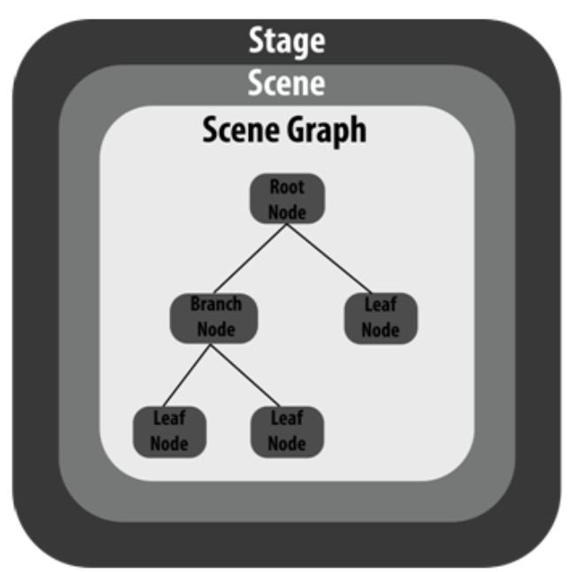

Slide 9
JavaFX Layouts
The graphical user interface of every desktop application mainly considers UI elements, layouts, and behaviour
Layouts are the top-level container classes that define the UI styles for scene graph objects
Layout defines the way in which the components are to be seen on the stage, in other words, it organizes the scene-graph nodes
All layout classes belong to javafx.scene.layout package; javafx.scene.layout.Pane class is the base class for all other layouts

Slide 10
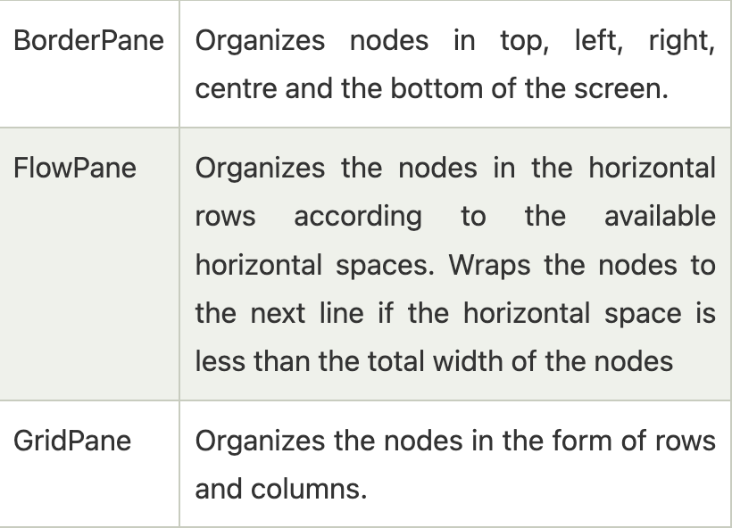

Slide 11
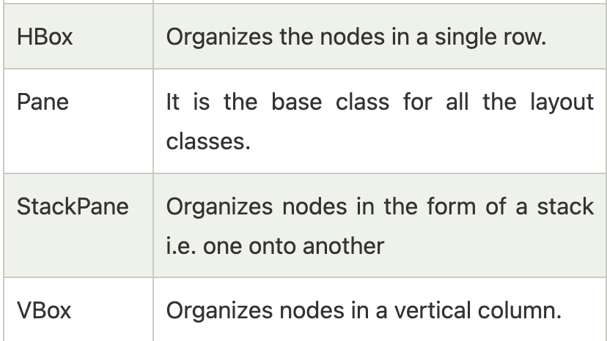

Slide 12
JavaFX UI Controls
The UI elements are the one which are actually shown to the user for interaction or information exchange
Layout defines the organization of the UI elements on the screen
Behaviour is the reaction of the UI element when some event is occurred on it

Slide 13
Package javafx.scene.control
Provides all the necessary classes for the UI components like Button, Label, etc
Every class represents a specific UI control and defines some methods for their styling

Slide 14
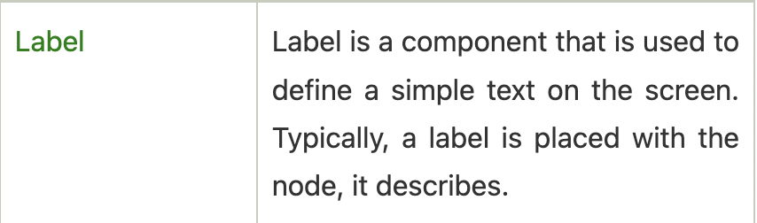
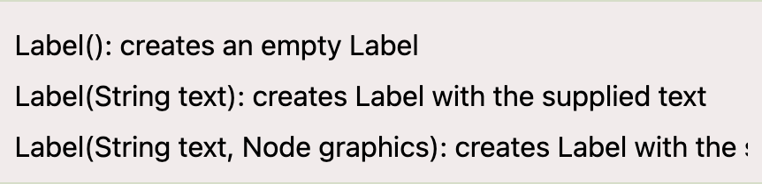

Slide 15
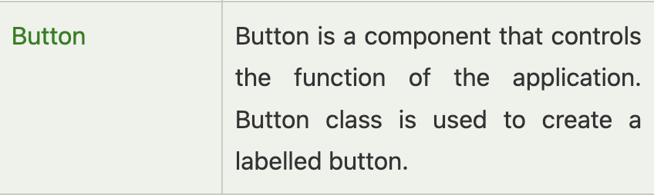


Slide 16
Java Event Handling
In modern day applications, users need to interact with the application in most of the cases
In JavaFX, an event occurs whenever user interacts with the application nodes
Pressing keys on the keyboard
Scroll any page of the application
A good application is the one which takes the least amount of time in handling events

Slide 17
Types of Events
Foreground events
Occurred due to the direct interaction of user with the GUI of an application
Example: clicking a button, pressing a key, selecting an item from the list, scrolling the page
Background events
Doesn’t require user interaction with the application
Occurs due to operating system interrupts, failure, operation completion, etc

Slide 18
Processing Events in JavaFX
Used to notify the application about actions taken by user
JavaFX provides the mechanism to capture the events, route the event to its target, and letting the application handle the events
Class javafx.event.Event: an event is an instance of the class Event or any of its subclasses
MouseEvent, KeyEvent, ScollEvent, DragEvent; we can also define our own event by inheriting the class javafx.event.Event

Slide 19
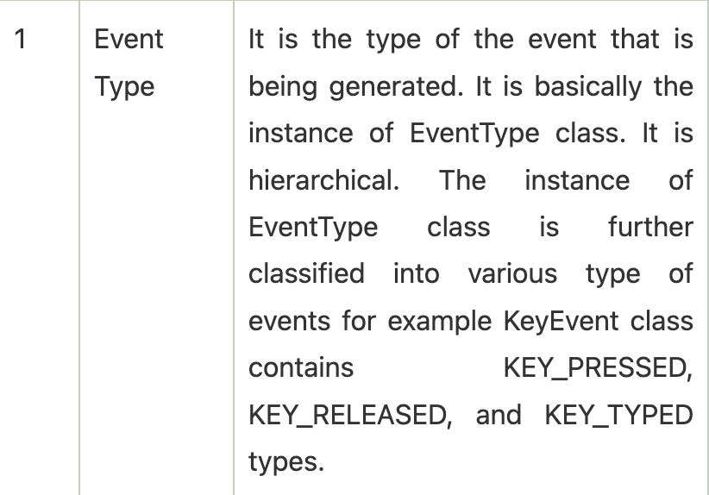

Slide 20
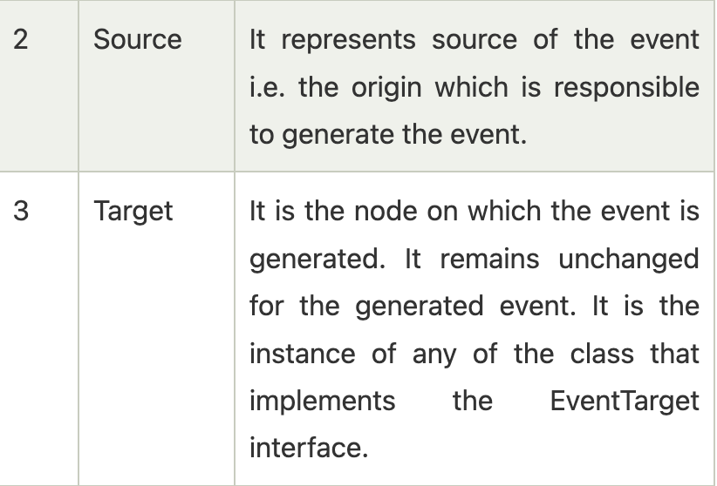

Slide 21
Route Construction
An Event Dispatch Chain is created in order to determine the default route of the event, whenever it is generated
The Event Dispatch Chain contains the path from the stage to the Node on which the event is generated (following the hierarchy tree)

Slide 22
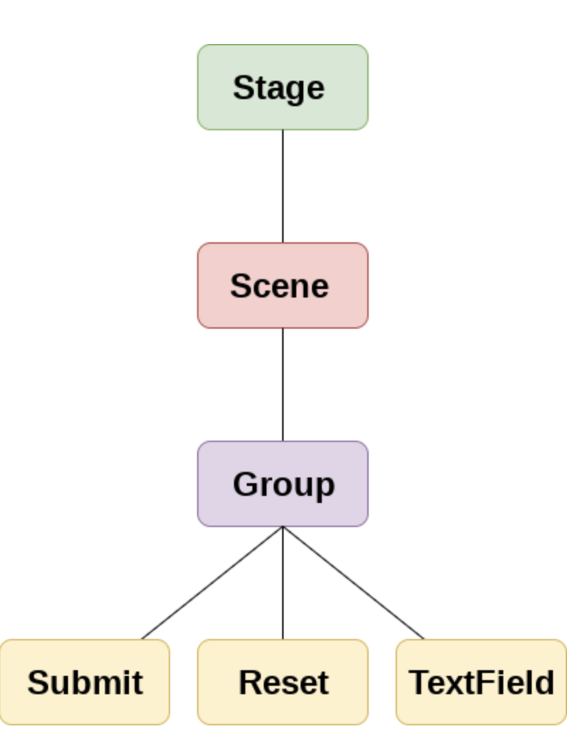

Slide 23
Event Capturing Phase
Once the Event Dispatch Chain is created, the event is dispatched from the source node of the event
All nodes are traversed by the event from top to bottom
If event filter is registered with any of these nodes, then it will be executed
If none of the nodes are registered with the event filter, then the event is transferred to the target node (the node that currently appears under the user cursor)
The target node processes the event

Slide 24
Event Bubbling
Once the event is processed by the target node or by some registered filter, the event traverses all the nodes again from bottom to the stage node
If any of these nodes are registered with the event filter, it will get executed, otherwise the process is complete

Slide 25
Event Handlers and Filters
Both contain application logic to process an event
A node can be registered to more than one event filters
The interface javafx.event.EventHandler must be implemented by all the event handlers and filters
Event filters are called during the event capturing phase
Event handlers are called during the event bubbling phase, which happens after the event capturing phase

Slide 26
Convenience Methods
Provide an easy way to create and register event handlers to respond to KeyEvent, MouseEvent, ActionEvent and many more
Node class contains various Event Handler properties which can be set to the user defined event handlers using the setter methods defined in the class

Slide 27
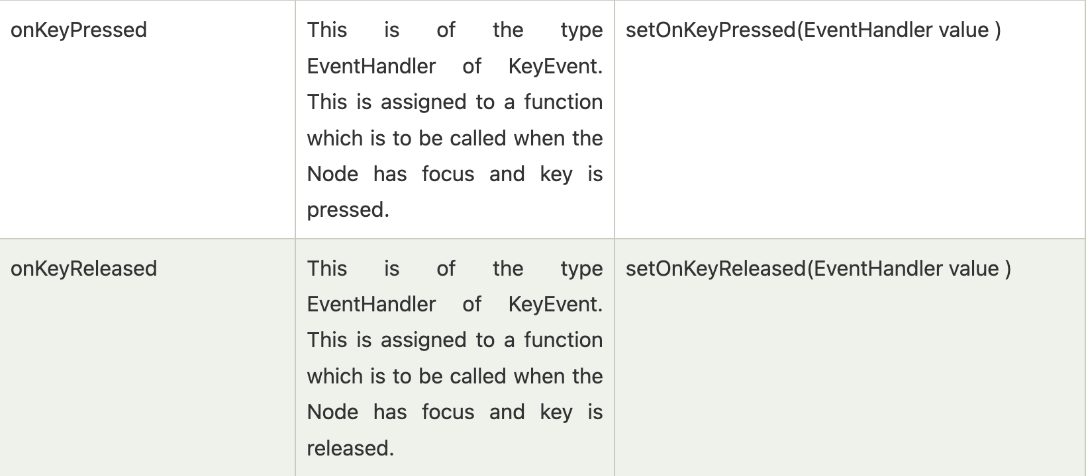

Slide 28
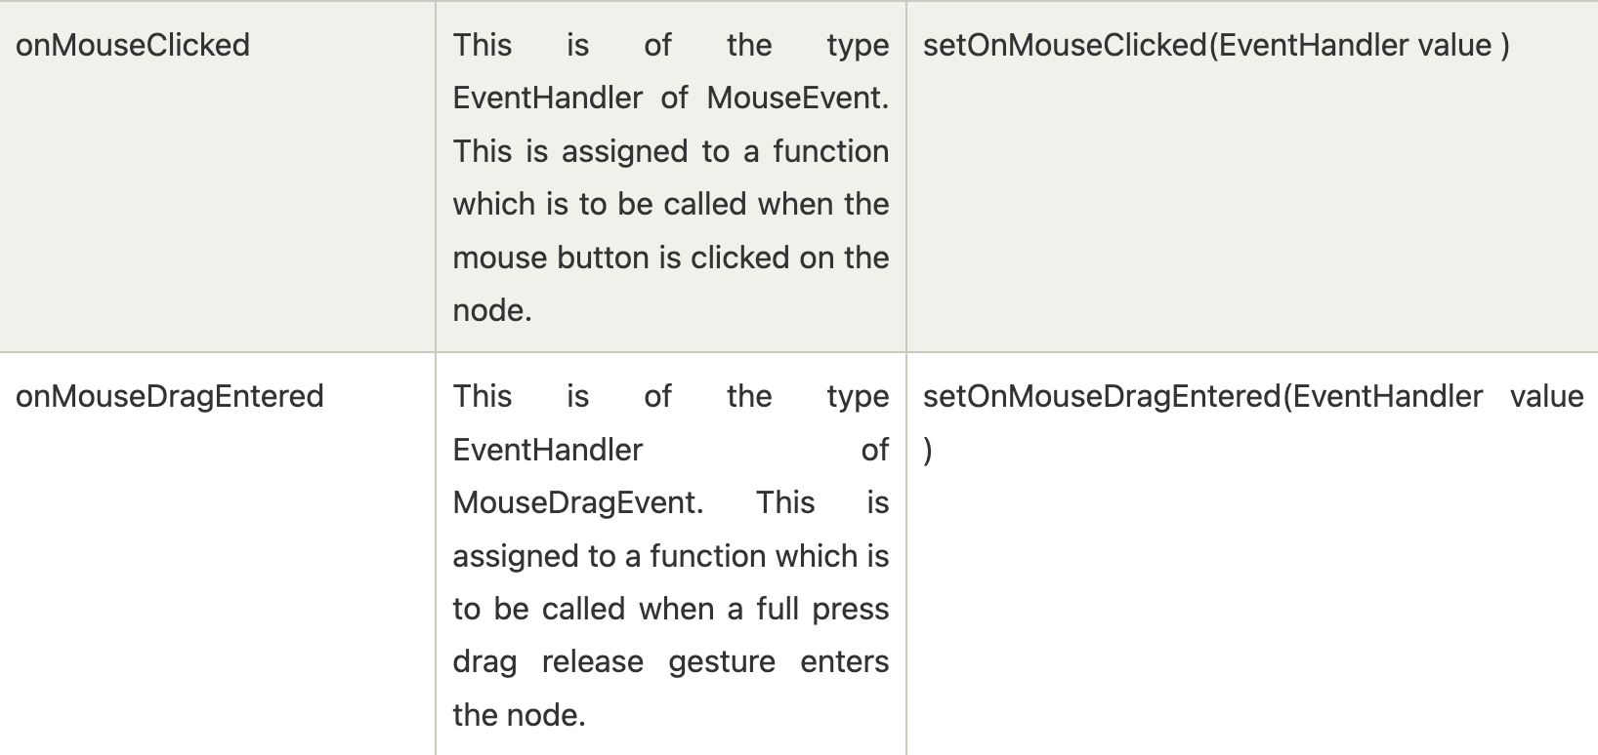

Slide 29
Canvas
Creates an image that can be drawn on using a set of graphics commands provided by a GraphicsContext. Canvas has a specified height and width and all the drawing operations are clipped to the bounds of the canvas

Slide 30
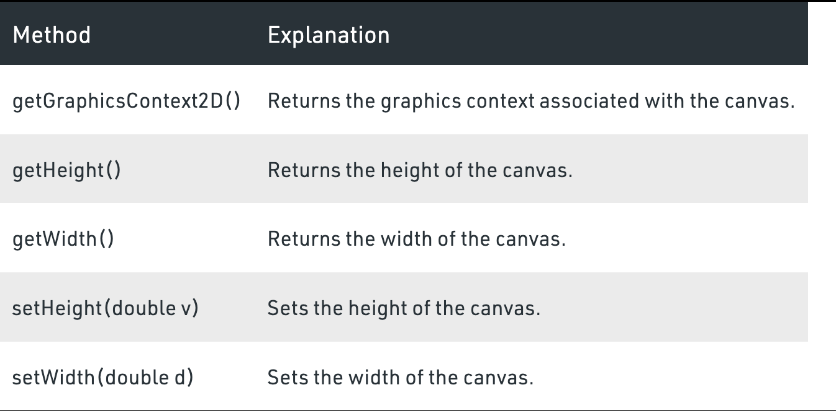

Slide 31


Timeline
When an animation occurs, each step is called a keyframe which is defined by a KeyFrame object
A Timeline is one animation sequence consisting of many KeyFrame objects
The cycle count is the number of times to play the animation. To play the animation indefinitely, use the value Timeline.INDEFINITE

Slide 32
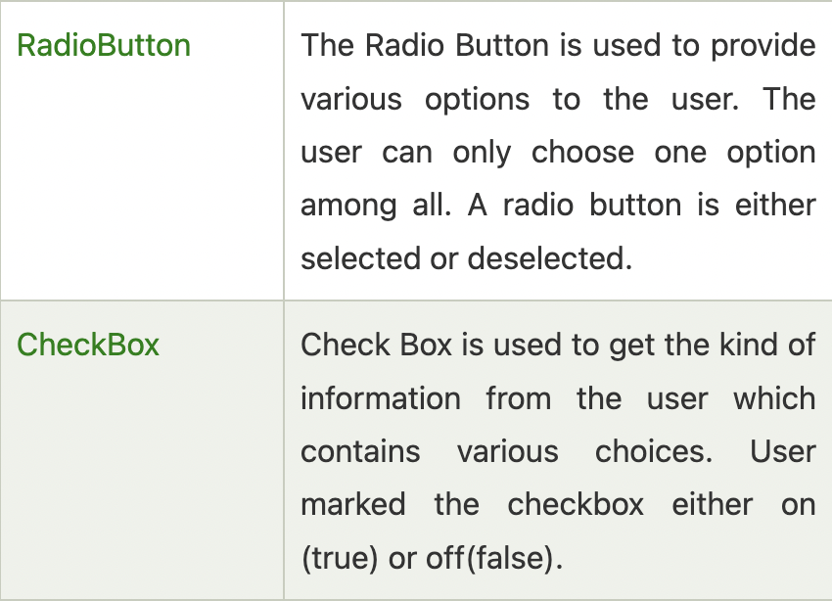

Slide 33
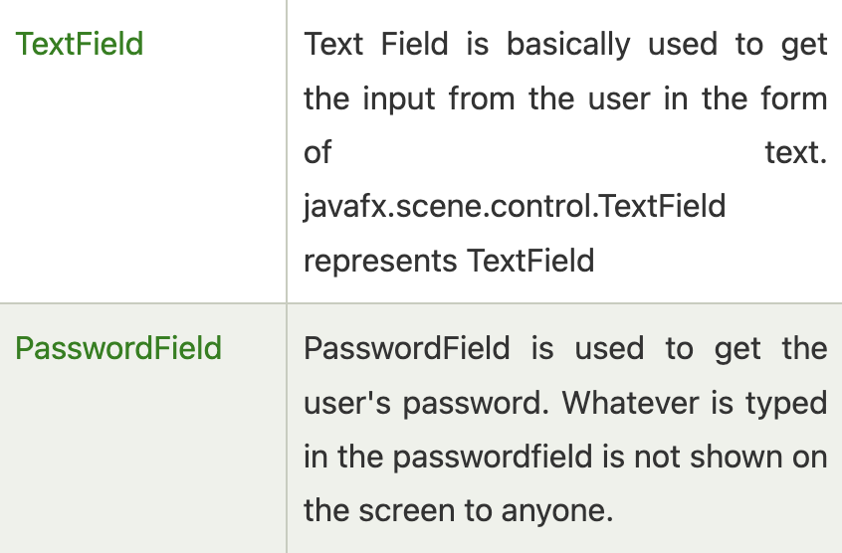

Slide 34
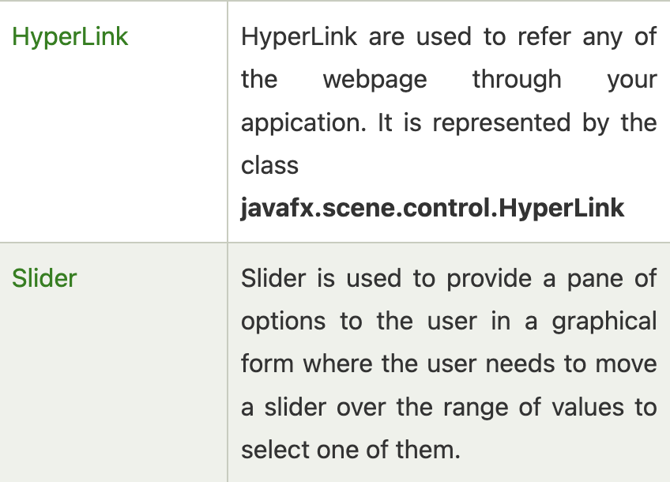

Slide 35
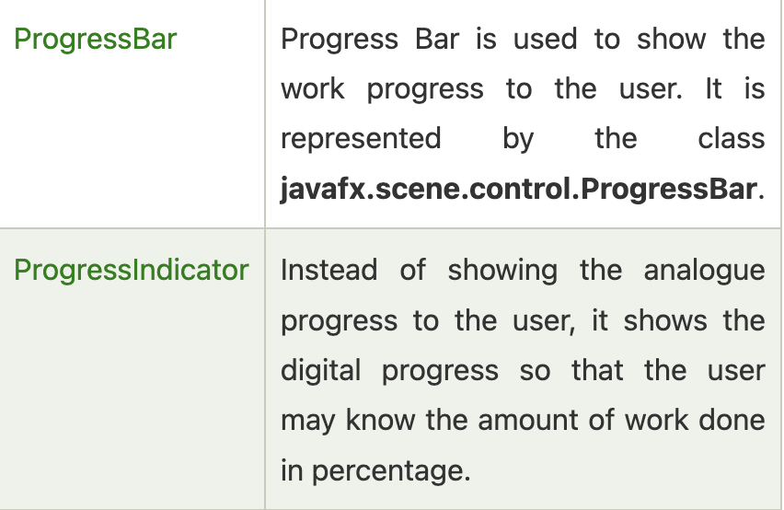

Slide 36
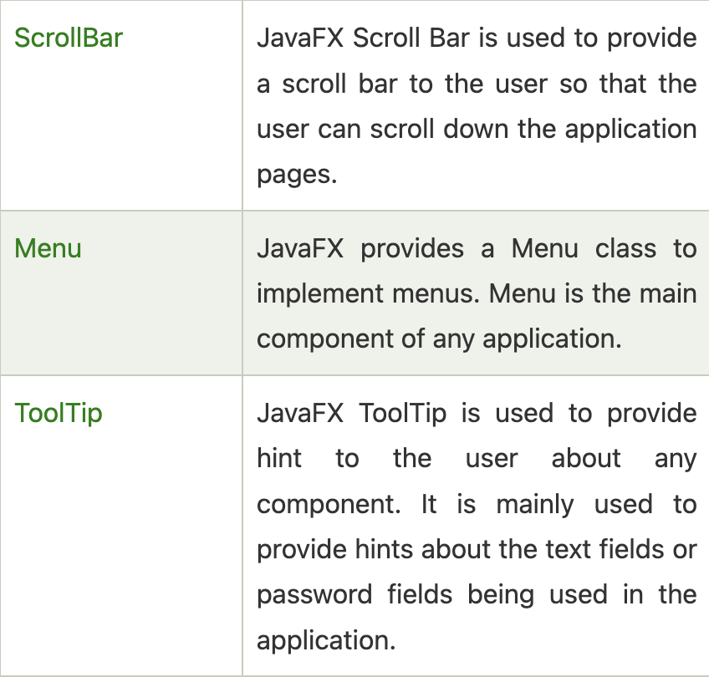

Slide 37
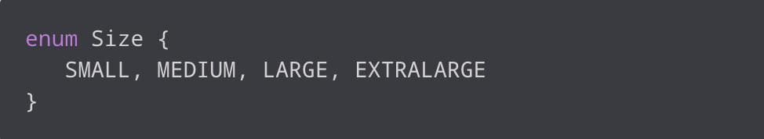
Java Enum
Enum is short for enumeration, which is a type that has a fixed set of constant values
We use the enum keyword to declare enums
Values inside the braces are called enum constants
Enum constants are usually represented in uppercase

Slide 38
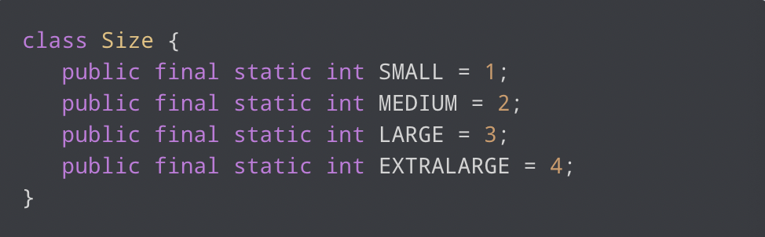
Why Java Enums?
Enum was introduced to replace the use of int constants
If we print the constants below, only numbers will be printed, which might not be helpful

Slide 39
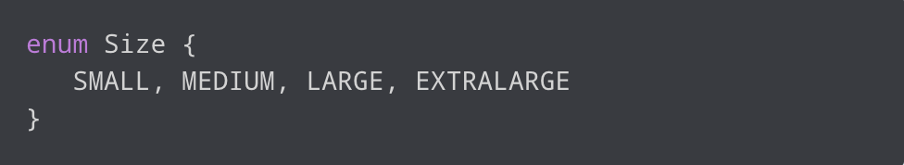

Why Java Enums?
Instead of using int constants, we can simply use enums
Makes our code more intuitive, and provides compile-time type safety
If we declare a variable of the Size type, it is guaranteed that the variable will hold one of the four values

