Slide 1

Program Design

Slide 2
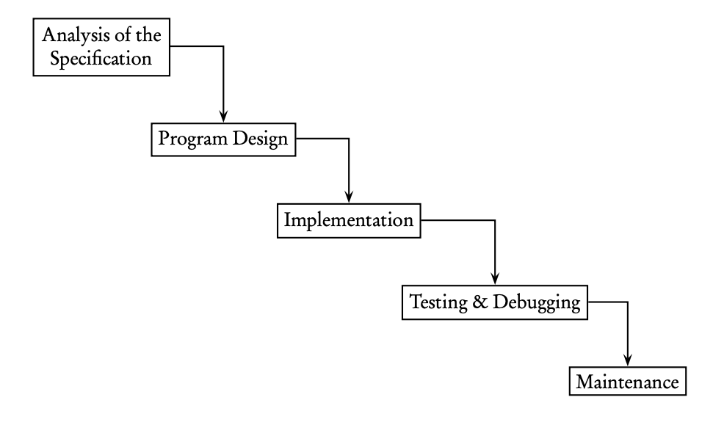
The Software Development Life Cycle
Waterfall Model

Slide 3
The Waterfall Model – Program Specification
A written description of the project, typically based on a customer’s requirements
The first step in writing a program is to analyze the specification, make sure you understand it, and clarify with the customer anything that is unclear

Slide 4
The Waterfall Model – Program Design
A fairly detailed plan for solving the problem outlined in the specification
Should include all objects that will be used in the solution, the data structures that will implement them, plus a detailed list of the tasks to be performed by the program
Should not include any Java code

Slide 5
The Waterfall Model – Program Implementation
The coding phase

Slide 6
The Waterfall Model – Testing and Debugging
Test data: programmers usually select a representative set of test data
Values in each part of a domain of the program
Endpoint values and out-of-range values
I.e. a program that insert a value into its correct position in this sorted list:
2, 5, 9
What test data should we use?

Slide 7
The Waterfall Model – Testing and Debugging
Types of Errors(Bugs):
A compile-time error occurs during compilation of the program. A syntax error is a compile-time error caused by violating the rules of the programming language. (i.e. omitting semicolons or braces)
A run-time error occurs during execution of the program. The Java run-time environment throws an exception, which means it stops program execution and prints an error message. (i.e. integer division by zero)
An intent or logical error occurs when the program fails to carry out the specification required by user. The program compiles and runs but does not do the job.

Slide 8
The Waterfall Model – Testing and Debugging
Robustness = write a program that
Won’t give inaccurate answers for some input data
Won’t crash if the input data are invalid
Won’t allow execution to proceed if invalid data are entered (i.e. entering out-of-range numbers, or a response of “maybe” when “yes” or “no” was asked for)

Slide 9
The Waterfall Model – Program Maintenance
Involves upgrading the code as circumstances change
New feature may be added, or new programmers may come on board
As a result, programs should have clear and precise documentation (comments)

Slide 10
The Waterfall Model – Program Design

