Slide 1

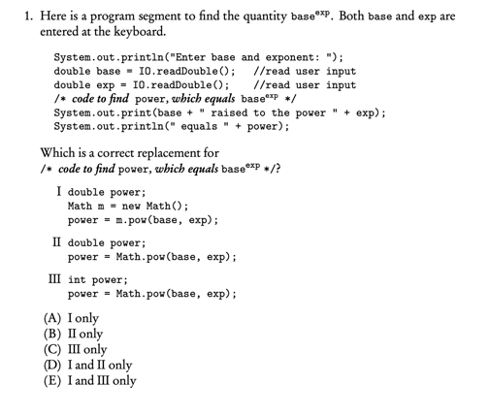
Week 6
Notes:
11, 14, 17
11, 13, 15, 16, 17, 18

Slide 2
One-dimensional arrays
An array is a data structure used to implement a list object, where elements in the list must be of the same type
Each element is associated with an index value. For an array of N elements in Java, index values go from 0 to N-1
If arr is the name of the array, the elements are arr[0], arr[1], … , arr[N-1]
If a negative index is used, or a index k where k is greater than N, then an ArrayIndexOutOfBoundsException is thrown

Slide 3
Array Initialization
In Java, an array is an object; therefore, the keyword new must be used in array creation
After array creation, we get a reference to the array object
Size of the array remains fixed once it has been created
An array reference may be reassigned to a new array of a different size
When arrays are declared, all elements are automatically initialized to 0 for int and double, false for boolean, or null for object references
Notes:
ArrayInitialization.java

Slide 4
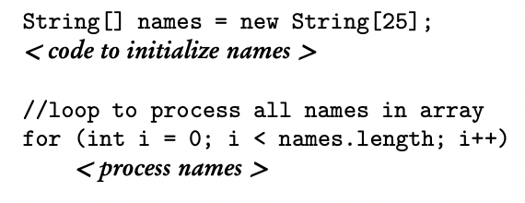

Length of Array
A Java array has a final public instance variable, length
Length is not a method in array and therefore is not followed by parentheses
Length in String is a method and must be followed by parentheses

Slide 5
Traversing an Array
Precondition: a statement of what is true immediately before execution of that code
Postcondition: a statement of what is true immediately after execution of that code
Use a for-each loop whenever you need access to every element in an array without replacing or removing any elements
Use a for loop: to access the index of any element, to replace or remove elements, or to access some of the elements
Notes:
TraversingArray.java

Slide 6
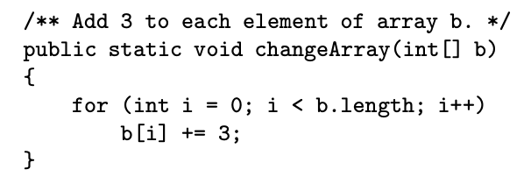
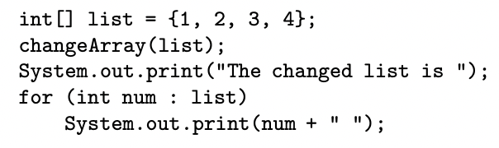
Arrays as Parameters
Arrays are treated as objects, so passing an array as parameter means passing its object reference
No copy is made of the array, but elements of the actual array can be accessed and modified

Slide 7
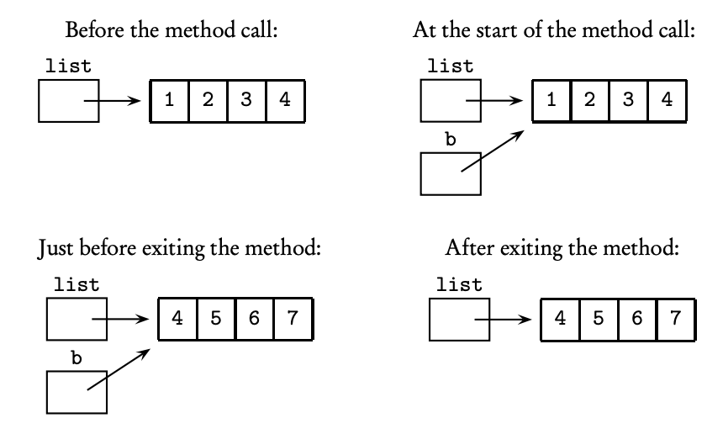

Slide 8
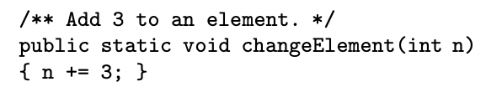
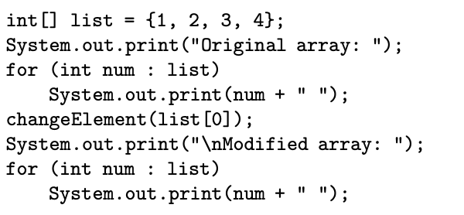

Slide 9
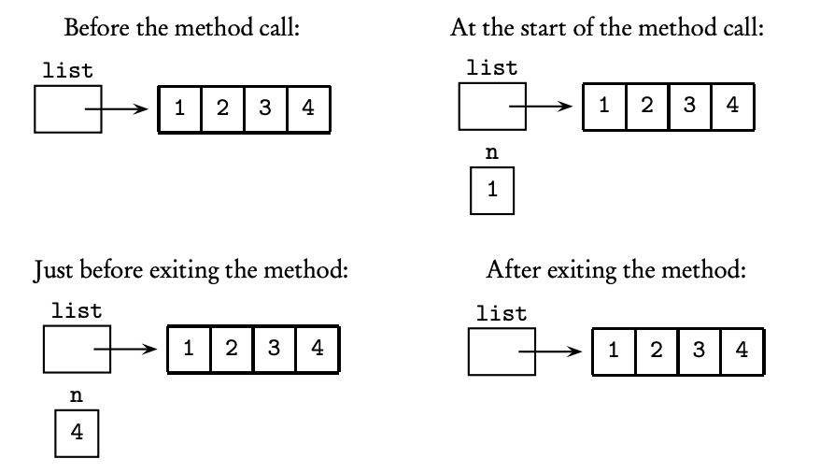

Slide 10
Usage of Arrays
Consider a simple Deck class in which a deck of cards is represented by the integers 0 to 51
No evidence of the array that holds the deck of cards -- deck is a private instance variable and is therefore invisible to clients of the Deck class
Suppose a large card tournament needs to keep track of many decks, we could implement it with an array of Deck

Slide 11
Efficiency of Algorithm
Best case: a configuration of data that causes the algorithm to run on the least possible amount of time
Worst Case: a configuration that leads to the greatest possible run time
Average case: typical configurations (not specifically chosen data) give the average case

Slide 12
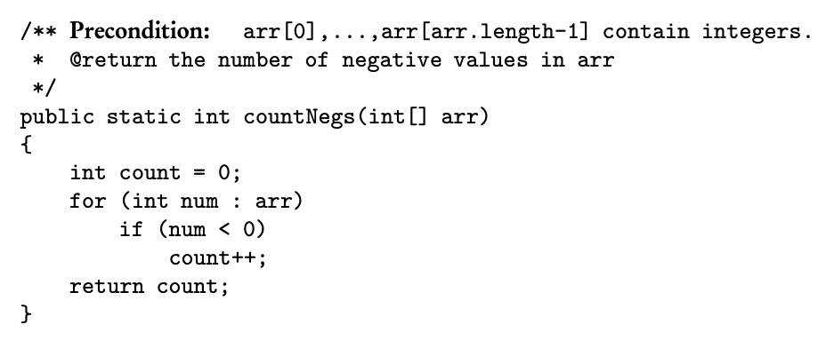
Efficiency of Algorithm
Best: never executed count++
Worst: all elements executed count++

Slide 13
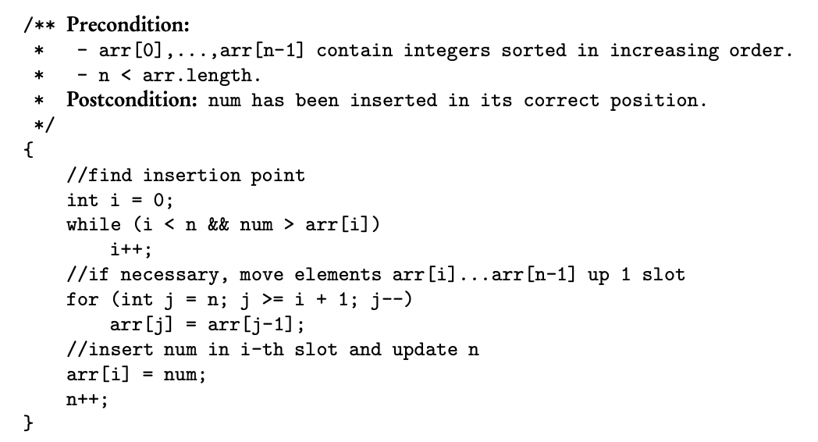
Efficiency of Algorithm
Best case: num is greater than all elements, so it gets inserted at the end of the list, no elements have to move to create a slot for it
Worst case: num is smaller than all elements in the array, so num must be inserted at arr[0], every element in the array must move up one position to create a slot

Slide 14
Disadvantage of Arrays
Insertion and deletion of an element in an ordered list is inefficient
In the worst case, may have to move all elements in the list
Solution: use ArrayList from the Java Library

Slide 15
ArrayList vs. Array
An ArrayList provides an alternative way of storing a list of objects
An ArrayList shrinks and grows as needed in a program; an array has a fixed length that is set when the array is created
In an ArrayList list, the last element is always list.size()-1; if an array is partially filled, then as programmers, we have to keep track of the index of the last element
There is a single statement for insertion and deletion with ArrayList; insertion and deletion in array requires us to write the code that shifts elements

Slide 16
The Collections API
The ArrayList class is in the Collections API(Application Programming Interface), provided by Java
Every class, including ArrayList from the Collections API has the following features:
Memory and run-time efficient
Have methods for insertion and removal of items
have default ways of iteration over the entire collection

Slide 17
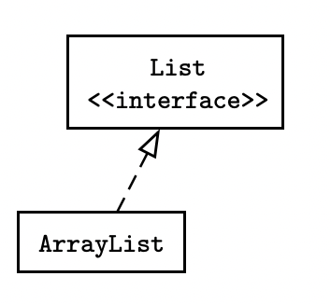
The Collections Hierarchy
Inheritance is a defining feature of the Collections API
The interfaces that are used to manipulate the collections specify operations that must be defined for any container class that implements the interface

Slide 18
ArrayList Initialization
The collections classes are generic, with type parameters wrapped inside <>
List<E> and ArrayList<E> contain elements of type E
E could be any object, in the example above, clowns must contain only Clown objects

Slide 19
The List <E> Interface
A list of elements of type E
Duplicate elements are allowed
Elements of the list are indexed, with 0 being the index of the first element

Slide 20






Methods of List<E>
Notes:
Ryan show sample code

Slide 21
Auto-Boxing and -Unboxing
There are no primitive types in collections classes
An ArrayList must contain objects, not types like double and int
Therefore, numbers must be boxed (placed inside wrapper classes like Integer and Double), before we can insert them into an ArrayList
Java provides auto-boxing and –unboxing of the primitive values when adding or retrieving them from an ArrayList

Slide 22
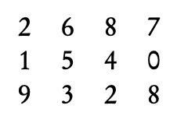
Two-dimensional Arrays
2D array = matrix
3 x 4 matrix
If mat is the matrix variable, the row subscripts go from 0 to 2 and the column subscripts go from 0 to 3
mat[1][2] = 4, mat[0][2] = mat[2][3] = 8
mat[5][5] = ?

Slide 23
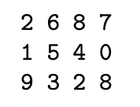
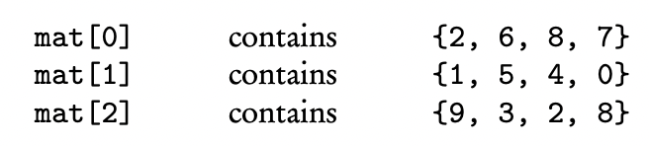
Matrix as Array of Row Arrays

Slide 24
Processing a 2D Array
Row-column (for accessing elements, modifying elements that are class objects, or replacing elements)
For-each loop (for accessing elements or modifying elements that are class objects, but no replacement)
Row-by-row array processing (for accessing, modifying, or replacement)

