Slide 1

2020 CCC

Slide 2
J5: Escape Room
BFS vs DFS
How can we convert the question to a graph problem?

Slide 3
BFS vs. DFS
Both for graph traversal, going through all nodes in a graph one by one, finishes traversal when all nodes have been visited
Graphs are non-sequential data structures, unlike linear data structures such as list, stack, queue, there are different orders for traversal
DFS is traversing in depth
BFS is traversing by level
We can see the order of traversal more clearly with a data structure called Binary Tree

Slide 4
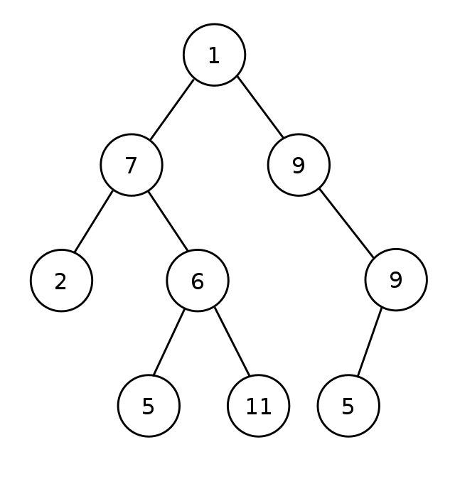
Binary Tree
A tree (a graph with no cycle) such that each node has a maximum of two children, known as the left child and right child
A tree always starts from a root node, root node is not unique

Slide 5
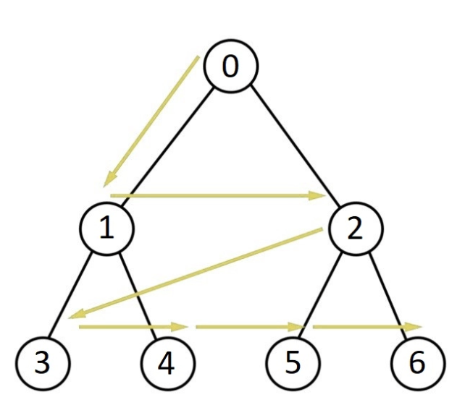
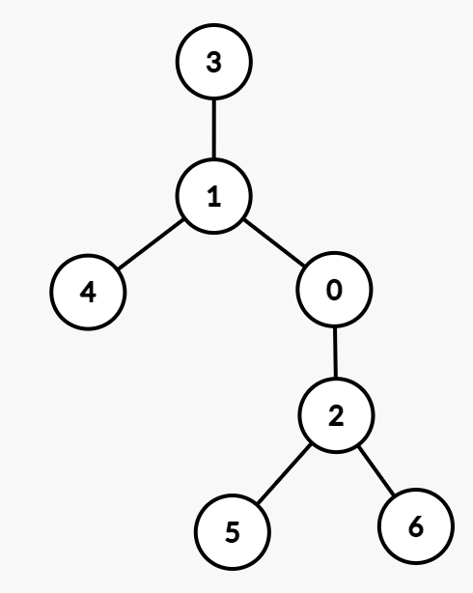
BFS: level order traversal, using Queue

Slide 6
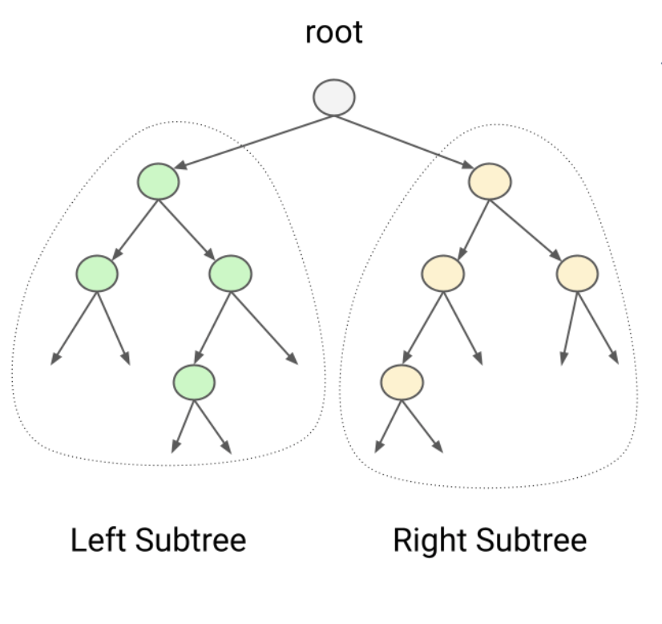
DFS traversal: preorder, inorder, postorder
Preorder: visit root, traverse left subtree, traverse right subtree
Inorder: traverse left subtree, visit root, traverse right subtree
Postorder: traverse left subtree, traverse right subtree, visit root

Slide 7
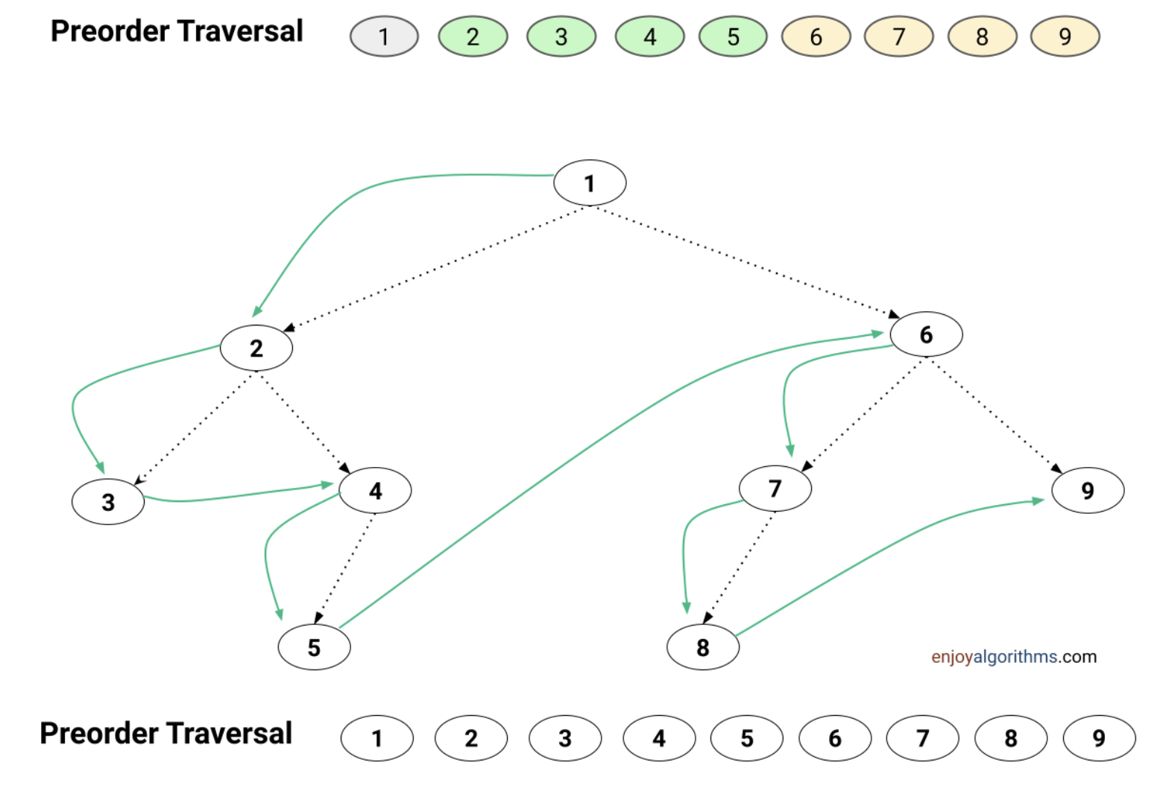

Slide 8
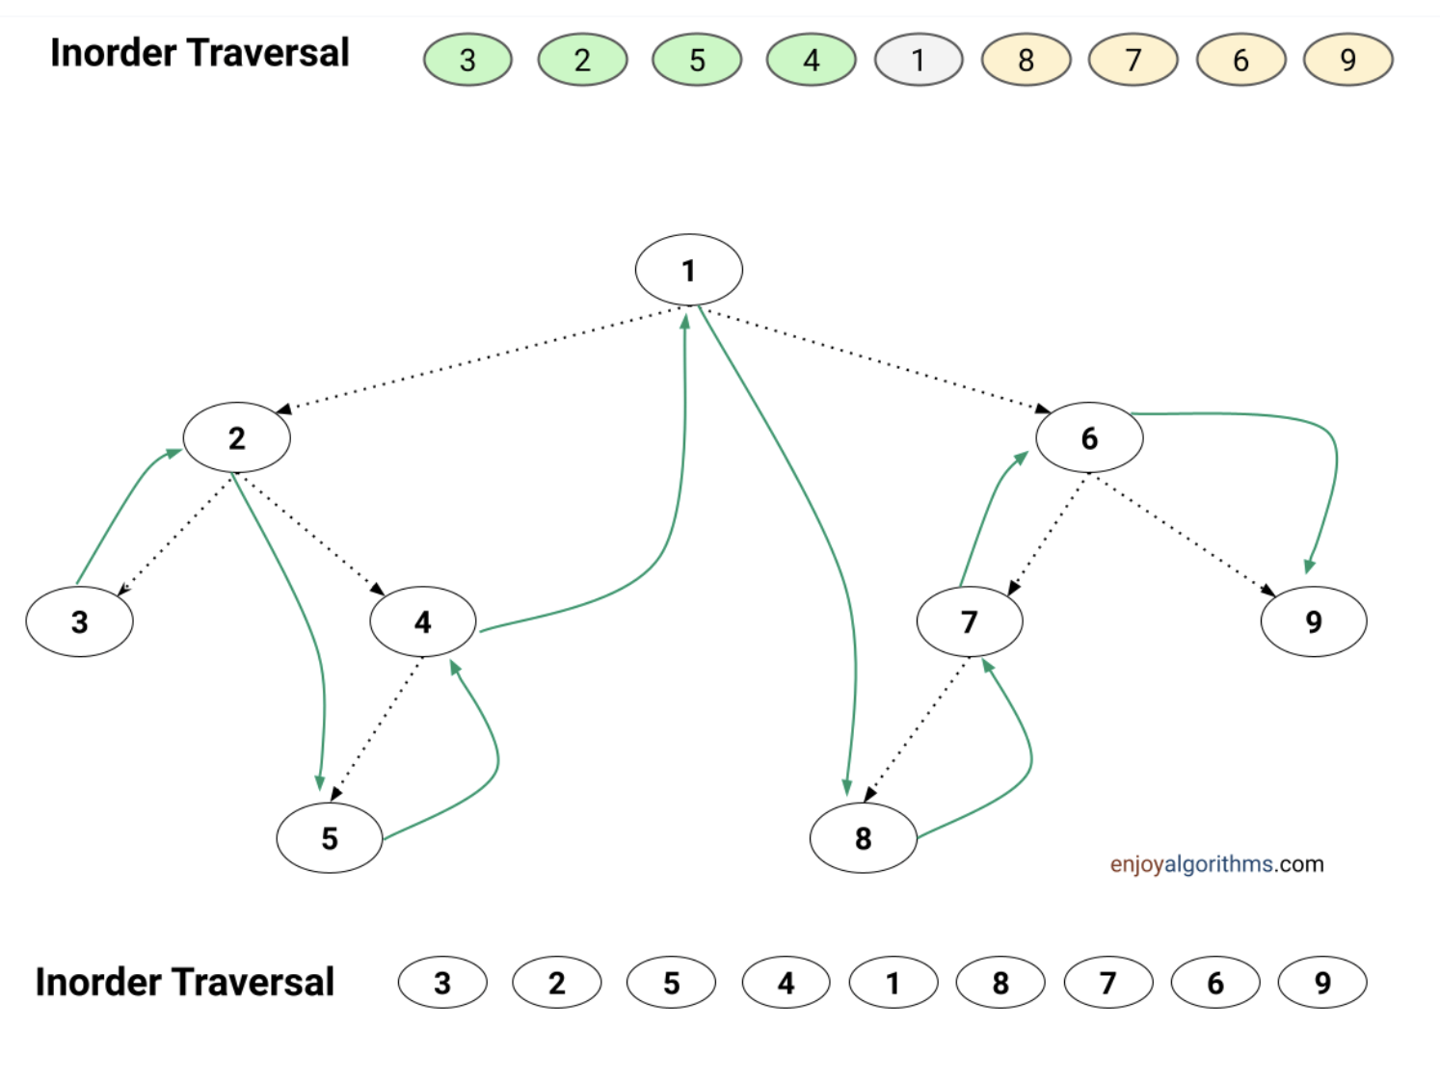

Slide 9
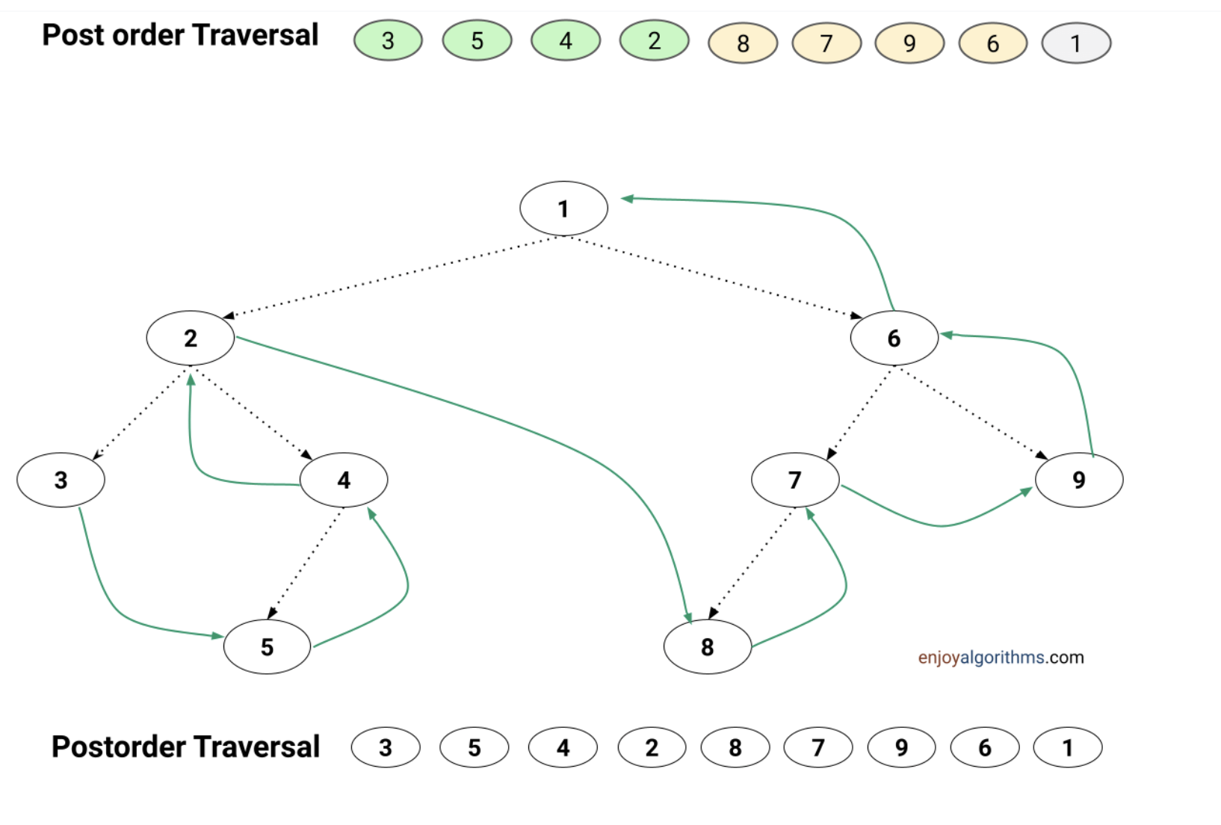

Slide 10
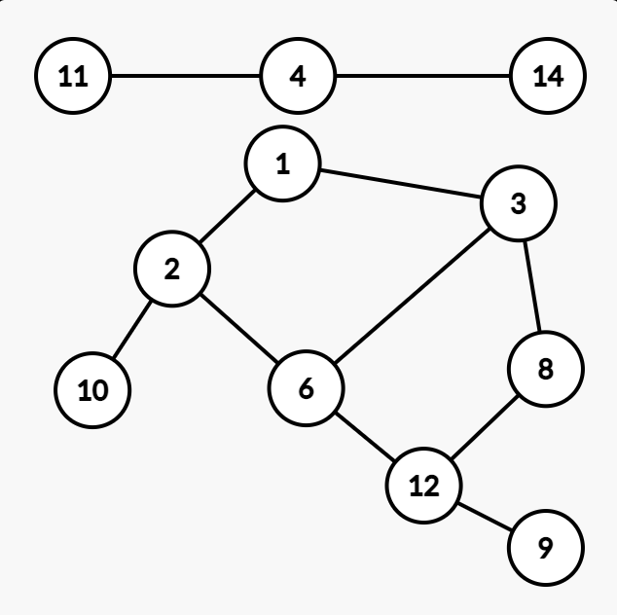
Converting Escape Room to a graph problem
3 | 10 | 8 | 14
1 | 11 | 12 | 12
6 | 2 | 3 | 9

Slide 11
2021 CCC

Slide 12
J4 Arranging Books
https://dmoj.ca/problem/ccc21j4
A math problem….

Slide 13
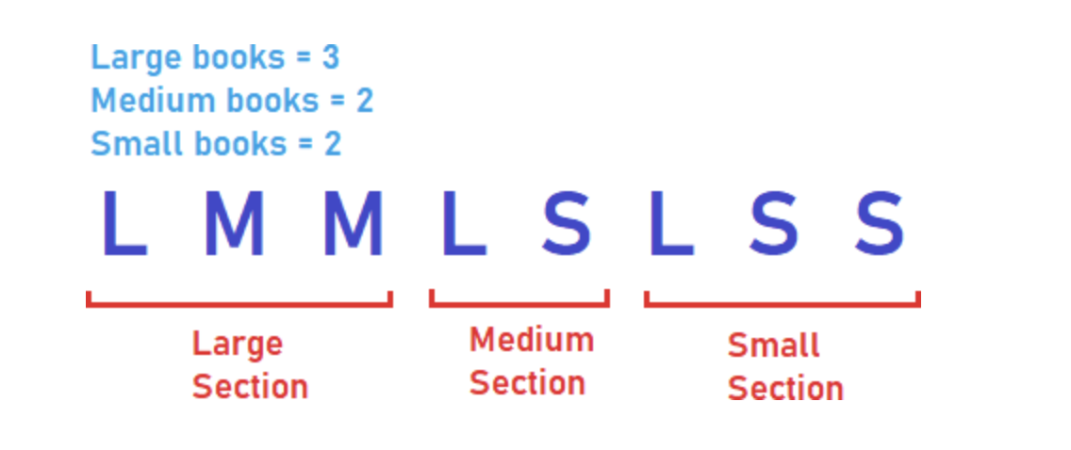

Slide 14
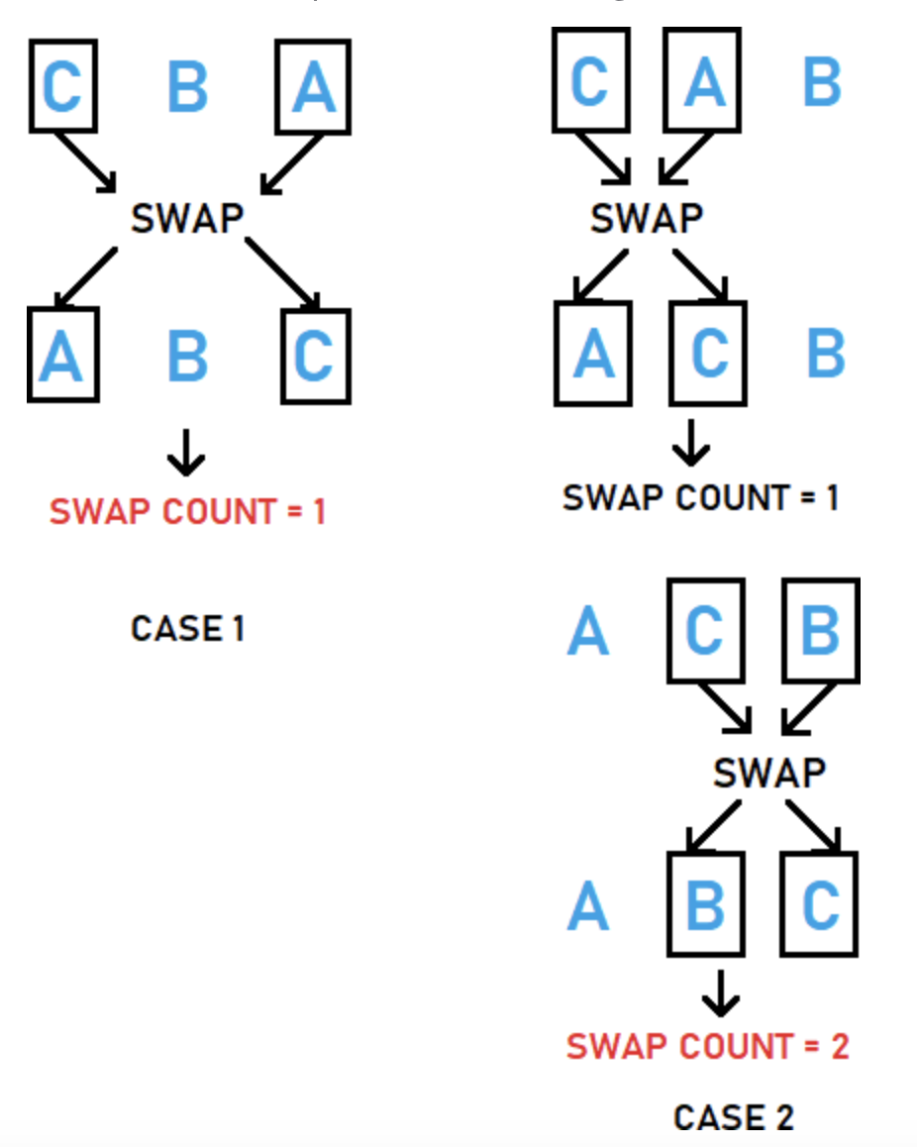

Slide 15
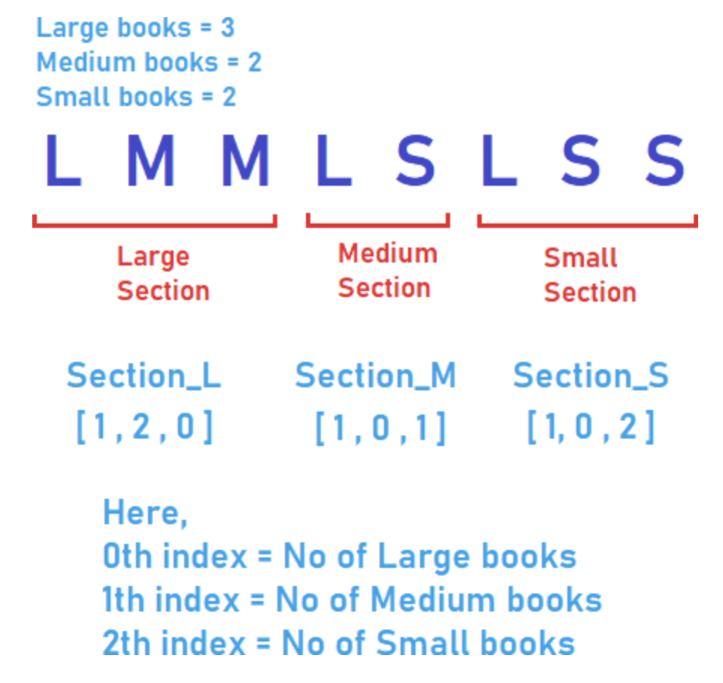

Slide 16
J5: Modern Art
https://dmoj.ca/problem/ccc21s2
A math problem….

Slide 17
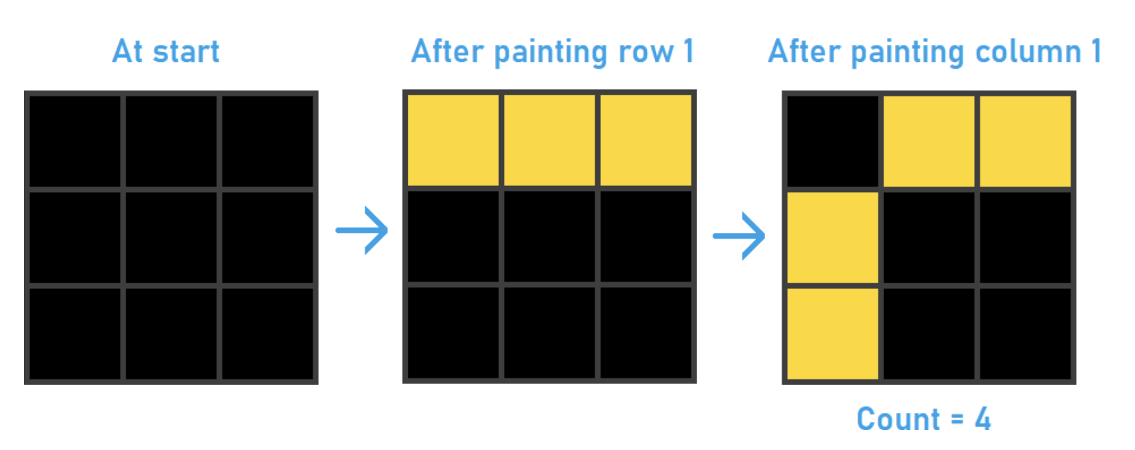

Slide 18
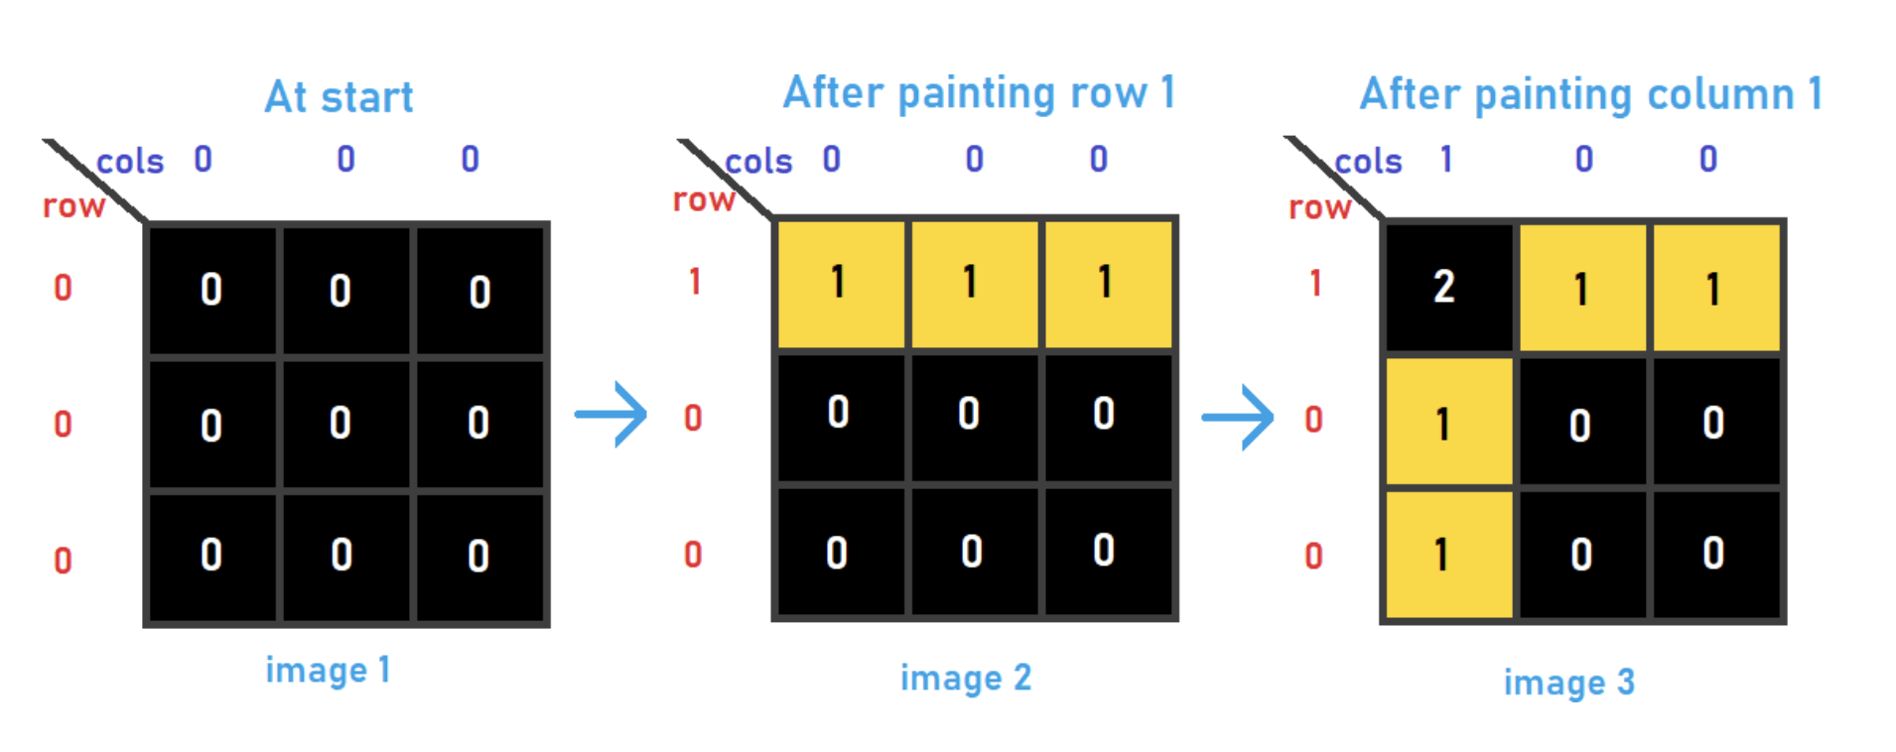

Slide 19
2019 CCC

Slide 20
J5: Rule of Three
https://dmoj.ca/problem/ccc19j5
A recursion problem

Slide 21
J5: Rule of Three
We want to determine the steps to take such that we can transform I (initial sequence) to F (final sequence) in S number of steps using the three rules
Rules:
1. AA -> AB
2. AB -> BB
3. B -> AA
Sequence:
AAAA
ABAB
AAAB

Slide 22
J5: Rule of Three
Define
Problem:
R(I, F, n) := list of steps to take such that I will become F
Reduction to subproblems:
R(I, F, n) depends on R(I, F, with rule 1 applied, n-1), R(I, F, with rule 2 applied, n-1), R(I, f with rule 3 applied, n-1),
Combine solutions:
If n < 0, we can take no more steps
If n == 0 and I == F, then the list of steps is what we want
If n > 0, do more processing

Slide 23
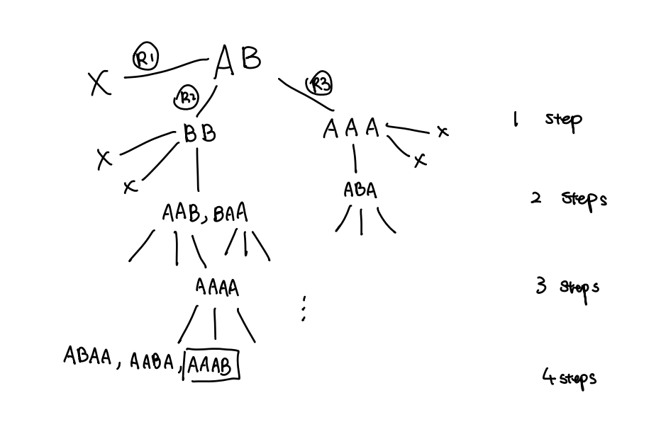

Slide 24
2014 CCC

Slide 25
J5: Assigning Partners
https://dmoj.ca/problem/ccc14s2

Slide 26
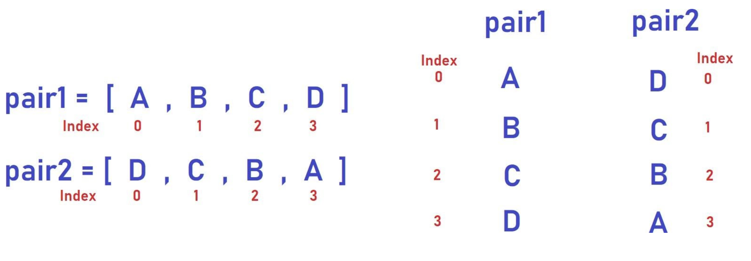

Slide 27
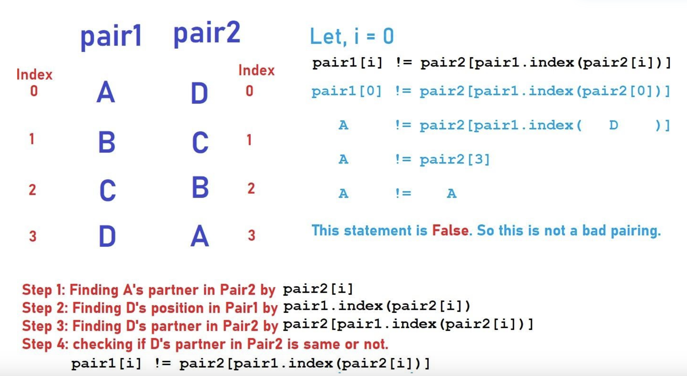

Slide 28
2022 CCC

Slide 29
J5: Square Pool
https://dmoj.ca/problem/ccc22j5

Slide 30
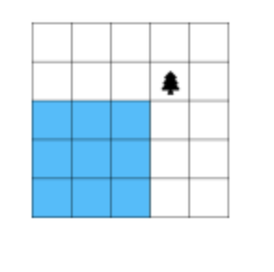
J5: Square Pool
If there is only one tree, then the largest pool must be at one of corners

Slide 31
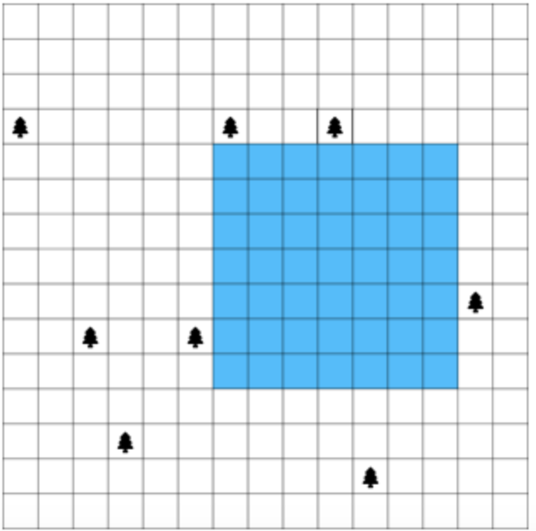


Use the location of trees to determine where the pool could potentially start at
Have a list of locations that the pool can begin at in terms of x and y
Make the pool as large as possible at first, then gradually reduce the size

Slide 32
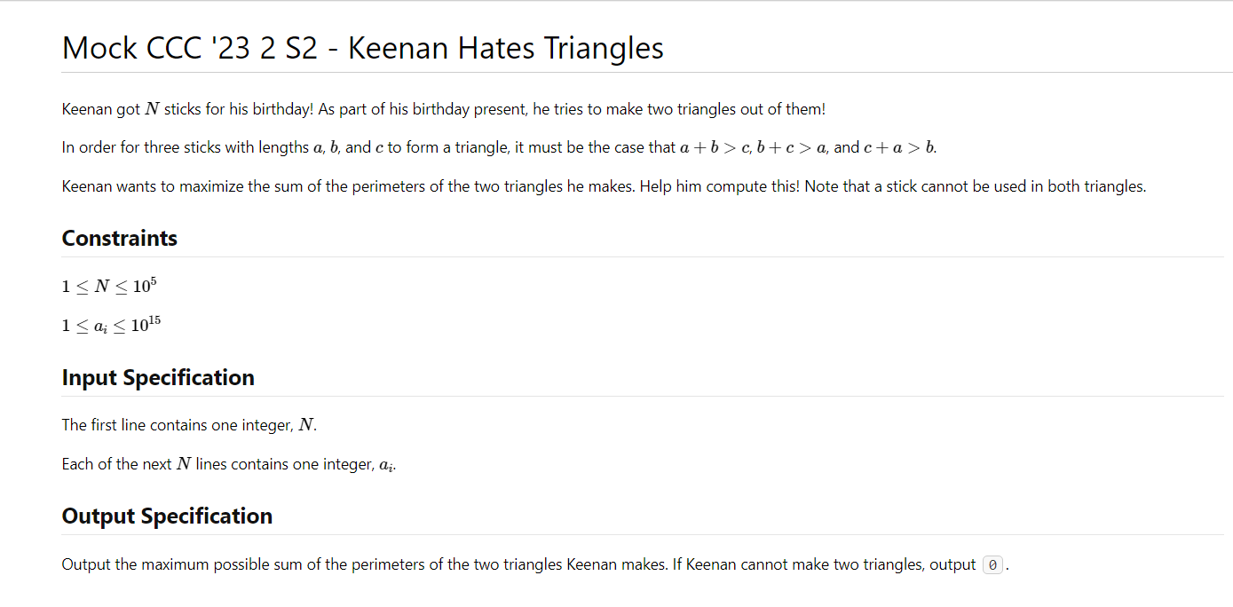

Slide 33
Brute force: go through all combinations of possible triangles, i.e. pick three lengths every time
Optimization: Sort!
What happens after sorting?

