Slide 1

Week 2

Slide 2
Summary
Type casting
Operators
Arithmetic Operators
Relational Operators
Logical Operators
Assignment Operators
Increment and Decrement Operators
Operator Precedence
Escape sequences

Slide 3
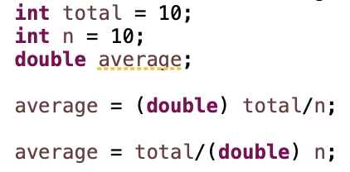
Type Casting
One type can be cast to another compatible type if appropriate
Variable total can be cast to double to ensure that real division is used, alternatively, we can cast variable n to double.

Slide 4
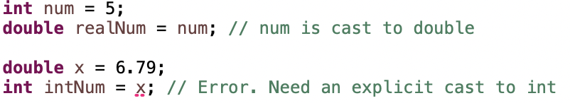
Type Casting
Java can automatically cast an int to a double
Assigning a double to an int without a cast will cause a compile-time error

Slide 5
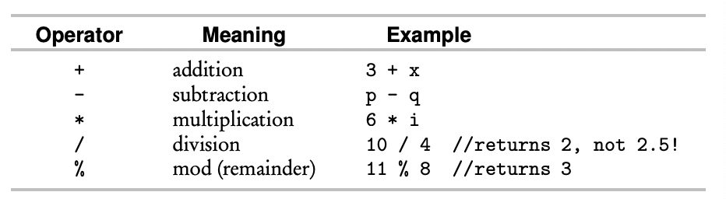
Arithmetic Operators
These operators can be applied to types int and double
If an operation involves both a double and an int, the int is promoted to double, and the result is double

Slide 6
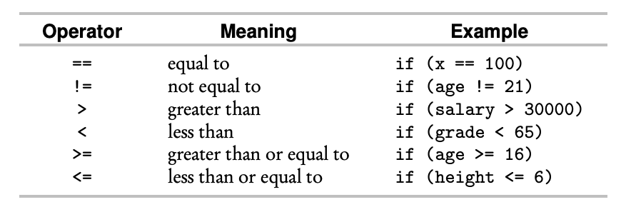
Relational Operators
Relational operators are used in boolean expressions that evaluate to true or false

Slide 7
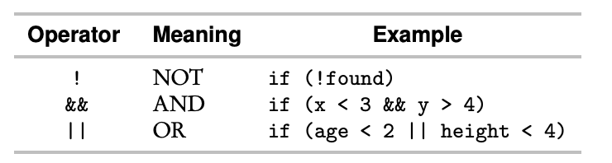
Logical Operators
Logical operators are applied to boolean expressions to form compound boolean expressions that evaluate to true or false

Slide 8

Truth Tables

Slide 9
Logical Operators
Short-circuit evaluation
Subexpressions in a compound boolean expression are evaluated from left to right
Evaluation automatically stops as soon as the value of the entire expression is known
Does not cause a run-time ArithemeticException (division-by-zero error) if the numScores is 0

Slide 10
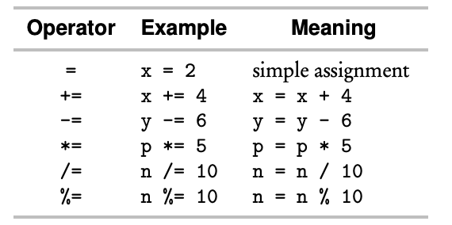
Assignment Operators

Slide 11
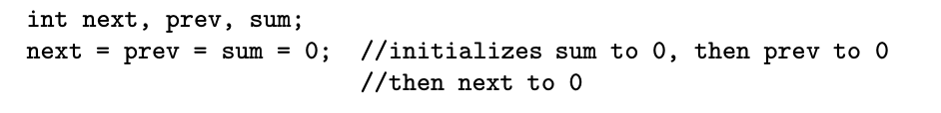
Assignment Operators
Chaining of assignment statements is allowed
Evaluation is from right to left

Slide 12
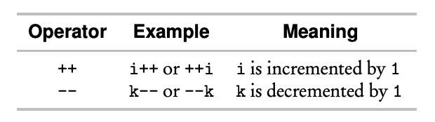
Increment and Decrement Operators

Slide 13
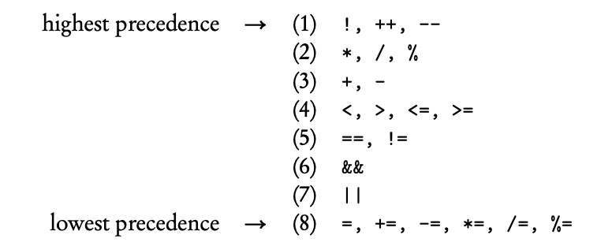
Operator Precedence

Slide 14
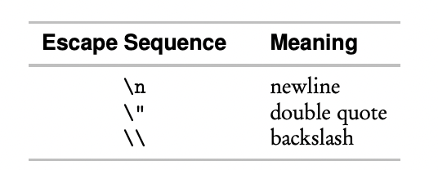
Escape Sequences
An escape sequence is a backslash followed by a single character
Used to print special characters

Slide 15
Summary

Slide 16
Control Structures
The mechanism for making statements to run in a nonsequential order
Two types: decision making & iteration

Slide 17
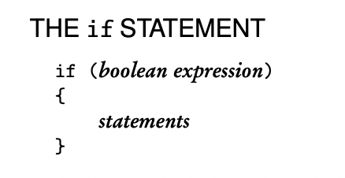
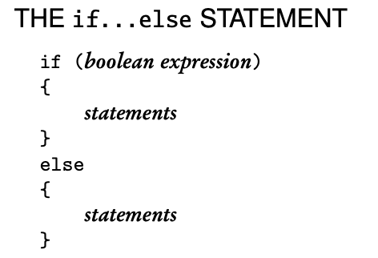
Decision-Making Control Structures

Slide 18
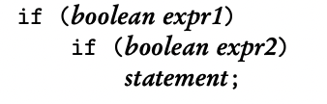
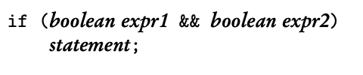
Nested if Statement

Slide 19
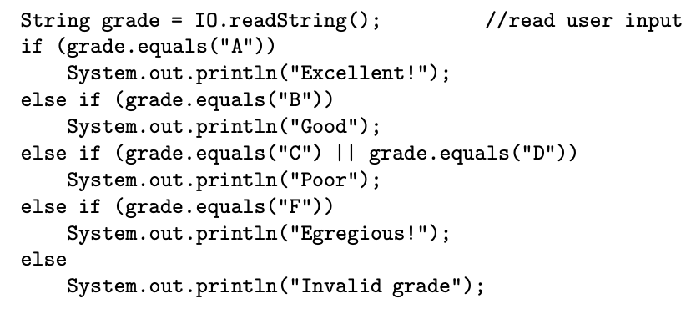
Extended if Statement

Slide 20
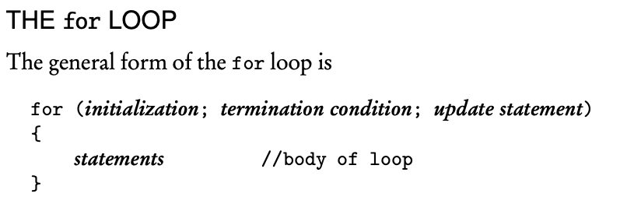
Iteration
Loop variable should not have its value changed inside the loop body

Slide 21
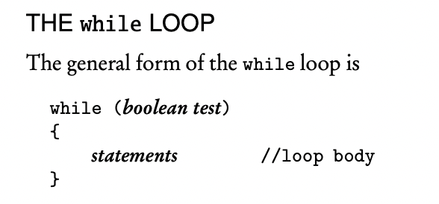
Iteration
Infinite loop occurs if the test can never be false!
The body of a while loop must contain a statement that leads to termination

Slide 22
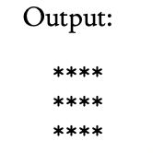
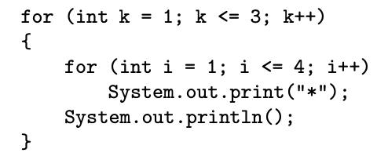
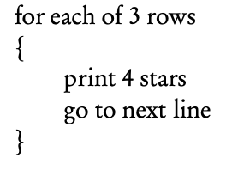
Nested Loops

Slide 23
Exceptions
An exception is an error condition that occurs during the execution of a Java program
ArithemeticException may occur when you divide an integer by zero
ArrayIndexOutOfBoundsException may occur when you use a negative array index

Slide 24
Exceptions
An unchecked exception is where you don’t provide code to deal with the error, then Java automatically terminates the execution
A checked exception is where you provide the code to handle the exception
try/catch/finally statement
throw new … Exception clause

Slide 25
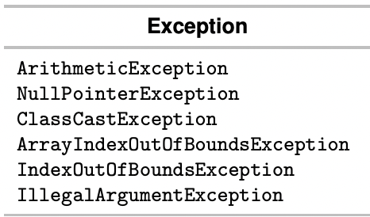
Exceptions

Slide 26
Integer constants
Integer.MIN_VALUE = - 2^31
Integer.MAX_VALUE = 2^31 - 1

Slide 27

Floating-point Numbers
Java has two built-in types that store real numbers: float and double
Type double has 11 bits allocated as the exponent, 52 bits as the mantissa, and 1 bit as the sign, makes it a double-precision number
When calculations are performed on floating-point numbers, they will be converted to binary numbers first, but most of them cannot be represented exactly, leading to round-off error

Slide 28
Floating-point Numbers
No exceptions are thrown for floating–point operations
Java displays NaN (not-a-number) when an operation is performed that gives an undefined result
Java displays Infinity or –Infinity when an operation is performed that gives an infinitely large or small number

Slide 29
Binary Number
A base-2 number system that uses 0, 1 to represent a number
Example: 45 is 101101 in binary
2^0*1 + 2^1*0 + 2^2*1 + 2^3*1 + 2^4*0 + 2^5*1 = 45
Alternatively, 2^0 + 2^2 + 2^3 + 2^5 = 45

Slide 30
Hexadecimal Number
A base-16 number system that uses 0-9 and A-F to represent numbers, where A represents 10 and F represents 15
To denote a hex number in Java, the prefix 0x or 0X is used, i.e. 0XC2A
C*(16^2) + 2*(16^1) + A*(16^0) = 12*16^2 + 2*16 + 10*1 = 3114

Slide 31


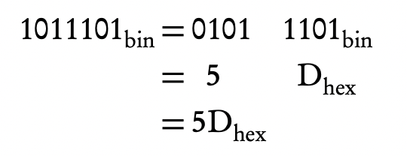
Hex to Binary

Slide 32

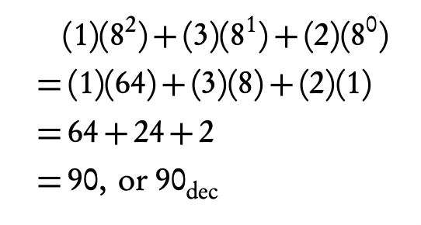
Octal Number
A base-8 number system, represented with symbols 0-7

