Slide 1

Week 3

Slide 2
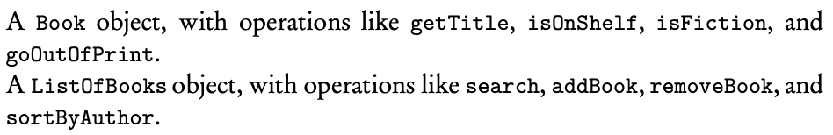
Revisit: Object
Every program that you write involves at least one thing that is being created or manipulated by the program, this thing, together with the operations that manipulate it, is called an object

Slide 3
Revisit: Classes
A software blueprint for implementing objects of a given type
An object is an instance of a class
Encapsulation: combining an object’s data and methods into a single unit

Slide 4
Keyword: public
Public classes are usable by all client programs
Public methods are accessible to all client programs

Slide 5
Keyword: private
Clients cannot access private instance variables or private methods of the class
Restriction of access is known as information hiding
Private methods and variables in a class can be accessed only by methods of that class

Slide 6
Keyword: static
A static variable contains a value that is shared by all instances of the class
Static means memory allocation happens once
Static final variables in a class cannot be changed

Slide 7
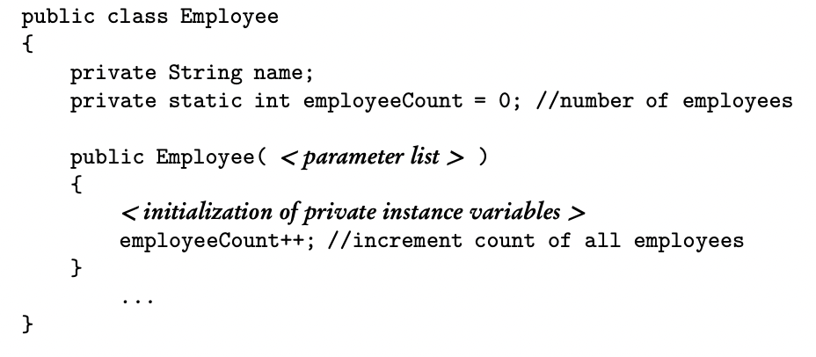
Employee employee1 = new Employee(); Employee employee2 = new Employee();

Slide 8
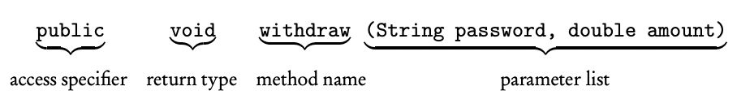
Method Headers
The access specifier/modifier tells other methods who can call this method
A return type of void signals no return value
Items in the parameter list are separated by commas

Slide 9
Constructors
Gets called when we create an object of the class
Name of the constructor is always the same as the class name
A constructor has no return type
Multiple constructors provide different ways of initializing class objects

Slide 10
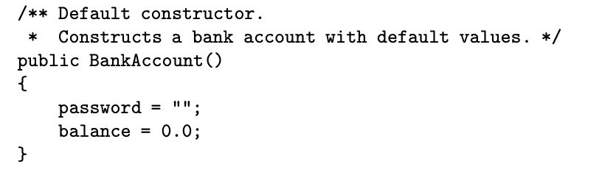
In a client method, the declaration is:

Slide 11
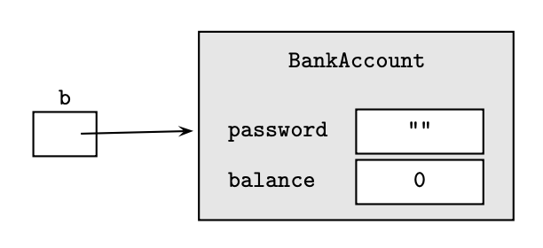
b is a reference to the object

Slide 12
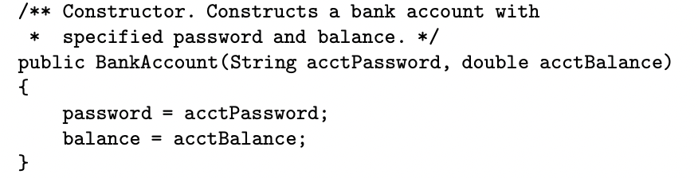
In a client method, the declaration is:

Slide 13
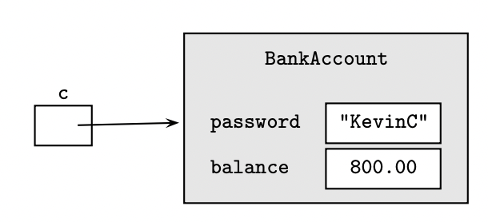

Slide 14
Accessors/Getters
An accessor method accesses a class object without altering the object
It returns some information about the object

Slide 15
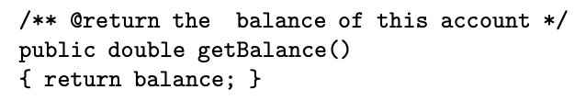
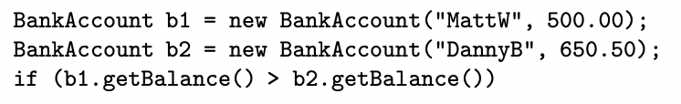
The . Operator indicates getBalance() is a method of the class to which b1 and b2 belong

Slide 16
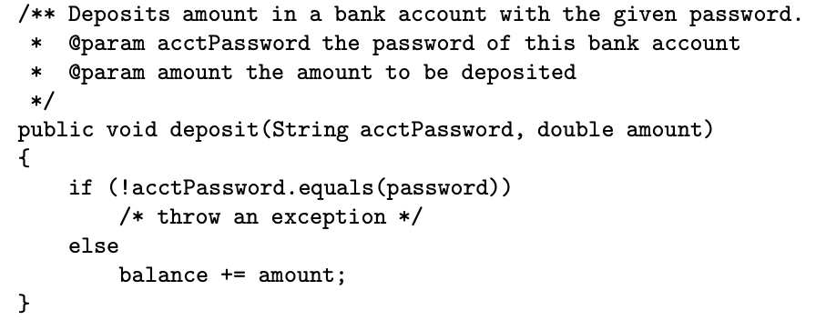
Mutators/Setters
Changes the state of an object by modifying at least one of its instance variables

Slide 17
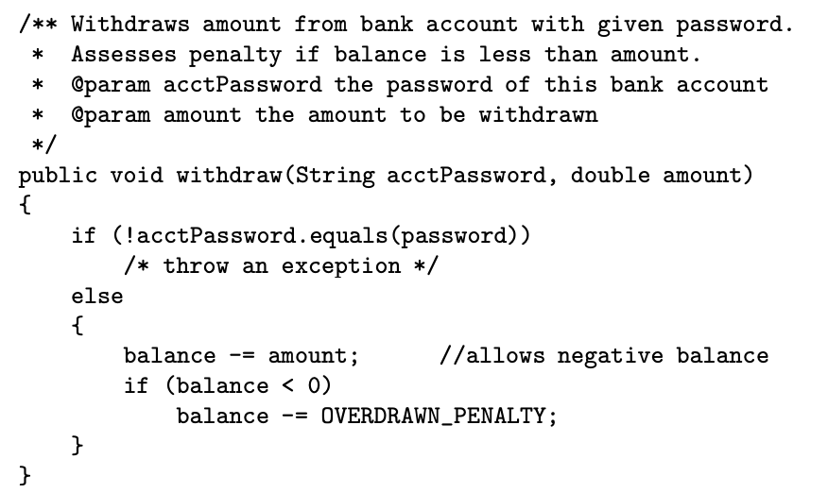


Slide 18
Static Methods
Constructors, accessors, and mutators are all instance methods
Instance methods operate on individual objects of a class
Static methods (class methods) perform operations for the entire class, not its individual objects
Static methods cannot use instance methods or instance variables, but static variables can be used

Slide 19

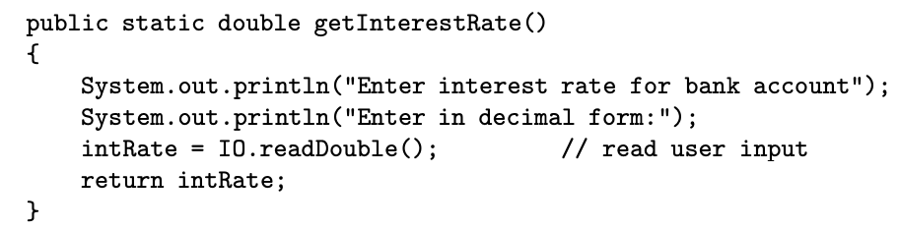

Slide 20
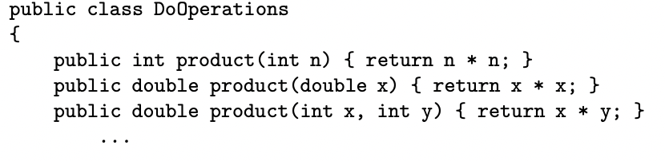
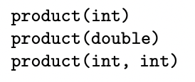
Method Overloading
Two or more methods in the same class with the same name but different parameter lists
Having multiple constructors is an example of overloading

Slide 21
Scope
The scope of a variable or method = the region in which that variable or method is visible and can be accessed
A local variable is defined inside a method, so the scope is only inside the method
Notes:
Homework: multiple choice 7, 11, 16, 22, 26

Slide 22
Keyword: this
All instance variables can be written with the prefix this followed by the dot operator
this represents an object, which is an implicit parameter to any methods that is invoked using this

Slide 23
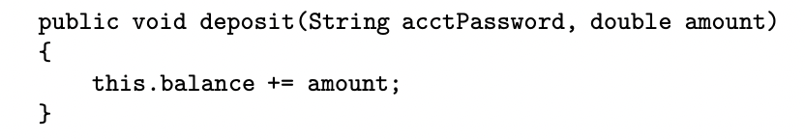

Slide 24
Reference Data Type
Int, boolean, double are primitive data types
Objects are reference data types
Difference is on how they are stored

Slide 25
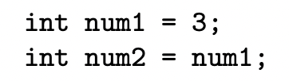
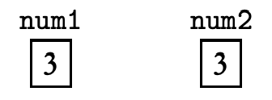
Num1 and num2 can be thought of as memory slots
If either of the above variables changed, the other is not affected

Slide 26

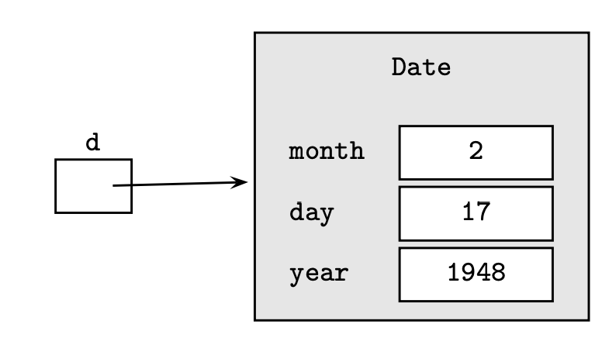
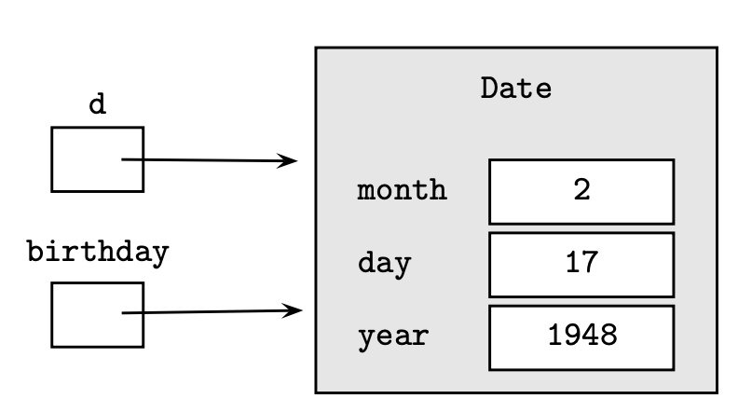
- Changing one Date object will affect the other
- Having two references for the same object is known as aliasing

Slide 27

The Null Reference
Is a declaration that defines a reference b that is uninitialized
An uninitialized variable is called a null reference or null pointer
Attempting to invoke a method with a null reference may cause the program to terminate with a NullPointerException

Slide 28
Variable Initialization
Not initializing a local variable before you use it will result in a compile-time error
Java will give your instance variable some default value if you do not initialize it (0 for numbers, false for booleans), program may run without error
Java will set your reference instance variables to null if you do not initialize it

Slide 29
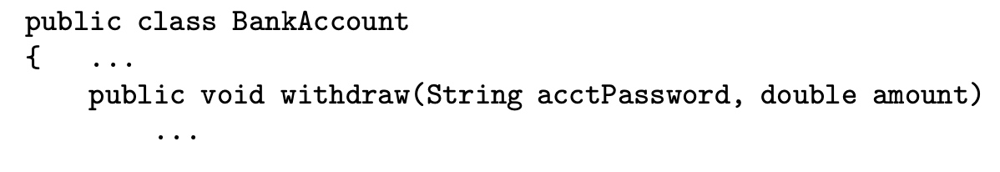
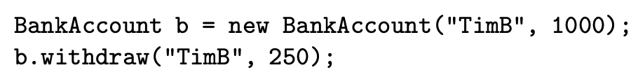
Method Parameters
acctPassword and amount are called dummy/formal parameters, they are placeholders for actual parameters that will be provided by a method call

Slide 30
Method Parameters
Parameters are passed by value
During execution of the method, the parameters are local to that method
Any changes made to the parameters will not affect the values of the arguments in the calling program

Slide 31
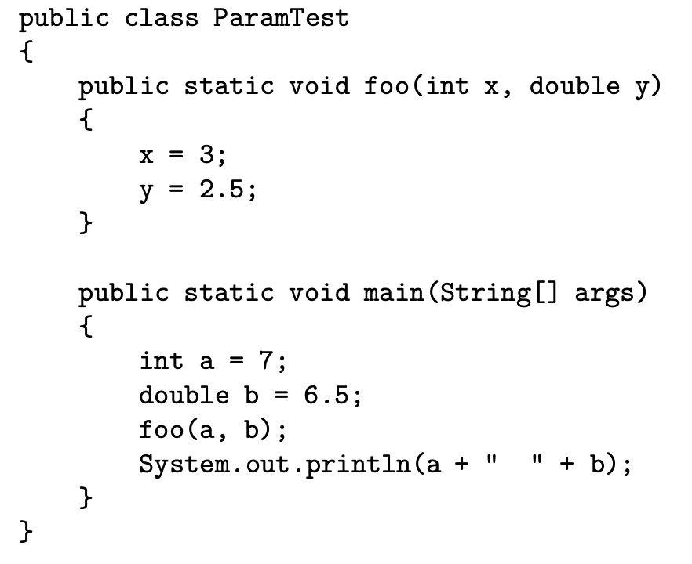

Slide 32
Passing Objects as Parameters
Objects references are passed by value
Object reference will not be changed, but the object it refers to might

Slide 33
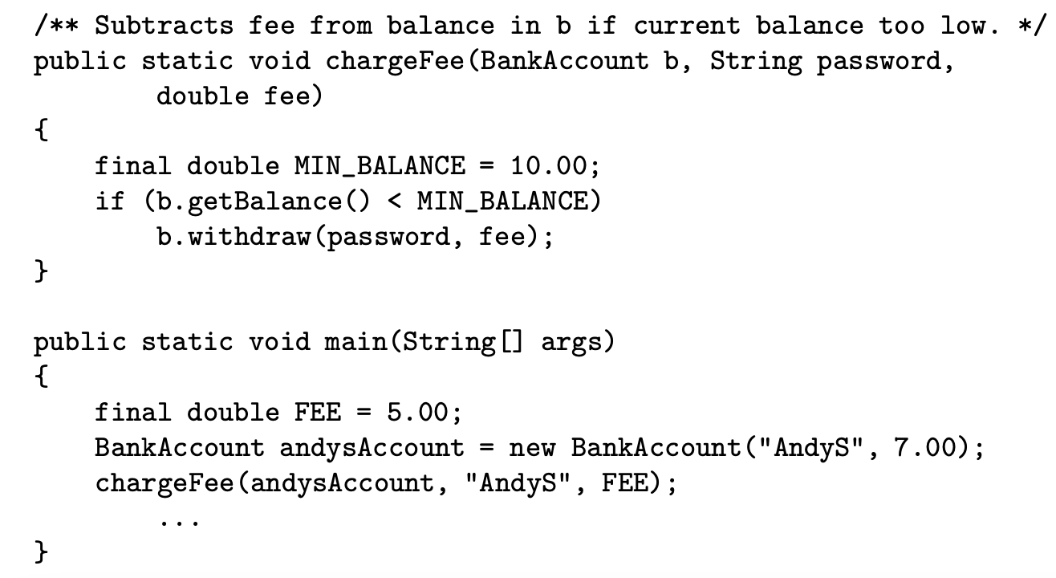

Slide 34
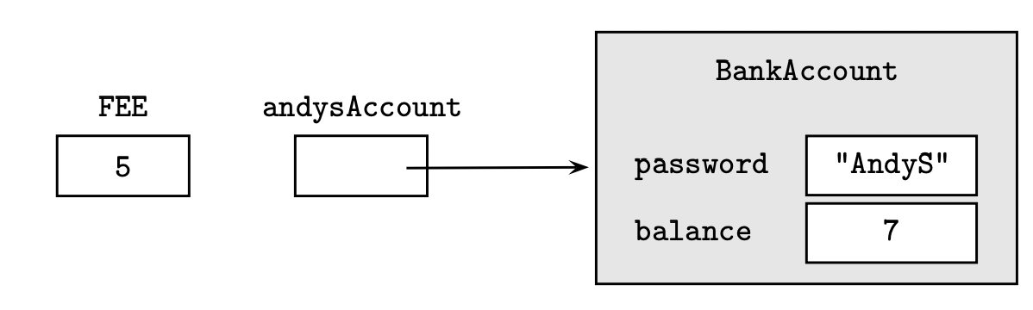
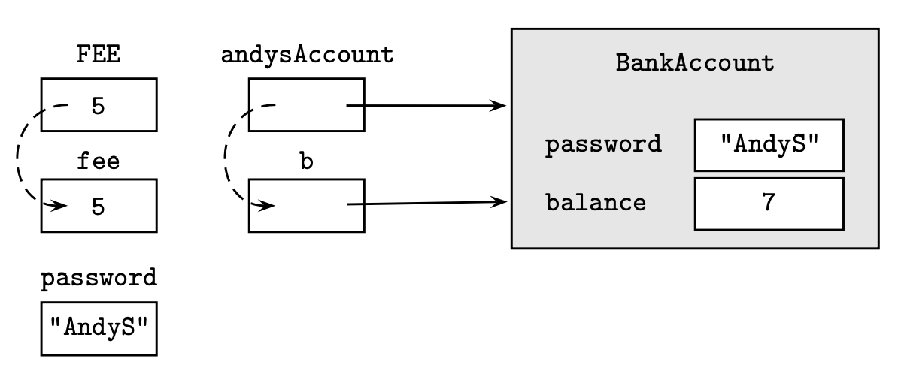

Slide 35
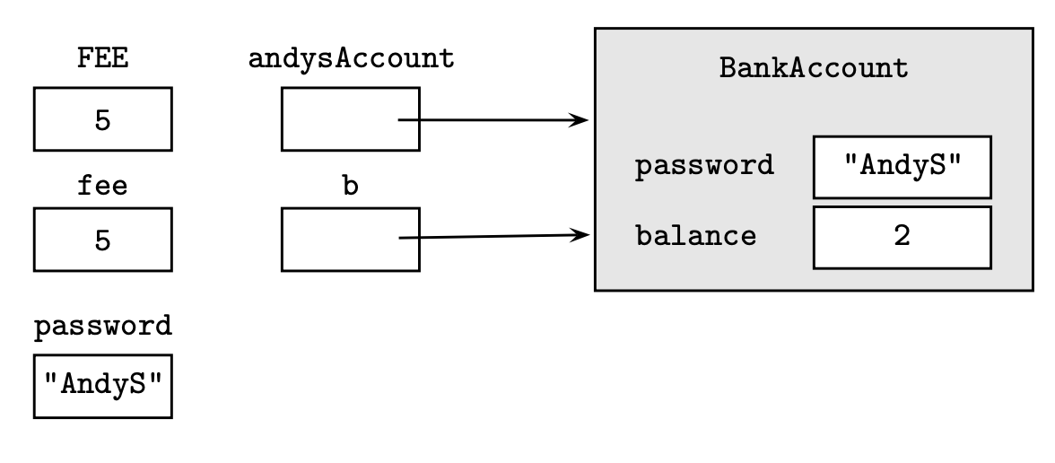
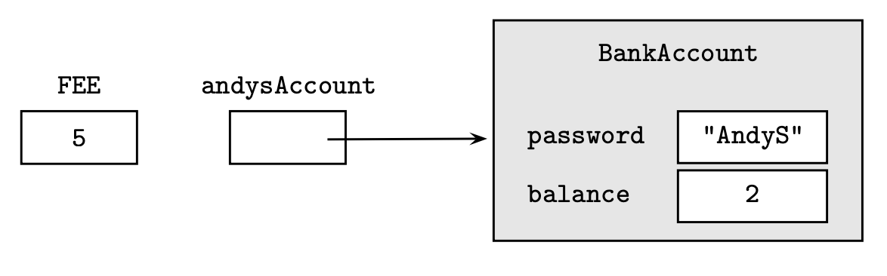


Slide 36
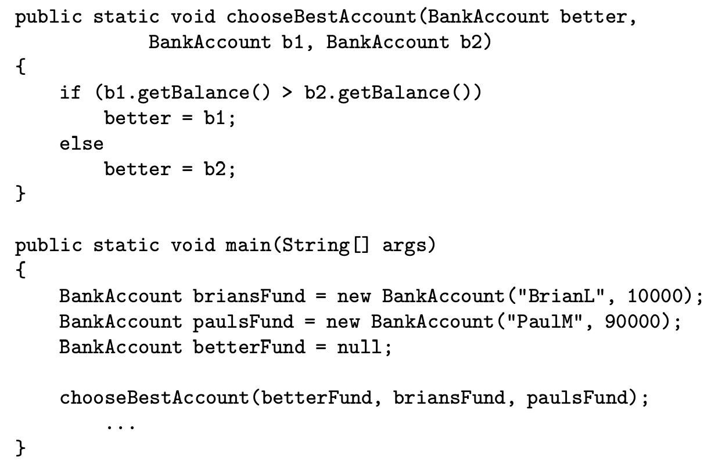

Slide 37
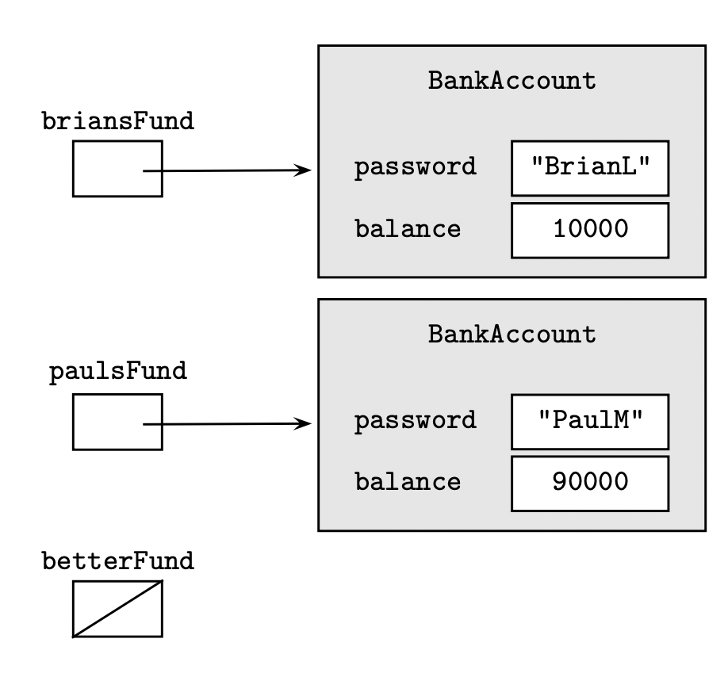
Before the chooseBestAccount method call

Slide 38
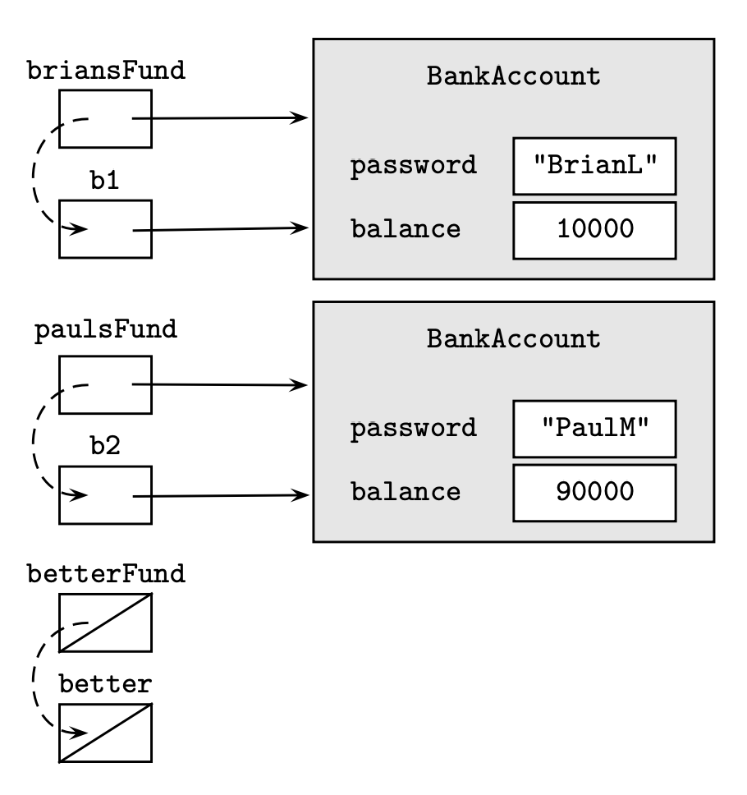

Slide 39
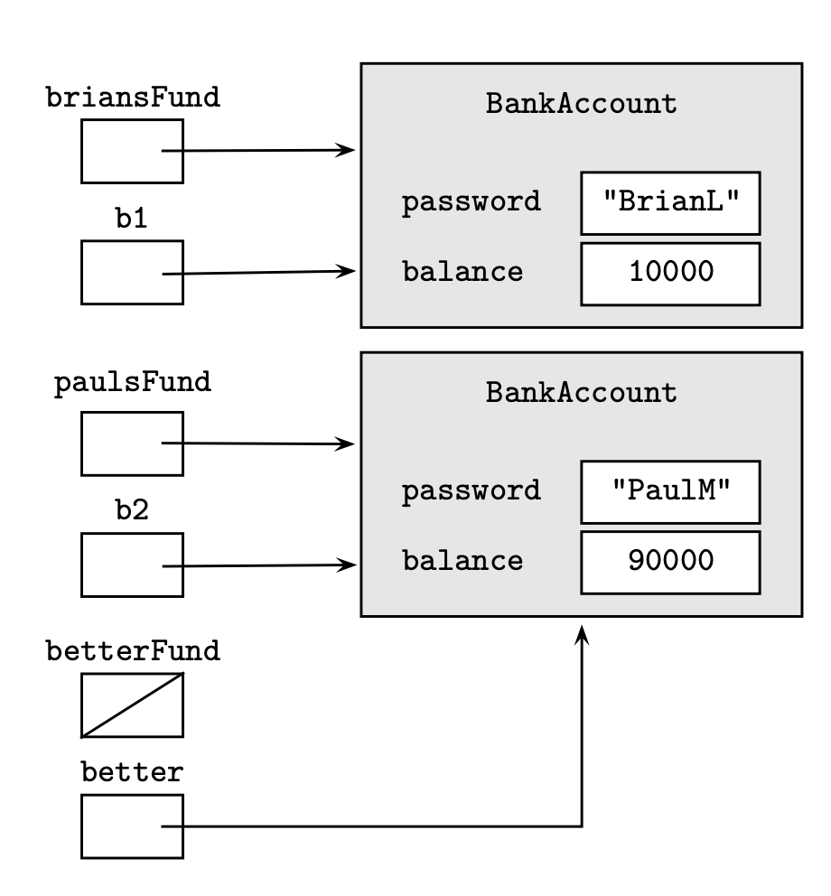

Slide 40


Slide 41
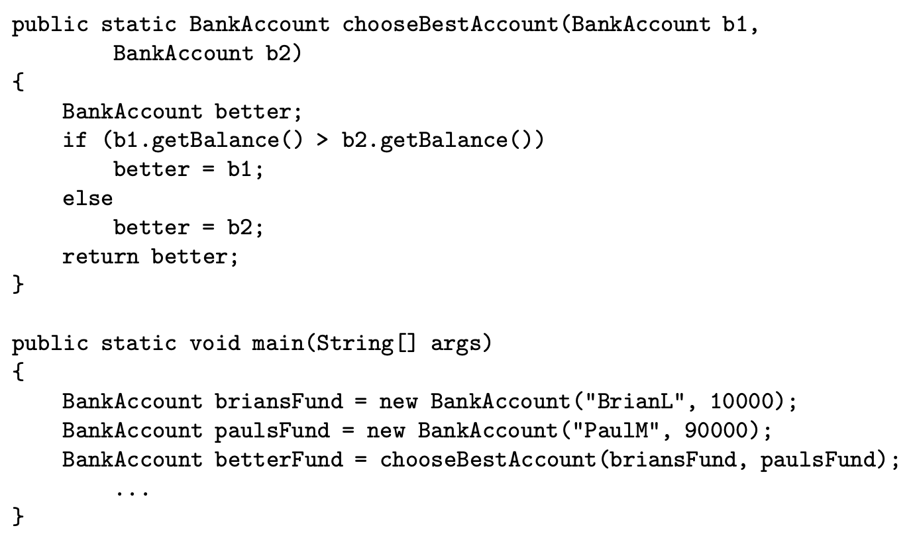

Slide 42
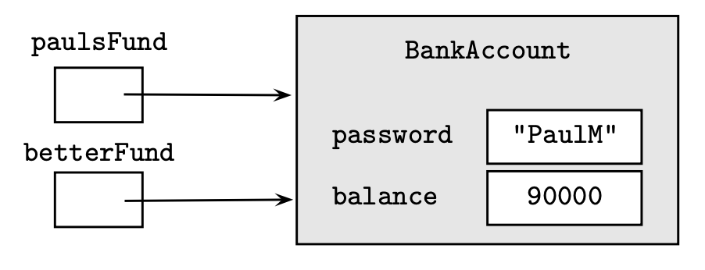
Create the betterFund reference
Does not create a new object to which betterFund refers to
New objects are created only when you use the new keyword

Slide 43
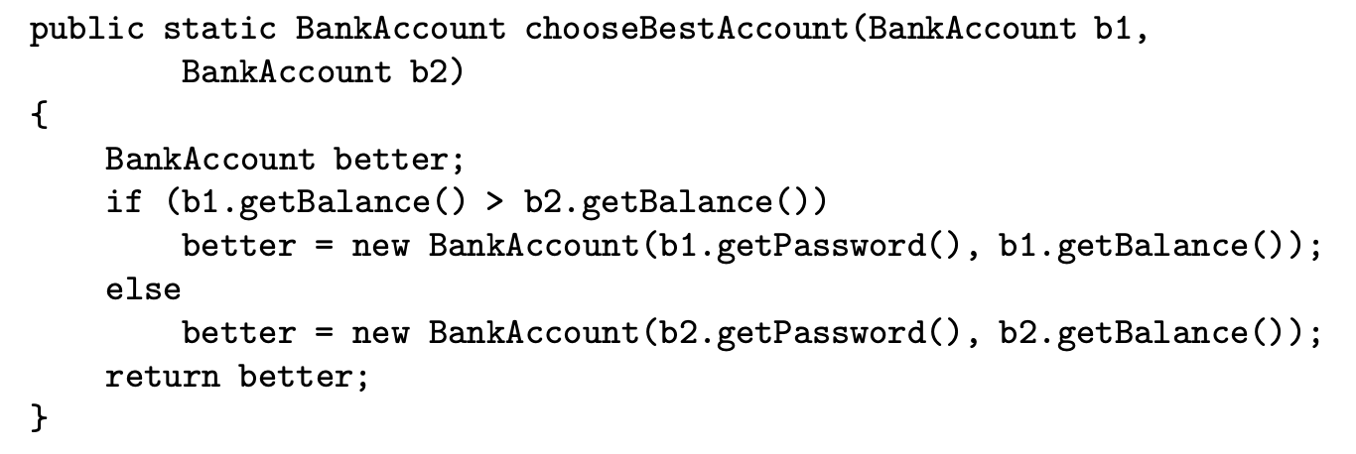

Slide 44
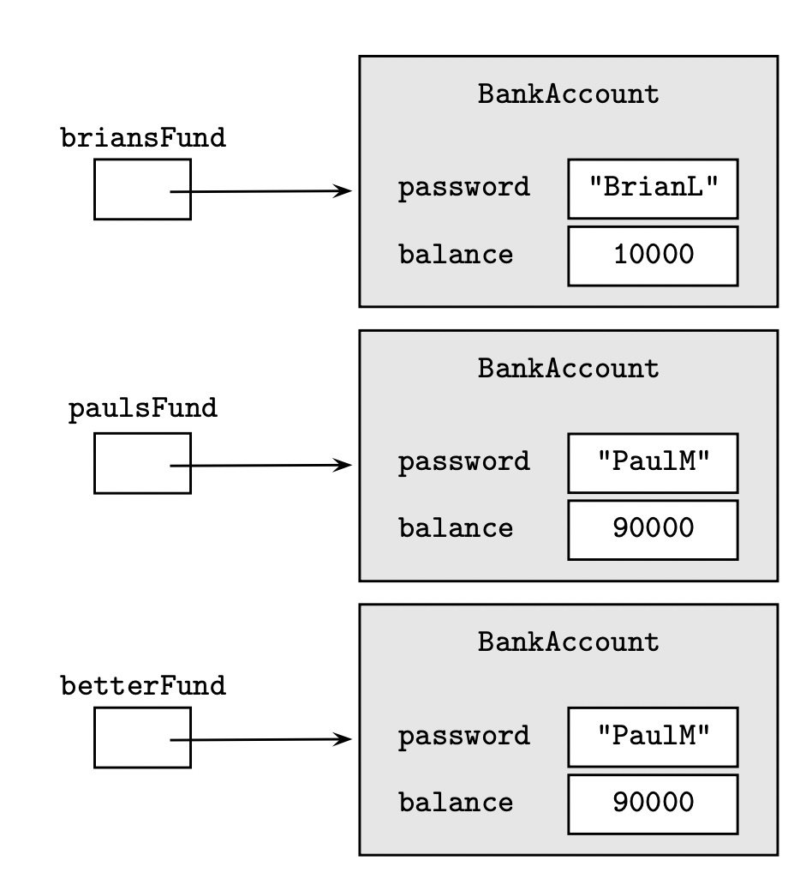

Slide 45
Inheritance
Defines a relationship between objects that share characteristics
When a new class, called a subclass, is created from an existing class, called a superclass, by absorbing its state and behaviour and add features unique to the new class
We say the subclass inherits characteristics of its superclass
Inheritance provides an effective mechanism for code reuse

Slide 46
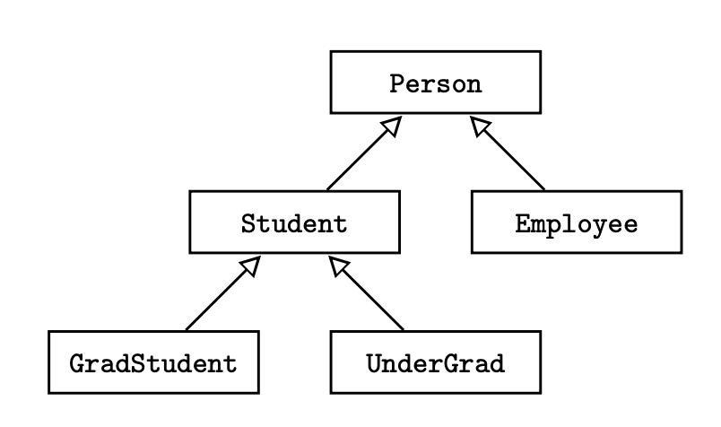
Inheritance Hierarchy
Inheritance relationship = is-a relationship
Employee is-a Person
UnderGrad is-a Student
Person may not be a Student
Student may not be a GradStudent

Slide 47
Inheritance Hierarchy
The is-a relationship is transitive
If a Gradstudent is-a Student and a Student is-a Person, then a GradStudent is-a Person

Slide 48
Inheritance Hierarchy
Every subclass inherits the public or protected variables and methods of its superclass
Subclass may have additional methods and instance variables that are not in the superclass
A subclass may redefine a methods it inherits
If Student has a method called computeGrade(), GradStudent and UnderGrad may use different algorithms for computing grade
This is called method overriding

