Slide 1

Week 4

Slide 2
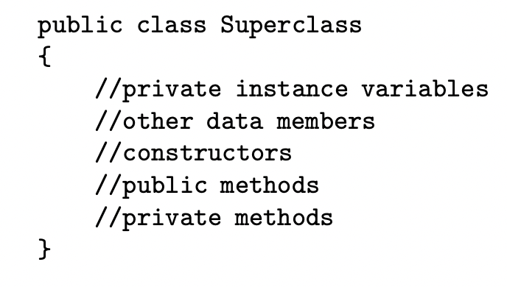
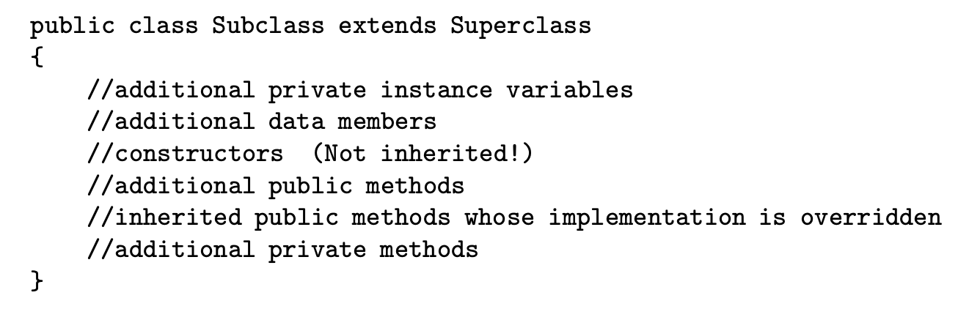
Implementing Subclasses

Slide 3
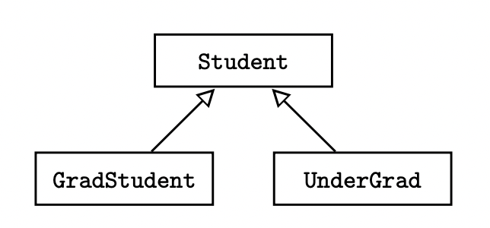
Implementing Subclasses
Uses the keyword extends
Class header for UnderGrad:
public class UnderGrad extends Student

Slide 4
Inheriting Instance Methods and Variables
Subclasses do not include the private instance variables or private methods of their superclasses
Subclasses contain memory for those private instance variables in their superclasses, with no direct access
Subclasses can directly invoke the public accessor or mutator method to access or modify the private instance variables in their superclasses

Slide 5
Inheriting Instance Methods and Variables
Classes on the same level in a hierarchy diagram do not inherit anything from each other (UnderGrad and GradStudent)
They only have identical codes that they inherit from their superclass

Slide 6
Method Overriding
Any public method in a superclass can be overridden in a subclass by defining a method with the same return type and signature (name and parameter types)
UnderGrad overrides the computeGrade method in Student
Note: private methods cannot be overridden

Slide 7
Method Overriding
While overriding a method, if we include a call to the superclass method, then this is called partial overriding
Partial overriding occurs when the subclass method wants to do what the superclass does, plus something extra
Achieved by using the keyword super
computeGrade in GradStudent class partially overrides computeGrade in Student class

Slide 8
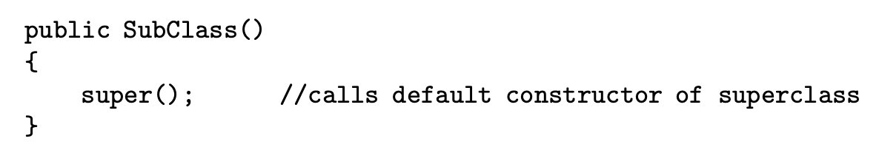
Constructors
Constructors are NEVER inherited
If no constructor is written for a subclass, then the super class default constructor with no parameters is generated
If the superclass does not have a default constructor, a compiler error will occur

Slide 9
Constructors
A subclass constructor can be implemented with a call to the super method, which invokes the superclass constructor
The default constructor in UnderGrad is identical to the Student class
If super is used in the implementation of a subclass constructor, it must be the first line of the constructor body

Slide 10
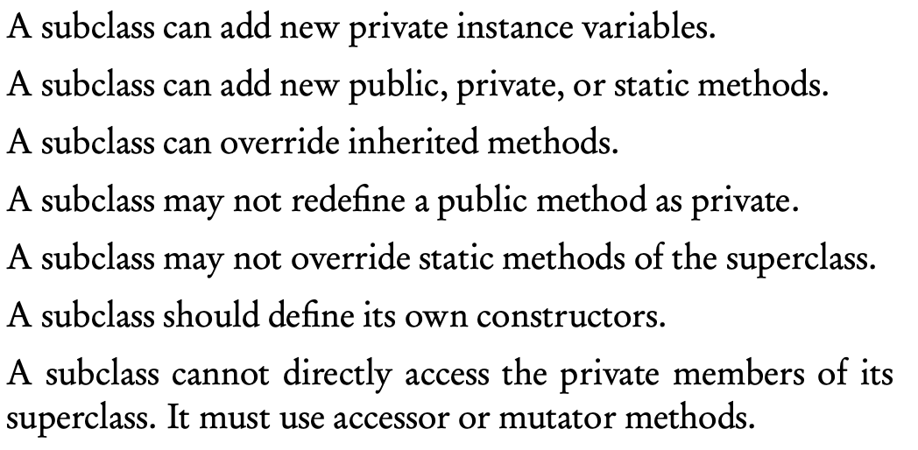
Rules for Subclasses

Slide 11
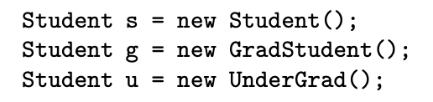
Declaring Subclass Objects
When a superclass object is declared in a client program, that reference can refer not only to an object of the superclass, but also to objects of any of its subclasses
GradStudent is-a Student, UnderGrad is-a Student

Slide 12

Declaring Subclass Objects
Student is not necessarily a GradStudent nor an UnderGrad, so the above declarations are not valid

Slide 13
Polymorphism
A method that has been overridden in at least one subclass is said to be polymorphic
Polymorphism is the mechanism of selecting the appropriate method for a particular object in a class hierarchy
Method calls are always determined by the type of the actual object, not the type of the object reference
The selection of the correct method occurs during the run of the program

Slide 14
Dynamic Binding (Late Binding)
Making a run-time decision about which instance method to call is known as dynamic binding or late binding (when methods are overridden)
The run-time environment determines how a method will be called (in which overridden form should it use)
Selecting the correct method when methods are overloaded is known as static binding or early binding

Slide 15
Using super in a Subclass
A subclass can call a method in its superclass by using super
If the superclass method calls another method that has been overridden in the subclass, by polymorphism, the method that is executed is the one in the subclass
Notes:
Amy sarah

Slide 16
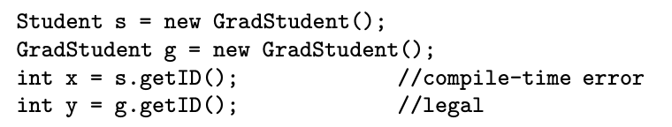
Type Compatibility
Error occurs because s is of type Student, Student class doesn’t have a getID method
At compile time, only non-private methods of the Student class can appear to the right of the dot operator when applied to s

Slide 17
Type Compatibility
getID is not a polymorphic method, it occurs in just the GradStudent class, so it can only be called by a GradStudent object

Slide 18
Downcasting
Since s represents a GradStudent object, this cast is allowed
Casting a superclass to a subclass type is called a downcast

Slide 19
ClassCastException
A run-time exception thrown to signal an attempt to cast an object to a class of which it is not an instance

Slide 20
Abstract Class
A superclass that represents an abstract concept, so it should not be instantiated
Example: a maze program could have several different maze components – paths, walls, entrances, and exits, where they share some features such as location, way of displaying

Slide 21
Abstract Class
All components can be declared as subclasses of the abstract class MazeComponent
The program will create path objects, wall objects, but no instances of MazeComponent

Slide 22
Abstract Method
An abstract class may contain abstract methods, and abstract methods only exist in an abstract class
An abstract method has no implementation code, just a header, because every subclass will need to override this method
The method that appears in the abstract class is just a placeholder for the actual overridden methods to be implemented in subclasses

Slide 23


The abstract keyword

Slide 24
The abstract keyword
If a subclass of an abstract class does not provide implementation code for all the abstract methods of its superclass, then the subclass also becomes an abstract class and must be declared to avoid a compile-time error

Slide 25
Note
It is meaningless to define perimeter and area methods for Shape, so they are declared as abstract methods
An abstract class can have both instance variables and concrete (nonabstract) methods
Abstract methods must be declared with the keyword abstract, with no method body, and the header is terminated with a semicolon

Slide 26
Note
A concrete subclass of an abstract superclass must provide implementation code for all abstract methods of the superclass
An abstract class can have no abstract methods
An abstract class may or may not have constructors

Slide 27
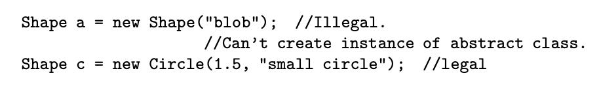
Note
No instances can be created for an abstract class
Polymorphism works with abstract classes as it does with concrete classes

Slide 28
Interface
A collection of related methods, either abstract(headers only), or default (implementation provided in the interface)
Classes that implement a given interface may represent objects that are vastly different
Example: an interface called FlyingObject may have methods fly and isFlying, where some classes that implement FlyingObject could be Bird, Airplane, Missile, Witch

Slide 29
Interface
A class that implements an interface can define any number of methods
If the class fails to implement any of the methods, the class must be declared as abstract

Slide 30
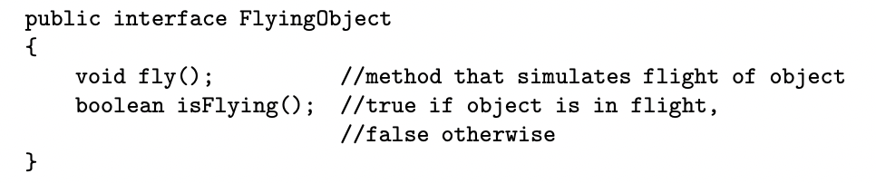
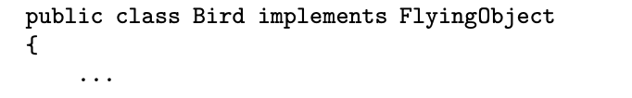
Defining an Interface
Declared with the interface keyword

