Slide 1
Week 6

Slide 2
Problems and Subproblems
We can often describe a problem as a function
fib(n): the n’th Fibonacci number
Substituting a number for n, we get an instance of the problem
fib(5): the 5’th Fibonacci number
For every instance of the problem, we can find a solution for it, or declare that none exists
fib(5) = fib(4) + fib(3) = … = 5

Slide 3
Problems and Subproblems
For some instance of fib(n), we can reduce it to smaller subproblems (another smaller instance of the same problem)
fib(n) = 0 when n = 0
fib(n) = 1 when n = 1
fib(n-1) + fib(n-2) when n > 1
In this case, fib(3) and fib(4) are smaller subproblems we need to solve to get fib(5)

Slide 4
Problems and Subproblems
For our instance of fib(n), we first decompose it into two subproblems fib(n-1) and fib(n-2)
Given the solution to these subproblems
A := fib(n-1) and
B := fib(n-2)
We can combine them to generate our solution to fib(n)
fib(n) = A + B

Slide 5
Recursion
A problem is recursive if we can decompose it into smaller subproblems, solve the subproblems, then combine their solutions to obtain the final solution
Need a base case and a recursive case

Slide 6
Dynamic Programming
An algorithmic paradigm that solves a given complex problem by breaking it into subproblems using recursion AND storing the results of subproblems to avoid computing the same results again

Slide 7
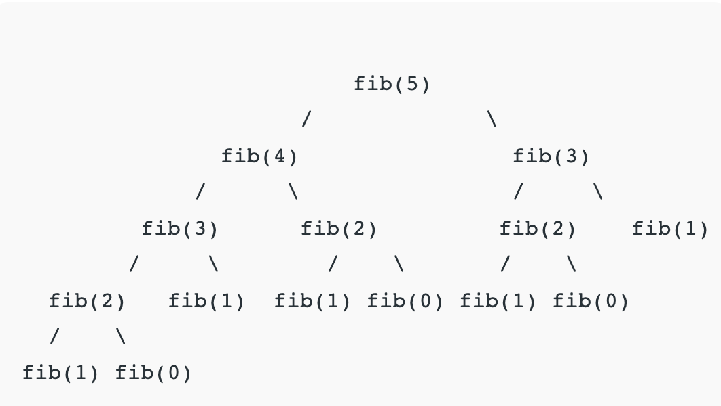

Slide 8
Memoization (Top Down)
Whenever we need a solution to a subproblem, look into a lookup table first
If the precomputed value is in the lookup table, then we return the value; otherwise, we calculate the value and save the result in the lookup table so it can be reused later

Slide 9
Tabulation (Bottom Up)
Builds a table in a bottom-up fashion and returns the last entry from the table
For the same Fibonacci number, we first calculate fib(0), then fib(1), then fib(2), and so on

Slide 10
Factorial
n! = 1 x 2 x … x n
5! = 120
How to reduce the above problem into subproblems?

Slide 11
Integer Exponentiation
a^{b} = a multiplied b times, assume a is fixed
If a = 2, a⁵ = 32
How to reduce the above problem into subproblems?

Slide 12
Longest Common Subsequence
Problem: Given two sequences, find the length of the longest subsequence present in both of them.
A subsequence is a sequence that appears in the same relative order, but not necessarily contiguous

Slide 13
Longest Common Subsequence
Example: ”abc”, “abg”, “bdf” are subsequences of “abcdefg”
LCS for input Sequences “ABCDGH” and “AEDFHR” is “ADH” of length 3
LCS for input Sequences “AGGTAB” and “GXTXAYB” is “GTAB” of length 4

Slide 14
Longest Common Subsequence
Naïve solution: generate all subsequences of both given sequences and find the longest matching subsequence

Slide 15
Longest Common Subsequence
Let the input sequences be X[0..m-1] and Y[0..n-1]
Define function LCS(X, Y) to return the length of the LCS of the two sequences X and Y
If X[m-1] == Y[n-1], last characters of both sequences match, then LCS(X[0..m-1], Y[0..n-1]) = 1 + LCS(X[0..m-2], Y[0..n-2])
If X[m-1] != Y[n-1], last characters of both sequences do not match, then LCS(X[0..m-1], Y[0..n-1]) = max(LCS(X[0..m-2], Y[0..n-1]), LCS(X[0..m-1], Y[0..n-2]))

Slide 16
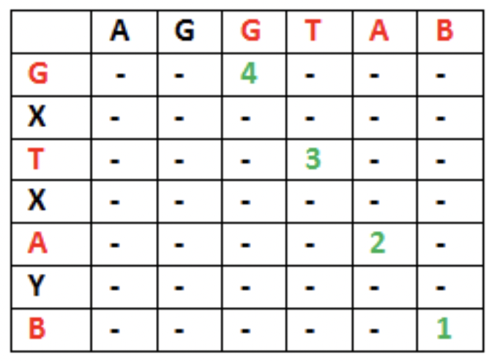
Longest Common Subsequence
Let X = “AGGTAB”, Y = “GXTXAYB”
LCS(“AGGTAB”, “GXTXAYB”) = 1 + LCS(“AGGTA”, “GXTXAY”)

Slide 17
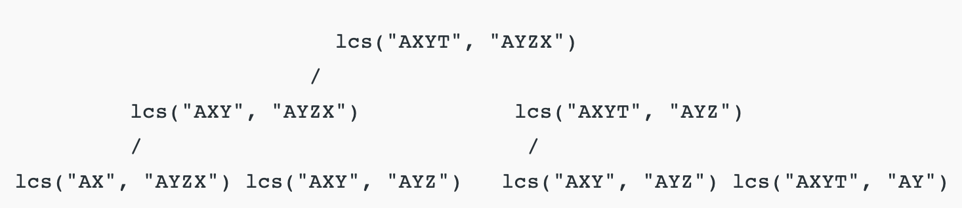

Slide 18
Longest Increasing Subsequence
Example: [10, 11, 1, 5, 3, 9, -1, 7, 25]
[1, 10, 11] is not a subsequence
[10, 11] is an increasing subsequence
[1, 3, 25] is the increasing subsequence
Longest increasing sequence(LIS)?
How to decompose LIS(A) into smaller subproblems?

Slide 19
Longest Increasing Subsequence
Example: A = [10, 11, 1, 5, 3, 9, -1, 7, 25]
If a₀ = 10
(keep 10) [10 LIS([11, 1, …])]
(don’t keep 10) LIS([11, 1, …])

Slide 20
Longest Increasing Subsequence
We can define the problem recursively as:
L(i) = 1 + max(L(j)) where 0 < j < i and A[j] < A[i]
Or L(i) = 1 if no such j exists
The length of the longest increasing subsequence ending at index i will be 1 greater than the maximum of lengths of all longest increasing subsequences ending at indices before i, if A[j] < A[i] for j < i

Slide 21
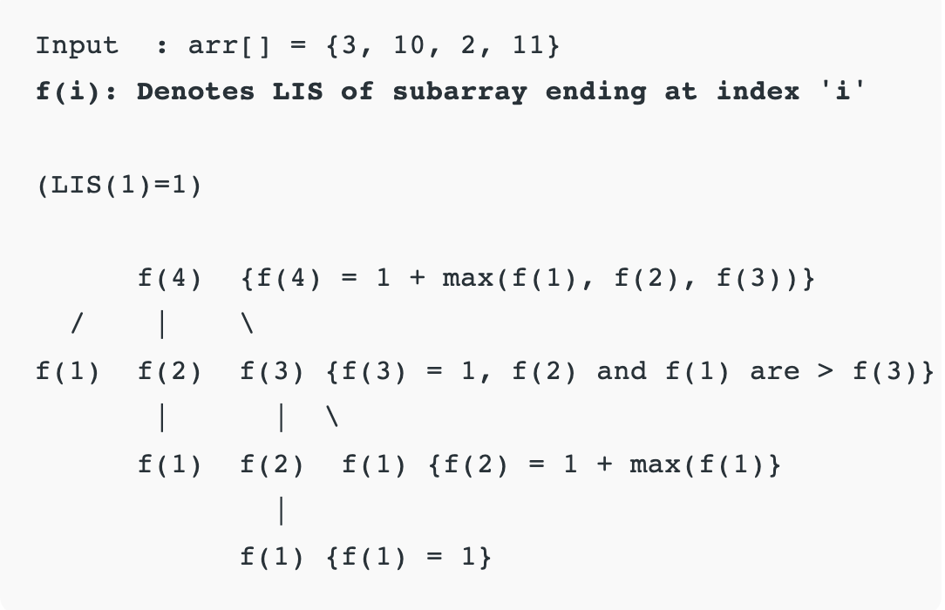

Slide 22
Time Complexity
Exponential, because there is a case of overlapping subproblems as shown in the recursive tree diagram

Slide 23
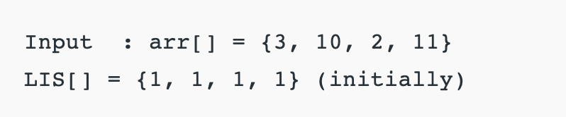
Tabulation
arr[2] > arr[1] {LIS[2] = max(LIS [2], LIS[1]+1)=2}
arr[3] < arr[1] {No change}
arr[3] < arr[2] {No change}
arr[4] > arr[1] {LIS[4] = max(LIS [4], LIS[1]+1)=2}
arr[4] > arr[2] {LIS[4] = max(LIS [4], LIS[2]+1)=3}
arr[4] > arr[3] {LIS[4] = max(LIS [4], LIS[3]+1)=3}

Slide 24
Big-O Complexity
Time: O(n^2), nested loop is used
Space: O(n), array for storing LIS values at each index

Slide 25
Homework
https://leetcode.com/problems/maximum-subarray/
https://leetcode.com/problems/longest-palindromic-substring/
https://leetcode.com/problems/longest-valid-parentheses/
For more practice, search for DP problems on LeetCode

