Slide 1

Program Design

Slide 2
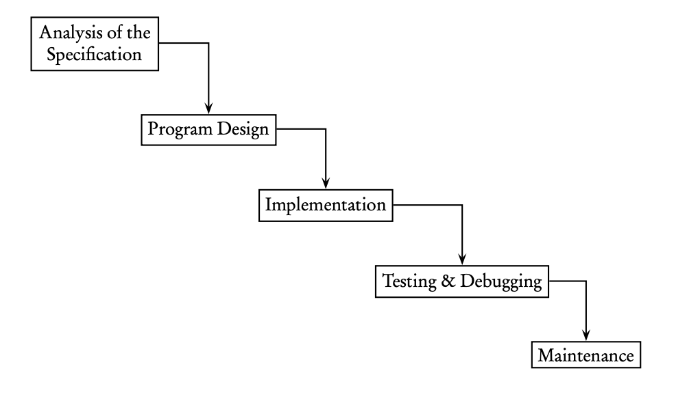
The Software Development Life Cycle
Waterfall Model

Slide 3
The Waterfall Model – Program Specification
A written description of the project, typically based on a customer’s requirements
The first step in writing a program is to analyze the specification, make sure you understand it, and clarify with the customer anything that is unclear

Slide 4
The Waterfall Model – Program Design
A fairly detailed plan for solving the problem outlined in the specification
Should include all objects that will be used in the solution, the data structures that will implement them, plus a detailed list of the tasks to be performed by the program
Should not include any Java code

Slide 5
The Waterfall Model – Program Implementation
The coding phase

Slide 6
The Waterfall Model – Testing and Debugging
Test data: programmers usually select a representative set of test data
Values in each part of a domain of the program
Endpoint values and out-of-range values
I.e. a program that insert a value into its correct position in this sorted list:
2, 5, 9
What test data should we use?

Slide 7
The Waterfall Model – Testing and Debugging
Types of Errors(Bugs):
A compile-time error occurs during compilation of the program. A syntax error is a compile-time error caused by violating the rules of the programming language. (i.e. omitting semicolons or braces)
A run-time error occurs during execution of the program. The Java run-time environment throws an exception, which means it stops program execution and prints an error message. (i.e. integer division by zero)
An intent or logical error occurs when the program fails to carry out the specification required by user. The program compiles and runs but does not do the job.

Slide 8
The Waterfall Model – Testing and Debugging
Robustness = write a program that
Won’t give inaccurate answers for some input data
Won’t crash if the input data are invalid
Won’t allow execution to proceed if invalid data are entered (i.e. entering out-of-range numbers, or a response of “maybe” when “yes” or “no” was asked for)

Slide 9
The Waterfall Model – Program Maintenance
Involves upgrading the code as circumstances change
New feature may be added, or new programmers may come on board
As a result, programs should have clear and precise documentation (comments)

Slide 10
Objected-oriented Program Design
Uses an approach that overlap analysis of the problem, development of the design, and part of the implementation
Steps:
Identify classes to be written
Identify behaviour(methods) for each class
Determine the relationships between classes
Write the interface(public method headers) for each class
Implement the methods

Slide 11
Identify Classes
We want to identify the objects in the program
Pick out nouns in the program specification
Many applications have similar object types: a low-level basic component; a collection of low-level components; a controlling object that puts everything together, and a display object that could be a GUI(graphical user interface)

Slide 12
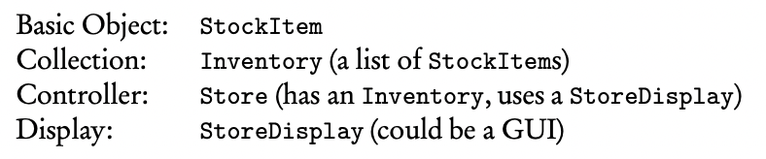
Write a program that maintains an inventory of stock items for a small store

Slide 13
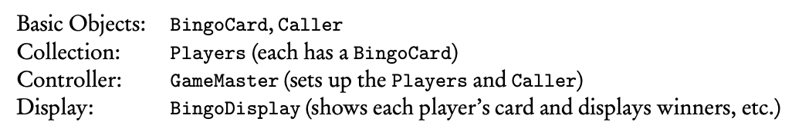
Write a program that simulates a game of bingo. There should be at least two players, each of whom has a bingo card, and a caller who calls the numbers

Slide 14
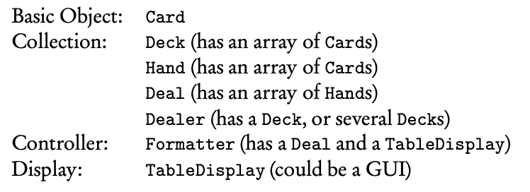
Write a program that creates random bridge deals and displays them in a specified format (deal: consists four hands, dealt from a deck of cards)

Slide 15
Identify Behaviours
Find all verbs in the program description that help lead to the solution of the programming task
The process of bundling a group of methods and data fields into a class is called encapsulation
Think carefully about who should do what. Do not ask a basic object to perform operations for the group. (i.e., A Card should know its value and suit, but should not be responsible for keeping track of how many cards are left in a deck)
Decide which data fields each class will need, and which data structures should store them (i.e., if an object represents a list of items, consider an array or ArrayList as the data structure)

Slide 16
Determining Relationships Between Classes
Inheritance relationships
Look for classes with common behaviours
Is-a relationship – if object1 is-a object2, then object2 is a candidate for a superclass
Composition Relationships
Has-a relationship (i.e., a Nurse has-a Uniform, a champion/agent has-a ?)
If two classes have a composition relationship, one of them contains an instance variable whose type is the other class

Slide 17
UML(Unified Modeling Language) Diagrams
A standard graphical scheme used by object-oriented programmers
UML rules:
Represent classes with rectangles
Use angle brackets with the word “abstract” or “interface” to indicate either an abstract class or interface
Show the is-a relationship between classes with an open up-arrow
Show the is-a relationship that involves an interface with an open, dotted up-arrow
Show the has-a relationship with a down arrow or sideways arrow (indicates composition)

Slide 18
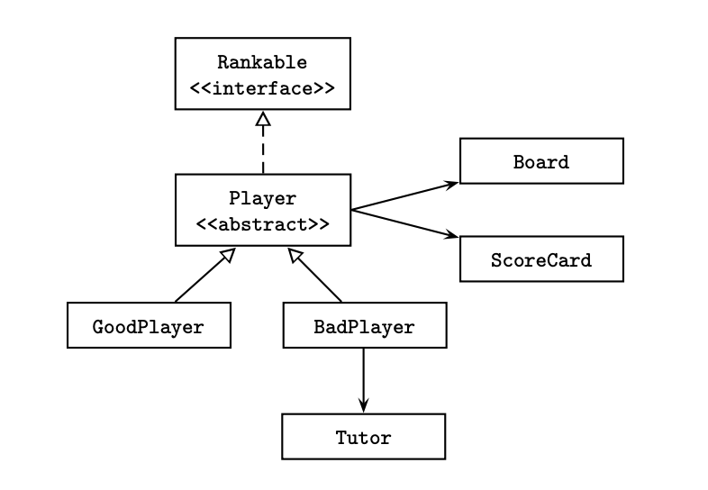

Slide 19
Implementing Classes
Bottom-up development
For each method in a class, list all other classes needed to implement that particular method. These classes are called collaborators. A class has no collaborators is independent
Independent classes, typically the basic objects, should be implemented and tested first before being incorporated into the overall project
When each of the independent classes is working, classes that depend on just one other class are implemented and tested, and so on

Slide 20
Implementing Classes
Top-down development
The programmer starts with an overview of the program, selecting the highest-level controlling object and the tasks needed
During development of the program, subsidiary classes may be added to simplify existing classes

Slide 21
Implementing Methods
Procedural abstraction
Helper methods
Stepwise refinement
Information hiding
Stub method (dummy method)
algorithm
Step by step procedure that solves a problem or achieves a goal

Slide 22
Example
A program that creates a teacher’s grade book. The program should maintain a class list of students for any number of classes in the teacher’s schedule. A menu should be provided that allows the teacher to
Create a new class of students.
Enter a set of scores for any class.
Correct any data that’s been entered.
Display the record of any student.
Calculate the final average and grade for all students in a class.
Print a class list, with or without grades.
Add a student, delete a student, or transfer a student to another class.
Save all the data in a file.

