Slide 1

Week 8

Slide 2
Recursive Sorts
Selection and insertion sorts are inefficient for large n, requiring approximately n passes through a list of n elements
More efficient algorithms can be devised using a “divide-and-conquer” approach, which is used in both the sorting algorithms that follow

Slide 3
Merge Sort
Idea:
If there is more than one element in the array:
Break the array into two halves
Mergesort the left half
Mergesort the right half
Merge the two subarrays into a sorted array

Slide 4
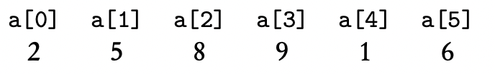
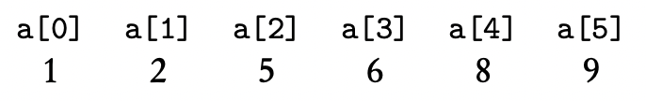
Merge Sort

Slide 5
Merge Sort
Algorithm:
Start with an unsorted list of n elements
The recursive calls break the list into n sublists, each of length 1 (we will end up with n arrays, each containing 1 element, which are sorted)
Recursively merge adjacent pairs of lists. There are then approximately n/2 lists of length 2; then, approximately n/4 lists of approximately length 4, and so on, until there is just one list of length n

Slide 6
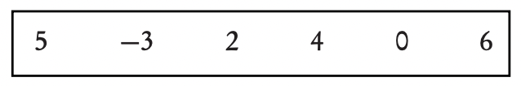
Merge Sort

Slide 7
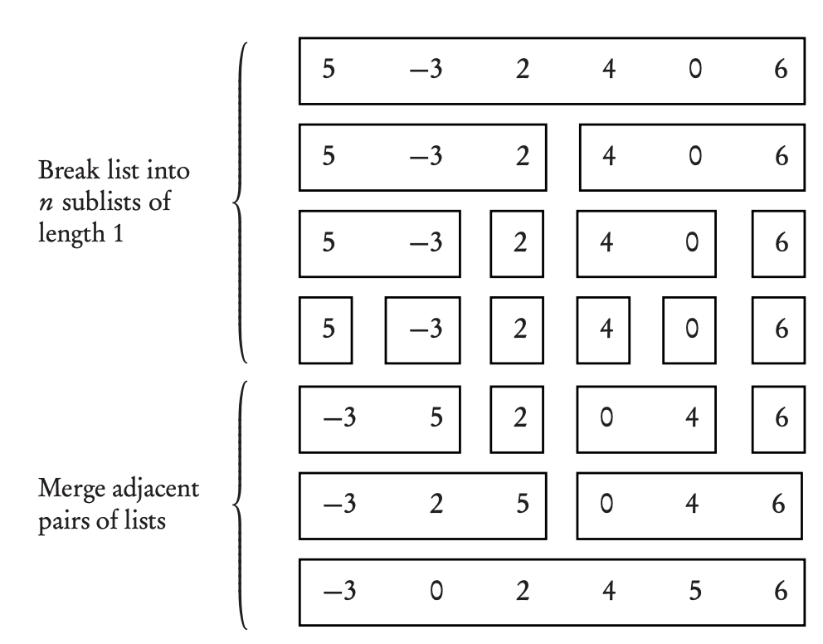

Slide 8
Analysis of Mergesort
Needs a temporary array that is as large as the original array to be sorted, could become a problem if space is a factor
Mergesort is not affected by the initial ordering of the elements, so best, worst, and average cases have similar run times
Runtime: O(nlogn)

Slide 9
Quicksort
For large n, quick sort is the fastest known sorting algorithm on average
Default sorting functions in language libraries use quicksort as implementation (i.e. Collections.sort() in Java)

Slide 10
Quick Sort
Idea:
If there are at least two elements in the array
Partition the array
Quicksort the left subarray
Quicksort the right

Slide 11
Quick Sort -- Partition
Splits the array into two subarrays as follows:
A pivot element is chosen at random from the array (often from the first element) and placed so that all items to the left of the pivot are less than or equal to the pivot; whereas those to the right are greater than or equal to it
Example: 4, 1, 2, 7, 5, -1, 8, 6 pick a[0] = 4 as the pivot

Slide 12
Quick Sort
Algorithm:
Have two marks up and down, which are initialized to index values 0 and n-1
Move the up marker until a value less than the pivot is found; move the down marker until a value greater than the pivot is found, or down equals up
Swap a[up] and a[down]
Continue the process until down equals up, which will be the final pivot position. Swap a[0] and a[pivotPosition]

Slide 13
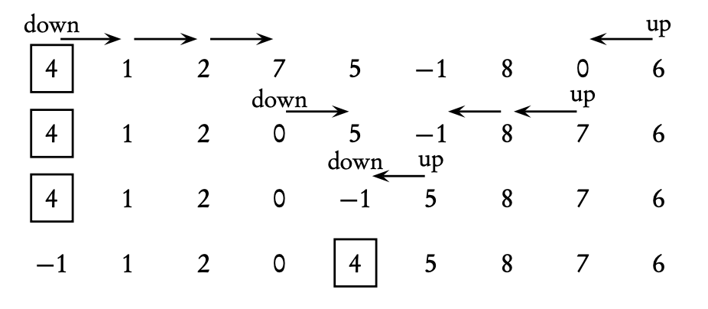
The pivot element 4, is in its final sorted position

Slide 14
Analysis of Quicksort
For the fastest run time, we want arrays to be partitioned into two parts of roughly the same size
If the pivot happens to be the smallest or largest element in the array, the split is not much of a split – one of the subarrays is empty. If this happens repeatedly, quicksort degenerates into a slow, recursive version of selection sort and is very inefficient

Slide 15
Analysis of Quicksort
The worst case for quicksort occurs when the partitioning algorithm repeatedly divides the array into pieces of size 1 and n-1
If the array is initially sorted in either order, and the fist or last element is chosen as the pivot, then the worst case will happen
Some algorithms avoid this situation by initially shuffling up the given array, or selecting the pivot by examining several elements of the array, and then taking the median

Slide 16
Sorting algorithms in Java
Recall: ArrayList can only hold objects; arrays can hold either objects or primitive types like int or double
A common way of organizing code for sorting arrays is to create a sorter class with an array private instance variable (i.e. SelectionSort.java)
In order to sort objects, there must be a compareTo method in the class, since we need to be able to compare elements

Slide 17
Sequential Search
Assume that you are searching for a key in a list of n elements
A sequential search starts at the first element and compares the key to each element in turn until the key is found or there are no more elements to examine in the list
If the list is sorted, in ascending order, stop searching as soon as the key is less than the current list element
Notes:
Ryan

Slide 18
Sequential Search
The best case has key in the first slot
The worst case occurs if the key is in the last slot or not in the list, so all n elements have to be examined
On average, there will be n/2 comparisons

Slide 19
Binary Search
If the elements are in a sorted array, a divide and conquer approach provides a much more efficient searching algorithm
Assume that a[low] … a[high] is sorted in ascending order and that a method binSearch returns the index of the key we are looking for
If key is not in the array, it returns -1

Slide 20
