Slide 1

Week 4

Slide 2
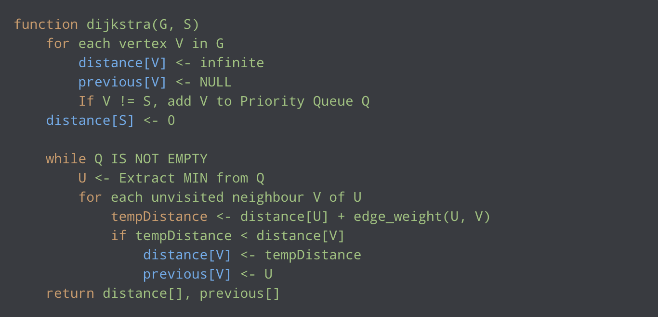
Review: Dijkstra’s Algorithm

Slide 3
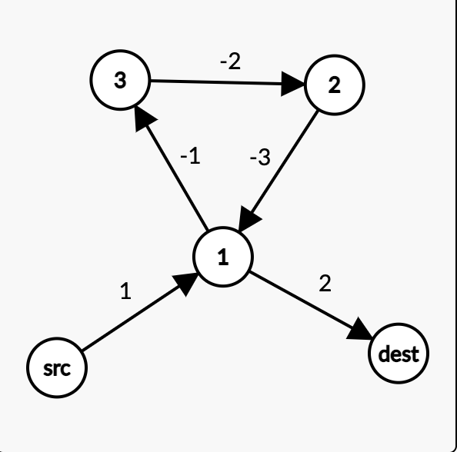
Negative Weight Cycles in Directed Graph
src -> 1 -> dest 3
src -> (1->2->3->1) -> dest -3
src -> (1->2->3->2->3->1) -> dest -9
…
Dijkstra’s algorithm does not terminate if a negative weight cycle exists
No solution to the shortest path problem

Slide 4
Bellman-Ford’s Algorithm
Similar to Dijkstra’s algorithm, but works with directed graphs in which edges can have negative weights
Practical use of negative weighted edges: cashflow, heat released/absorbed in a chemical reaction

Slide 5
Bellman-Ford’s Algorithm
Bellman-ford first calculates the shortest distances which have at most one edge in the path, then it calculates the shortest paths with at most 2 edges, and so on
After the i-th iteration, the shortest paths with at most i edges are calculated
There can be a maximum of |V|-1 edges in any simple path, so we will repeat |V|-1 times

Slide 6
Bellman-Ford’s Algorithm
Create a list dist[] of size |V| with all values as infinite except dist[src] where src is the source vertex
For each edge (u, v), perform edge relaxation: if dist[v] > dist[u] + weight(u, v), update dist[v] = dist[u] + weight(u, v)
Repeat step 2 |V|-1 times
Checks for negative weighted cycle, do the following for each edge(u, v): if dist[v] > dist[u] + weight(u, v), then this graph contains a negative weight cycle

Slide 7
Some Insights
Step 4: Since step 2 and 3 guarantee the shortest distances if the graph doesn’t contain a negative weight cycle, then if we iterate through all edges one more time and get a shorter path for any vertex, then there is a negative weight cycle

Slide 8
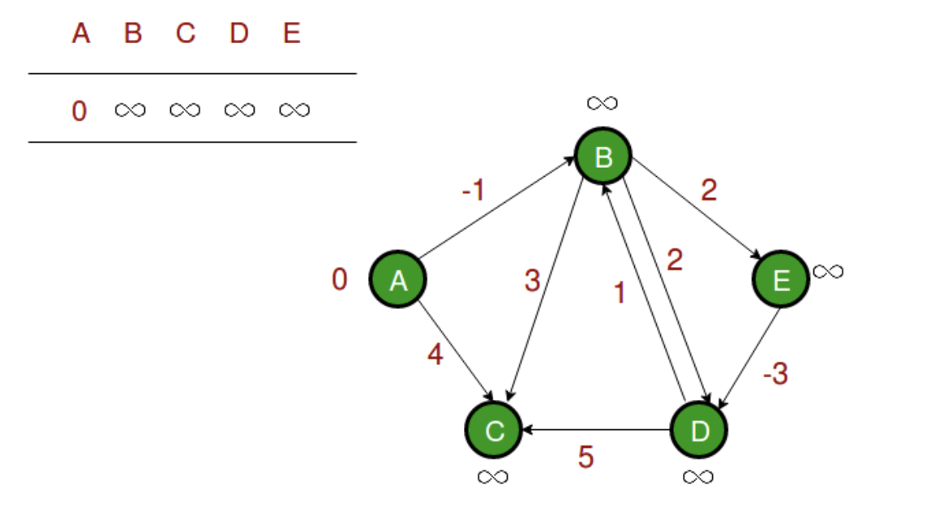
Let all edges be processed in the following order: (B, E), (D, B), (B, D), (A, B), (A, C), (D, C), (B, C), (E, D)

Slide 9
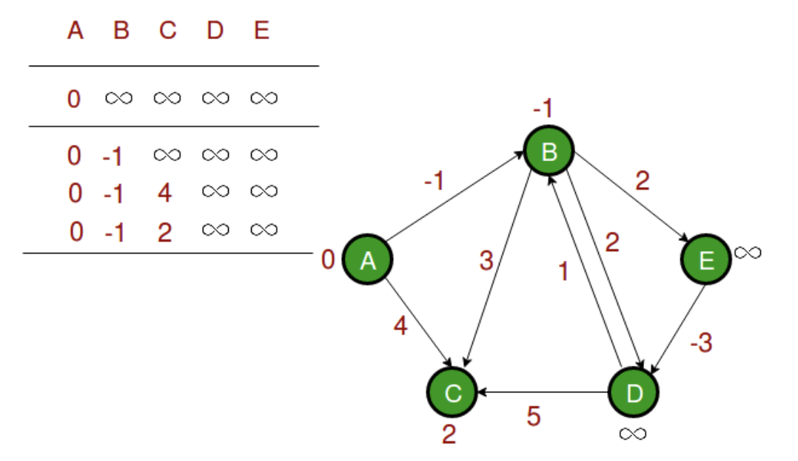
Let all edges be processed in the following order: (B, E), (D, B), (B, D), (A, B), (A, C), (D, C), (B, C), (E, D)
First iteration

Slide 10
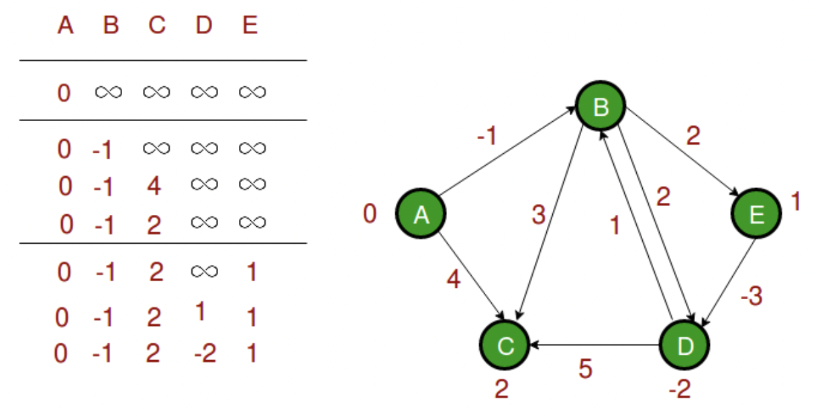
Let all edges be processed in the following order: (B, E), (D, B), (B, D), (A, B), (A, C), (D, C), (B, C), (E, D)
Second iteration

Slide 11
Let all edges be processed in the following order: (B, E), (D, B), (B, D), (A, B), (A, C), (D, C), (B, C), (E, D)
Third iteration

Slide 12
Let all edges be processed in the following order: (B, E), (D, B), (B, D), (A, B), (A, C), (D, C), (B, C), (E, D)
Fourth iteration

Slide 13
Let all edges be processed in the following order: (B, E), (D, B), (B, D), (A, B), (A, C), (D, C), (B, C), (E, D)
Fifth iteration, no negative cycle

Slide 14
Notes
Bellman-ford does not work with undirect graph with negative edges, because an undirected negative edge contains a negative weight from u->v and v->u, which Bellman-ford will pick up as a negative weight self-cycle
Time complexity: O(VE)

Slide 15
Spanning Tree
A spanning tree is a sub-graph of an undirected connected graph, which includes all vertices of a graph with a minimum possible number of edges
If a vertex is missed, then it is not a spanning tree
The edges may or may not have weights assigned to them

Slide 16
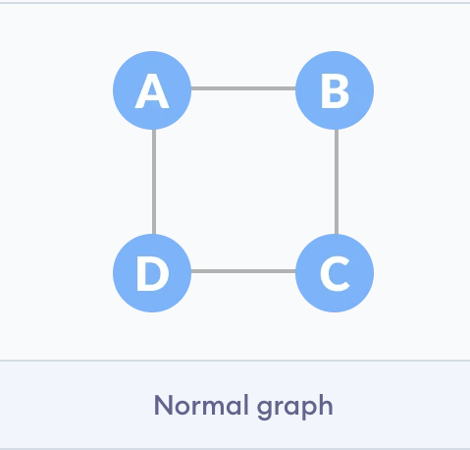
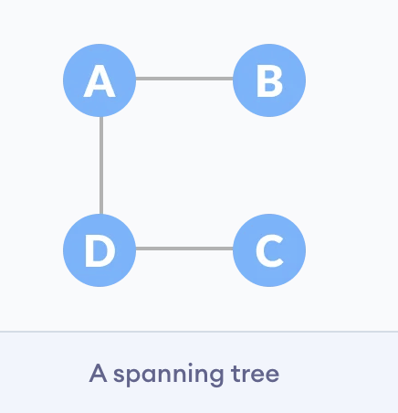
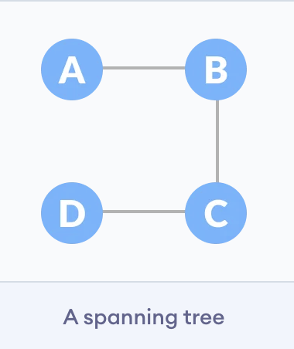
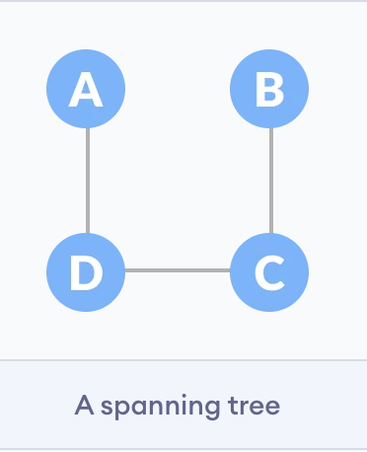

Slide 17
Minimum Spanning Tree (MST)
A spanning tree in which the sum of the weight of the edges is as minimum as possible
Used in Kruskal’s Algorithm and Prim’s Algorithm

Slide 18
Activity
Give Examples of:
A graph with no (minimum) spanning trees
A graph with a unique spanning tree
A graph with a unique minimum spanning tree
A graph with many minimum spanning trees

Slide 19
Union Find Algorithm
Used to check whether a graph contains cycle or not, assuming the graph doesn’t contain any self-loops
Disjoint Set: a data structure that keeps track of a set of elements partitioned into a number of disjoint(non-overlapping) subsets

Slide 20
Union Find Algorithm
Union Find algorithm performs union and find on disjoint sets
Find: Determine which subset a particular element is in, can be used for determining if two elements are in the same subset
Union: Join two subsets into a single subset. First check if two subsets belong to the same set, if they don’t, then we can perform union

Slide 21
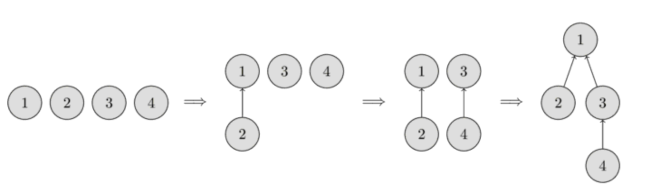
- Union(1, 2), Union(3, 4), Union(2, 4) - Find(2) = 1 - Find(4) = Find(3) = 1

Slide 22
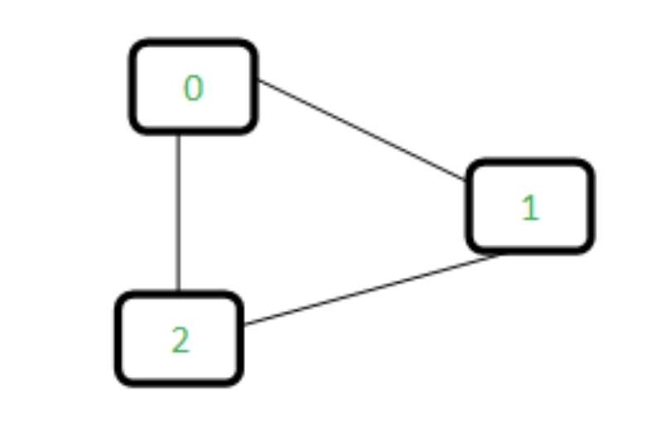
Union Find Algorithm
Keep track of subsets in a 1D array called parent[]
For each edge, make subsets using both vertices of the edge
If both vertices are in the same subset, then a cycle is found

Slide 23
Union Find Algorithm
Initially, the parent array is set to
0 1 2
-1 -1 -1

Slide 24
Union Find Algorithm
Edge 0-1: since vertices 0 and 1 are in different subsets, take the union of the two nodes by either making node 0 as a parent of node 1 or vice-versa
0 1 2
1 -1 -1

Slide 25
Union Find Algorithm
Edge 1-2: node 1 is in subset 1, and node 2 is in subset 2, so we take the union of the two sets by either making node 1 a parent of node 2 or vice versa
0 1 2
1 2 -1

Slide 26
Union Find Algorithm
Edge 0-2: 0 is in subset 2 and 2 is also in subset 2, so including this edge forms a cycle
0->1->2 // 1 is a parent of 0 and 2 is a parent of 1
0 1 2
1 2 -1

Slide 27
Time Complexity
Union: O(n)
Find: O(n)

Slide 28
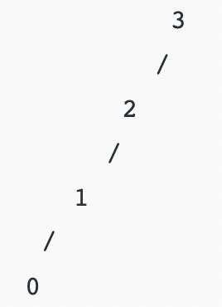
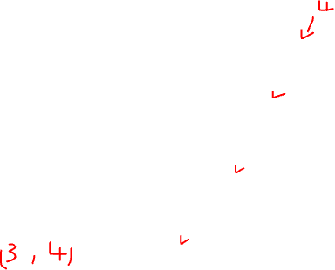
Union by Rank
In the previous union and find approach, the final tree created to represent subsets can be skewed and become like a linked list in the worst case
Consider node 0, 1, 2, 3, if we perform union(0, 1), union(1, 2), union(2, 3), in the worst case, a tree will become:

Slide 29
Union by Rank
We want to optimize the union operation such that it is O(log n) in the worst case
Idea: always attach the smaller depth tree under the root of the deeper tree

Slide 30
Union by Rank
Each node is associated with a rank, initially a set has one element and a rank of zero
If we union two sets and both trees have the same rank, then the resulting set’s rank is one larger
If we union two sets and two trees have different ranks, the resulting rank becomes the larger one of the two
Ranks are used instead of height or depth because path compression will change tree’s heights over time

Slide 31
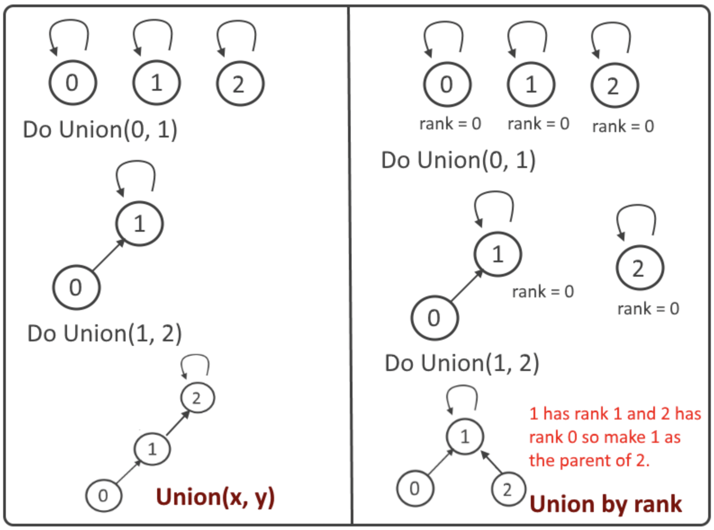

Slide 32
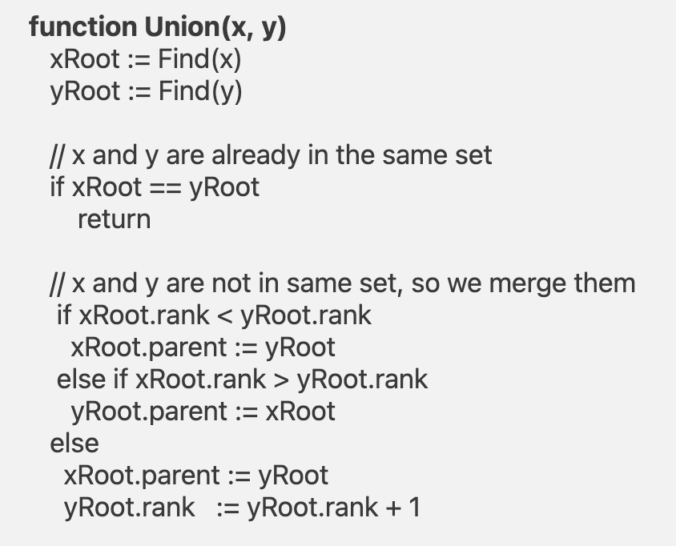
Pseudo Code for Union by Rank

Slide 33
Path Compression
A way of flattening the structure of the tree whenever Find is used on it
Since each element visited on the way to a root is part of the same set, all of these visited elements can be reattached directly to the root
We are only interested in finding out the root of a node as fast as possible
The resulting tree becomes much flatter

Slide 34
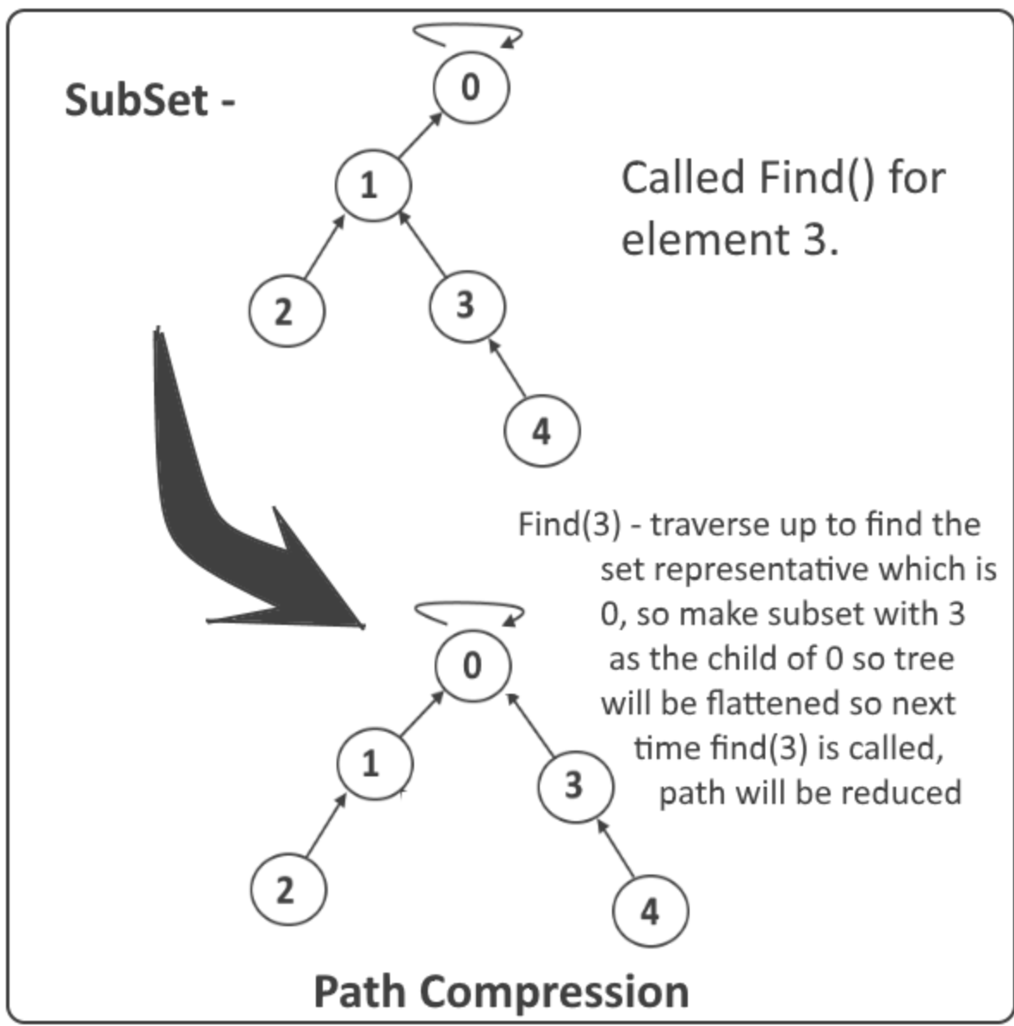

Slide 35
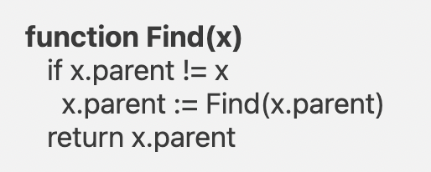
Pseudo Code for Path Compression

Slide 36
Very fun homework question
https://dmoj.ca/problem/dmopc16c2p2

Slide 37
Kruskal’s Algorithm
Is a greedy algorithm
Start from edges with the lowest weight and keep adding edges until we reach our goal

Slide 38
Kruskal’s Algorithm
Sort all edges from low weight to high
Take the edge with the lowest weight and add it to the spanning tree. If adding the edge created a cycle, then reject this edge
Keep adding edges until we reach all vertices

Slide 39
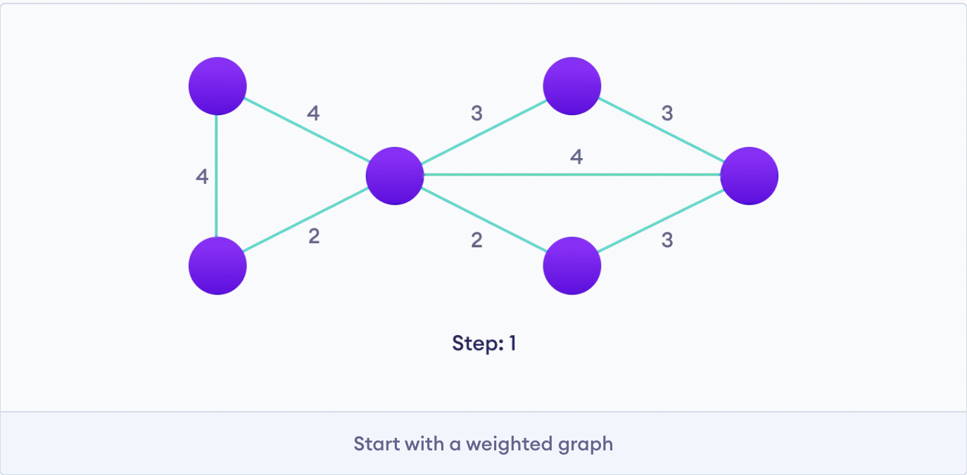

Slide 40
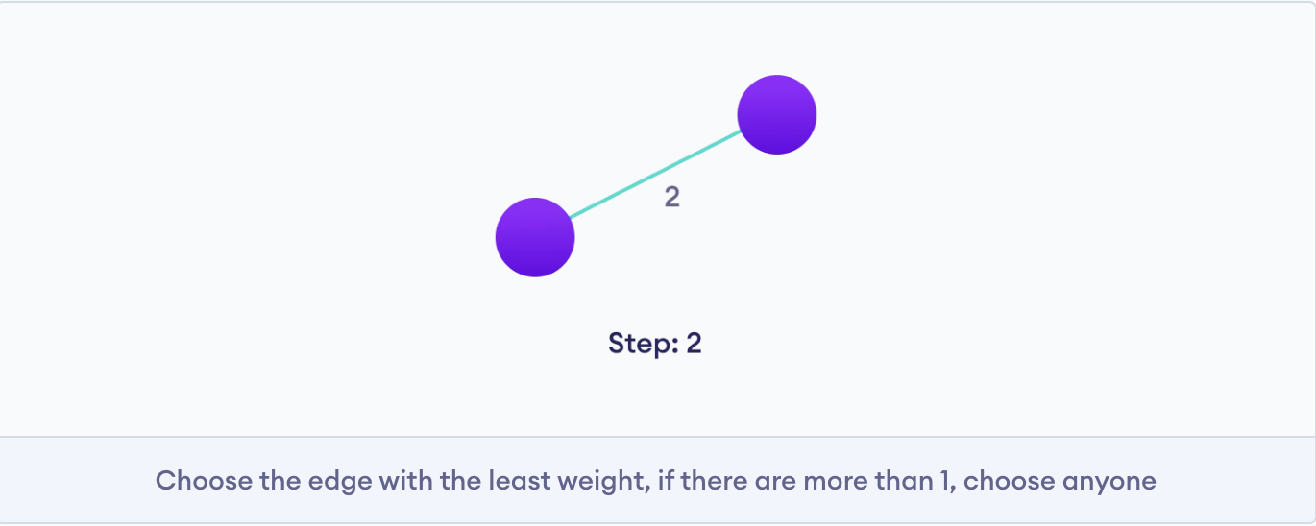

Slide 41
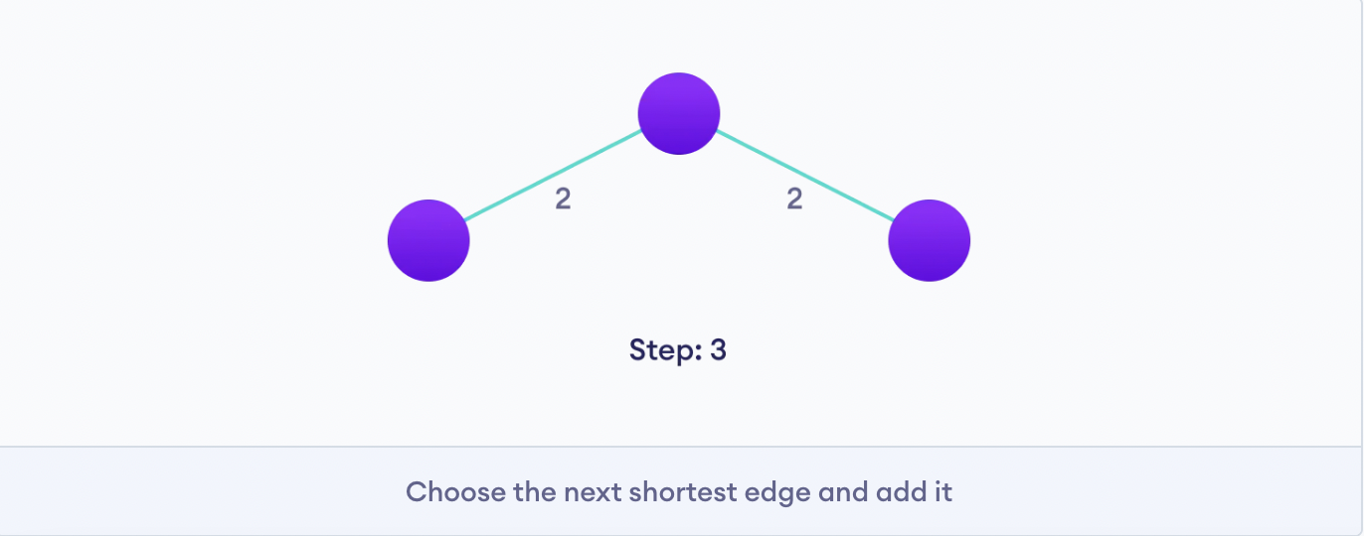

Slide 42
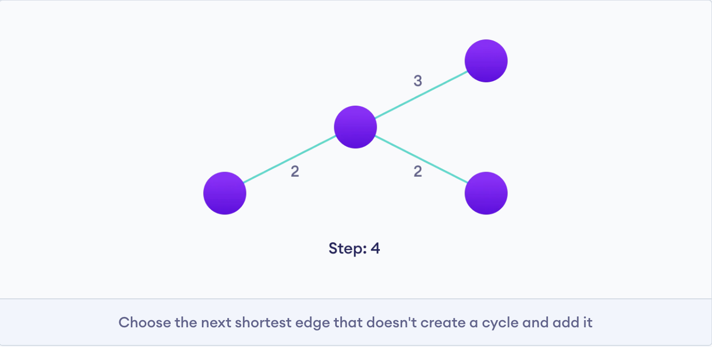

Slide 43
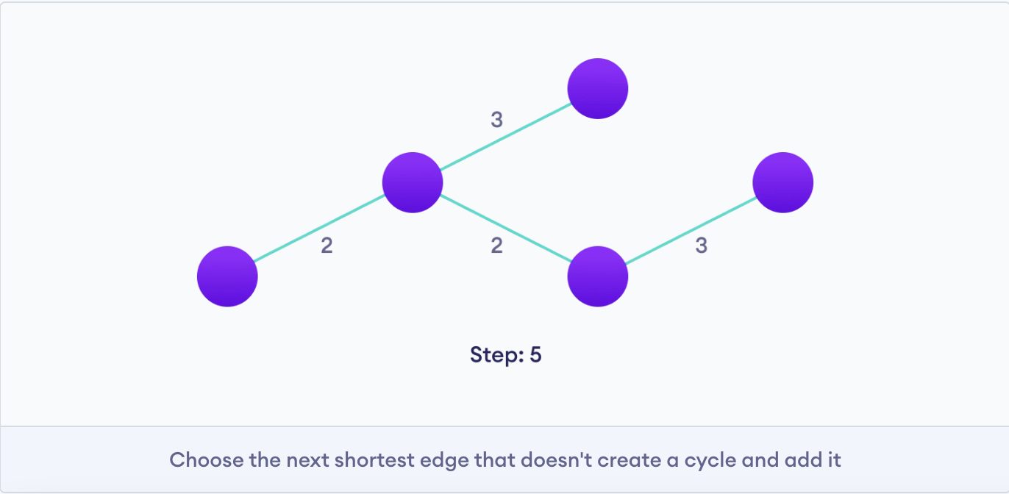

Slide 44
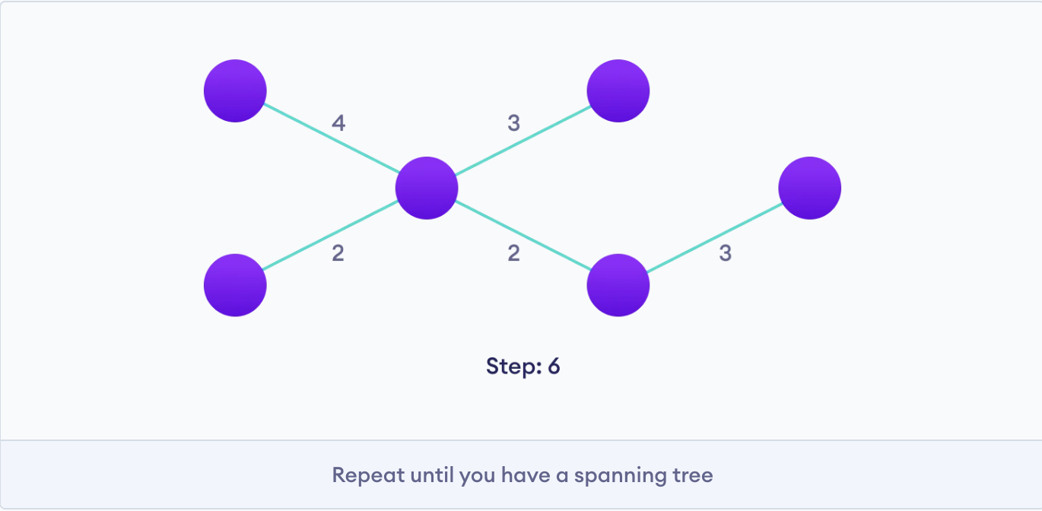
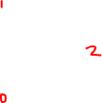
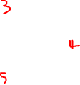

Slide 45
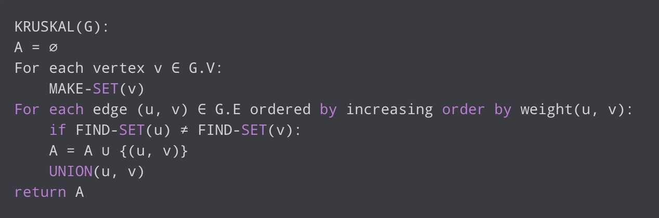
Kruskal’s Algorithm Pseudocode

Slide 46
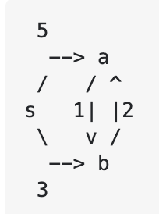
Note
Time complexity: O(E log E)
Kruskal’s algorithm does not work with directed graph

Slide 47
Homework
https://dmoj.ca/problem/dmopc15c6p4

