Slide 1
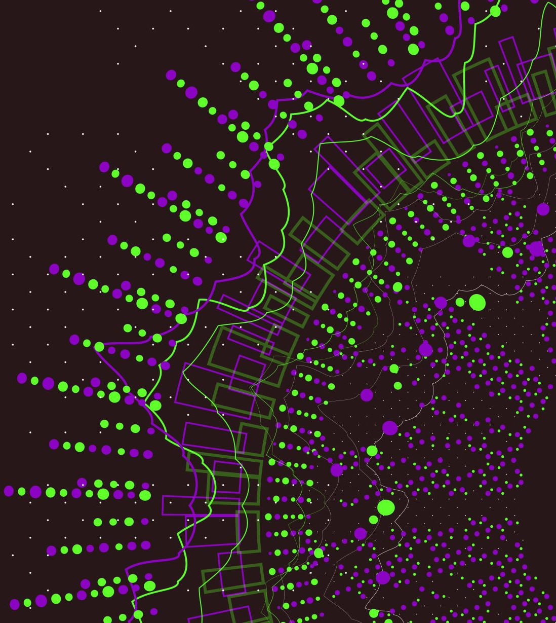
Design Patterns

Slide 2
What makes you a good game developer?
Know the basic syntax of a programming language
Knowledge on data structures
Knowledge on algorithms
Knowledge on design patterns

Slide 3
What are design patterns
A template/description on how to solve a program that can be used in many different situations
There are three types of design patterns:
Creational Design Patterns: used for class instantiation (only applied to one class)
Structural Design Patterns: used for class and objects composition; how we group objects and compose them to have new functionalities (inheritance is often used)
Behavioural Design Patterns: used for designing how objects will communicate with each other

