Slide 1

Week 7

Slide 2
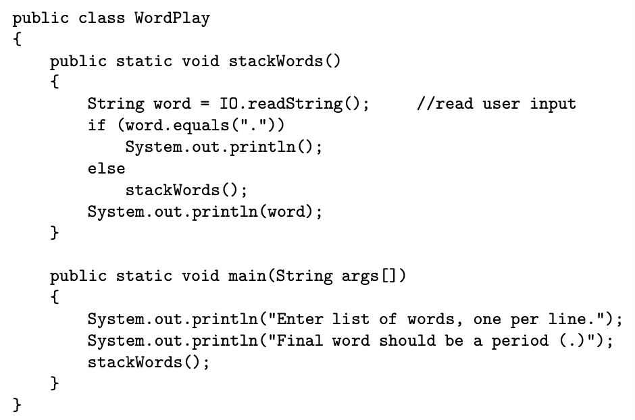
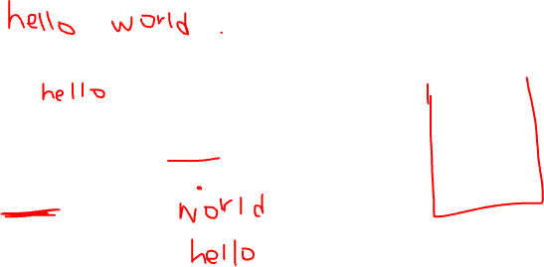

Slide 3
Recursive Methods
A method that calls itself
Each time the recursive call to stackWords() is made, execution go back to the start of a new method call
Computer must remember to complete all pending calls to the method
Computer stores all the pending calls in a stack, pops the top statement off the stack, then execute that statement

Slide 4
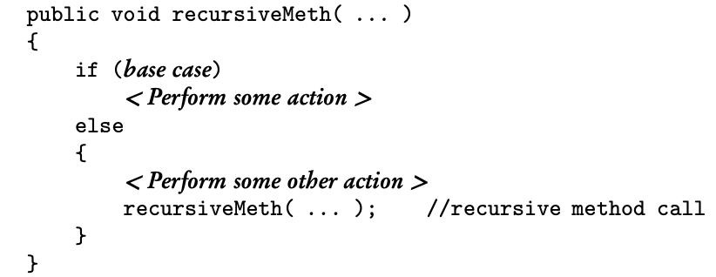
General Form of Recursive Methods
Every recursive methods has two distinct parts:
A base case or termination condition that causes the method to end
A non-base case whose actions move the algorithm toward the base case and termination

Slide 5
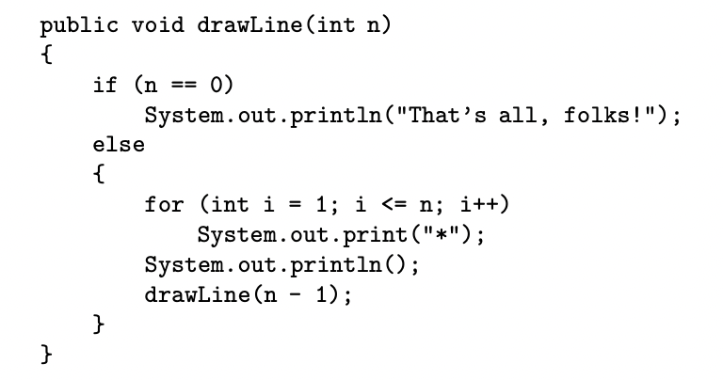
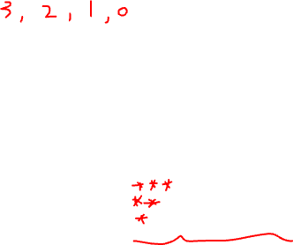

Slide 6
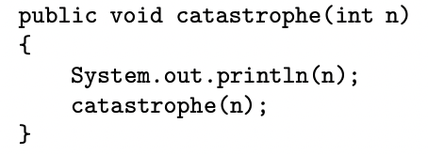

Slide 7
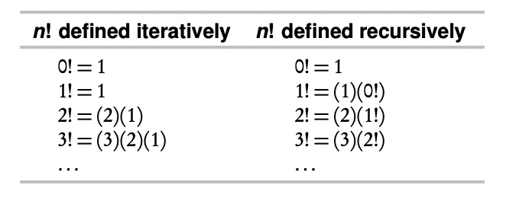
Writing Recursive Methods
To come up with a recursive algorithm, we must identify the subproblems within the main problem
Problem: write a method that return n! (n factorial)

Slide 8
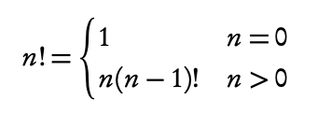

Slide 9
Writing Recursive Methods
Write a recursive method revDigs that outputs its integer parameter with the digits reversed
revDigs(147) = 741
revDigs(4) = 4
Idea: output the rightmost digit, then if there are still digits left in the remaining number n/10, reverse its digits. Repeat the process until n/10 is 0

Slide 10
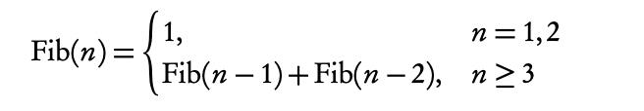
Fibonacci Number
Fibonacci sequence: 1, 1, 2, 3, 5, 8, 13, …

Slide 11
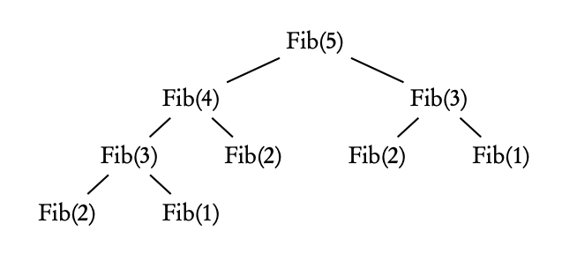
Each call to fib makes two more calls, which hints at an exponential algorithm (one that is very inefficient)

Slide 12
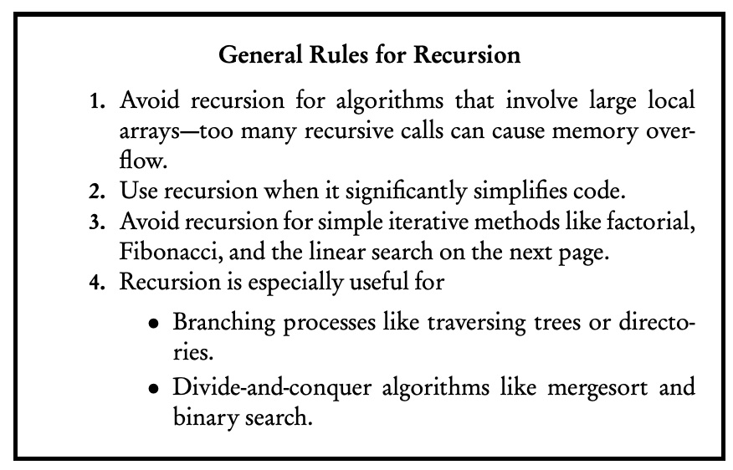

Slide 13
Sorting and Searching
Searching: finding an item in the array that meets some specified criteria
Sorting: rearranging all items in the array into increasing or decreasing order

Slide 14
Selection Sort
A “search and swap” algorithm
Find the smallest element in the array and exchange it with a[0], the first element
Now find the smallest element in the subarray a[1] ... a[n-1] and swap it with a[1], the second element in the array
Continue this process until just the last two elements remain to be sorted, a[n-2] and a[n-1]
The smaller of these two elements is placed in a[n-2]; the larger, in a[n-1]; and the sort is complete

Slide 15
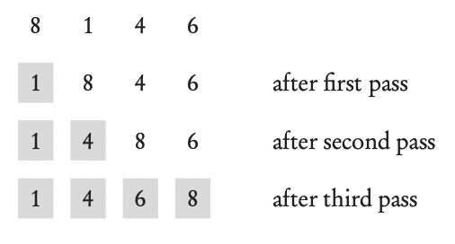

Slide 16
Selection Sort
For an array of n elements, the array is sorted after n-1 passes
After the kth pass, the first k elements are in their final sorted position

Slide 17
Insertion Sort
Assume that a[0] is sorted with respect to itself; the array can now be thought of as consisting of two parts: a sorted list followed by an unsorted list
Idea: move elements from the unsorted list to the sorted list one at a time; as each item is moved, it is inserted into its correct position in the sorted list
In order to place the new item, some elements may need to be moved down to create a slot

Slide 18
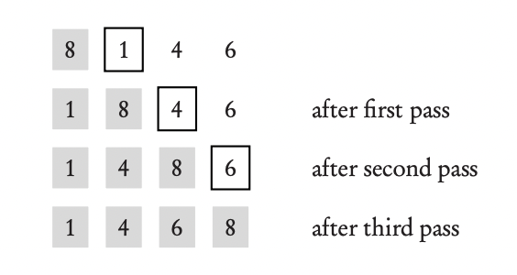

Slide 19
Insertion Sort
For an array of n elements, the array is sorted after n-1 passes
After the kth pass, a[0], a[1], …, a[k] are sorted with respect to each other but not necessarily in their final sorted positions
Worse Case: if the array is initially sorted in reverse order, since this will lead to the maximum possible number of comparisons and moves

Slide 20
Insertion Sort
Best Case: if the array is already sorted in increasing order. In this case, each pass through the array will involve just one comparison, which will indicate that “it” is in its correct position with respect to the Both insertion and selection sorts are sorted list. Therefore, no elements will need to be moved.
Both insertion and selection sorts are inefficient for large n

Slide 21
Recursive Sorts: MergeSort and QuickSort
Selection and insertion sorts are inefficient for large n, requiring approximately n passes through a list of n elements
Divide-and-conquer approach

