Slide 1

Week 1

Slide 2
What are data structures?
Stores and organizes data
A way of arranging data on a computer such that it can be accessed and updated efficiently
Linear data structures: array, stack, queue, etc
Non-linear data structures: graph, tree

Slide 3
Tuple
Similar to a list, but we cannot change elements of a tuple once it is assigned, whereas we can change the elements of a list
A tuple is created by placing all items inside ()
A tuple can have any number of items and they may be of different types (integer, float, list, string, etc)

Slide 4
Tuple
Unlike lists, tuples are immutable
Elements of a tuple cannot be changed once they have been assigned, but if the element itself is a mutable data type like a list, then its nested items can be changed

Slide 5
Why use Tuple over List?
Tuples are immutable, so iterating through a tuple is faster than with list
Tuples contain immutable elements can be used as a key for a dictionary, lists cannot be used as a key for a dictionary
If you have data that doesn’t change, implementing it as tuple will guarantee it to remain write-protected

Slide 6
Dictionary
Unordered collection of items, each item of a dictionary has a key/value pair
Dictionaries are optimized to retrieve values when the key is known
Values can be of any data type and can repeat, keys must be of immutable type(string, number, or tuple) and must be unique

Slide 7
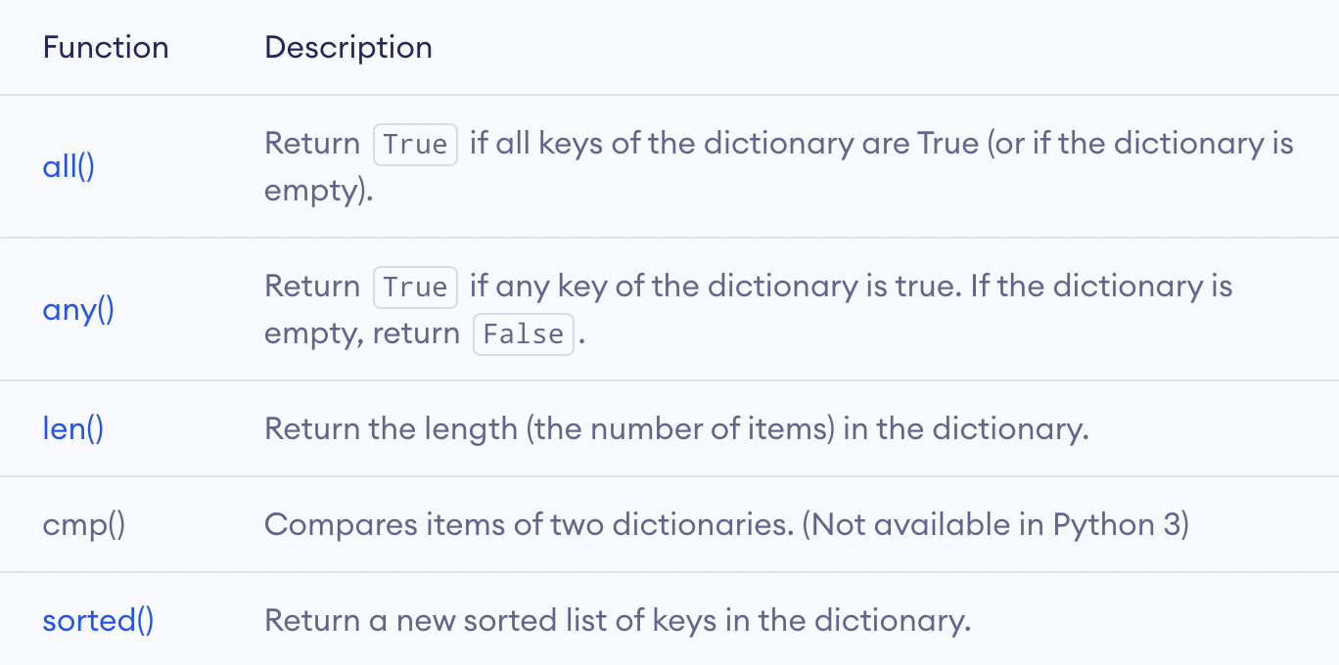
Other Built-in Functions of Dictionary

Slide 8
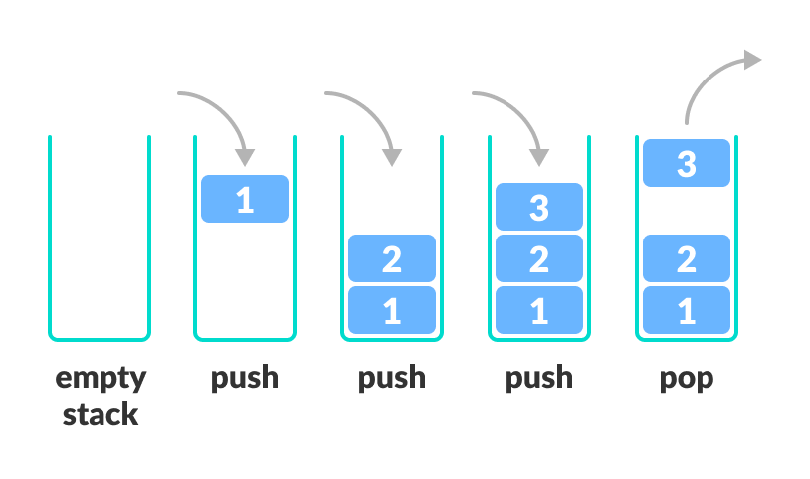
Stack
Follows the LIFO(Last-In-First-Out) principle and allows insertion and deletion operations from one end of the stack

Slide 9
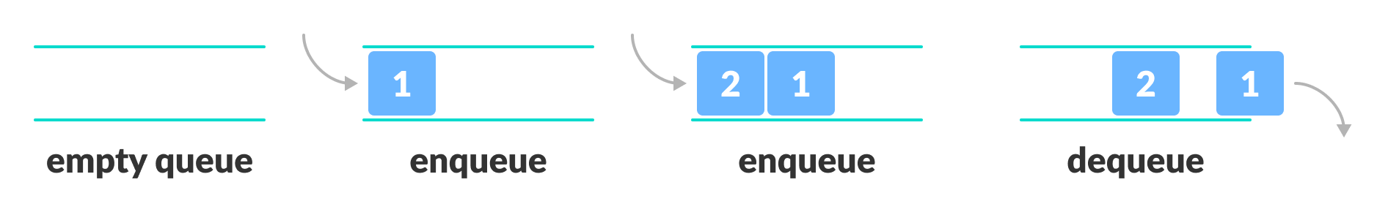
Queue
Open at both ends, one end for inserting data (enqueue), the other for removing data (dequeue)
Follows FIFO (First-In-First-Out), the data item stored first will be accessed first

Slide 10
What is Big O
The language and metrics we use to describe the efficiency of algorithms
Both an upper bound and a lower bound on the time it takes to run an algorithm

Slide 11
Linear Search Runtime Analysis
An algorithm can be described in three ways
Best Case: O(1), we run the search once, the first element is what we are looking for
Worst Case: O(n), we search through all the elements in a list, the last element is what we are looking for
Expected/Average Case: O(n/2)

Slide 12
Space Complexity
Parallel concept to time complexity
If we need to create an array of size n, then this requires O(n) space
If we need to create a two-dimensional array of size n by n, then this requires O(n^2) space

Slide 13
Drop the Constants
Big O only describes the rate of increase
An algorithm that might be described as O(2n) should be described as O(n)

Slide 14
Drop the Non-Dominant Terms
We know O(n^2 + n^2) should be described as O(n^2), so n in O(n^2 + n) is even less important
O(n^2 + n) should be described as O(n^2)

Slide 15
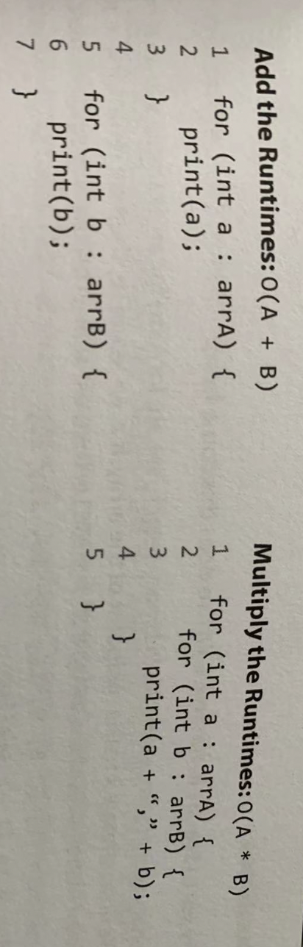
Multi-Part Algorithms: Add vs. Multiply

Slide 16
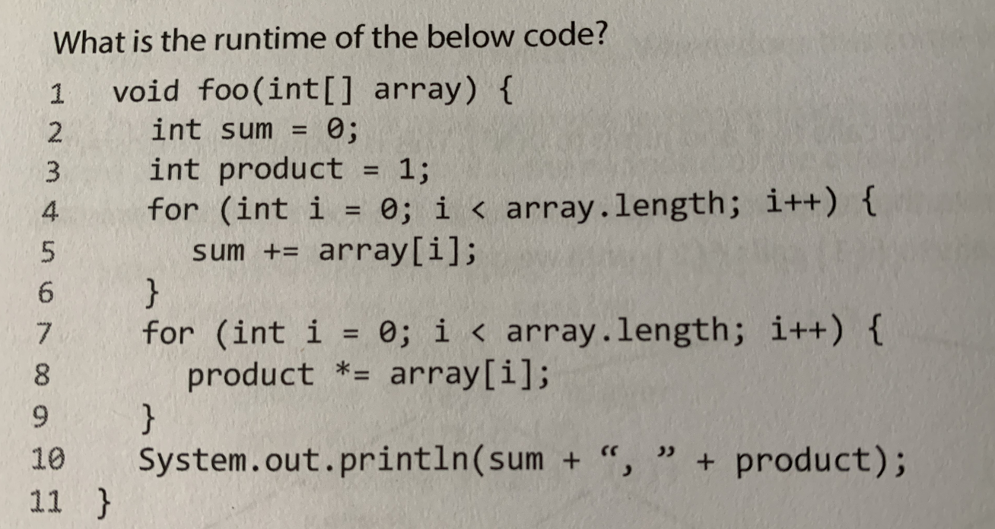

Slide 17
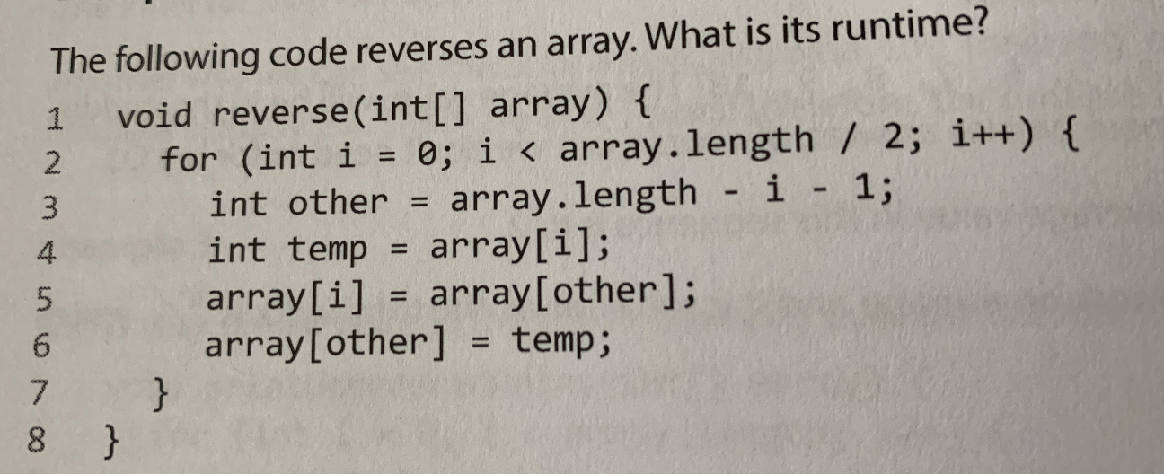

Slide 18
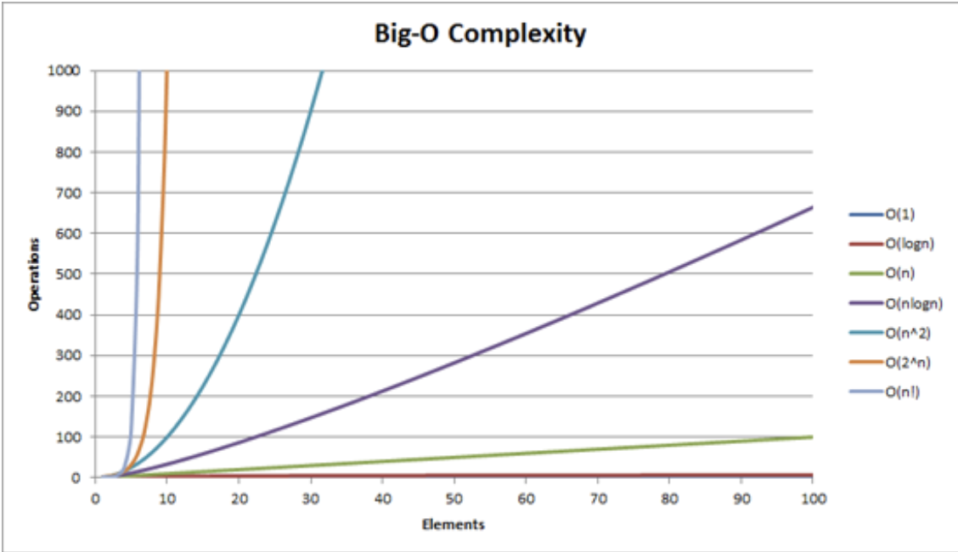

Slide 19
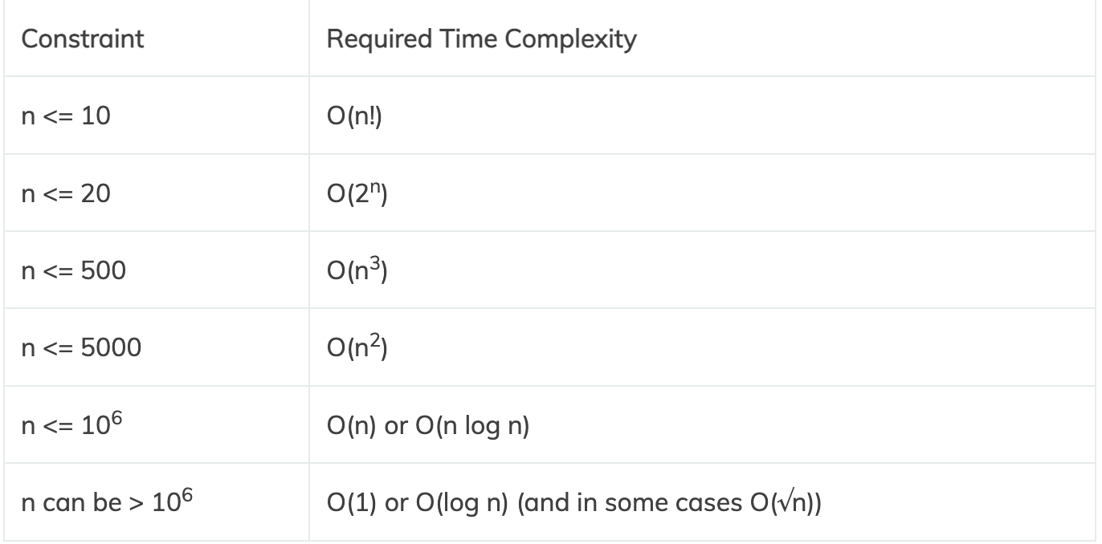

Slide 20
Homework - Tuple Practice
https://pynative.com/python-tuple-exercise-with-solutions/

Slide 21
Homework - Dictionary Practice
https://pynative.com/python-dictionary-exercise-with-solutions/

