Slide 1
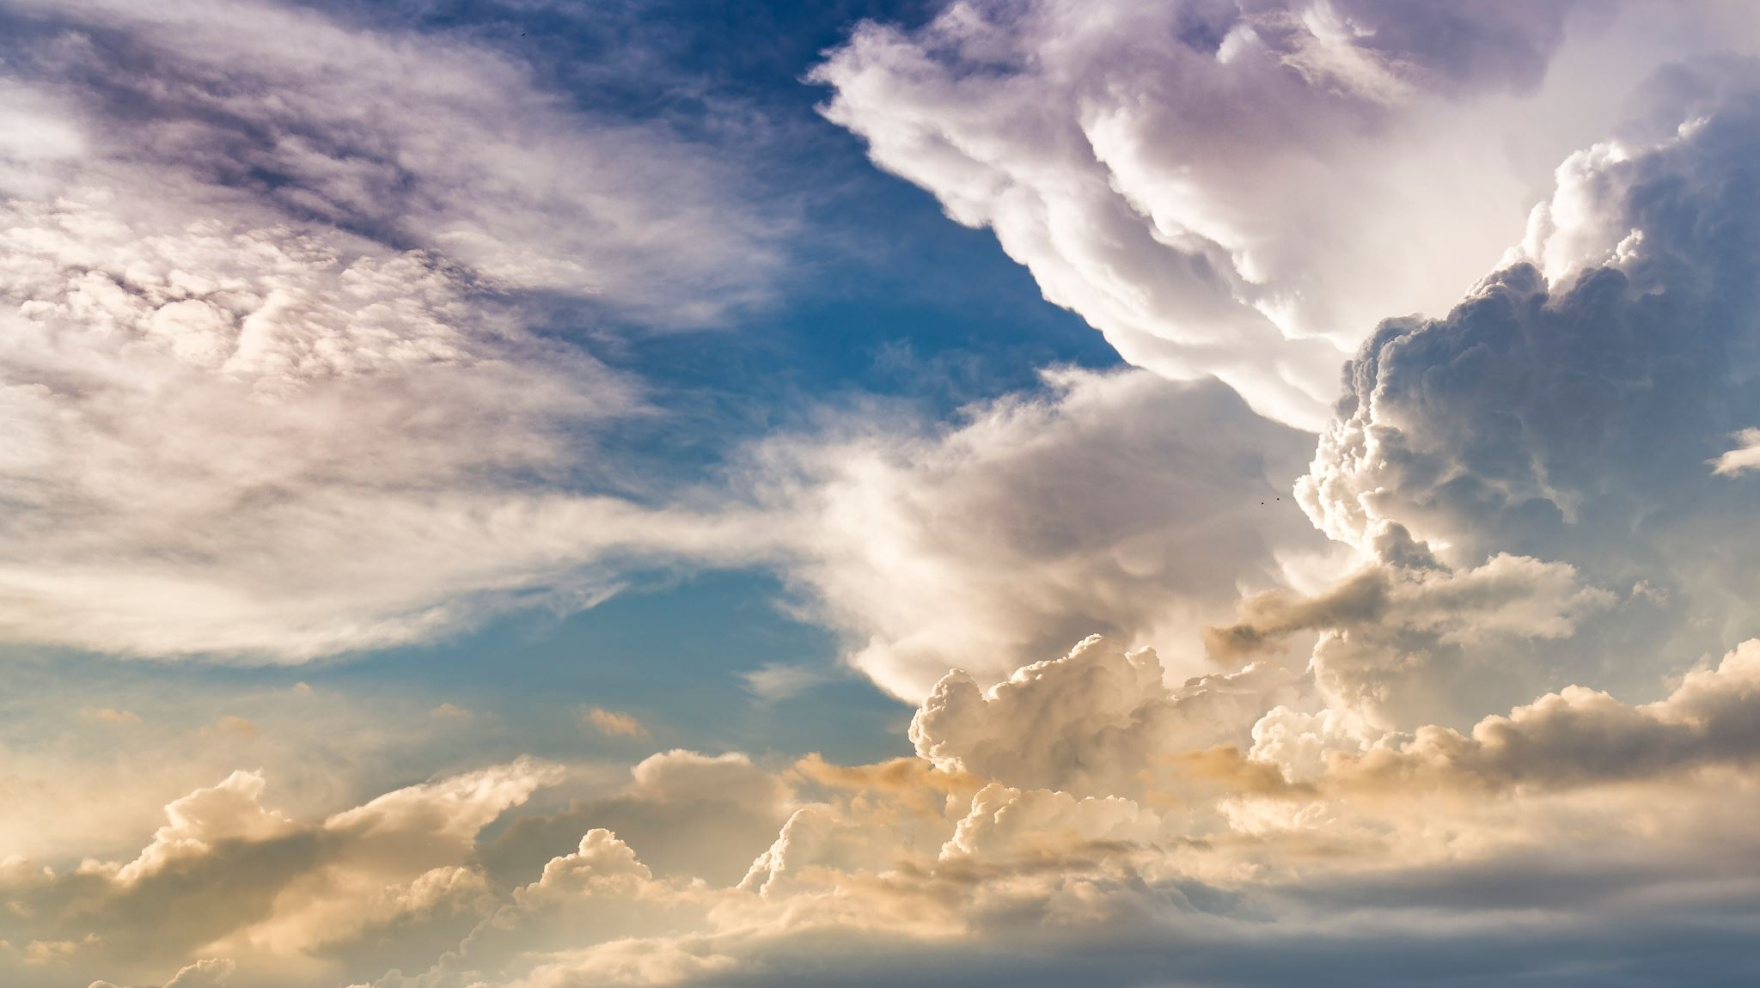
2021 CCC

Slide 2
J4 Arranging Books
https://dmoj.ca/problem/ccc21j4
A math problem….

Slide 3
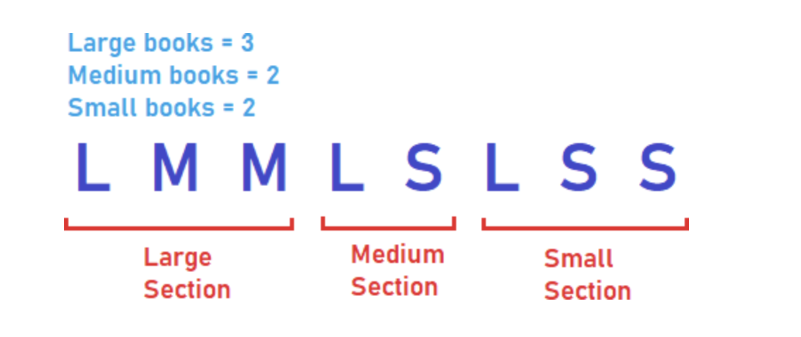

Slide 4
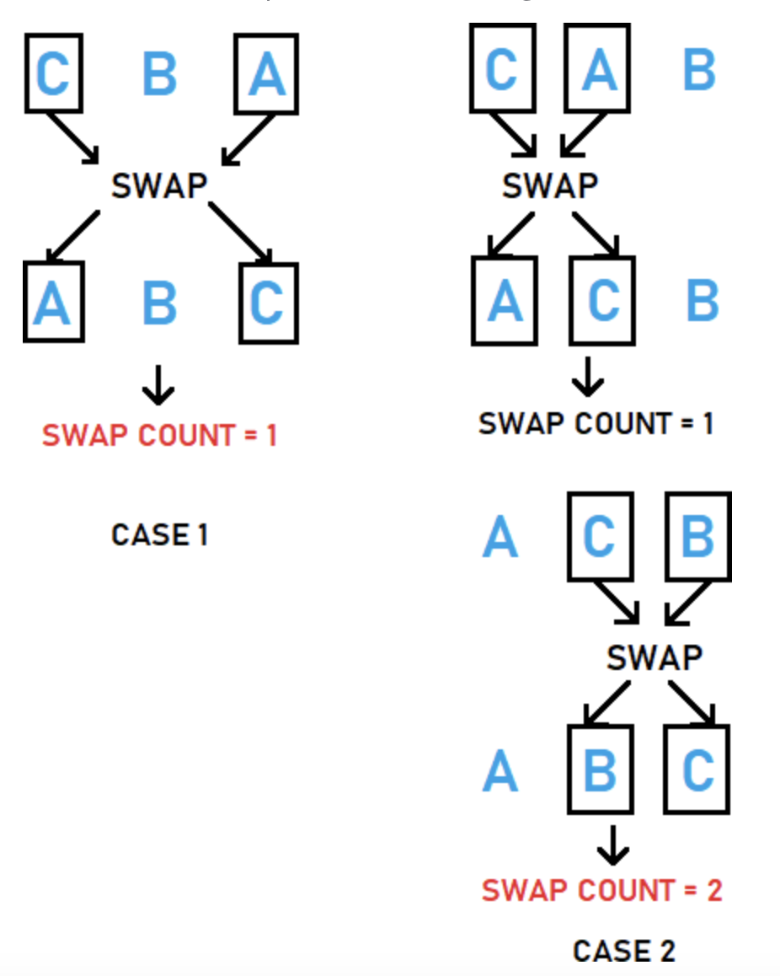

Slide 5
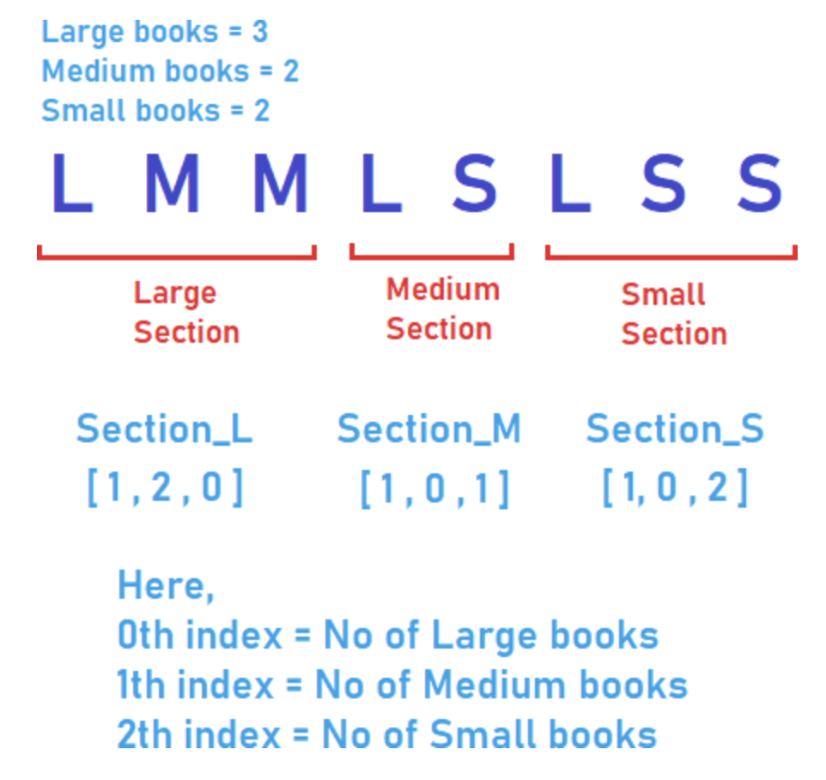

Slide 6
J5: Modern Art
https://dmoj.ca/problem/ccc21s2
A math problem….

Slide 7
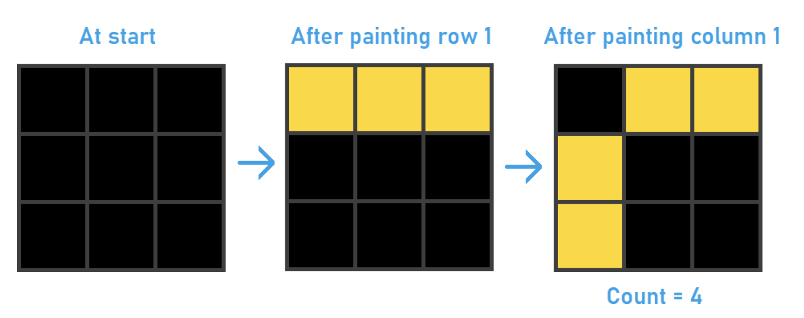

Slide 8
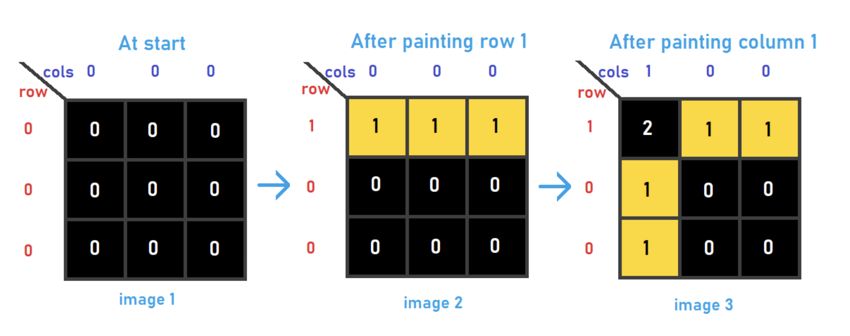

Slide 9
2019 CCC

Slide 10
J5: Rule of Three
https://dmoj.ca/problem/ccc19j5
A recursion problem

Slide 11
J5: Rule of Three
We want to determine the steps to take such that we can transform I (initial sequence) to F (final sequence) in S number of steps using the three rules
Rules:
1. AA -> AB
2. AB -> BB
3. B -> AA
Sequence:
AAAA
ABAB
AAAB

Slide 12
J5: Rule of Three
Define
Problem:
R(I, F, n) := list of steps to take such that I will become F
Reduction to subproblems:
R(I, F, n) depends on R(I, F, with rule 1 applied, n-1), R(I, F, with rule 2 applied, n-1), R(I, f with rule 3 applied, n-1),
Combine solutions:
If n < 0, we can take no more steps
If n == 0 and I == F, then the list of steps is what we want
If n > 0, do more processing

Slide 13
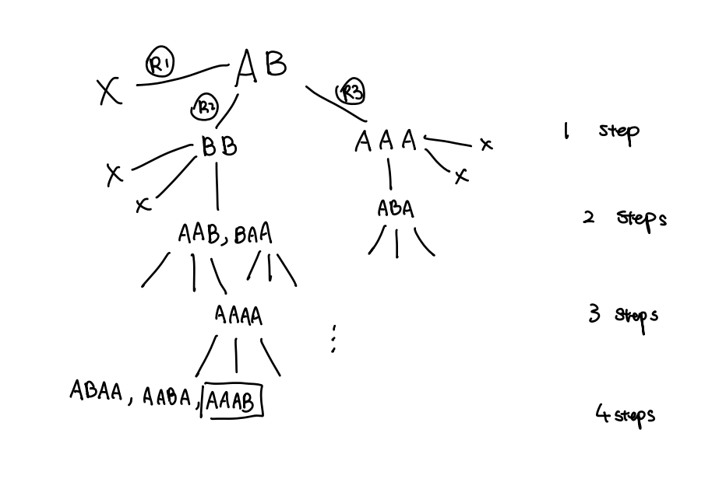

Slide 14
2014 CCC

Slide 15
J5: Assigning Partners
https://dmoj.ca/problem/ccc14s2

Slide 16
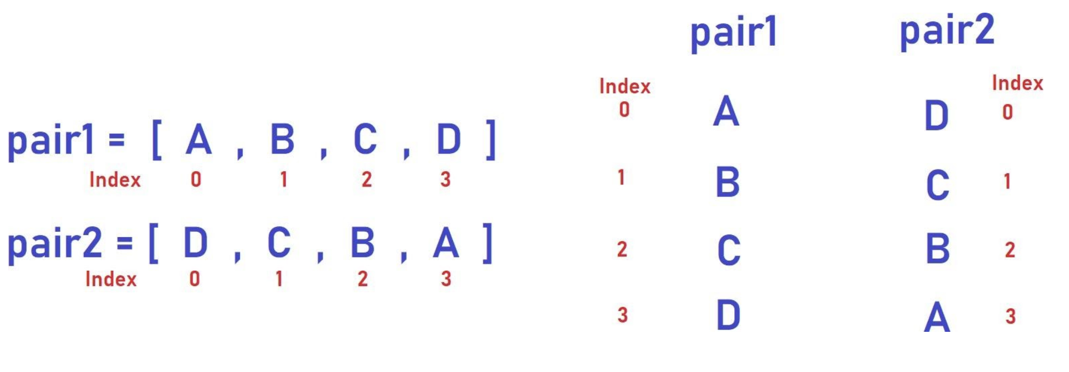

Slide 17
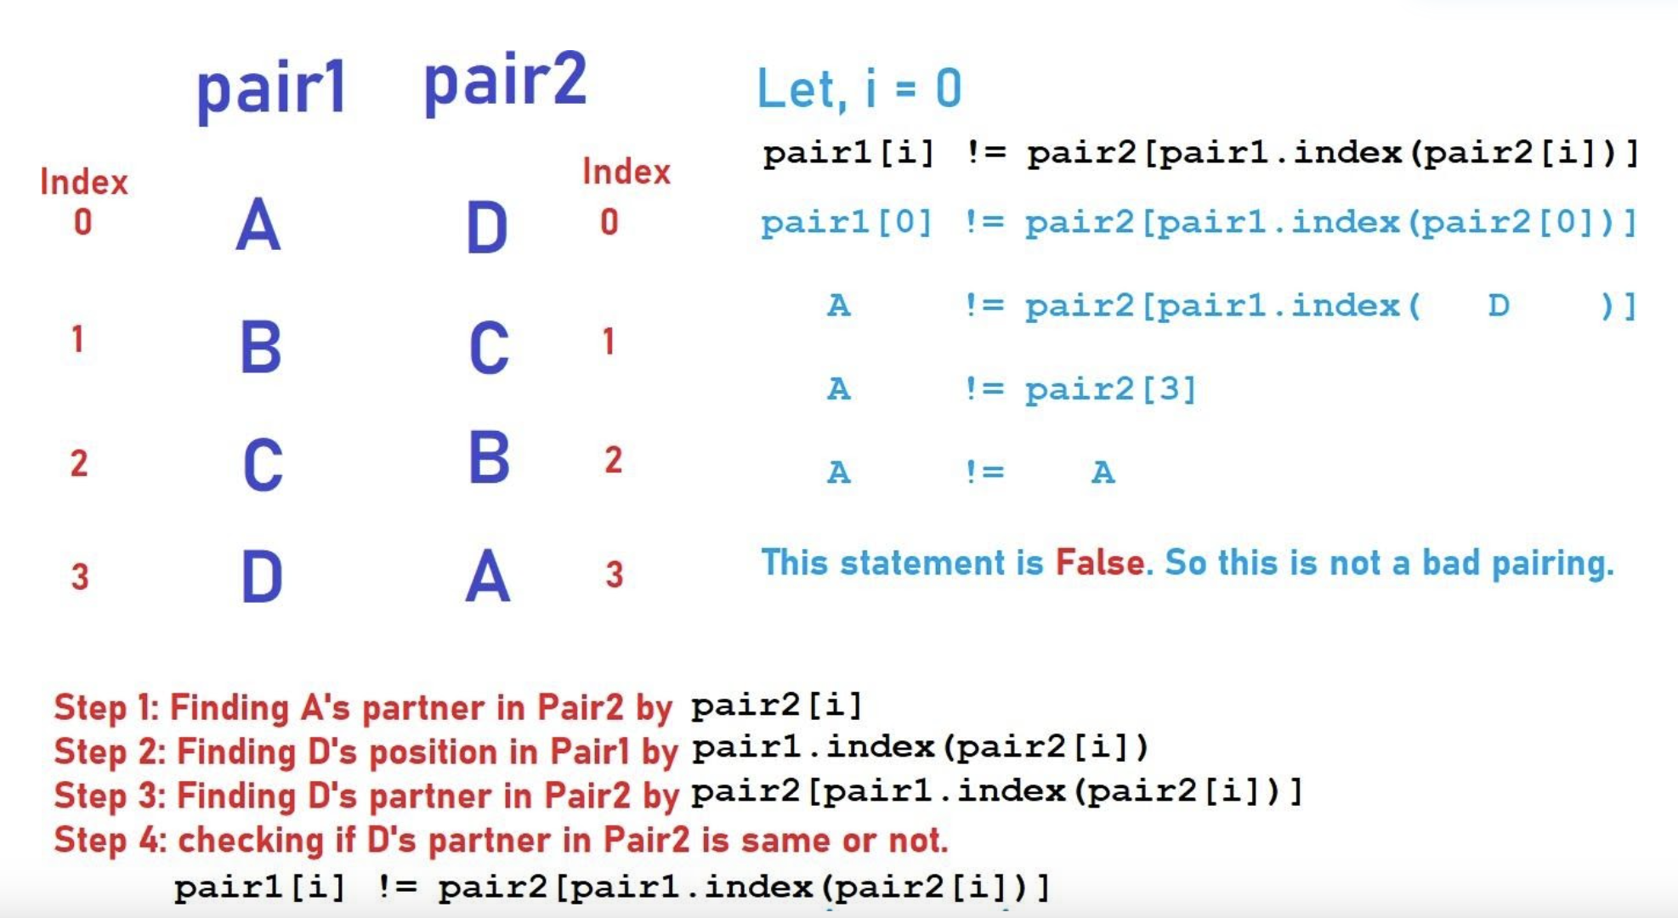

Slide 18
2022 CCC

Slide 19
J5: Square Pool
https://dmoj.ca/problem/ccc22j5

Slide 20
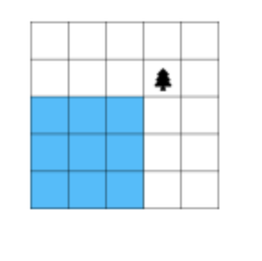
J5: Square Pool
If there is only one tree, then the largest pool must be at one of corners

Slide 21
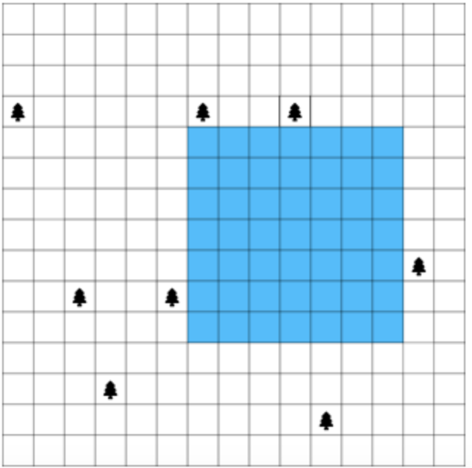
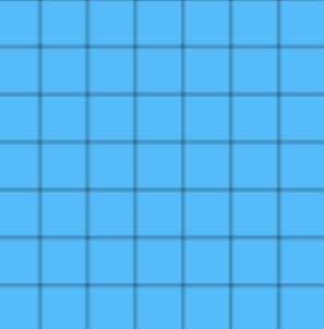
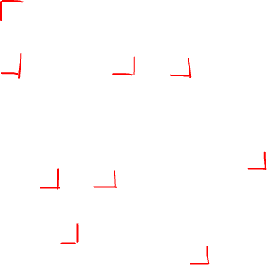
Use the location of trees to determine where the pool could potentially start at
Have a list of locations that the pool can begin at in terms of x and y
Make the pool as large as possible at first, then gradually reduce the size

Slide 22
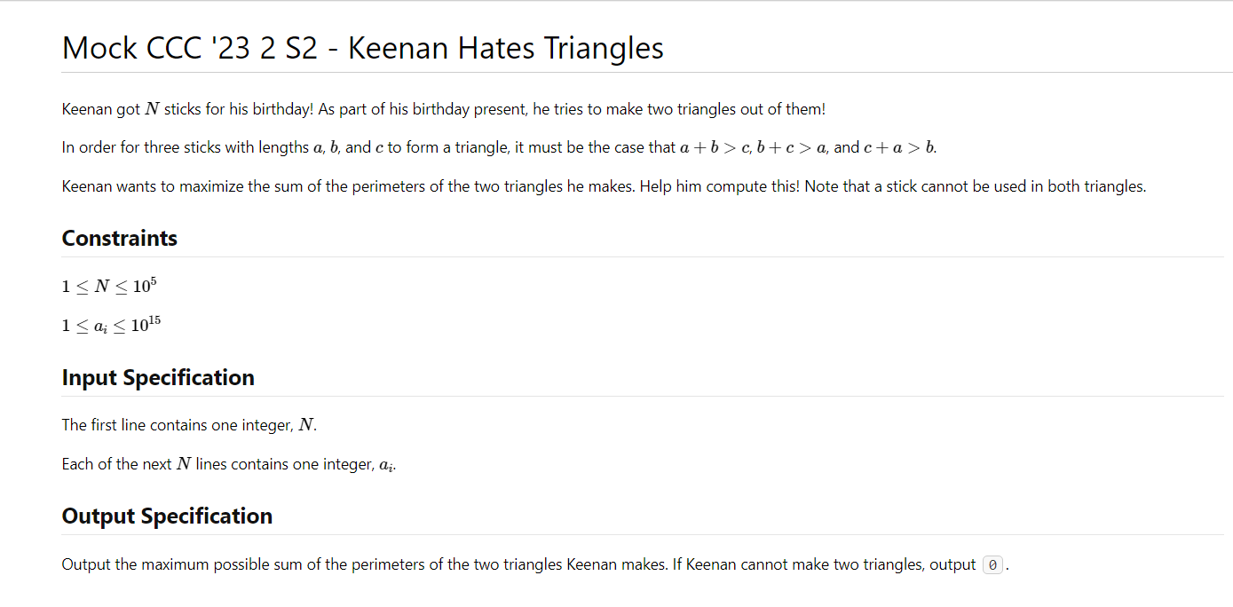

Slide 23
Brute force: go through all combinations of possible triangles, i.e. pick three lengths every time
Optimization: Sort!
What happens after sorting?

