Slide 1
Week 6

Slide 2
Problems and Subproblems
We can often describe a problem as a function
fib(n): the n’th Fibonacci number
Substituting a number for n, we get an instance of the problem
fib(5): the 5’th Fibonacci number
For every instance of the problem, we can find a solution for it, or declare that none exists
fib(5) = fib(4) + fib(3) = … = 5

Slide 3
Problems and Subproblems
For some instance of fib(n), we can reduce it to smaller subproblems (another smaller instance of the same problem)
fib(n) = 0 when n = 0
fib(n) = 1 when n = 1
fib(n-1) + fib(n-2) when n > 1
In this case, fib(3) and fib(4) are smaller subproblems we need to solve to get fib(5)

Slide 4
Problems and Subproblems
For our instance of fib(n), we first decompose it into two subproblems fib(n-1) and fib(n-2)
Given the solution to these subproblems
A := fib(n-1) and
B := fib(n-2)
We can combine them to generate our solution to fib(n)
fib(n) = A + B

Slide 5
Recursion
A problem is recursive if we can decompose it into smaller subproblems, solve the subproblems, then combine their solutions to obtain the final solution
Need a base case and a recursive case

Slide 6
Dynamic Programming
An algorithmic paradigm that solves a given complex problem by breaking it into subproblems using recursion AND storing the results of subproblems to avoid computing the same results again

Slide 7
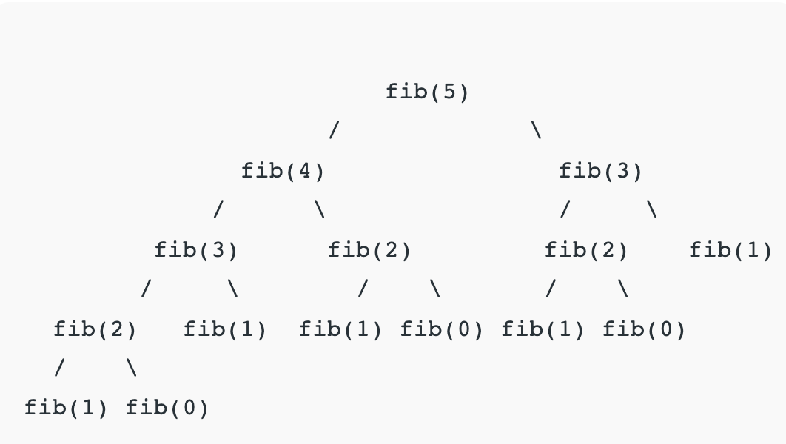

Slide 8
Memoization (Top Down)
Whenever we need a solution to a subproblem, look into a lookup table first
If the precomputed value is in the lookup table, then we return the value; otherwise, we calculate the value and save the result in the lookup table so it can be reused later

Slide 9
Tabulation (Bottom Up)
Builds a table in a bottom-up fashion and returns the last entry from the table
For the same Fibonacci number, we first calculate fib(0), then fib(1), then fib(2), and so on

Slide 10
Factorial
n! = 1 x 2 x … x n
5! = 120
How to reduce the above problem into subproblems?

Slide 11
Integer Exponentiation
a^{b} = a multiplied b times, assume a is fixed
If a = 2, a⁵ = 32
How to reduce the above problem into subproblems?

Slide 12
Binary Search
Problem: Given a sorted array arr[] of n elements, write a function to search a given element x in arr[] and return the index of x in the array
Input: arr[] = {10, 20, 30, 50, 60, 80, 110, 130, 140, 170}, x = 110
Output: 6
Naïve solution: linear search

Slide 13
Binary Search
A searching algorithm used in a sorted array by repeatedly dividing the search interval in half
Time Complexity: O(logn)

Slide 14
Binary Search Algorithm
Begin with the mid element of the whole array as a search key
If the value of the search key == x then return an index of the search key
Or if the value of the search key < x in the middle of the interval, narrow the interval to the lower half
Otherwise, narrow it to the upper half
Repeatedly check from the second point until the value is found or the interval is empty

Slide 15
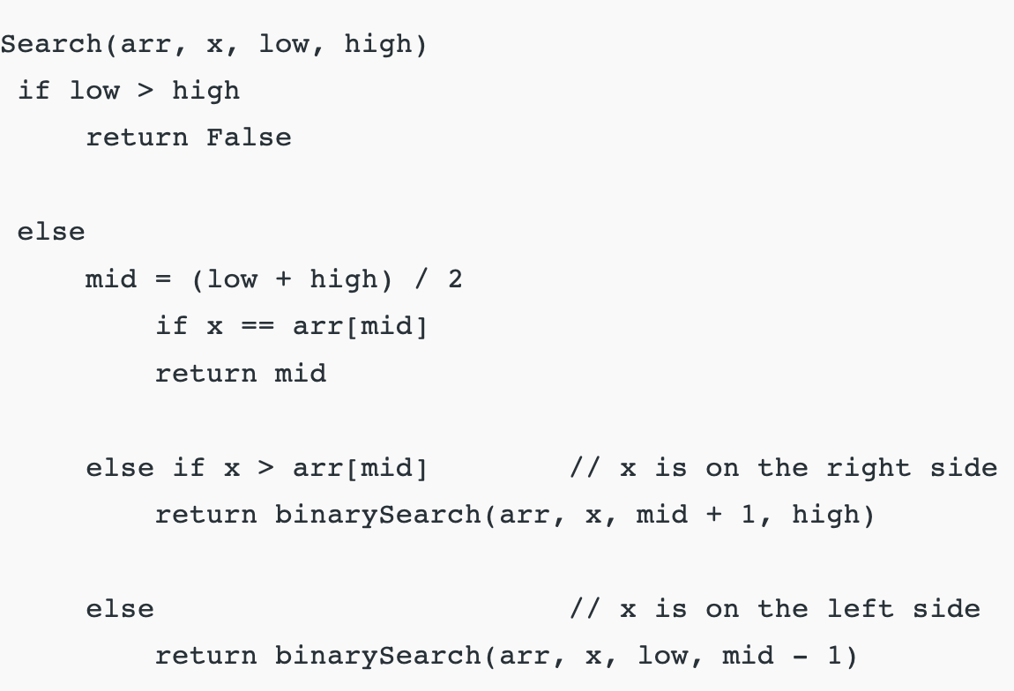
Binary Search Recursive

Slide 16
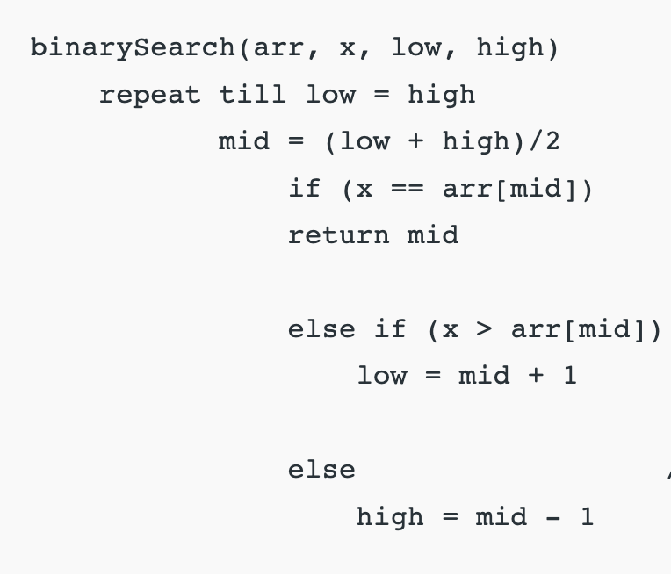
Binary Search Iterative

Slide 17
Longest Common Subsequence
Problem: Given two sequences, find the length of the longest subsequence present in both of them.
A subsequence is a sequence that appears in the same relative order, but not necessarily contiguous

Slide 18
Longest Common Subsequence
Example: ”abc”, “abg”, “bdf” are subsequences of “abcdefg”
LCS for input Sequences “ABCDGH” and “AEDFHR” is “ADH” of length 3
LCS for input Sequences “AGGTAB” and “GXTXAYB” is “GTAB” of length 4

Slide 19
Longest Common Subsequence
Naïve solution: generate all subsequences of both given sequences and find the longest matching subsequence

Slide 20
Longest Common Subsequence
Let the input sequences be X[0..m-1] and Y[0..n-1]
Define function LCS(X, Y) to return the length of the LCS of the two sequences X and Y
If X[m-1] == Y[n-1], last characters of both sequences match, then LCS(X[0..m-1], Y[0..n-1]) = 1 + LCS(X[0..m-2], Y[0..n-2])
If X[m-1] != Y[n-1], last characters of both sequences do not match, then LCS(X[0..m-1], Y[0..n-1]) = max(LCS(X[0..m-2], Y[0..n-1]), LCS(X[0..m-1], Y[0..n-2]))

Slide 21
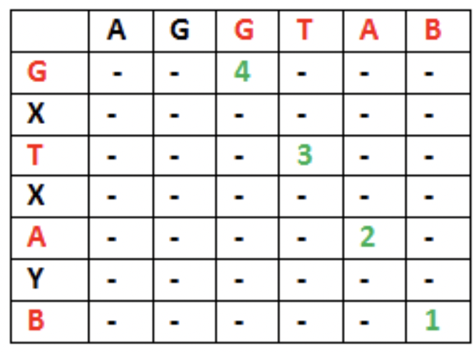
Longest Common Subsequence
Let X = “AGGTAB”, Y = “GXTXAYB”
LCS(“AGGTAB”, “GXTXAYB”) = 1 + LCS(“AGGTA”, “GXTXAY”)

Slide 22
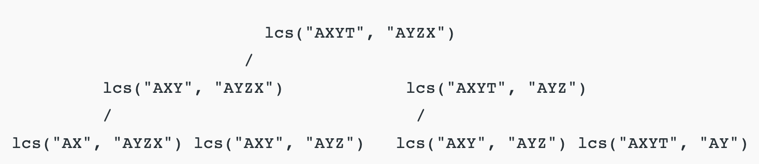

Slide 23
Longest Increasing Subsequence
Example: [10, 11, 1, 5, 3, 9, -1, 7, 25]
[1, 10, 11] is not a subsequence
[10, 11] is an increasing subsequence
[1, 3, 25] is the increasing subsequence
Longest increasing sequence(LIS)?
How to decompose LIS(A) into smaller subproblems?

Slide 24
Longest Increasing Subsequence
Example: A = [10, 11, 1, 5, 3, 9, -1, 7, 25]
If a₀ = 10
(keep 10) [10 LIS([11, 1, …])]
(don’t keep 10) LIS([11, 1, …])

Slide 25
Longest Increasing Subsequence
We can define the problem recursively as:
L(i) = 1 + max(L(j)) where 0 < j < i and A[j] < A[i]
Or L(i) = 1 if no such j exists
The length of the longest increasing subsequence ending at index i will be 1 greater than the maximum of lengths of all longest increasing subsequences ending at indices before i, if A[j] < A[i] for j < i

Slide 26
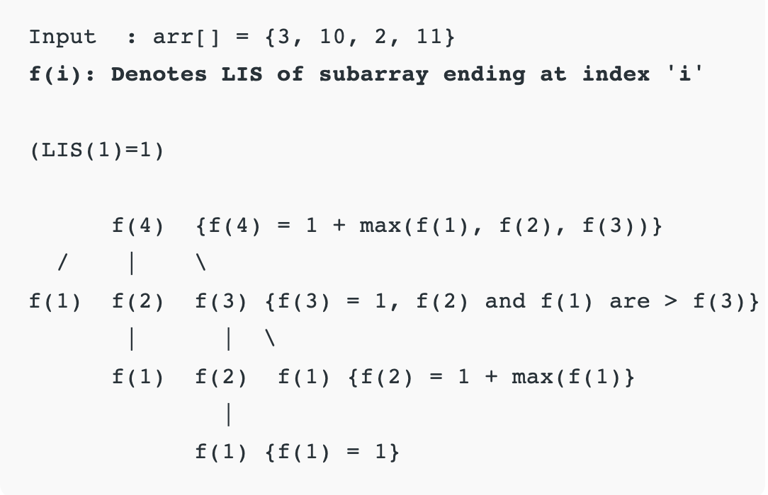

Slide 27
Time Complexity
Exponential, because there is a case of overlapping subproblems as shown in the recursive tree diagram

Slide 28
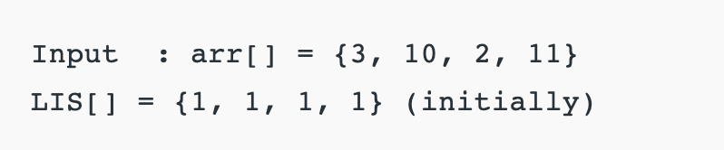
Tabulation
arr[2] > arr[1] {LIS[2] = max(LIS [2], LIS[1]+1)=2}
arr[3] < arr[1] {No change}
arr[3] < arr[2] {No change}
arr[4] > arr[1] {LIS[4] = max(LIS [4], LIS[1]+1)=2}
arr[4] > arr[2] {LIS[4] = max(LIS [4], LIS[2]+1)=3}
arr[4] > arr[3] {LIS[4] = max(LIS [4], LIS[3]+1)=3}

Slide 29
Big-O Complexity
Time: O(n^2), nested loop is used
Space: O(n), array for storing LIS values at each index

Slide 30
Homework
https://leetcode.com/problems/maximum-subarray/
https://leetcode.com/problems/longest-palindromic-substring/
https://leetcode.com/problems/longest-valid-parentheses/
For more practice, search for DP problems on LeetCode

