Slide 1

Week 8

Slide 2
Data Structures
Something that stores data in a structured way
Examples of data: nodes in a graph, numbers, strings
Make data retrieval (query) more efficient
Data structures are designed to be problem dependent
There is no data structure that solves all problems efficiently

Slide 3
Data Structures
For every data structure, we wish to provide a list of “interfaces” to the users
We call these operations of the data structure
Array: access and element and assignment, sorting
Stack: push(x), pop()
Dictionary: get(k), set(k, v)
Priority Queue (heapq): push(x)/heappush(x), extractMin/heappop()

Slide 4
Prefix Sum
Suppose I need to support 2 operations:
SET(i, val): sets element i to val
SUM(l, r): returns the sum of lth – rth elements
How would I get the value of the ith element?
How would I get the range sum from l to r?

Slide 5
Implement with arrays
Let A be an array of length n. Implement Set and Sum using A_{i} where A[i] stores the ith element
Set(i, val): A[i] = val O(1)
Sum(l, r): sum = 0
for i = l, …, r
sum = sum+A[i]
return sum O(n)

Slide 6
Implement with Prefix Sum Arrays
Let A be the elements, let B be a length of n array where
B[i] = A[0] + A[1] + … A[i]
Sum(l, r): return B[r] – B[l] O(1)
Set(i, val): A = [1, 2, 3, 4, 5]
B = [1, 3, 6, 10, 15] O(n)
Set(3, 10)?

Slide 7
Comparing the Costs
 | Set | Sum
Array | O(1) | O(n)
Prefix Sum Array | O(n) | O(1)
Segment Tree | O(log(n)) | O(log(n))
Use prefix sum array if Sum is used much more frequently than Set

Slide 8
Tree
A tree is a non-linear and hierarchical data structure consisting of a collection of nodes such that each node of the trees stores a value and a list of references to other nodes (the “children)
Recursive Definition: A tree consists of a root, and zero or more subtrees T1, T2, …, Tk such that there is an edge from the root of the tree to the root of each subtree
Depth: the number of edges from the node to the tree’s root node
Height: the number of edges on the longest path from the node to a leaf
Notes:
Baron

Slide 9
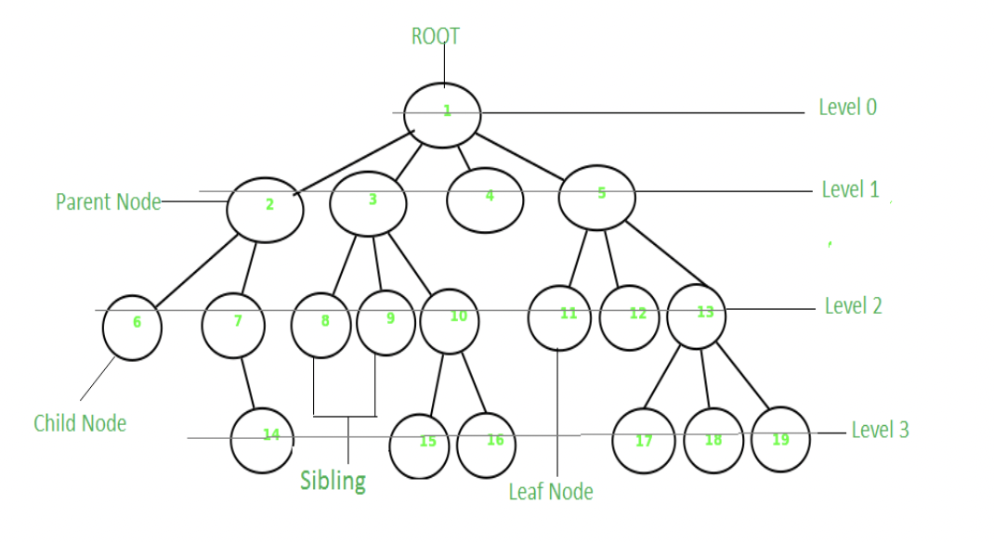

Slide 10
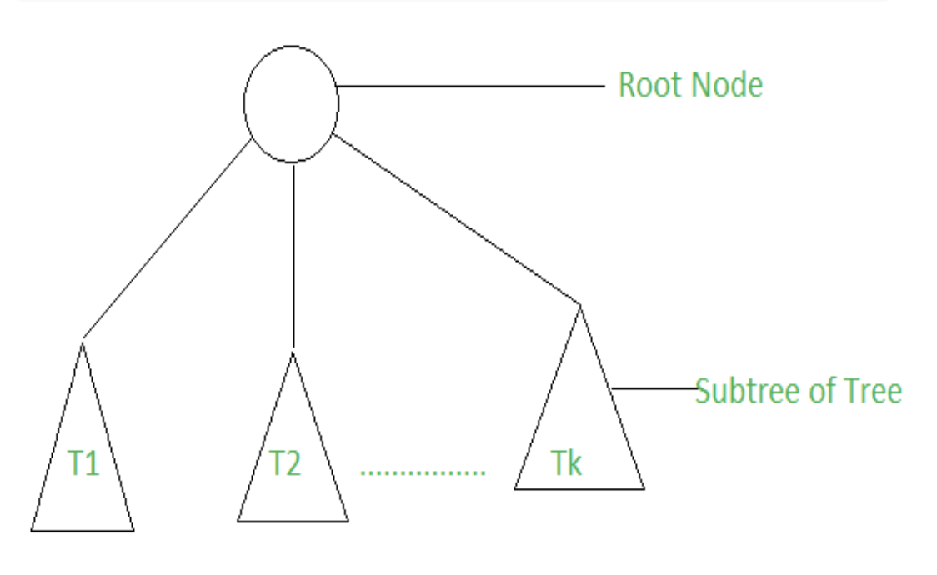

Slide 11
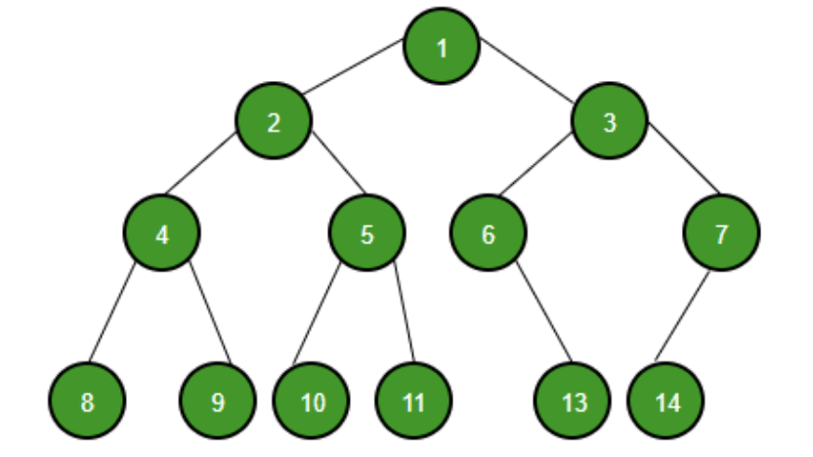
Binary Tree
A tree data structure with at most 2 children, a special type of segment tree
Since each element in a binary tree can have only 2 children, we typically name them the left and right child

Slide 12
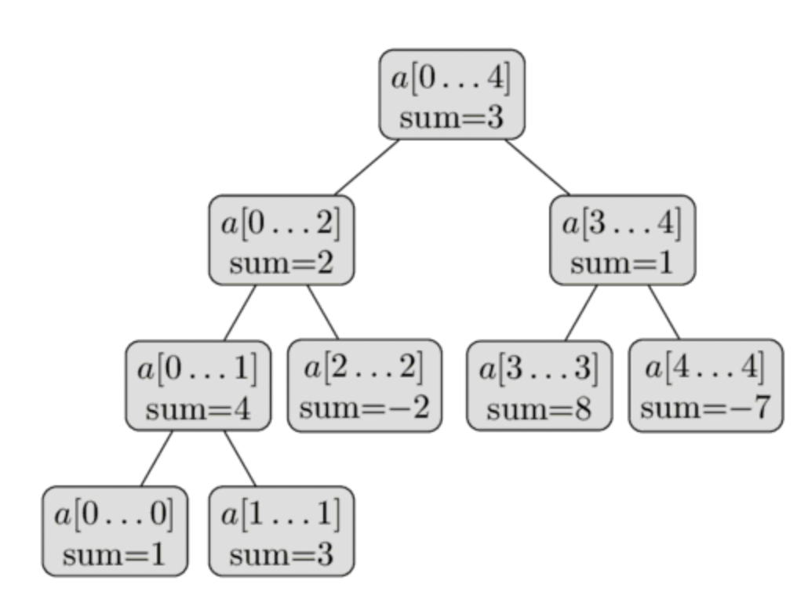
Implement using Binary Trees
Organize an interval as a binary tree
A = [1, 3, -2, 8, -7]
Whenever n is not a power of two, not all levels of the binary tree will be completely filled
The height of the binary tree is O(logn), because when going down from the root to the leaves, the size of the segments decreases approximately by half

Slide 13
Implementation
We could create a node object and let it store sum, left node, and right node
However, since we are only interested in the sums, we will use an array to store the sums
The sum of the root vertex is at 1, the sum of its two child vertices at indices 2 and 3, the sum of the children of those two vertices at indices 4 to 7, and so on
In other words, we want the left child of a vertex at index i to be stored at 2i, and the right on at 2i+1

Slide 14
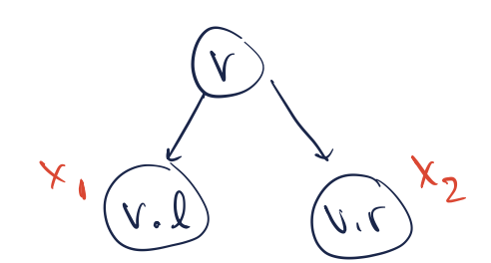
Updating the Binary Tree
Set new value at the leaf node
Propagate sums up the tree, stop at the root
The value of v = x1+x2, and each propagation step takes O(1)
Since the height of the tree <= log(n), we need at most log(n) propagations
The time complexity is O(logn)

Slide 15
Implementation
Descend to node responsible for index i and update its value
Set(node, i, x):
if node has a single element: update value to x and return
if i is in left half: Set(node.left, i, x)
else: Set(node.right, i, x)
node.value = node.left.value + node.right.value

Slide 16
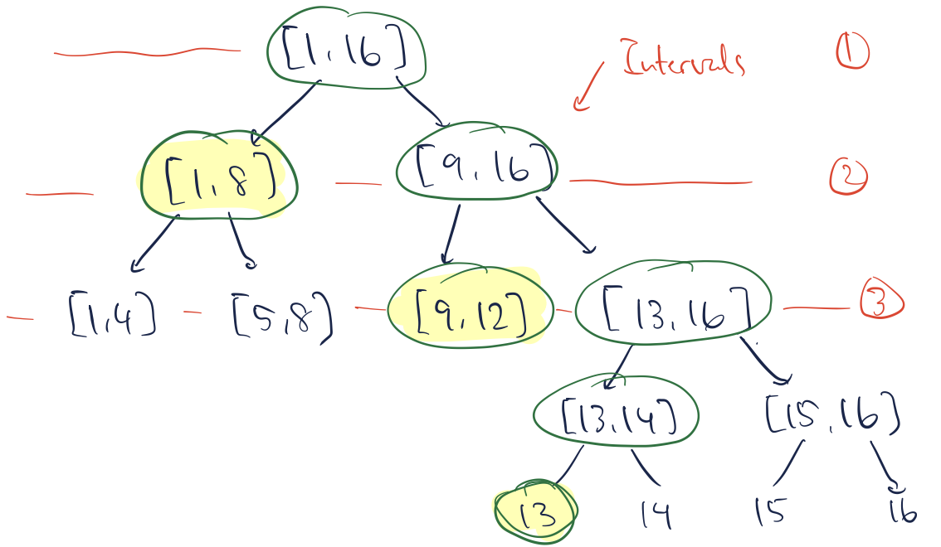
Querying from the Binary Tree
How to compute Sum(13)? Assuming n = 16
Sum(13) = [1, 13] = [1, 8] + [9, 12] + [13]
Since the height of the tree <= log(n), we can descend at most log(n) times
Touch <= 2 vertices in each level
Time complexity: O(logn)

Slide 17
Implementation
Sum(node, l, r):
if l == node.left && r == node.right : return node.value
if i covers only left half:
return Sum(node.left, left, right)
if i covers exactly the left half:
return node.left.value
if i also covers part of the right half:
return node.left.value + Sum(node.right, mid, right)

Slide 18
Generalizing to other operations
Suppose we replace the sum(+) operation with one of the following:
Find the maximum in the range of [l, r]
and the number of times it appears
Find the minimum in the range of [l, r]
Find the product in the range of [l, r]
Find the gcd/lcm in the range of [l, r]
Counting the number of zeros, searching for the k-th zero
Which part would you update?
What operations would segment trees support?
Notes:
https://cp-algorithms.com/data_structures/segment_tree.html#implicit-segment-tree

Slide 19
Homework
https://dmoj.ca/problem/segtree
https://cses.fi/problemset/task/1735
https://cses.fi/problemset/task/1143
https://cses.fi/problemset/task/1736

