Slide 1

Week 9

Slide 2
What are bits?
Computers store everything as a stream of binary digits called bits, everything will be converted to ones and zeros
For example, the number 5 can be represented as 0101 in bit representation
We can use bitwise operators to manipulate individual bits of data
Bits grow from right to left, starting at the least-significant bit (rightmost bit), which determines if the number is even or odd

Slide 3
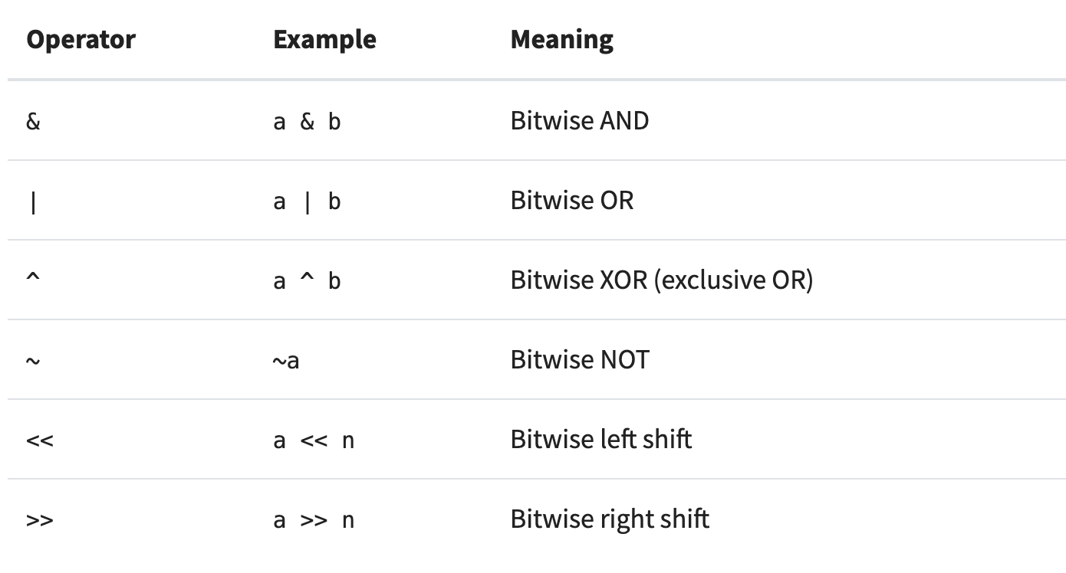
Bitwise operators

Slide 4
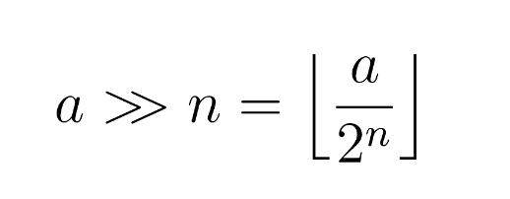
Bitwise right shift
Bitwise right shift by 1 is the same as floor division by 2
Using bitwise right shift is a common way of improving the performance of some arithmetic divisions

Slide 5
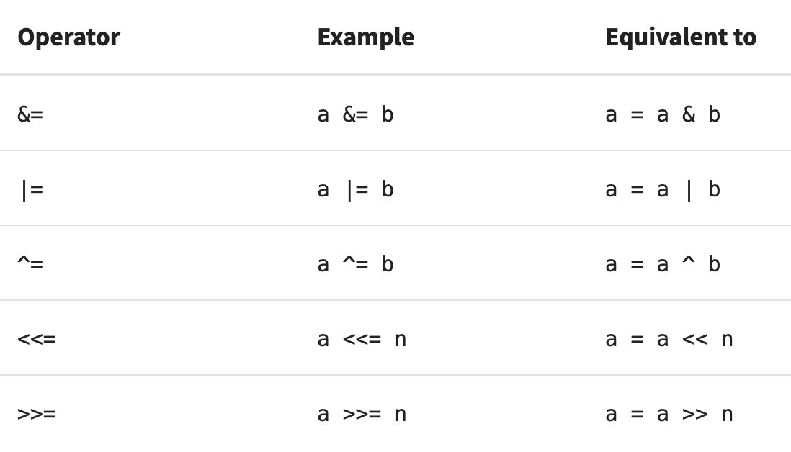
Compound bitwise operators

Slide 6
Bitmasks
Lets you isolate the bits to apply some function on them selectively
Bitmasking usually involves bitwise logical operators and bitwise shift operators

Slide 7
Clear all bits from LSB to the ith bit
Logic: Given a number n, we want to AND n with a bitmask that has LSB to the ith bit 0
To obtain such mask, first left shift 1 i times
If we minus 1 from that, all the bits from 0 to i-1 become 1 and remaining bits become 0
Now we can take the complement of the mask to get all first i bits to 0 and remaining to 1

Slide 8
Dynamic programming and bitmasking
Problem: Given a set, count how many subsets have sum of elements greater than or equal to a given value
Idea: iterate over every possible subset and check the value
Consider the set A = {1, 2, 3, 4, 5}, we can represent a subset A using 5 bits, where 0 means element is not in the set, and 1 means element is in the set
i.e. 01010 represents the subset {2, 4}

Slide 9
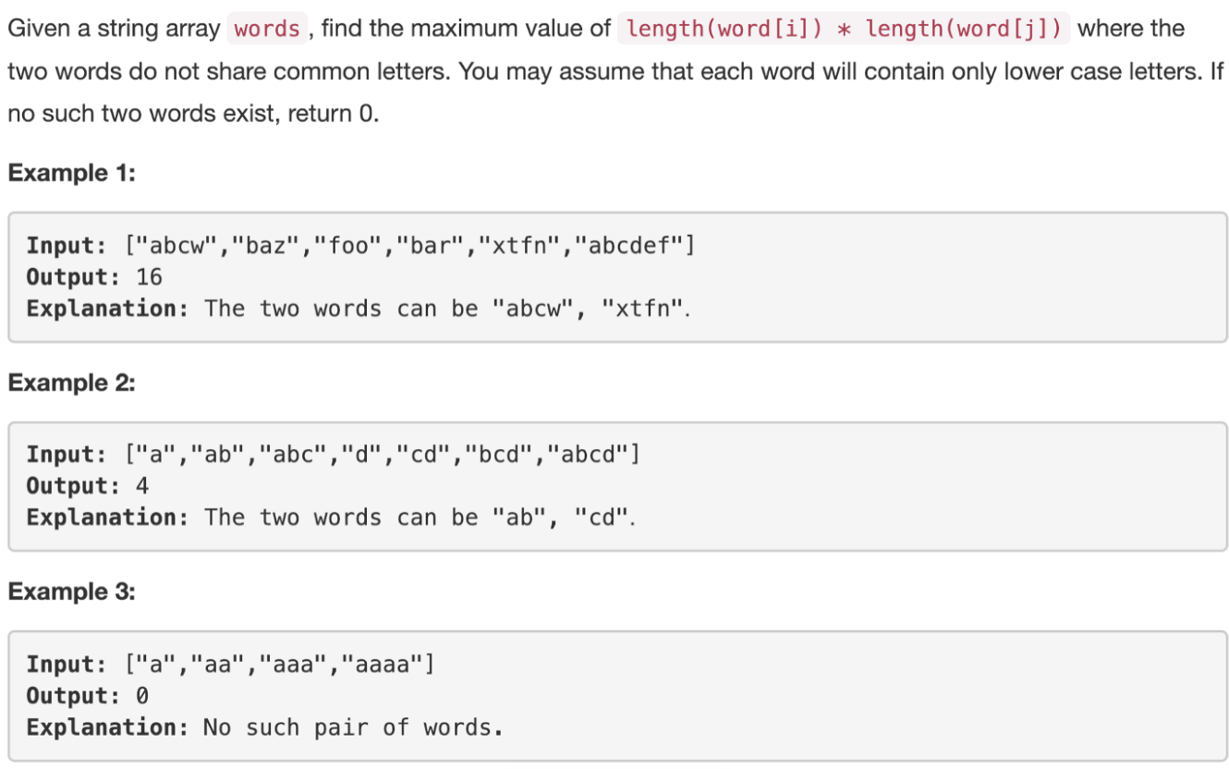
https://leetcode.com/problems/maximum-product-of-word-lengths/

Slide 10
Maximum product of word lengths
Brute force way: check all pairs of words and for each pair, check if there are any common characters between them
for all pairs that do not share common characters, record the maximum value of len(word1) * len(word2)
We always have to check every pair of words, but we can optimize how we check whether two words have any common characters or not

Slide 11
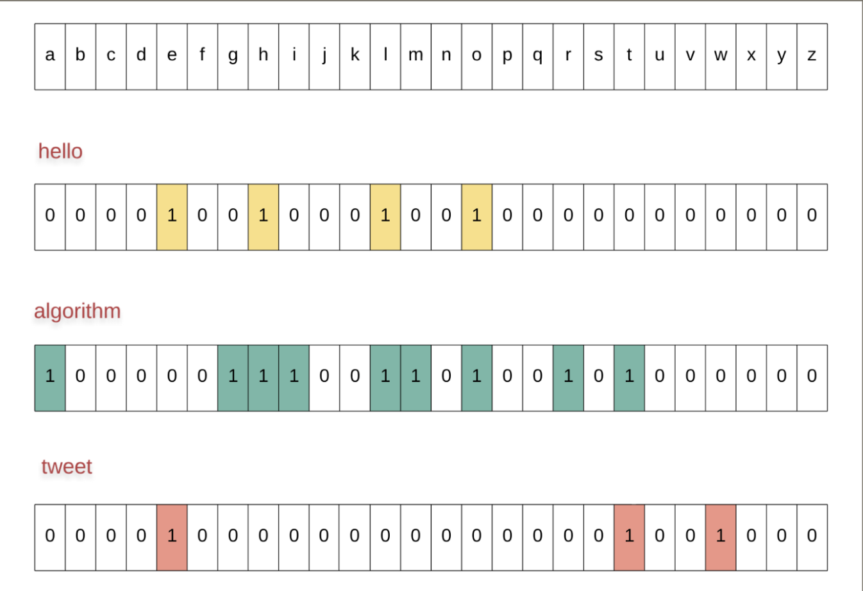
Use a bitwise AND on the two words’ bit representation
If we get a 0, then the two words have no common characters

Slide 12
More Optimization
Two different words can have the same bitmask
i.e. hello and llohhel have the same mask, but we will always pick the latter one to possibly include it in the final max product calculation
Idea: store the longest word for a given bitmask

Slide 13
Pseudocode

