Slide 1

Week 3

Slide 2
Adjacency List
Used to represent a graph as an array of linked lists
The index of the array represents a vertex and each element in its linked list represents the other vertices that form an edge with the vertex

Slide 3
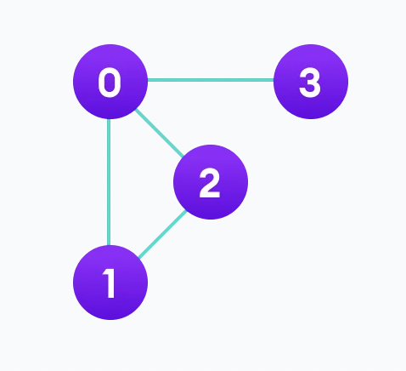
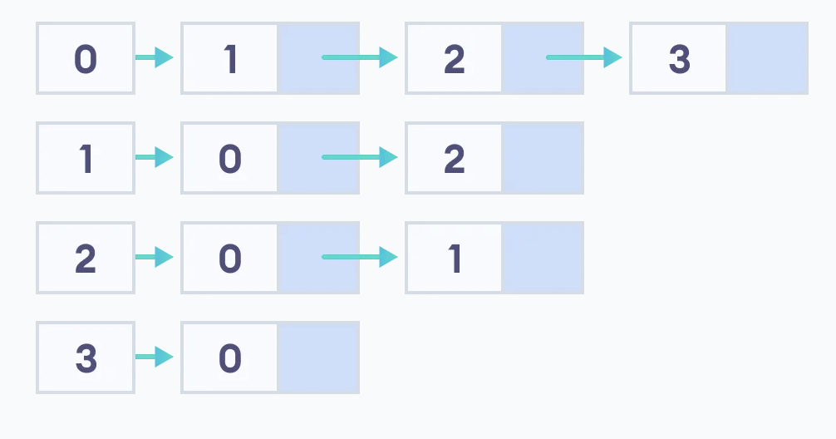

Slide 4
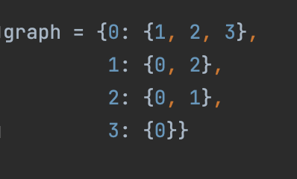

Slide 5
Adjacency Matrix
Used to represent a graph as a matrix of booleans
A finite graph can be represented in the form of a square matrix, where the boolean value of the matrix indicates if there is a direct path between two vertices
Matrix: a rectangular array or tables of numbers, symbols, or expressions, arranged in rows and columns

Slide 6
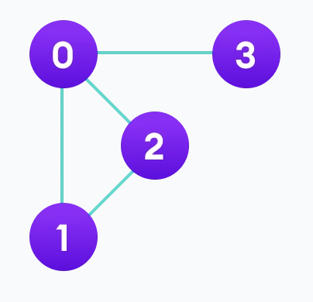
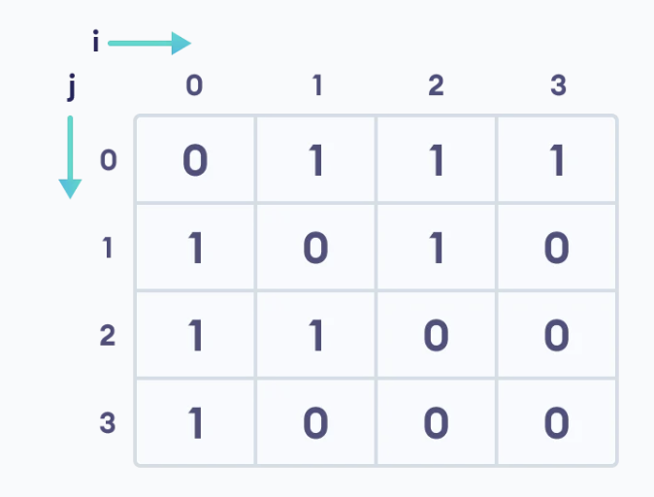

Slide 7
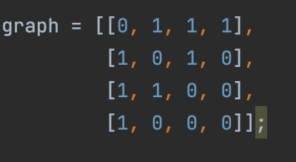

Slide 8
Bipartite Graph
A graph whose vertices can be divided into two independent sets, U and V, such that every edge (u, v) either connects a vertex from U to V or a vertex from V to U
For every edge (u, v), either u belongs to U and v to V, or u belongs to V and v to U
No edge connects vertices of the same set

Slide 9
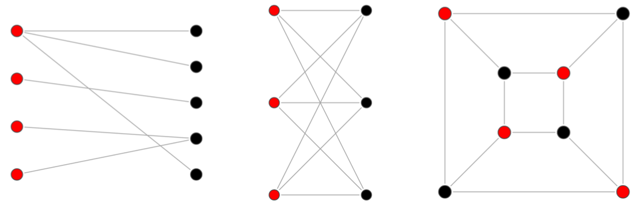

Slide 10
Examples
Give examples of (or show that it is impossible):
A cyclic, bipartite graph
A cyclic, non-bipartite graph
An acyclic, bipartite graph
An acyclic, non-bipartite graph

Slide 11
Bi-coloring Problem
Decide if one can assign colors (from a palette of two) to the nodes in such a way that no two adjacent nodes have the same color
No self-loop (no node will have an edge to itself)
Graph is nondirected
Graph is strongly connected, there will be at least one path from any node to any other node

Slide 12
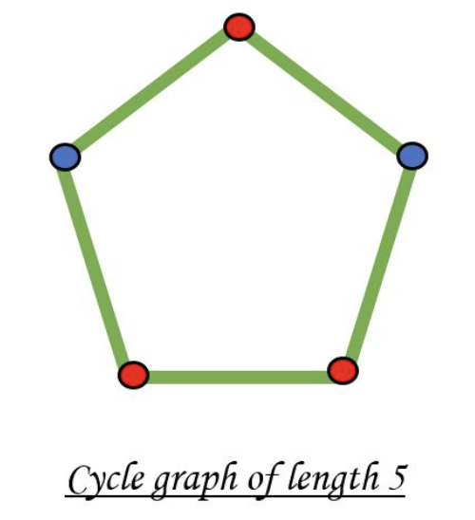
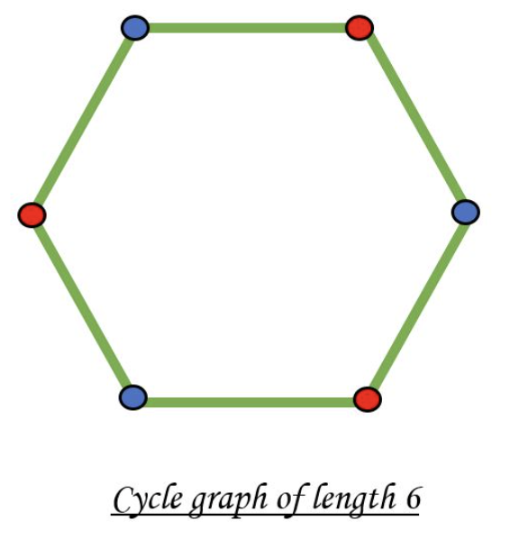
Bi-coloring Problem
A graph is bipartite if it is two-colourable
Even cycle vs. odd cycle

Slide 13
Algorithm 1
Assign RED colour to the source vertex (putting a node into set U)
Color all neighbours with BLUE (putting nodes into set V)
Color all neighbours’ neighbours with RED (putting nodes into set U)
Repeat step 3 until all nodes are visited
While assigning colours, if we find a neighbour which is coloured with the same colour as the current vertex, then the graph is not bi-colourable/bipartite

Slide 14
Big-O Complexity
Time complexity: O(V*V) using adjacency matrix, O(V+E) using adjacency list
Space complexity: O(V) for queue and colour_arr

Slide 15
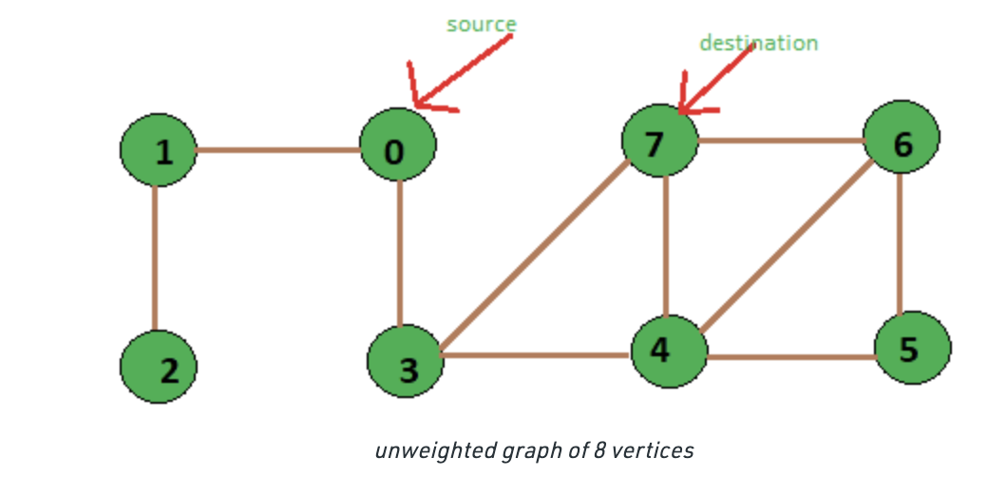
Shortest Path (Unweighted Graph)
Find the shortest path from source -> destination

Slide 16
Shortest Path (Unweighted Graph)
If v is reachable from u, then u is a predecessor of v and v is a successor of u
If there is an edge from u to v, then u is a direct predecessor of v and v is a direct successor of u

Slide 17
Shortest Path (Unweighted Graph)
Idea: use a modified version of BFS in which we keep storing the predecessor of a given vertex while doing BFS

Slide 18
Shortest Path (Unweighted Graph)
Initialize an array dist[] such that dist[i] stores the distance of vertex i from the source vertex
Initialize an array pred[] such that pred[i] stores the direct predecessor of vertex i
Length of the path from source to any other vertex: dist[i]
Printing the path: pred[i], pred[pred[i]], …

Slide 19
Big-O Complexity
Time: O(V+E)
Space: O(V)

Slide 20
Homework
https://dmoj.ca/problem/ccc10j5

Slide 21
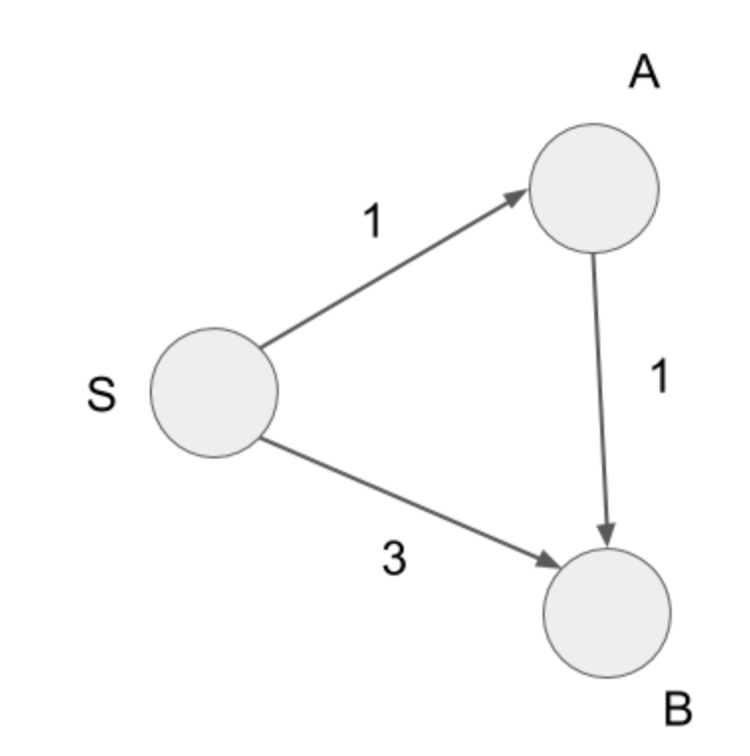
Shortest Path (Weighted Graph)
Weighted graph: a graph where each edge is given a numerical weight (cost); a special type of labeled graph in which all labels are numbers
Notes:
Find shortest path from S -> B

Slide 22
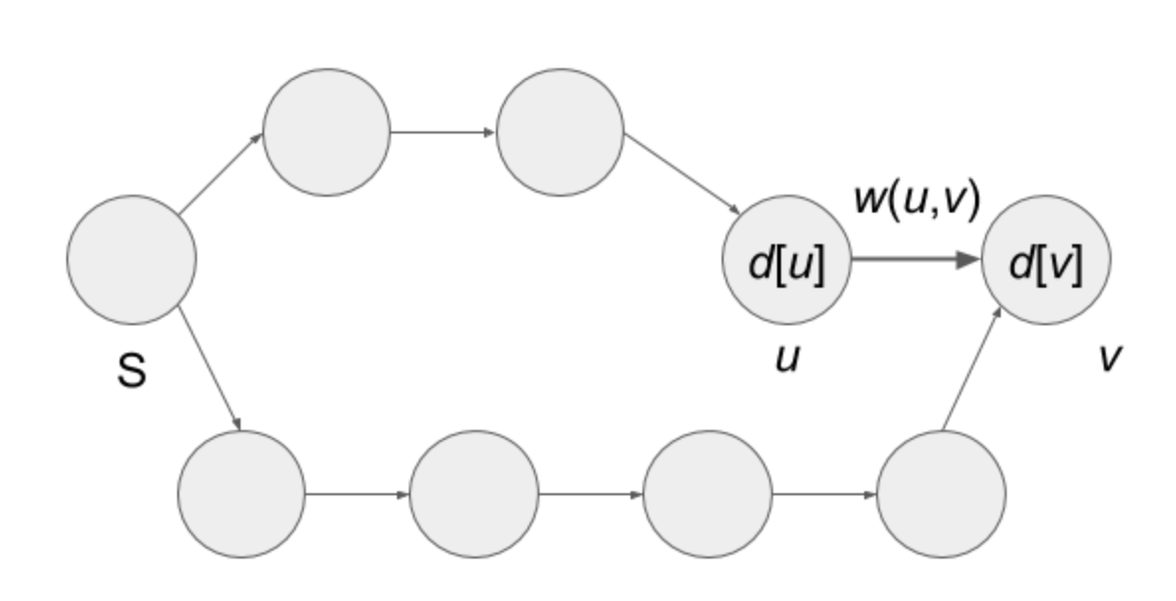
Edge Relaxation
For the edge from vertex u to vertex v,
if dist[u] + weight(u, v) < dist[v] is satisfied,
Update dist[v] to dist[u] + weight(u, v)

Slide 23
Edge Relaxation
Updates the current reaching cost dist[v] to a lower reaching cost dist[u]+weight(u, v)
Idea: repeatedly use edge relaxation will solve the shortest paths problem

Slide 24
Dijkstra’s Algorithm
Satisfies any subpath B->D of the shortest path A->D is also the shortest path of B->D
Greedy algorithm: find the next best solution, hoping that the end result is the best solution for the whole problem

Slide 25
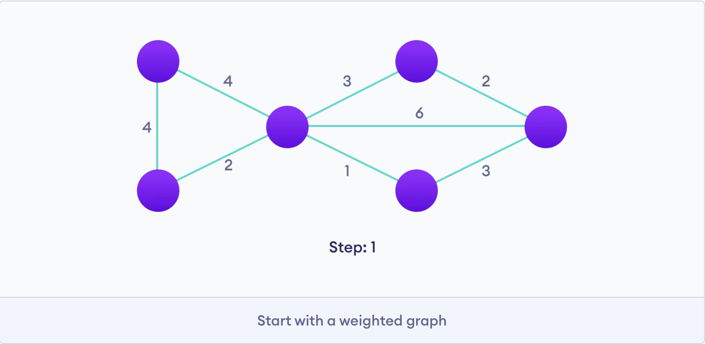
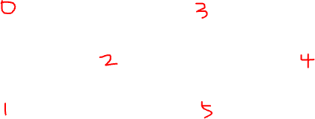

Slide 26
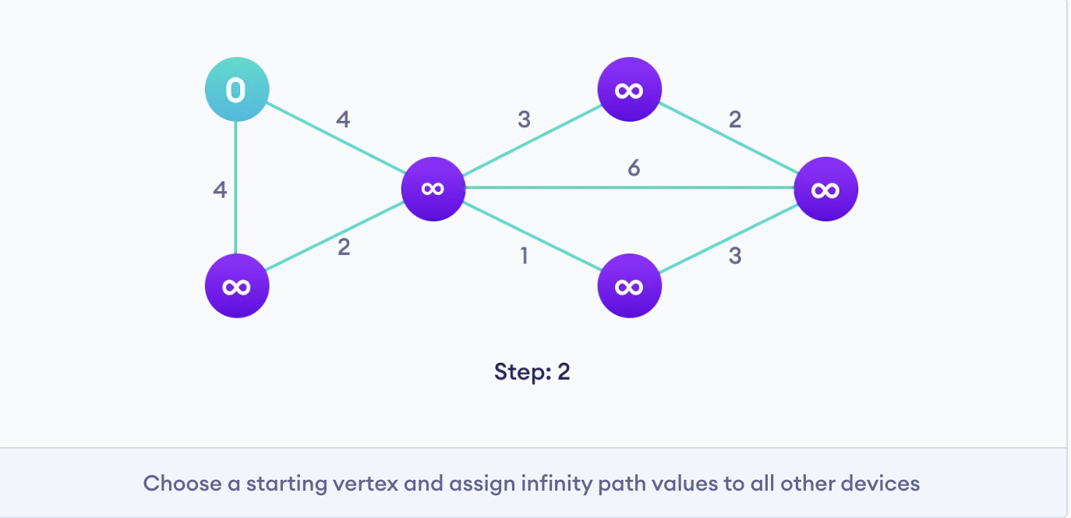

Slide 27
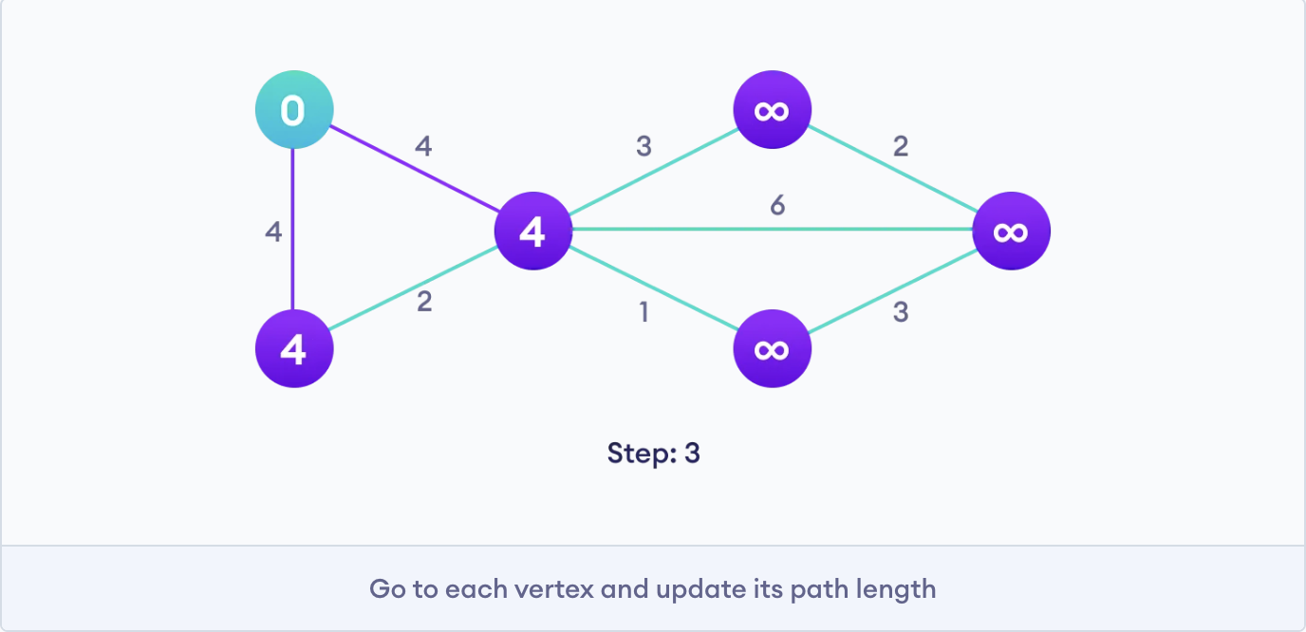

Slide 28
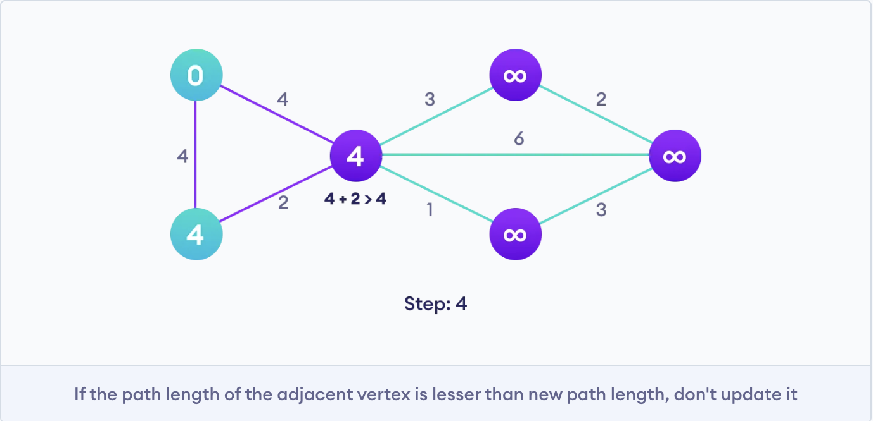

Slide 29
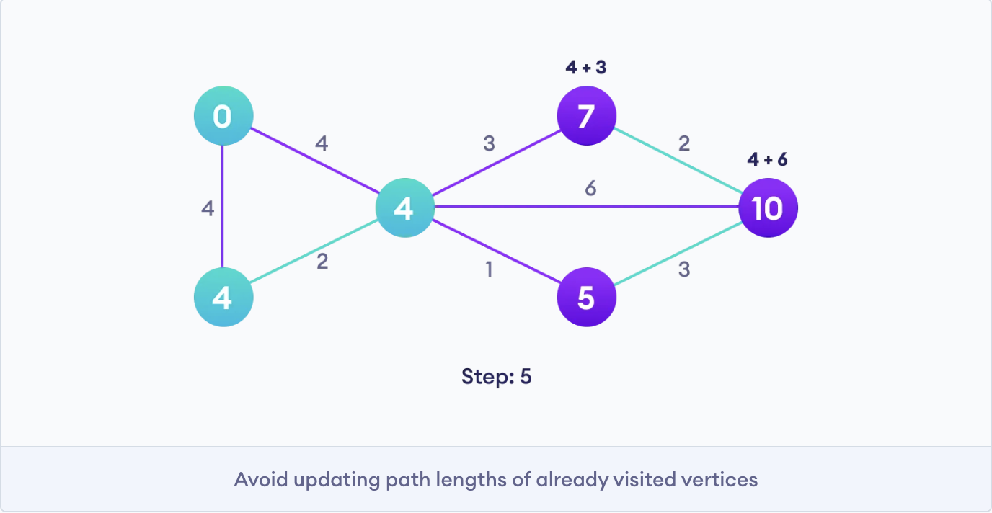

Slide 30
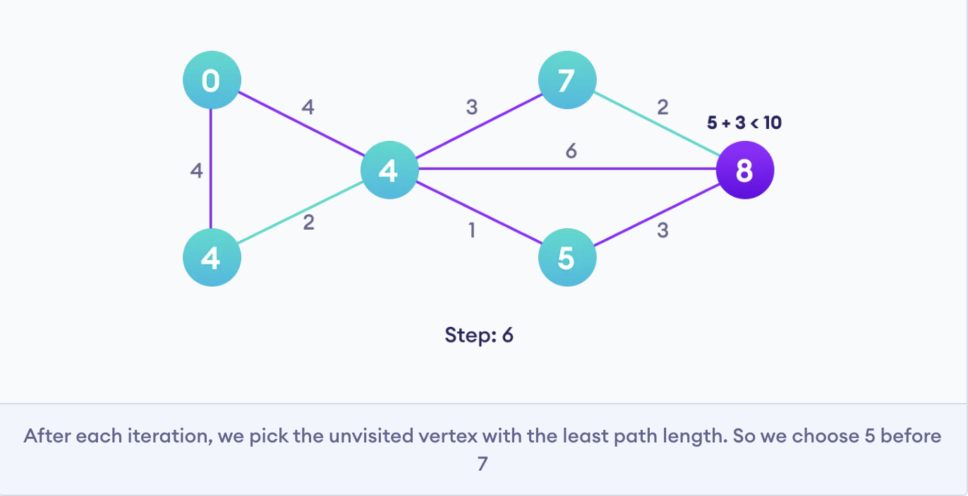

Slide 31
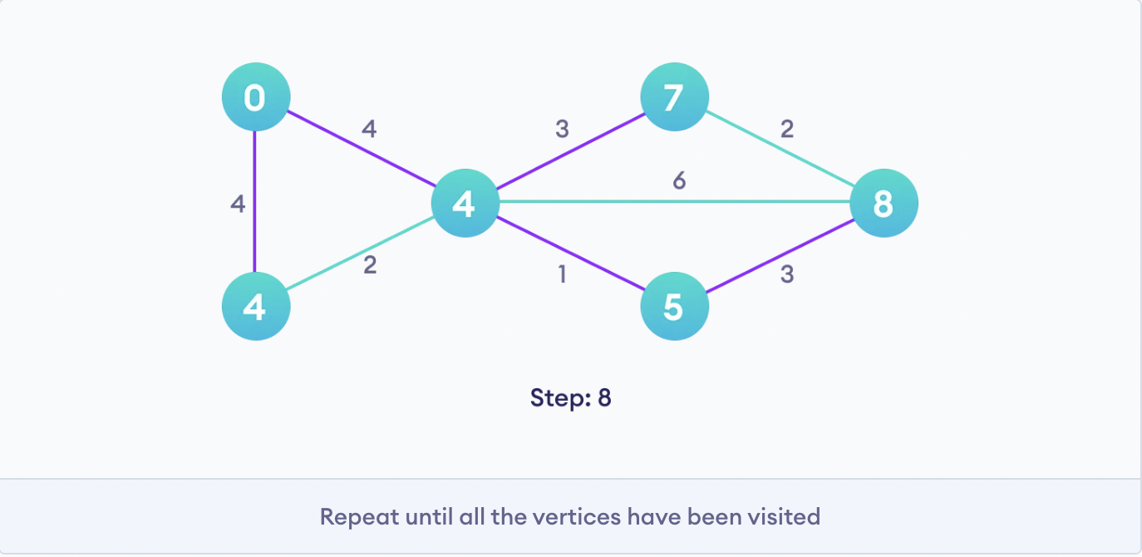

Slide 32
Dijkstra’s Algorithm (adjacency matrix)
Repeat the following steps until all vertices are processed
pick a vertex u which is not visited and has minimum distance from the source
mark u as visited
loop over all neighbours of u
for each neighbour v of u, if v is not visited and dist[v] > dist[u] + weight(u, v), then update distance[v] = dist[u] + weight(u, v) and set prev[v] = u

Slide 33
Big-O Complexity
Time: O(V^2)
O(V) -> iterate through all vertices and mark them as visited
O(V) -> each time selecting a vertex with minimum distance
Space: O(V)

Slide 34
Priority Queue (heapq)
An abstract data structure where each data/value in the queue has a certain priority
An element with high priority is dequeued before an element with low priority
If two elements have the same priority, they are served according to their order in the queue

Slide 35
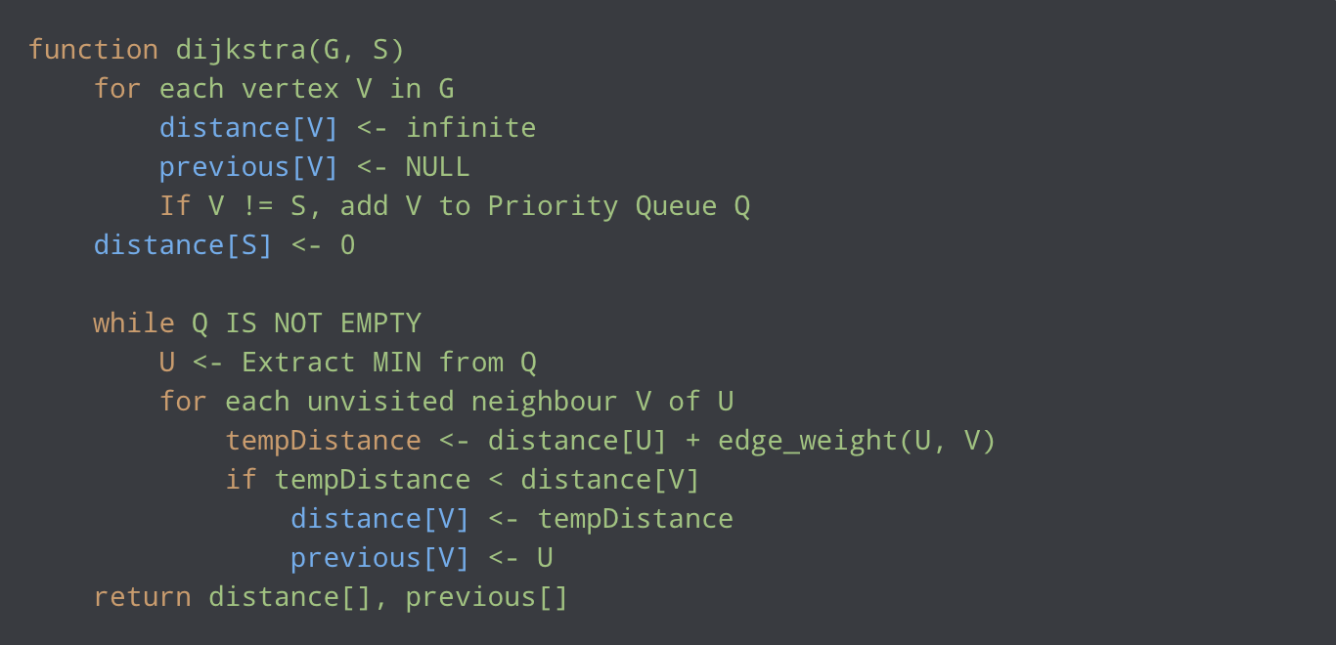
Dijkstra’s Algorithm (adjacency list)

Slide 36
Big-O Complexity
Time Complexity: heappop and heappush both take O(logn) time, so the overall time complexity is O((E+V)logV)
Space Complexity: O(V)

Slide 37
Homework
https://dmoj.ca/problem/sssp

