Slide 1

Rpg game

Slide 2
Java Map Interface
Elements of Map are stored in key/value pairs
Keys are unique values associated with individual Values
A map cannot contain duplicate keys, and each key is associated with a single value
A map is an interface, we cannot create objects from it, so we need concrete classes like HashMap to use functionalities inside Map

Slide 3
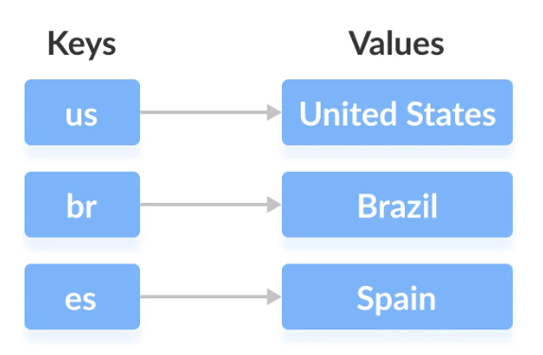
Java Map Interface
We can access values in the diagram via their corresponding keys
The map interface maintains 3 sets:
The set of keys
The set of values
The set of key/value associations (mapping)

