Slide 1

Week 1

Slide 2
What is an algorithm?
A set of well-defined instructions to solve a particular problem
Takes a set of input and produces the desired output
Example: an algorithm to add two numbers
Take two numbers as input
Add numbers using the + operator
Display the result

Slide 3
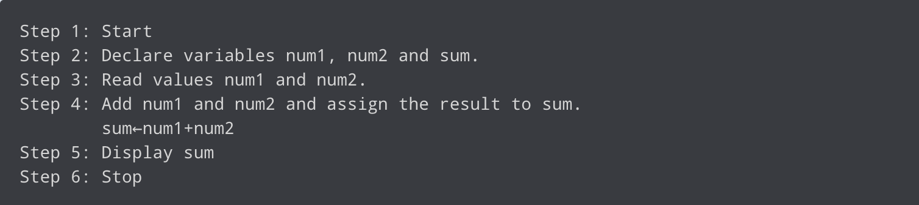
What is Pseudocode?
An artificial and informal language that helps programmers develop algorithms
A text-based algorithmic design tool
Example: add two numbers entered by user

Slide 4
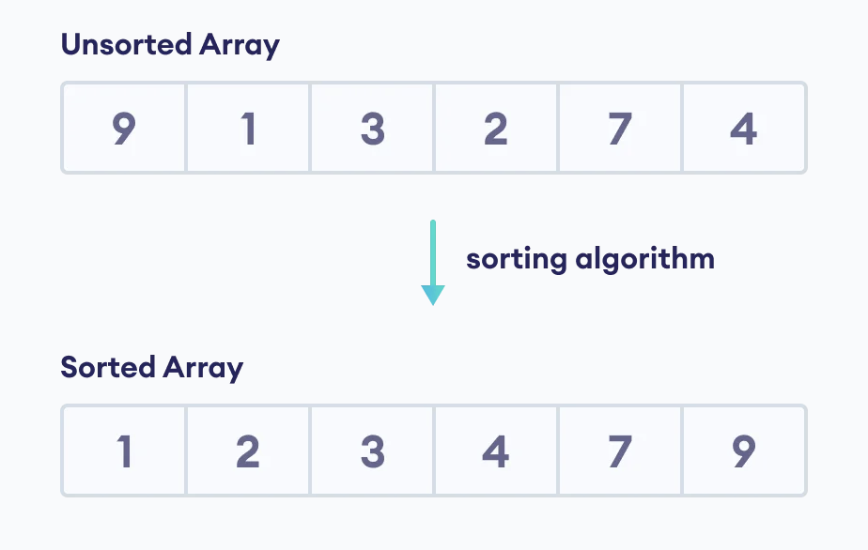
Sorting Algorithms
Used to rearrange elements of an array/list in a specific order (i.e. ascending/descending)
Many sorting algorithms are comparison based: by using a comparison operation (i.e. “less than equal to” operator <=) to determine which of two elements should occur first in the final sorted list

Slide 5
Counting Sort
A sorting algorithm that sorts the elements of an array by counting the number of occurrences of each unique element in the array

Slide 6
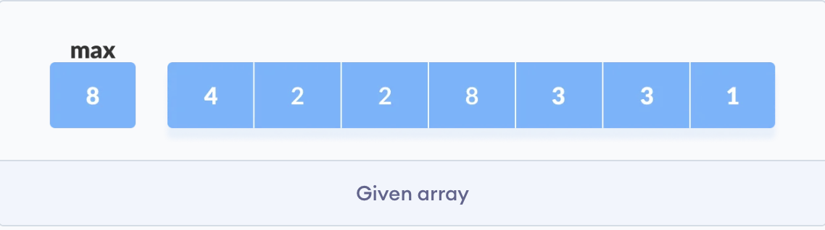
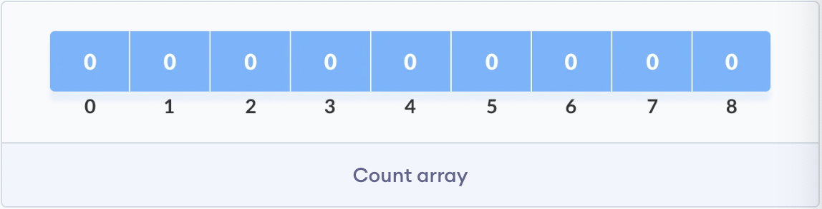
The length of the count array is max + 1

Slide 7
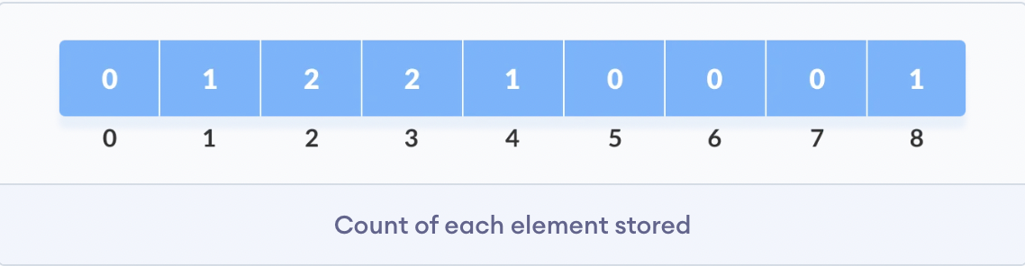

Slide 8
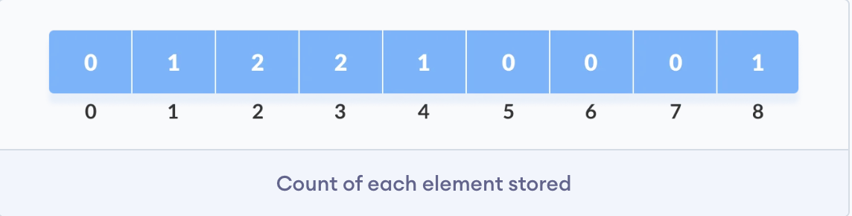
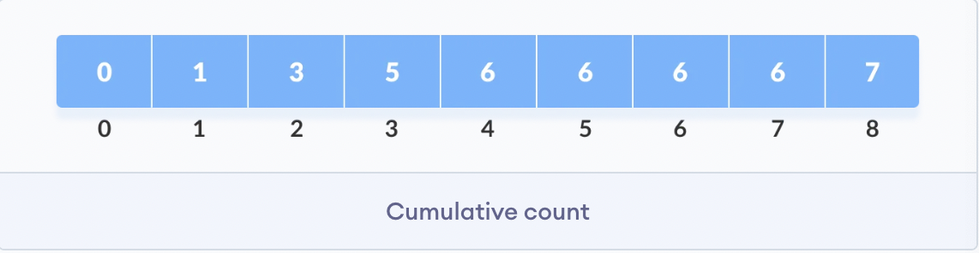

Slide 9
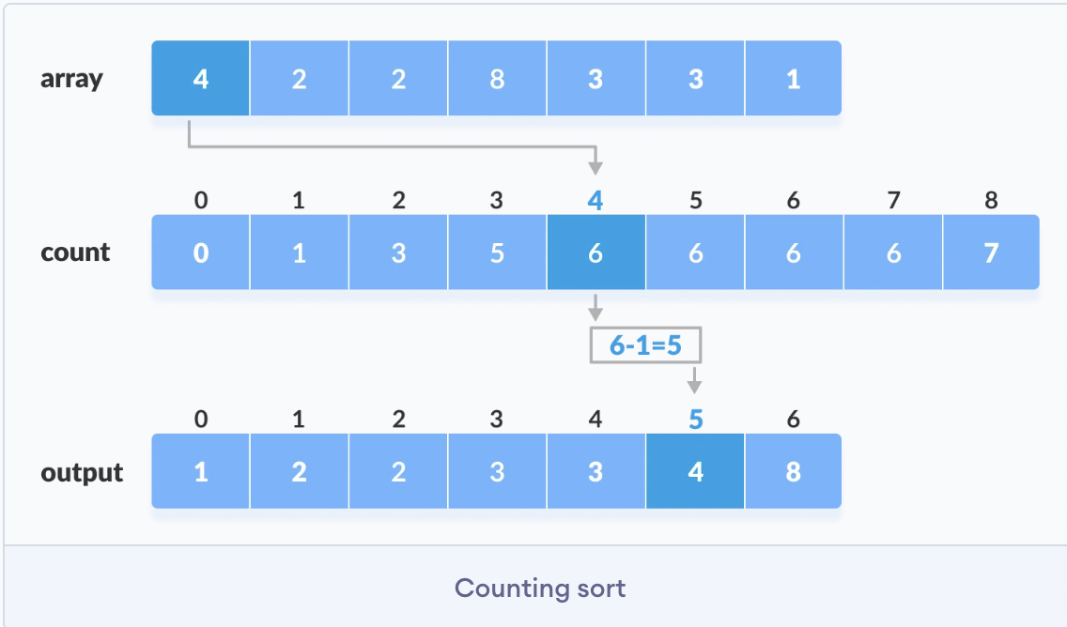
After placing each element at its correct position, decrease its count by one
Notes:
https://www.programiz.com/dsa/counting-sort

Slide 10
Let’s code Counting Sort…

Slide 11
Properties of Counting Sort
Runs in O(n) time, faster than comparison-based algorithms like quicksort or mergesort
Only works when the range of items in the input is known
Becomes inefficient when the range is too big, because the count array will take up too much space

Slide 12
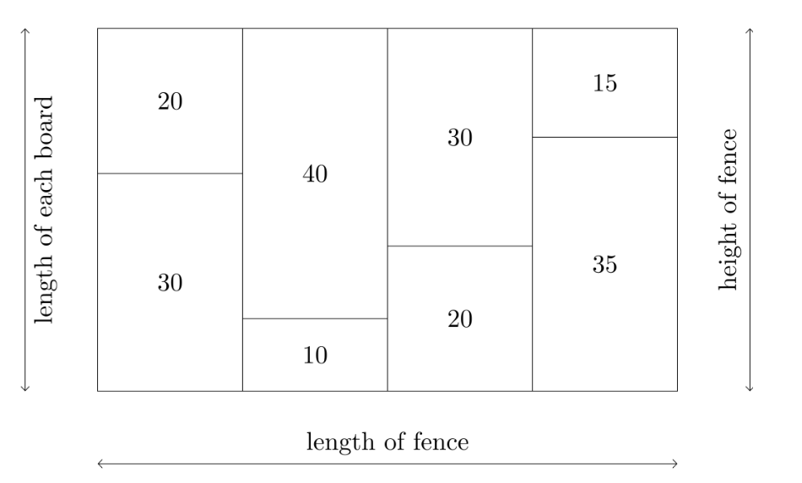
CCC 2017-S3 Nailed It!
Notes:
https://dmoj.ca/problem/ccc17s3

Slide 13
Some Insights
Each piece of wood can be in between 1 to 2000 units long, meaning boards can be between 2 to 4000 units long, fixed range
Have a board_count array that stores the number of occurrences of each board length
Looking for the longest fence, meaning we want to put as many boards of the same length together as possible

