Slide 1

Platformer Game

Slide 2
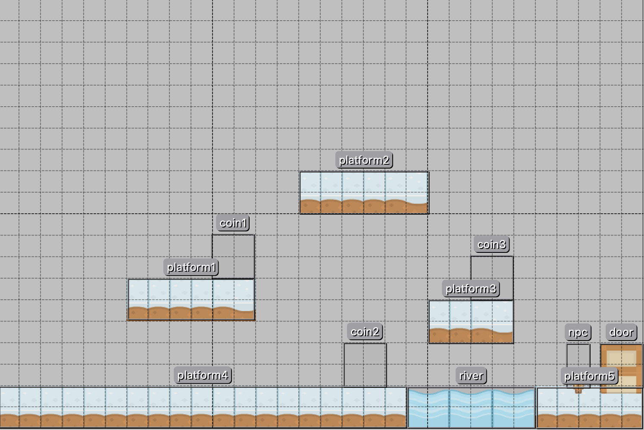
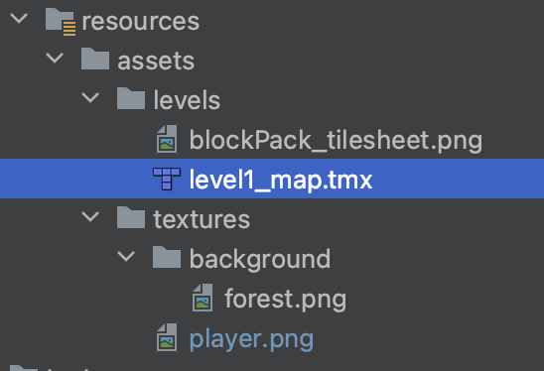
Tiled

Slide 3
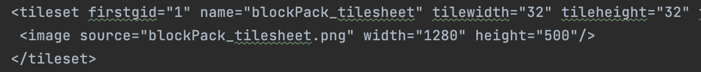
.tmx file
Must exist in your project directory

Slide 4
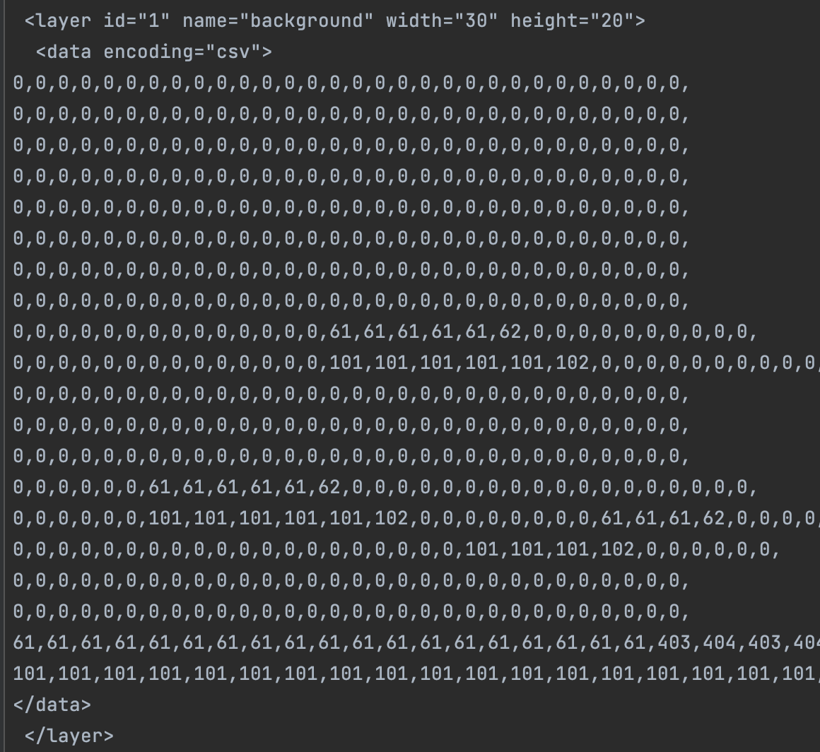
.tmx file
Tile layer

Slide 5
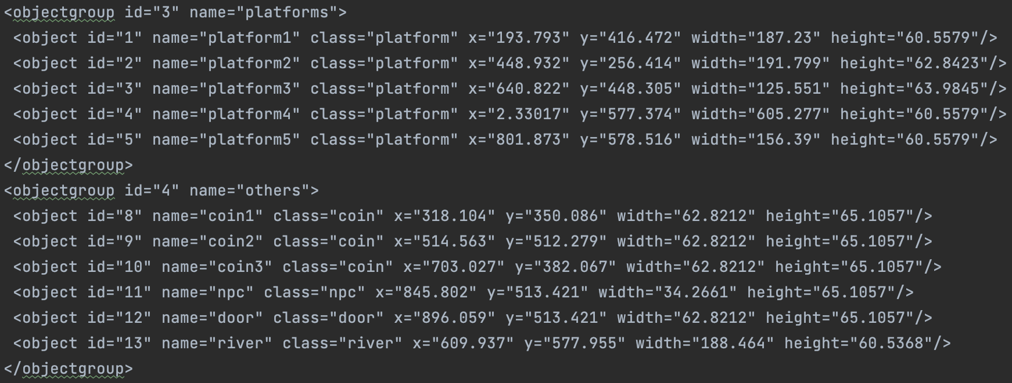
Preparing the .tmx file
Object layer
Must change to type

Slide 6
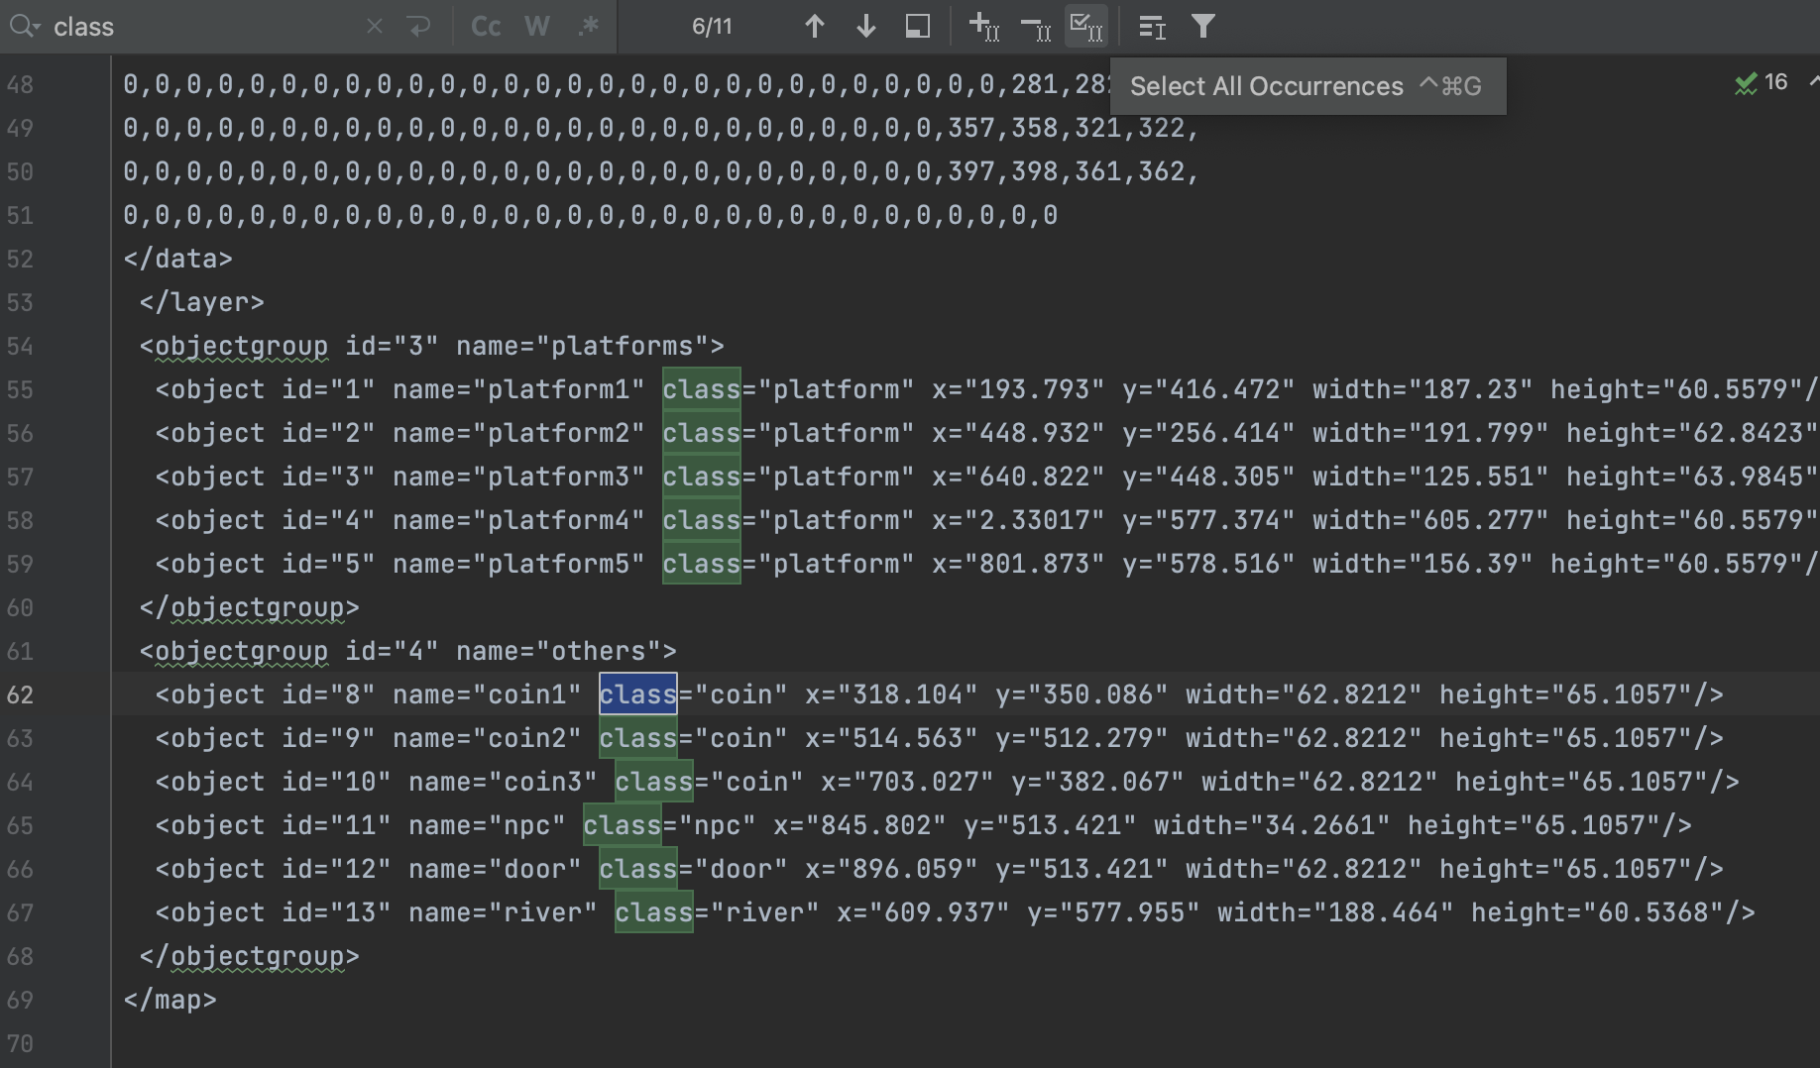

Slide 7
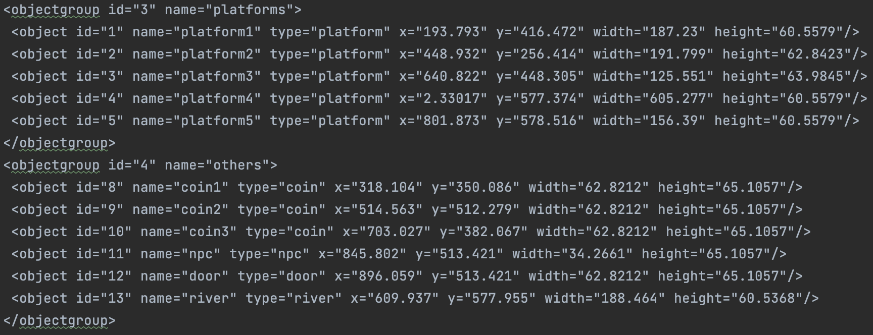

Slide 8
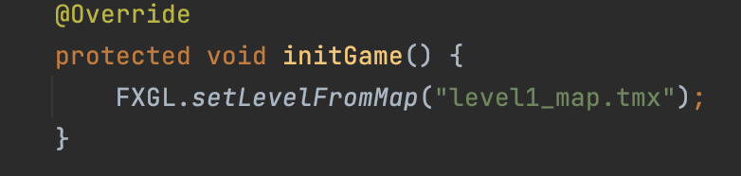
Loading the map…
Belongs to game initialization => codes should be under initGame()

Slide 9
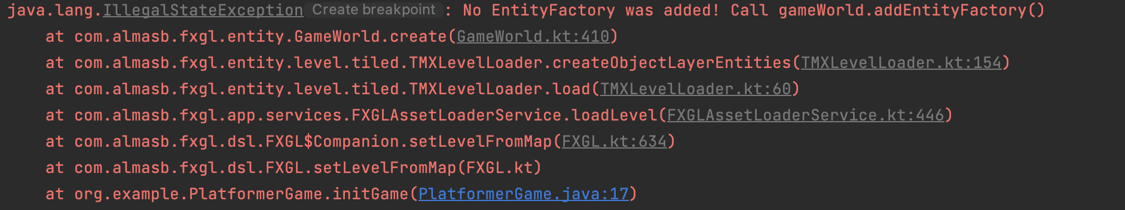
Loading the map
Objects that belong to the object layer in Tiled must be defined in an EntityFactory

Slide 10
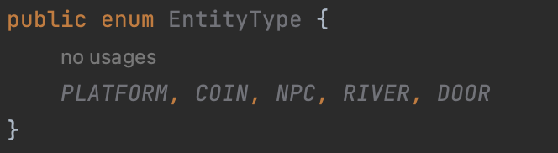
Adding an EntityType enum class
All objects have a type, we can add a customized enum class to represent these types

Slide 11
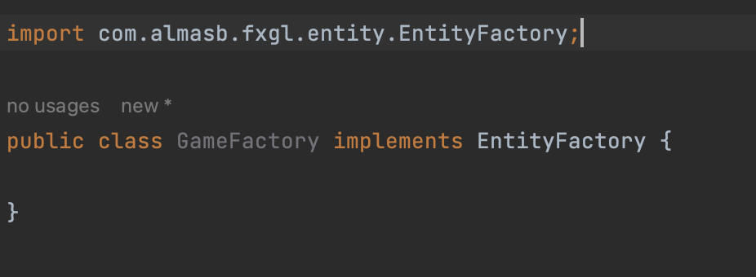
Adding an EntityFactory
Recall: factory defines how we are going to create game entities
Must use the EntityFactory interface

Slide 12
Defining a game Entity
Each Entity will have:
type => defined in EntityType.java
view => already defined in tiled map, EXCEPT coins
Various components => PhysicsComponent, CollidableComponent, etc
boundingbox => outline of the Entity

Slide 13
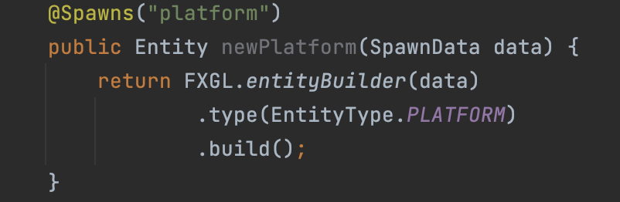
Defining a platform Entity
Must be the same!
Case sensitive

Slide 14
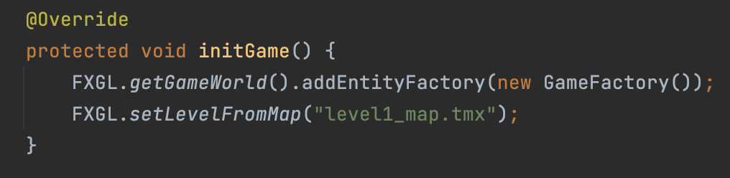
Adding EntityFactory to GameApplication
PlatformerGame.java
Could we switch the order of these two lines?
No, we must be able to DEFINE entities before the map loads

Slide 15
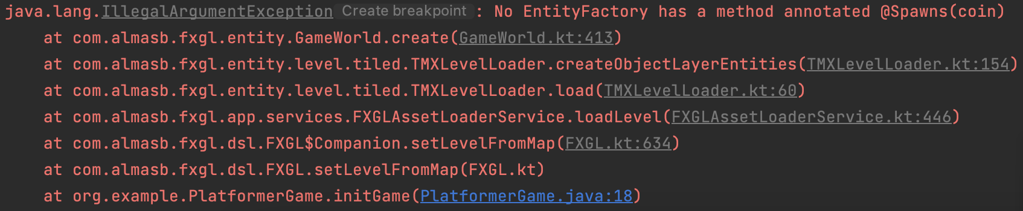
Running the code again… ERROR

Slide 16
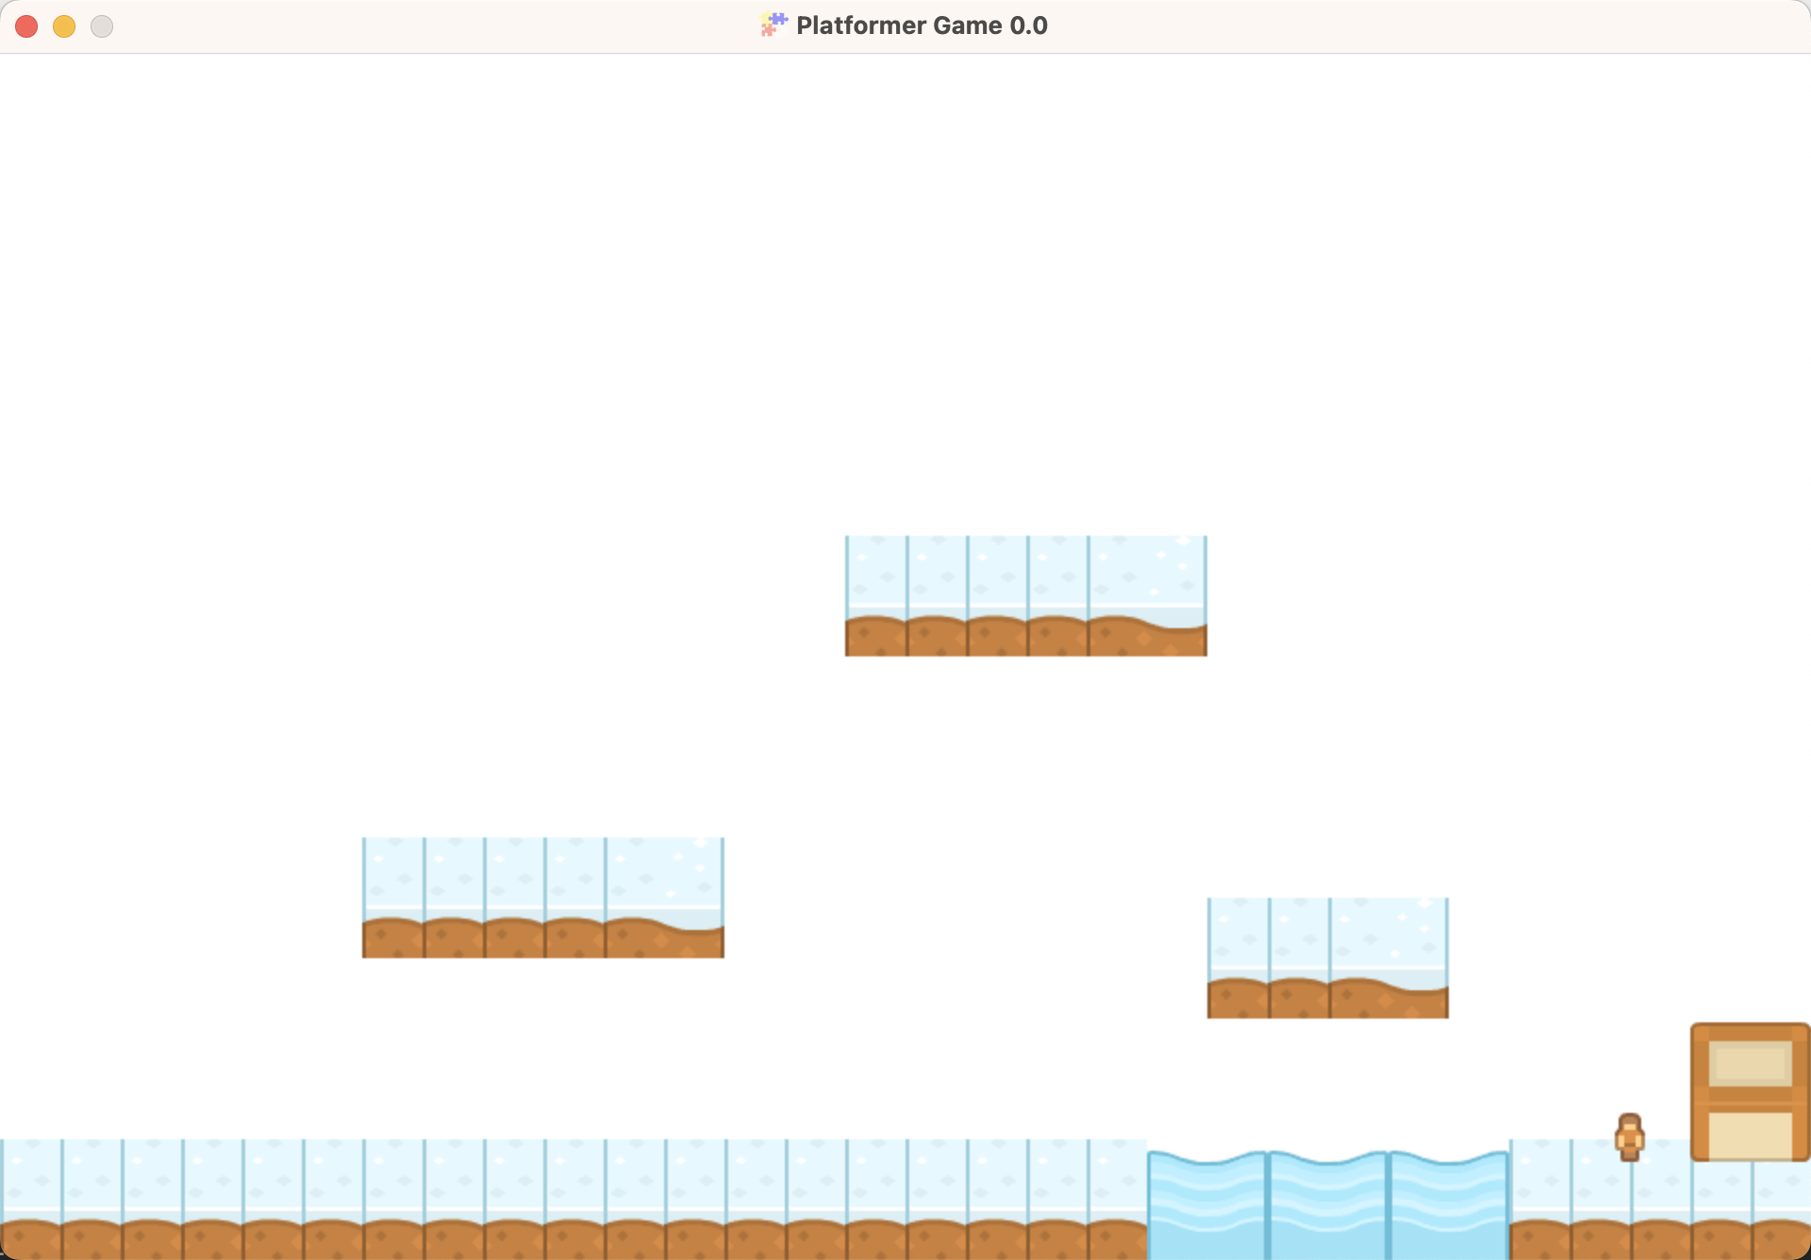
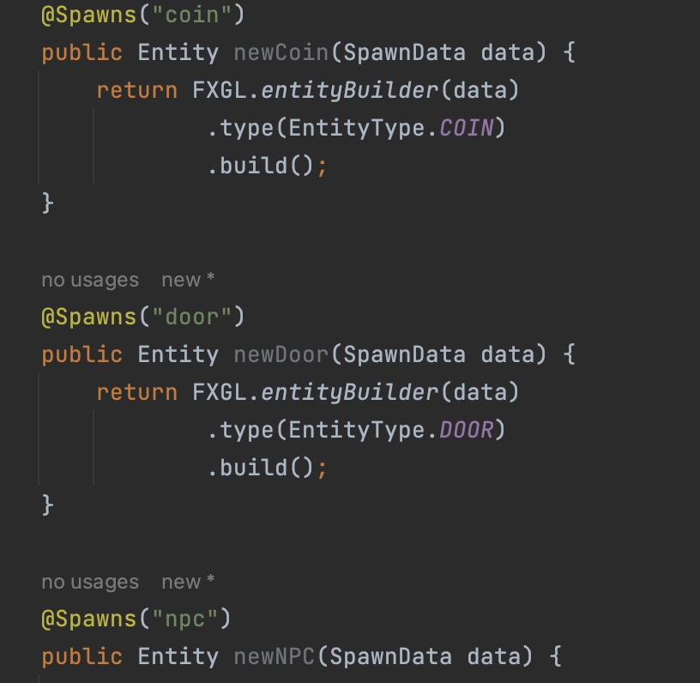
Adding the rest of the Entities

Slide 17
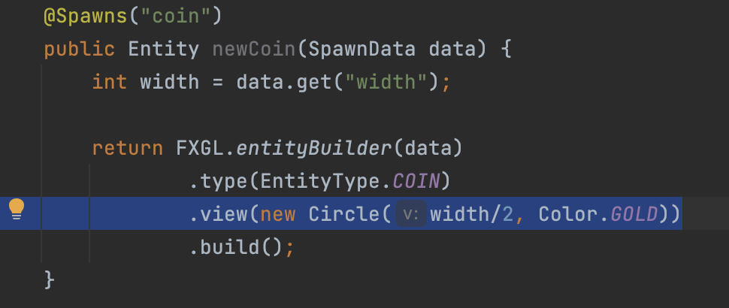
Adding a view to a coin Entity
GameFactory.java
Dimensions of the coin?
Radius

Slide 18
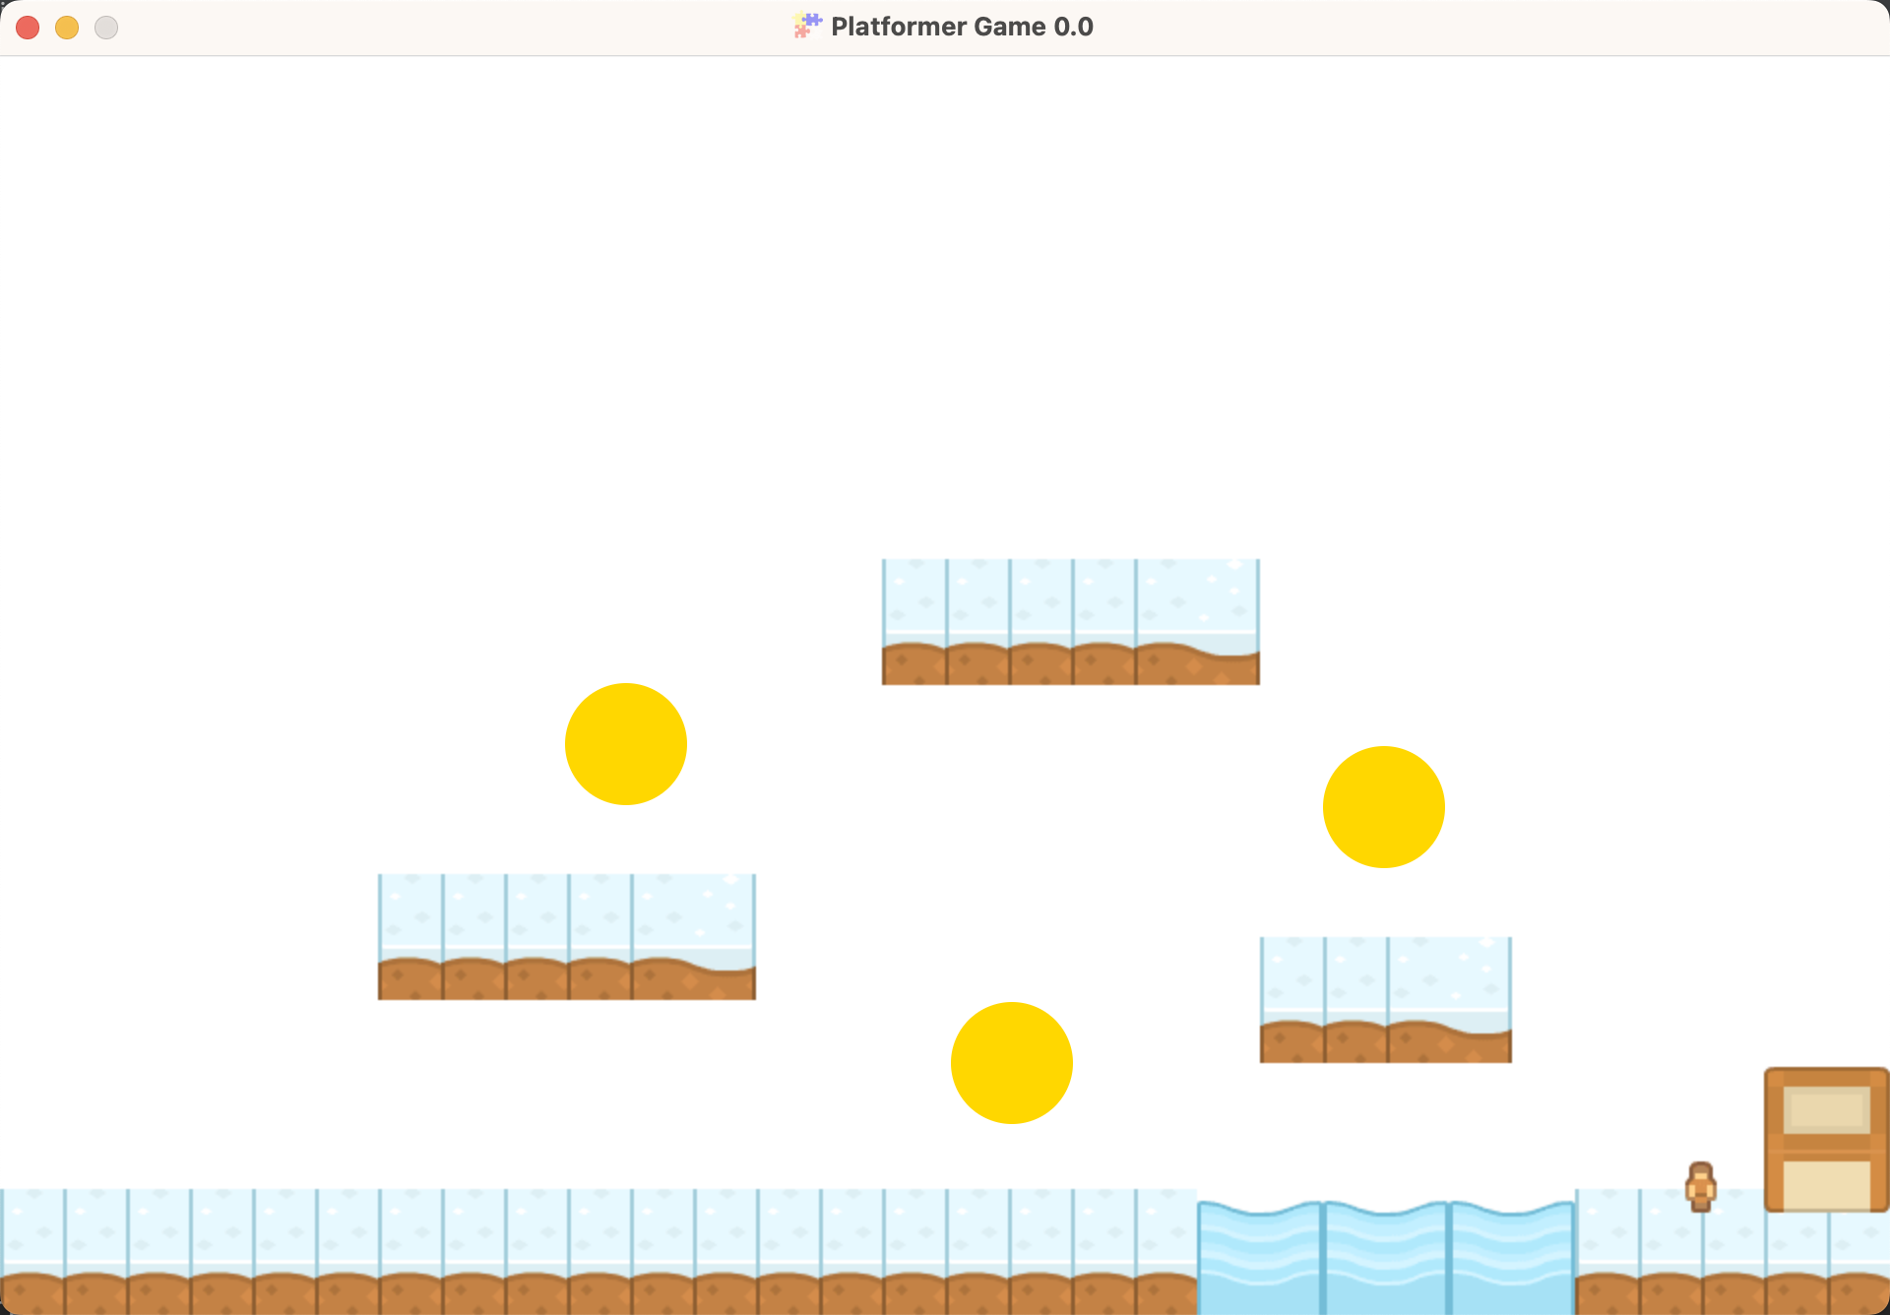
Coins are not on the ground?

Slide 19
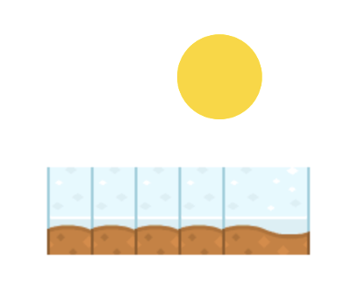
A circle is drawn from the center
A rectangle is drawn from the top left corner
Solution: move the spawn point/center by (radius, radius)

Slide 20
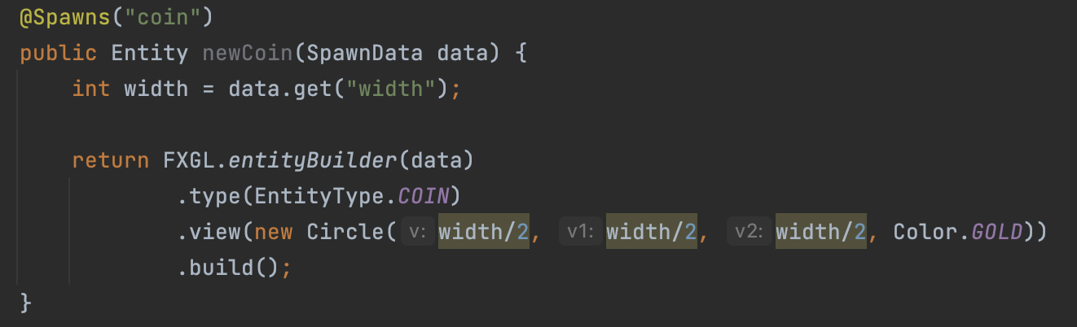
Modifying the coin Entity
GameFactory.java
Radius x y

Slide 21
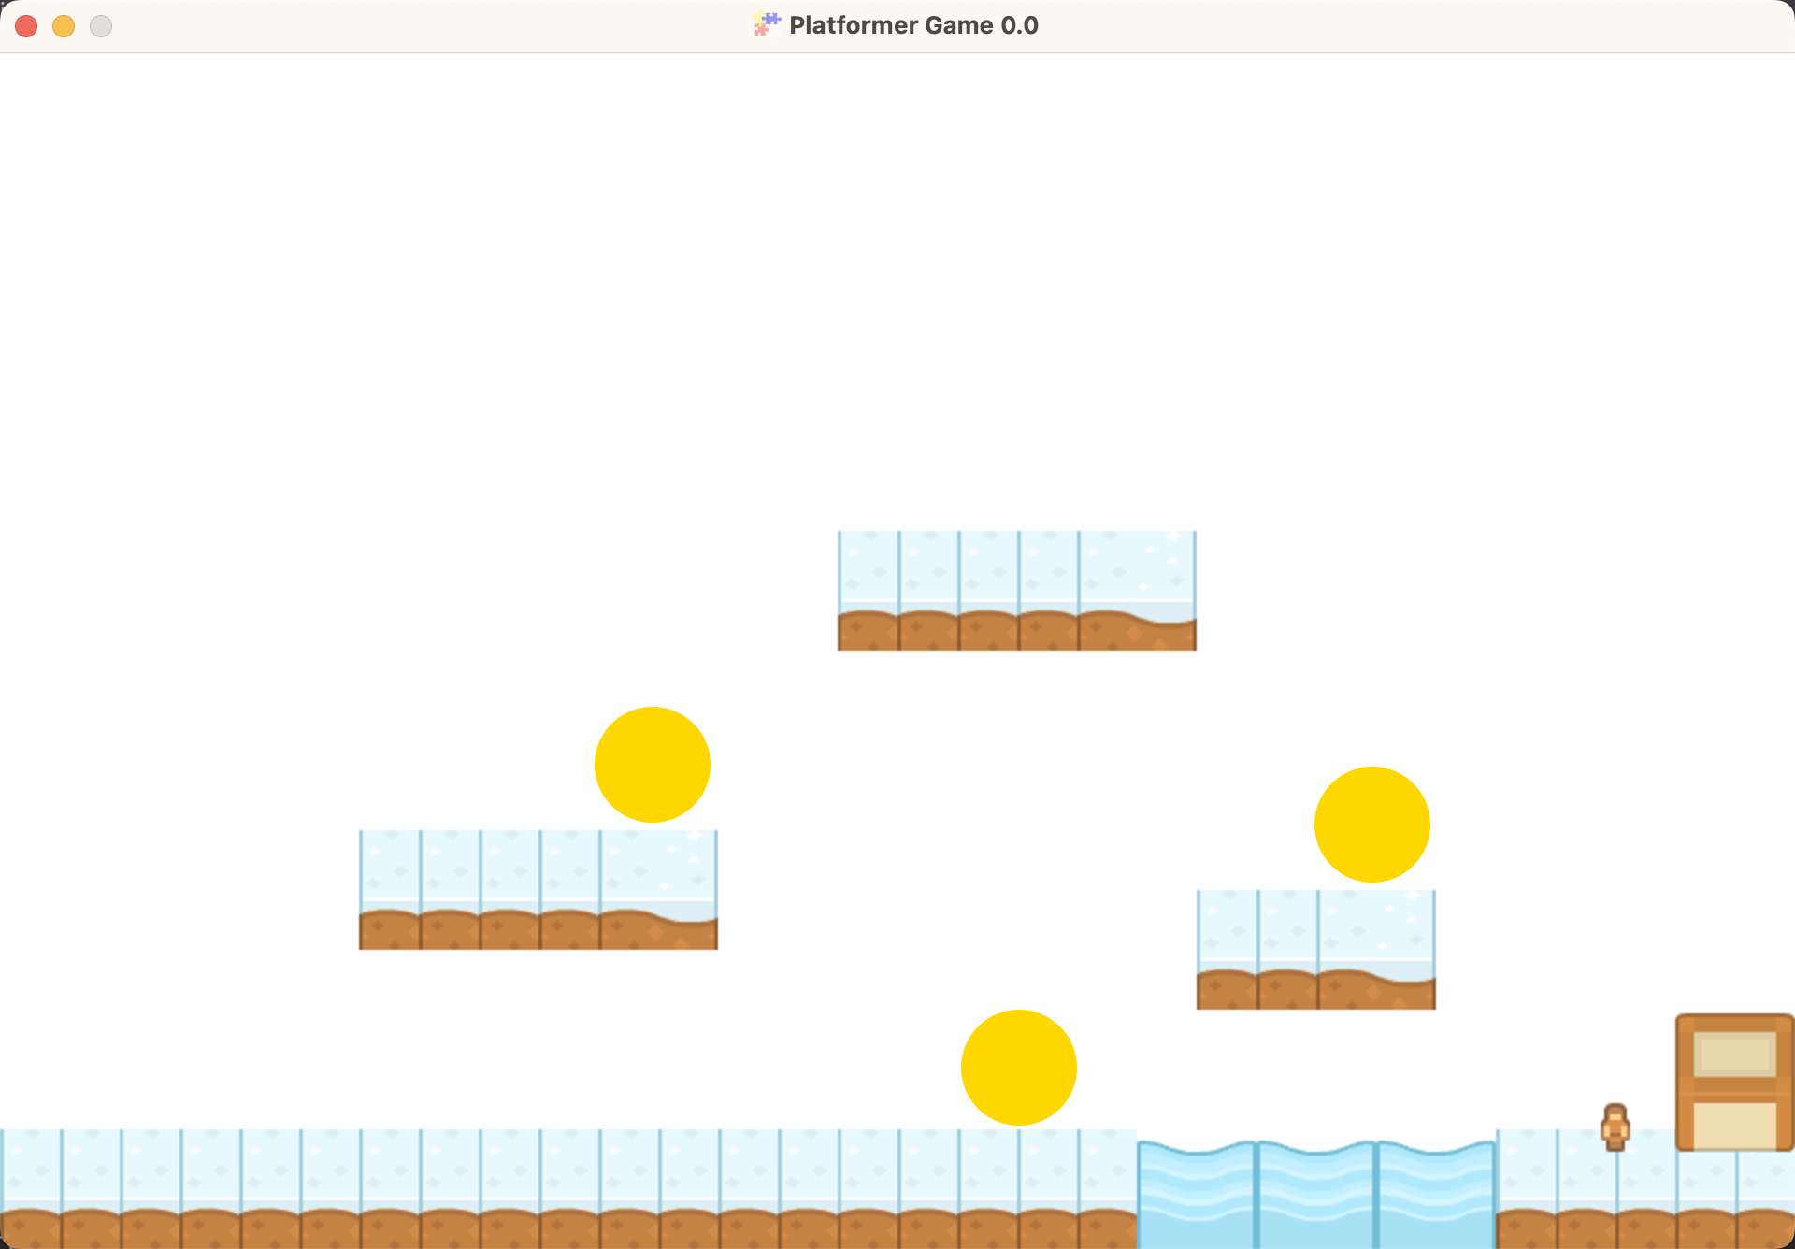

Slide 22
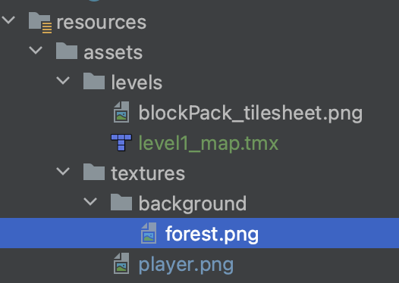
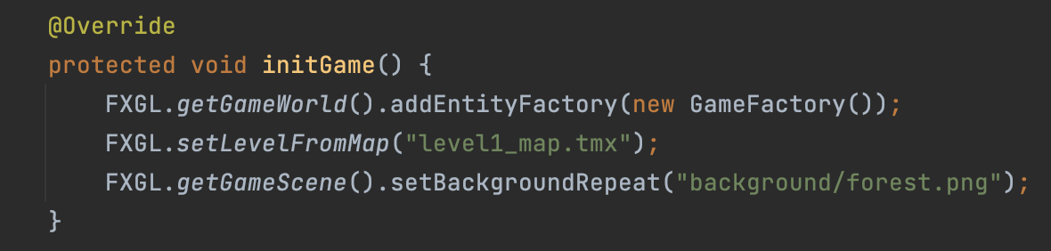
Adding a background

Slide 23
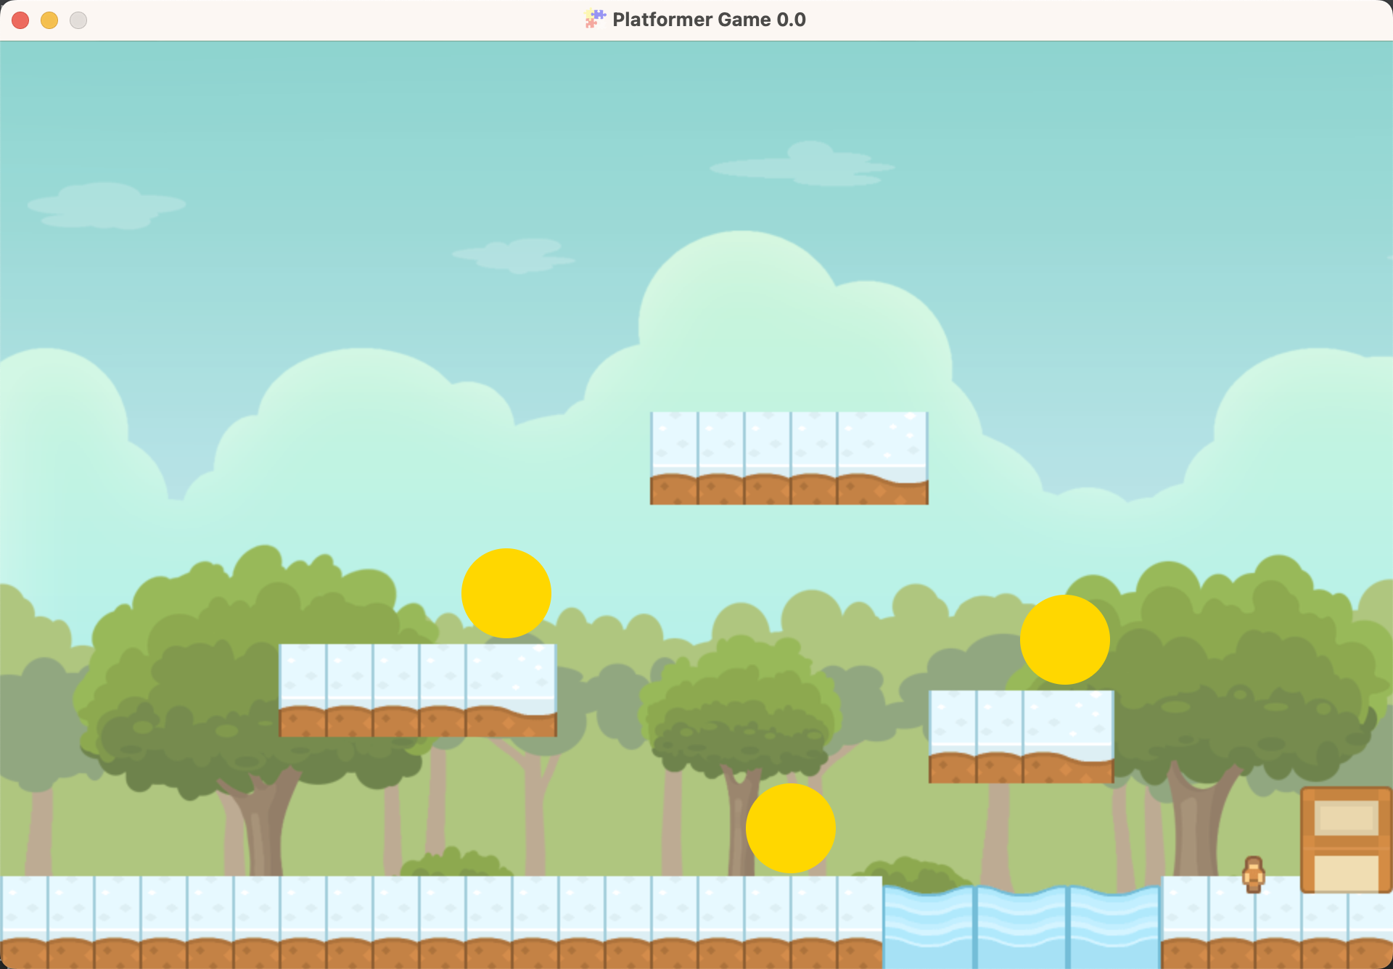

Slide 24
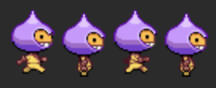
Defining a player Entity
type => EntityType.PLAYER
view => player.png
components => Customize a PlayerComponent.java class + any additional components from the FXGL library
boundingbox => outline of the Entity

Slide 25
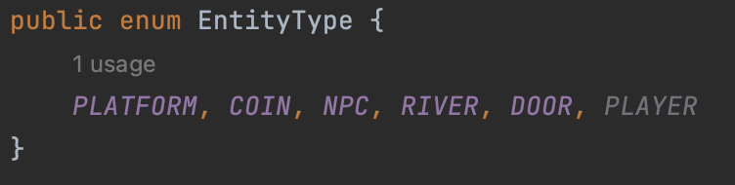
Defining a player Entity
EntityType.java

Slide 26
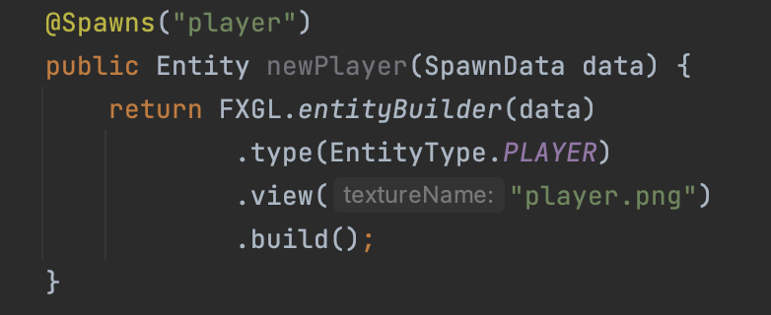
Defining a player Entity
We don’t want a flat view, we want animation!
GameFactory.java

Slide 27
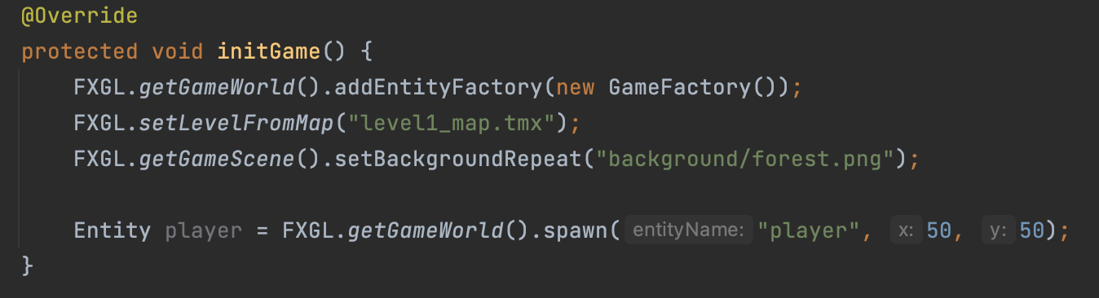
Spawning a player Entity
PlatformerGame.java

Slide 28
Frame by frame animation
Frame 1
Frame 2
Frame 3
Frame 4
Player Idle: either frame 2 or frame 4
Player walking: LOOP from frame1 to frame 3

Slide 29
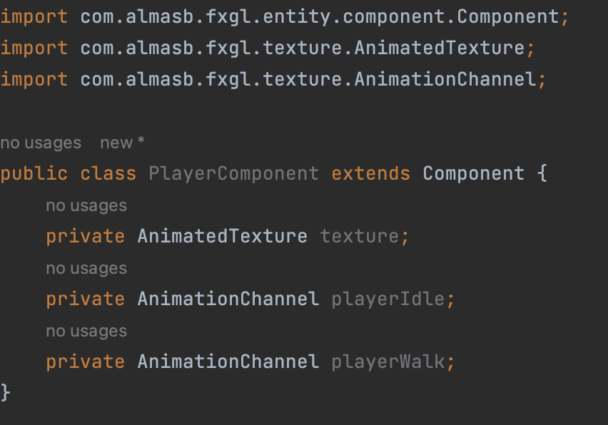
Defining a player Entity
NEW CLASS: PlayerComponent.java
Hold and execute an AnimationChannel
Defines a sequence of images to loop from, and set the loop speed

Slide 30
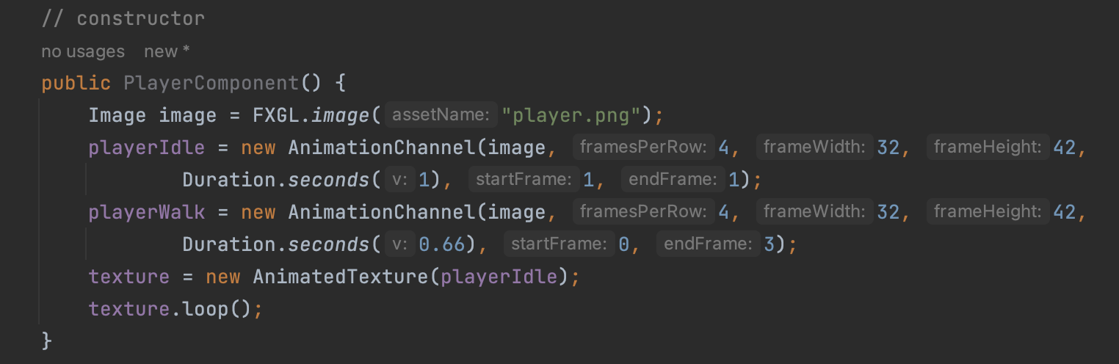
Defining a player Entity
Original image is 128 x 42 pixels
Holds 4 frames
PlayerComponent.java
Starts the animation

Slide 31
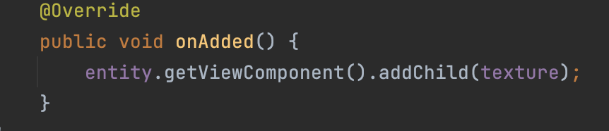
Defining a player Entity
We need to bind the texture with the character
PlayerComponent.java
Same as using .view() in the Factory class

Slide 32
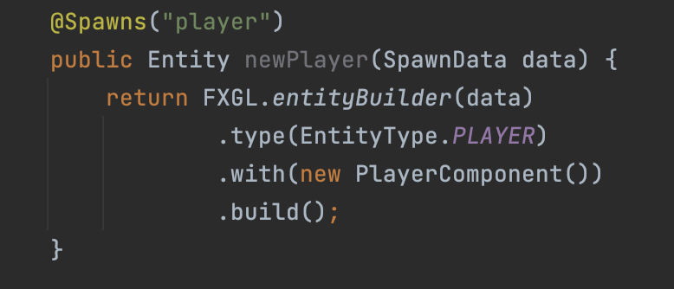
Defining a player Entity
GameFactory.java

Slide 33
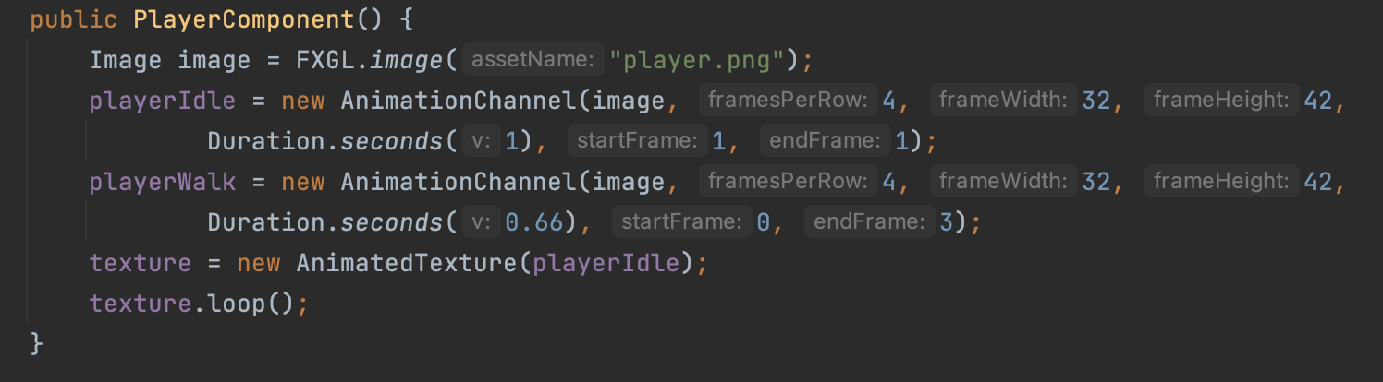
Testing the walking animation
PlayerComponent.java
playerWalk

Slide 34
