Slide 1

Introduction on Git/Github

Slide 2
What is Git?
Creates a copy of your program every time you commit (save)
Can have multiple people working on the same program
Changes by different people should be saved on different branches

Slide 3
What is GitHub?
An online/remote/cloud Git, allows you to track changes to projects via the internet

Slide 4
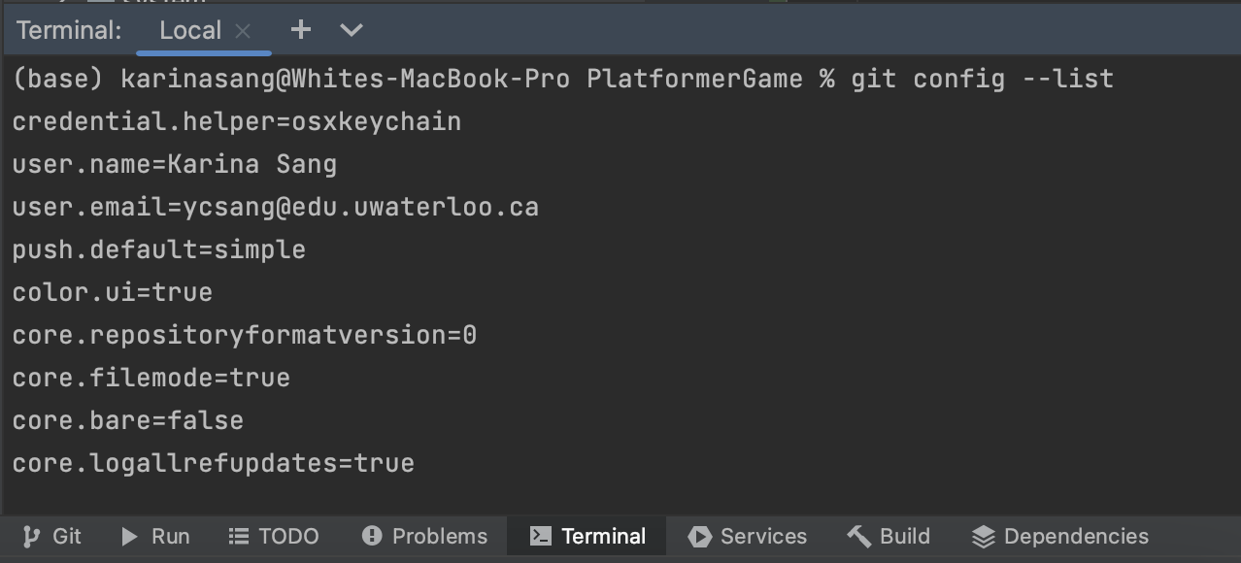
Github and Git

Slide 5

If your git credentials don’t match your github credentials
Don’t forget to run git config –list again to verify your changes

Slide 6
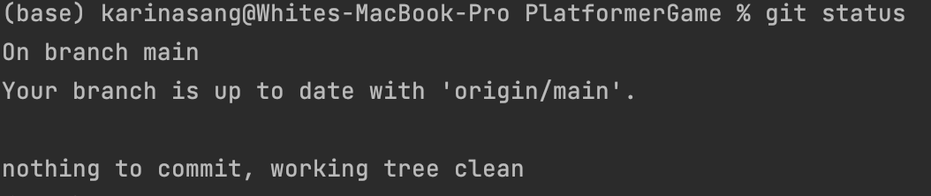
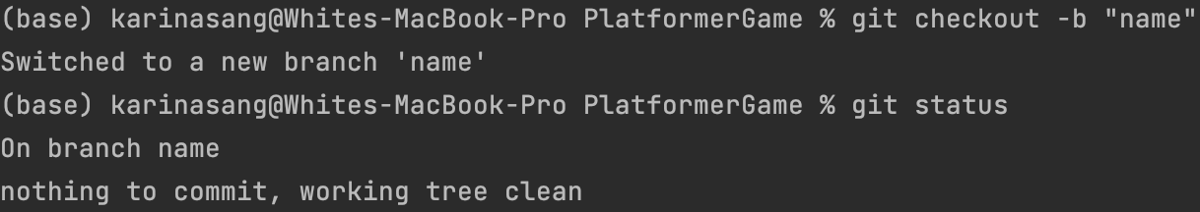
Set up your own branch

Slide 7
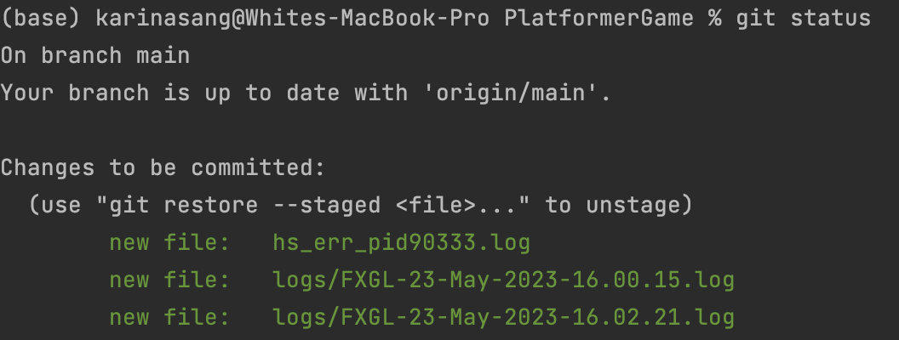
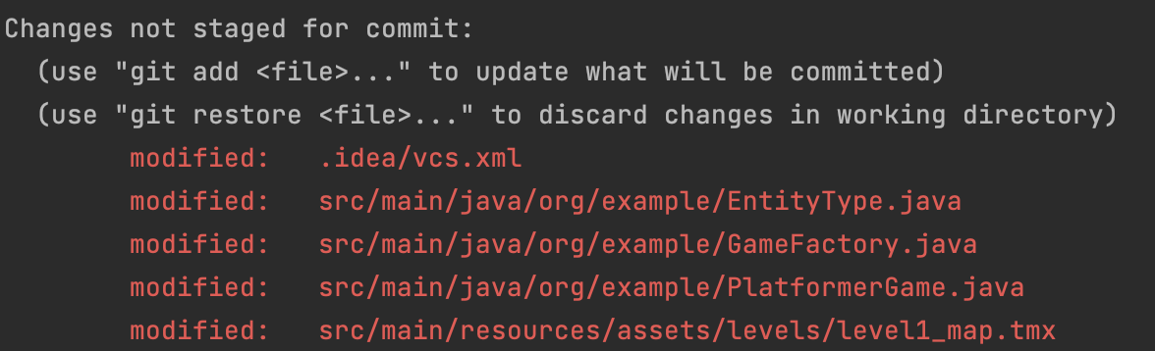
After making some changes…

Slide 8
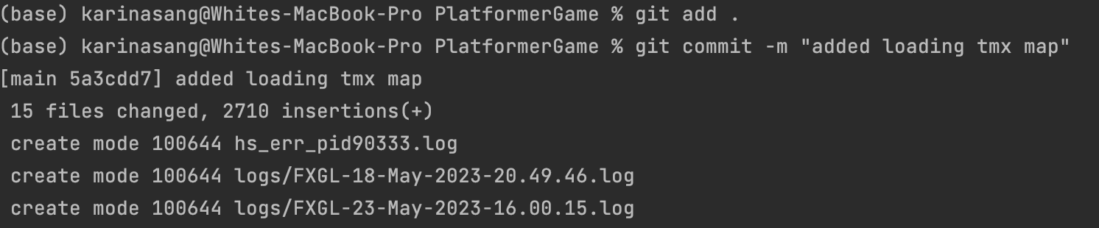
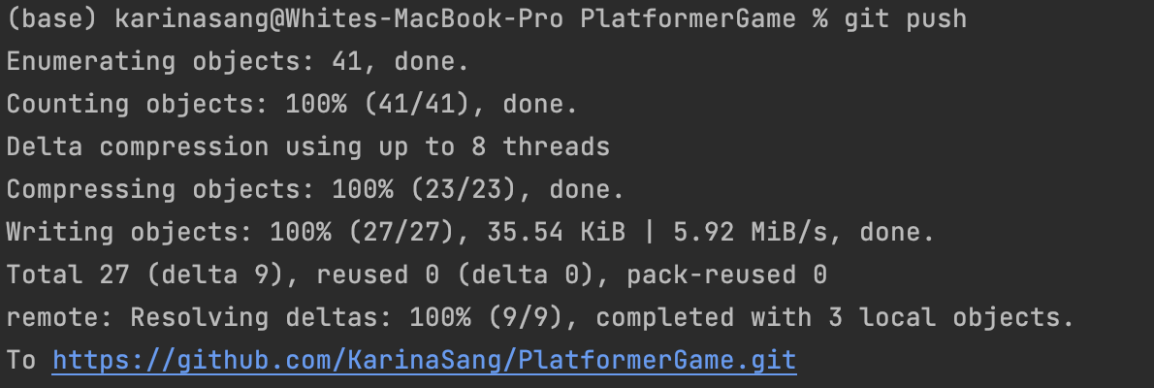
Save your changes to your own branch
Record all files that have changed
Save all files that have changed, locally, customize a commit message, which should describe what you changes you have done
Run git status again
Upload all changes to Git on GitHub, remotely

