Slide 1
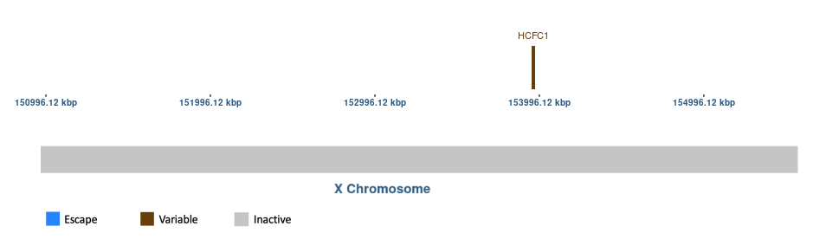
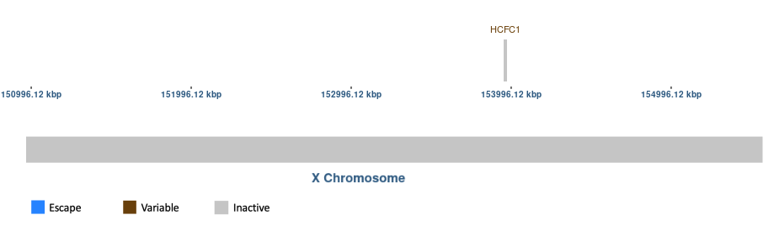
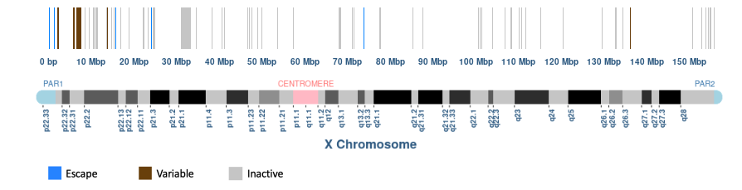
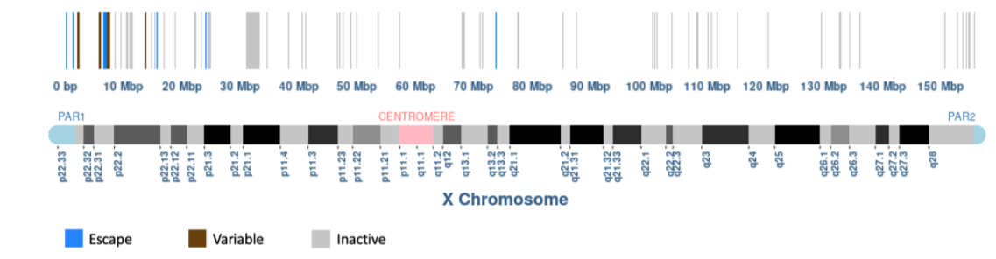
Graphic of 25% and 75% escape thresholds for HCFC1
Graphic of 33% and 66% escape thresholds for HCFC1
Graphic of 25% and 75% escape thresholds for Tukiainen et al. GTEx study
Graphic of 33% and 66% escape thresholds for Tukiainen et al. GTEx study

