Slide 1
Microservice Architecture

Slide 2

Introduction
Microservice Architecture(MSA) is a special design pattern of Service-oriented Architecture (SOA).
SOA - A service-oriented architecture is essentially a collection of services.
Microservice is the process of implementing SOA by dividing the entire application as a collection of interconnected services.
How MSA differs from SOA? In one word, Microservice is implementation methodology to implement SOA or we say Microservice is a type of SOA.

Slide 3
The Concept of Going Micro
Following are some rules that we need to keep in mind while developing a Microservice-oriented application.
Independent − Each microservice should be independently deployable.
Coupling − All microservices should be loosely coupled with one another such that changes in one will not affect the other.
Business Goal − Each service unit of the entire application should be the smallest and capable of delivering one specific business goal.

Slide 4

Example

Slide 5
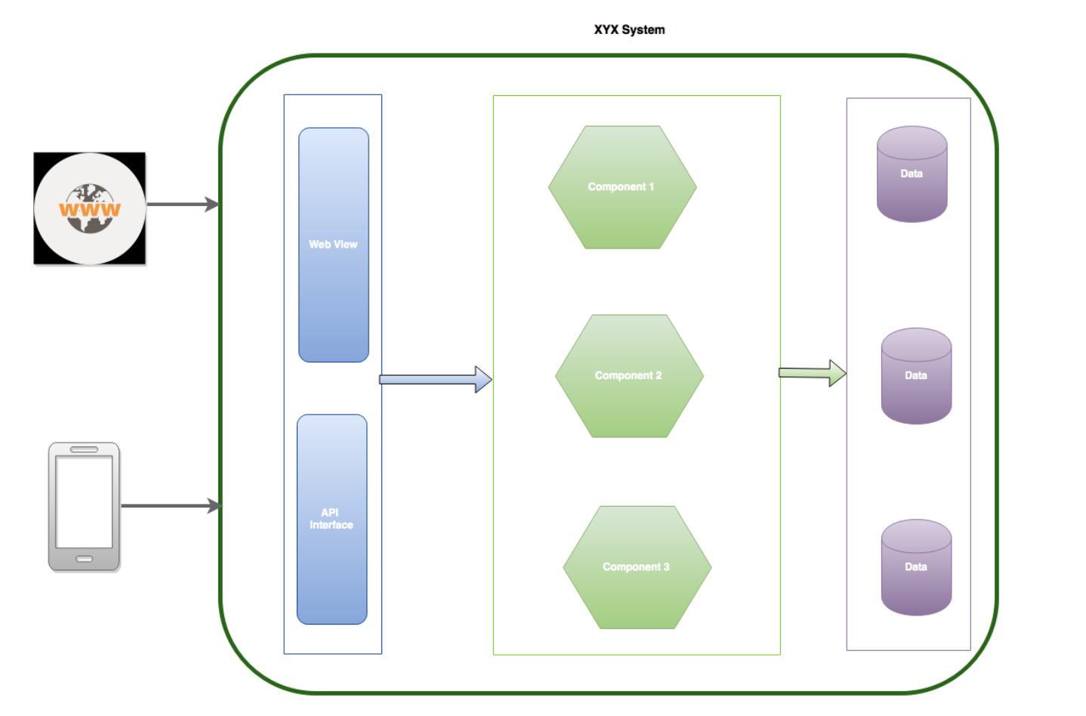
Monolithic architecture

Slide 6
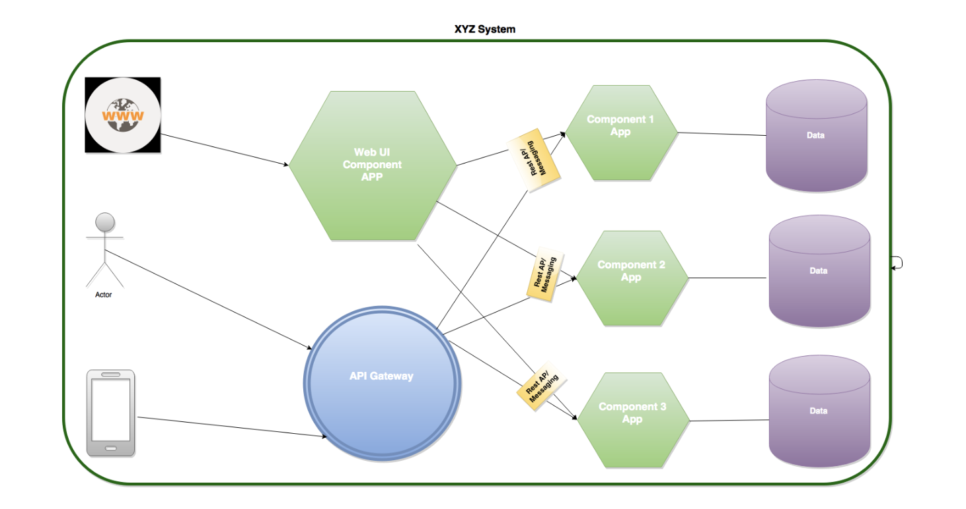
Microservice setup

Slide 7
Advantages
Small in size
Focused
Technology heterogeneity
Autonomous - Loosely coupled
Ease of deployment

Slide 8
Disadvantages
Distributed system
Cost
Enterprise readiness

Slide 9
“The more you learn,
The more you earn.”
–Warren Buffett

