Slide 1
Open source, high performance database MongoDB is written in C++.
MongoDB is a cross-platform, document oriented database that provides,
high performance, high availability, and easy scalability. MongoDB works
on concept of collection and document.

Slide 2
MongoDB stores data as documents in a binary representation called BSON (Binary JSON). Related information is stored together for fast query access through the MongoDB query language. Fields can vary from document to document; If a new field needs to be added to a document, then the field can be created without affecting all other documents in the collection, without updating a central system catalog, and without taking the system offline.
MongoDB 4.0 added support for multi-document transactions, making it the only database to combine the ACID guarantees of traditional relational databases, the speed, flexibility, and power of the document model, with the intelligent distributed systems design to scale-out and place data where you need it. Through snapshot isolation, transactions provide a consistent view of data, and enforce all-or-nothing execution to maintain data integrity. Transactions in MongoDB feel just like transactions developers are familiar with in MySQL. They are multi-statement, with similar syntax (e.g. start_transaction and commit_transaction), and therefore easy for anyone with prior transaction experience to add to any application.
Unlike MySQL and other relational databases, MongoDB is built on a distributed systems architecture, rather than a monolithic, single node design. As a result, MongoDB offers out-of-the-box scale-out and data localization with automatic sharding, and replica sets to maintain always-on availability.

Slide 3
Terminology b/w SQL VS NOSQL
MySQL | MongoDB
ACID Transactions | ACID Transactions
Table | Collection
Row | Document
Column | Field
Secondary Index | Secondary Index
JOINs | Embedded documents, $lookup & $graphLookup
GROUP_BY | Aggregation Pipeline

Slide 4
Query Language:
 | MySQL | MongoDB
Insert | INSERT INTO users (user_id, age, status) VALUES ('bcd001', 45, 'A') | db.users.insert({ user_id: 'bcd001', age: 45, status: 'A' };)
Select | SELECT * FROM users | db.users.find()
Update | UPDATE users SET status = 'C' WHERE age > 25 | db.users.update( { age: { $gt: 25 } }, { $set: { status: 'C' } }, { multi: true } )
Delete | delete from users | db.users.remove()
Cursor | db.start_transaction() cursor.execute(orderInsert, orderData) cursor.execute(stockUpdate, stockData) db.commit() | s.start_transaction() orders.insert_one(order, session=s) stock.update_one(item, stockUpdate, session=s) s.commit_transaction()

Slide 5
Why use MongoDB instead of MySQL?
Organizations of all sizes are adopting MongoDB because it enables them to build applications faster, handle highly diverse data types, and manage applications more efficiently at scale.
Development is simplified as MongoDB documents map naturally to modern, object-oriented programming languages. Using MongoDB removes the complex object-relational mapping (ORM) layer that translates objects in code to relational tables.
MongoDB can also be scaled within and across multiple distributed data centers, providing new levels of availability and scalability previously unachievable with relational databases like MySQL. As your deployments grow in terms of data volume and throughput, MongoDB scales easily with no downtime, and without changing your application.
Documents represent data in the same way that applications do. Unlike the tabular rows and columns of a relational database, data can be structured with arrays and subdocuments – in the same way applications represent data, as lists and members / instance variables respectively.
Each document can store data with different attributes from other documents.
With data for an entity stored in a single document, rather than spread across multiple relational tables, the database only needs to read and write to a single place. Having all the data for an object in one place also makes it easier for developers to understand and optimize query performance.

Slide 6
SQL Vs NoSQL Differences:
SQL | NoSQL
Relational store data in a table. | Non-Relational store data in JSON Documents, key-value pairs,columns or graphs.
SQL databases have fixed or static or predefined schema. | NoSQL databases have dynamic schema.
Support ACID transactions. | Depends on different schema.
Strong Consistency enforced,prioritized over availability & performance. | Consistency,availability & performance can be trade to meet the need of the application(CAP theorem)
Insert & Update performance depends on disk's 10 speed. | Performance can by maximized by reducing consistency.
SQL databases are vertically scalable. | NoSQL databases are horizontally scalable.
SQL databases use a powerful language "Structured Query Language" to define and manipulate the data. | In NoSQL databases, collection of documents are used to query the data. It is also called unstructured query language. It varies from database to database.
MySQL, Oracle, Sqlite, PostgreSQL and MS-SQL etc. are the example of SQL database. | MongoDB, BigTable, Redis, RavenDB, Cassandra, Hbase, Neo4j, CouchDB etc. are the example of nosql database

Slide 7
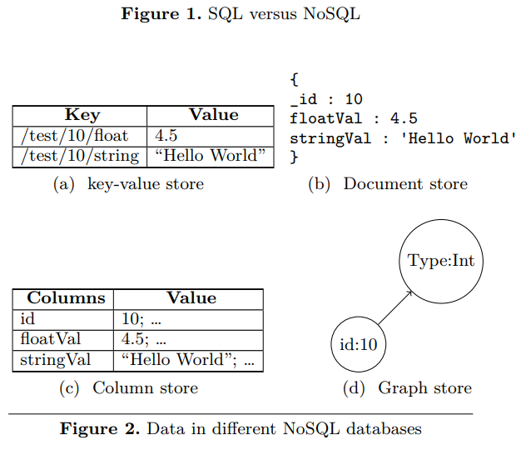
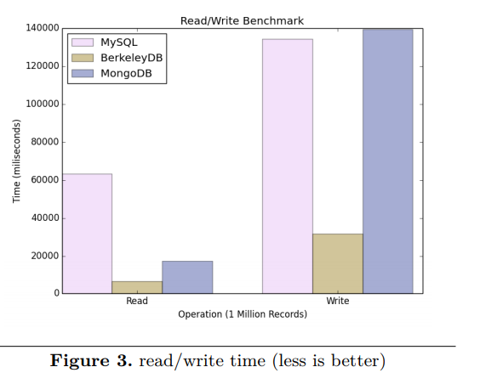

Slide 8
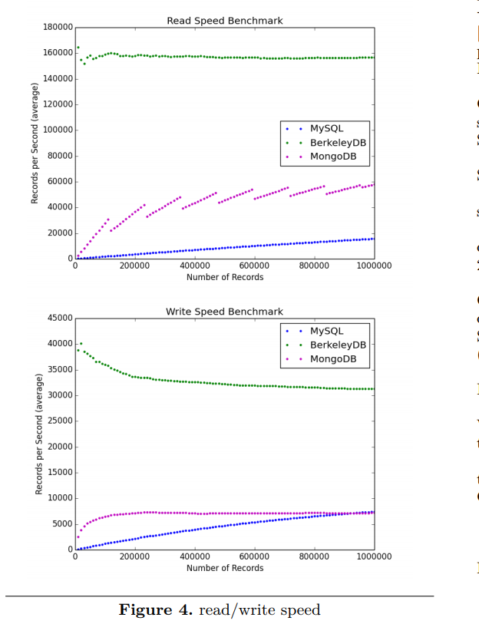

Slide 9
Most of the noSQL engines like MongoDB are not robust and not resilient to crashes and other outages. This security is what they sacrifice to gain speed.
MongoDB is faster
Not ACID and availability is given preference over consistency.
Asynchronous insert and update: What it means is MongoDB doesn't insert data to DB as soon as insert query is processed. Same is true for updates.
No Joins overhead: When they say MongoDB is a document database, what they mean is a database that contains data that is self sufficient and all the information is embedded like a real document.
NO Relations b/w tables.
The important character of NoSQL is that it relaxes one or more of the ACID properties for a better performance in desired fields.
The non-relational model is designed for processing huge amount of data in a second, with relatively low consistency requirement. As a consequence, it relaxes the ACID constraints provided by many relational database systems, in exchange for the improvement of performance.

Slide 10
CAP Theorem:-
CAP Theorem For a distributed database, the CAP theorem states that it’s impossible to simultaneously provide more than two out of the following three guarantees:
Consistency:- Every read receives the most recent write or an error.
Availability:- Every request receives a (non-error) response – without guarantee that it contains the most recent write. Partition tolerance:- The system continues to operate despite an arbitrary number of messages being dropped (or delayed) by the network between nodes.
Based on CAP theorem, different database picks different combination of consistency, avalability, and partition tolerence:
• CA: Relational Database
• CP, AP: Non-Relational Database

Slide 11
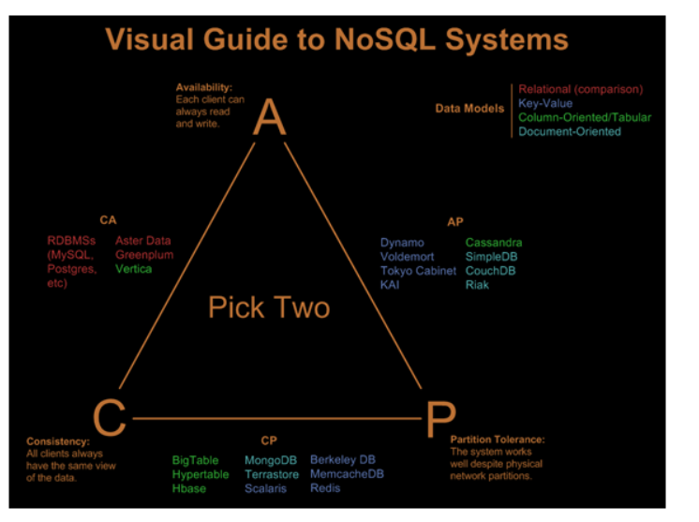

Slide 12
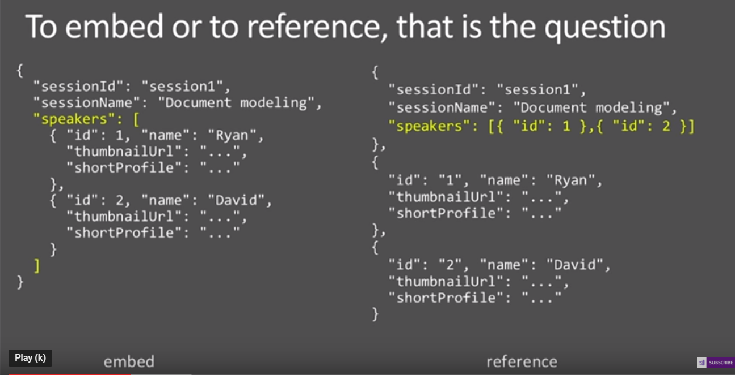
Data Model:

Slide 13
2018/2019 Approved Rates
COTS Apps
$80.52 per CPU Request per Month & $29.28 per GB of Memory Request per Month
WAS Liberty Apps
$109.80 per CPU Request per Month & $43.92 per GB of Memory Request per Month
MongoDB Apps
$219.60 per CPU Request per Month & $146.40 per GB of Memory Request per Month

Slide 14
Useful Links
https://www.cloudportal.ford.com/infrastructure/success
https://www.tutorialspoint.com/mongodb/
https://docs.mongodb.com/manual/
https://spring.io/guides/gs/accessing-data-mongodb/
https://www.youtube.com/watch?v=GtD93tVZDX4&list=PLS1QulWo1RIZtR6bncmSaH8fB81oRl6MP
https://studio3t.com/download-thank-you/?OS=win64&email=testkapu%40gmail.com&form=ok#gf_27

