Slide 1
HTTPS and SSL Connections

Slide 2
Technicality of https
What are SSL and TLS Protocols?
Both are cryptographic protocols that provide security over network.
SSL and its latest versions has lot of vulnerabilities TLS was introduced as an updated version.
So lot of SSL terminology is deprecated.

Slide 3
How does HTTPs works?
HTTPS is secured version of HTTP.
Many websites and applications are now a days establishing secure connection with HTTPs.
Every packet transferred between client and server is encrypted using public or private key cryptography.
HTTPS ensures there is at least a basic level of security involved in communication between two parties, whereas HTTP is insecure and an attacker (MiM) can breach the security.

Slide 4
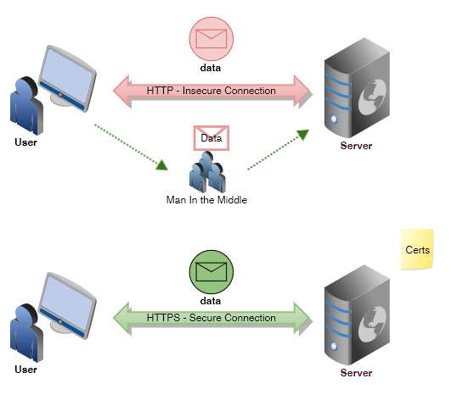
HTTPS vs HTTP

Slide 5
Different types of Key store
.jks acronym for Java Key Store is the most common default Keystore type if you are in Java world.
.jceks is the Java cryptography extension Keystore. It has all the features of JKS with more algorithms permitted.
.p12 or PKCS12 is a Keystore type for Java and other languages. Unlike JKS, you can extract private keys from PKCS#12.
PKCS11 or .p11 is used less frequently for accessing hardware cryptographic tokens like network cards
.bks are a BouncyCastle provider used across Android and mobile devices

Slide 6
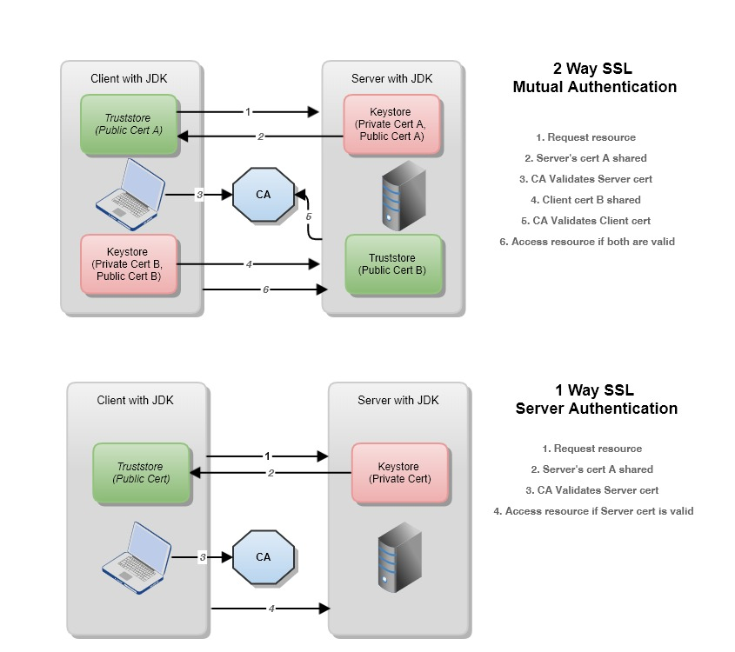
Difference Between 1-Way and 2-Way SSL?
1-way SSL is the common way to verify the authenticity of the website you are accessing and form a secure channel. In this authentication, client is never verified, as content being verified is with the server.
2-way SSL is the way of communication in which both parties, client and server exchanges the certificates and verifies authenticity. Mutually trust is captured.

Slide 7
Java
What we are using:
Java 11
Spring Boot 2.3.0
keytool — this comes already with jdk installation.

Slide 8
Strategy followed
We will create 2 Spring Boot applications. Ideally, we can call it client and server, but just because we are using spring boot and as per microservice principle, it is better to have a gateway application fronting all your underlying microservices. We will refer to the client as gateway and the server as ms — for microservice obviously.

Slide 9
Create A Self Signed Client Cert
We will use key tool command for this.
keytool -genkeypair -alias nt-gateway -keyalg RSA -keysize 2048 -storetype JKS -keystore nt-gateway.jks -validity 3650 -ext SAN=dns:localhost,ip:127.0.0.1

Slide 10
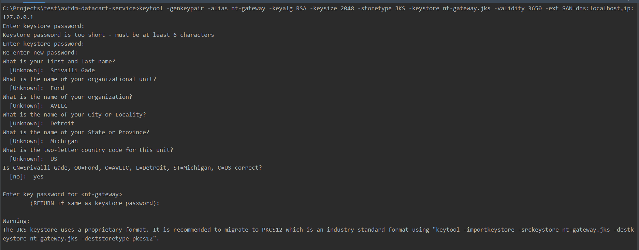
CONTD..

Slide 11
Create self-signed cert
keytool -genkeypair -alias nt-ms -keyalg RSA -keysize 2048 -storetype JKS -keystore nt-ms.jks -validity 3650 -ext SAN=dns:localhost,ip:127.0.0.1

Slide 12
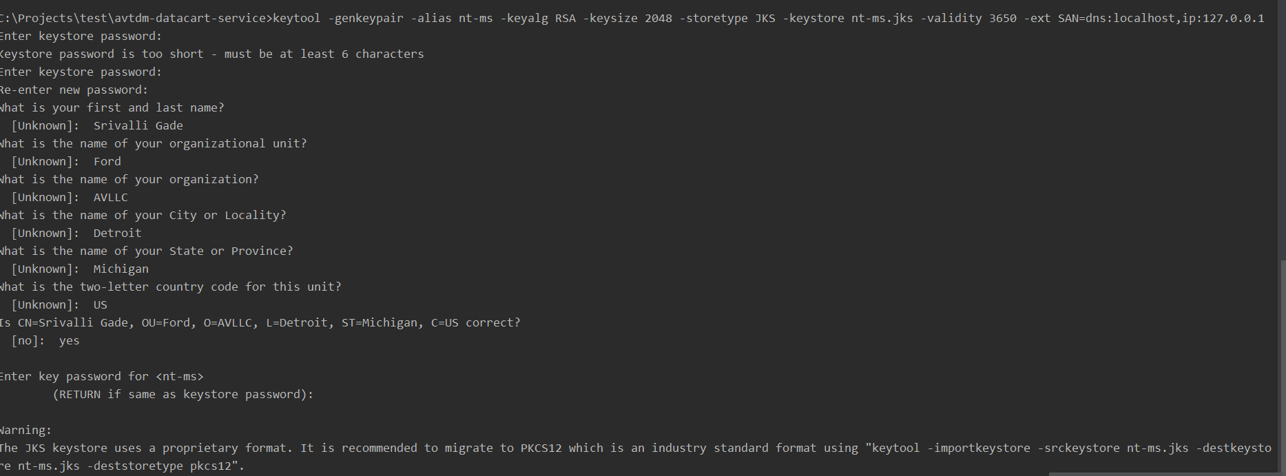
CONTD…

Slide 13
Create public certificate file from client cert:
Now that we’ve client and server certs created, we need to set up trust between both. To do that, we’ll import client cert in to the server’s trusted certificates and vice versa. But before we can do that, we need to extract public certificate of each jks file.
keytool -export -alias nt-gateway -file nt-gateway.crt -keystore nt-gateway.jks
Enter keystore password:
Certificate stored in file <nt-gateway.crt>

Slide 14
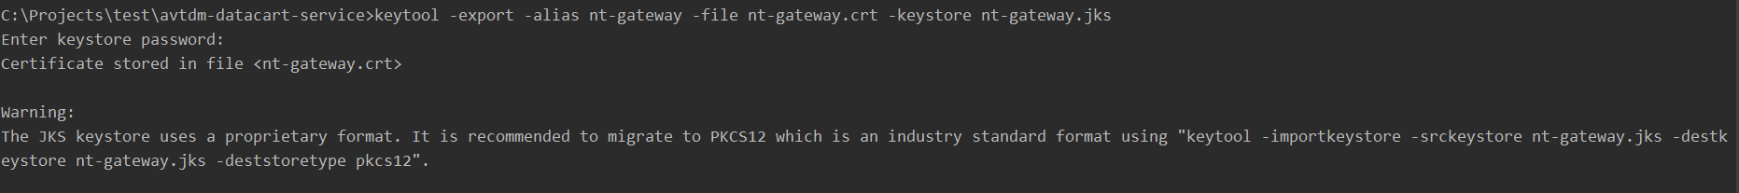
Contd…

Slide 15
Create Public Certificate File From Server Cert:
keytool -export -alias nt-ms -file nt-ms.crt -keystore nt-ms.jks
Enter keystore password:
Certificate stored in file <nt-ms.crt>

Slide 16
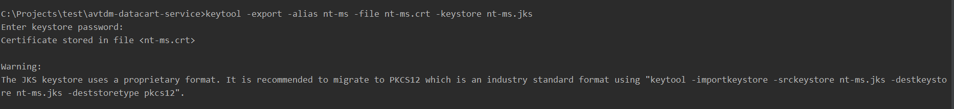
Cont.…

Slide 17
Importing certs…
Import Client Cert to Server jks File:
keytool -import -alias nt-gateway -file nt-gateway.crt -keystore nt-ms.jks
Import Server Cert to Client jks file:
keytool -import -alias nt-ms -file nt-ms.crt -keystore nt-gateway.jks

Slide 18
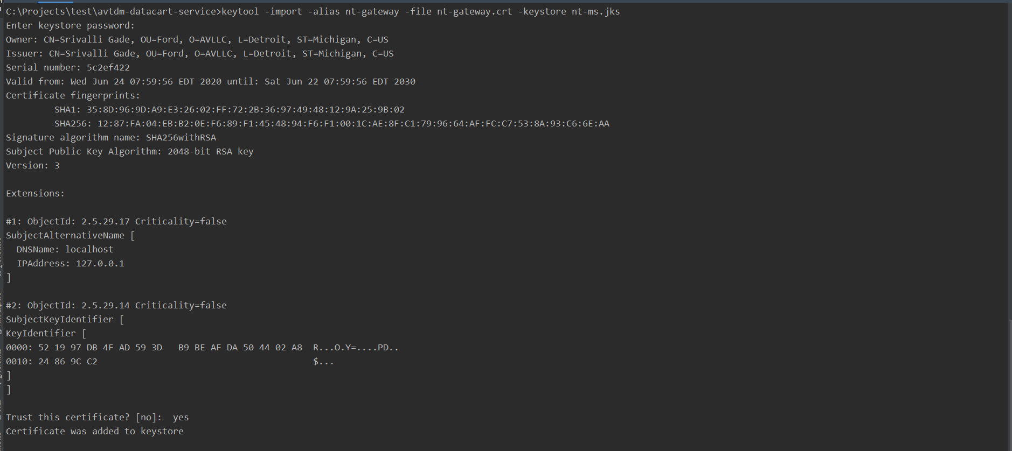
Step1 – import client cert to server

Slide 19
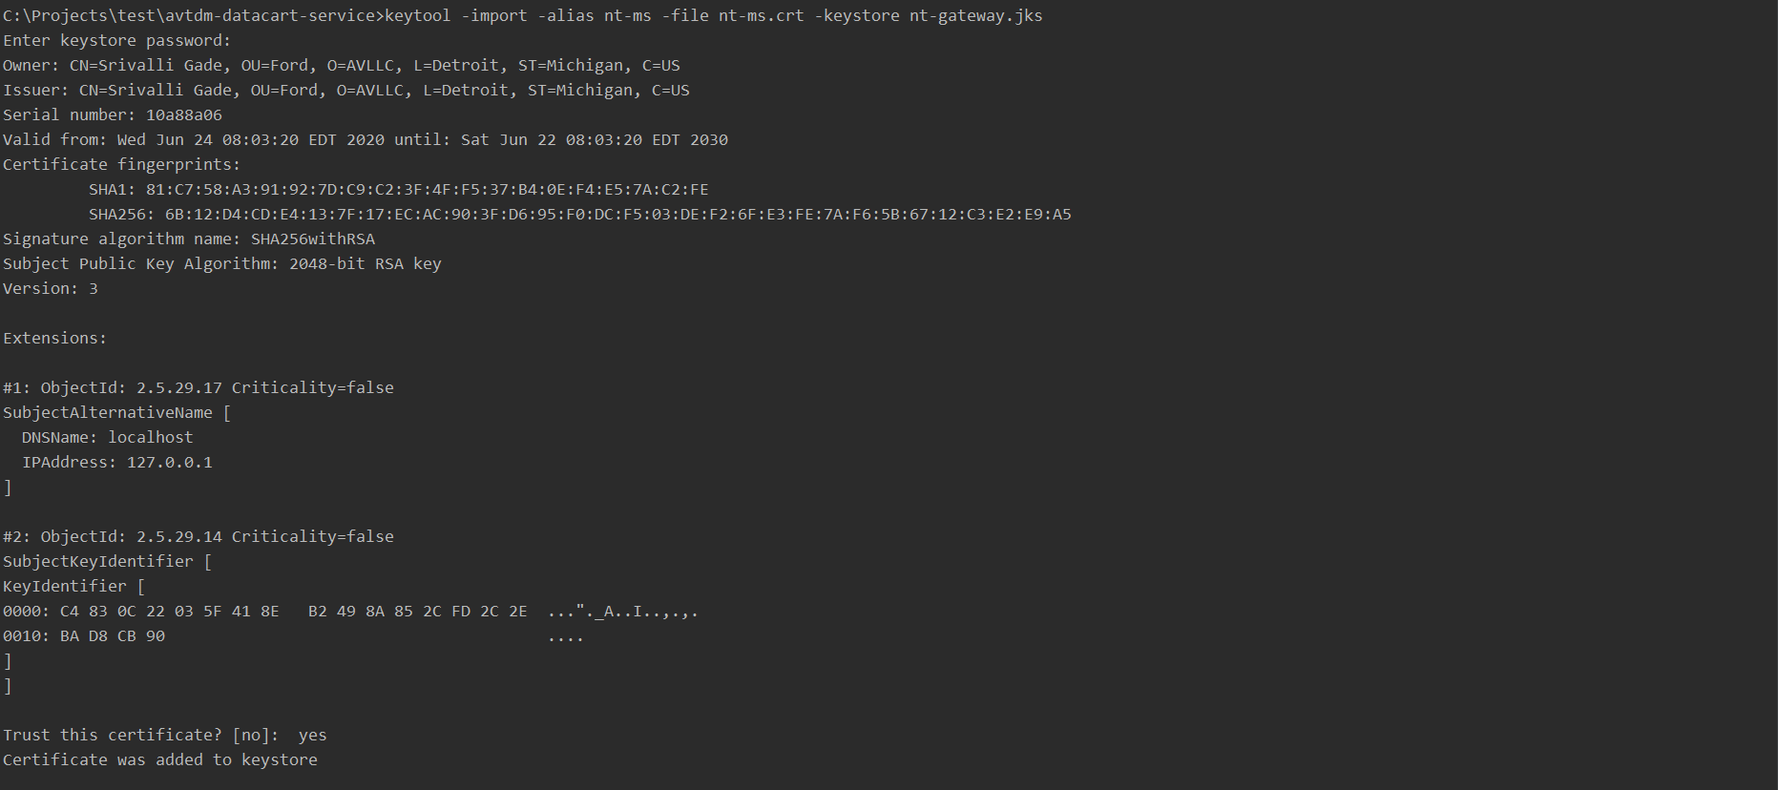
Step2 – import server cert to client

Slide 20
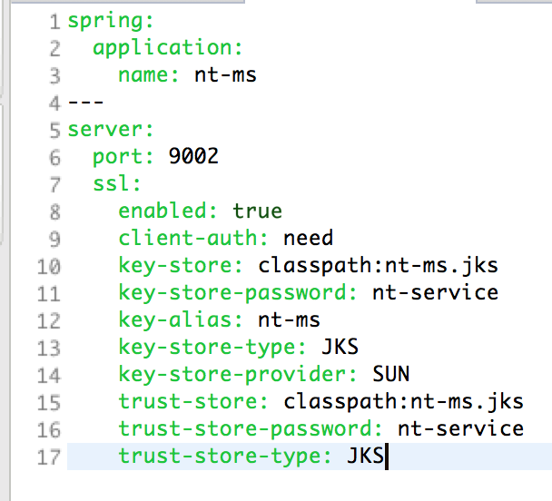
Configure Server For 2 Way SSL:
Copy final server jks file (in my case, nt-ms.jks) to the src/main/resources/ folder of nt-ms application.
Add the entries shown below in application.yml (or application.properties. But I prefer .yml)

Slide 21
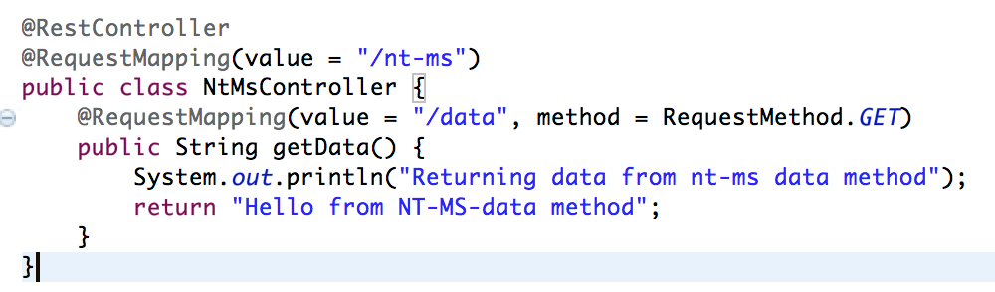
Create a controller class with REST endpoint to serve the incoming request

Slide 22
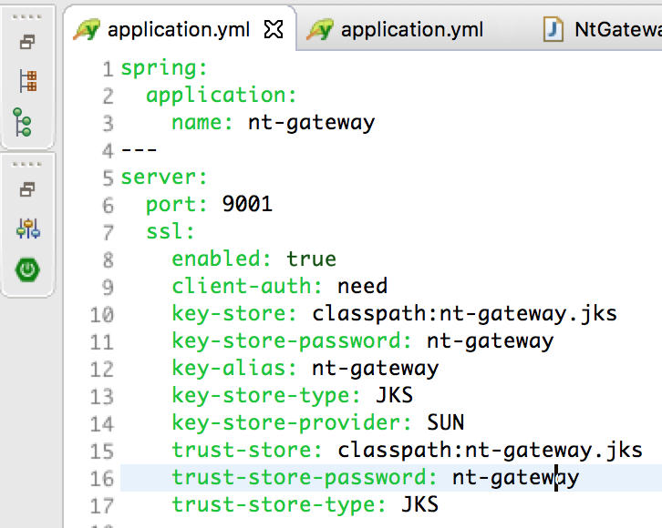
Configure CLIENT For 2 Way SSL:
Now, this requires some more changes than the server side as https communication is going to be initiated from here. But don’t worry. We’ll go step by step.
First, copy final client jks (in my case nt-gateway.jks) to src/main/resources/ folder
Next, add the entries shown below in application.yml

Slide 23
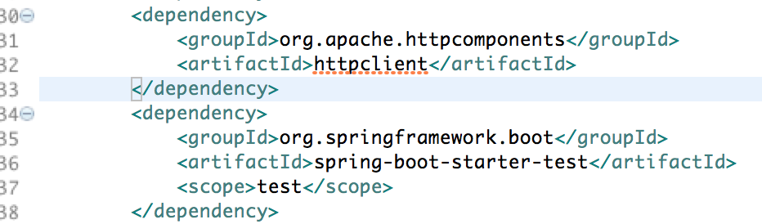
Configure Client for 2 way SSL:
We will need to add the below dependency in our pom

Slide 24
Cont…
Luckily, Spring Boot comes with a cool RestTemplate class for http communication. We will use this class for our https call from the client application to the server. And because we are going with 2 way SSL, we need to configure this RestTemplate to use the trust store with server certificate.

Slide 25
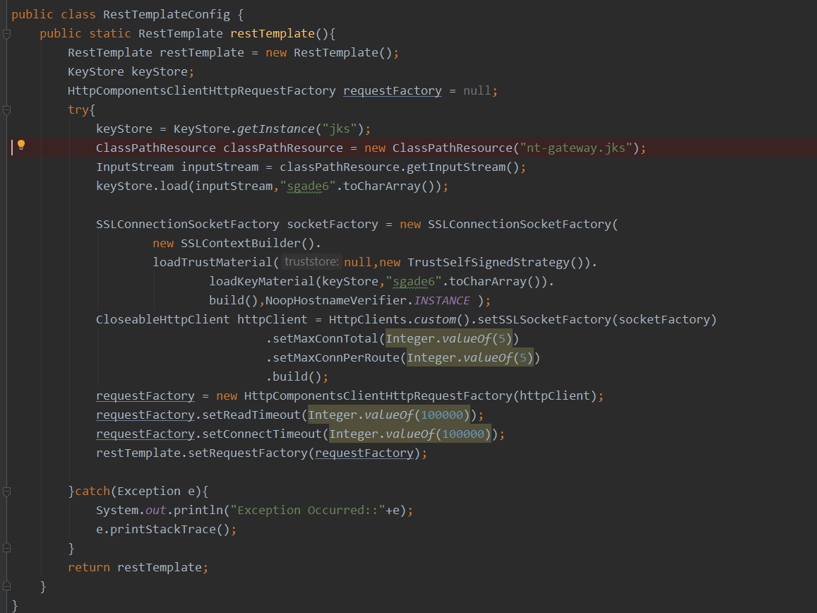
Cont…

Slide 26
Conversion commands
keytool -genkeypair -alias datacart -keyalg RSA -keysize 2048 -storetype JKS -keystore datacart.jks -validity 3650 -ext SAN=dns:localhost,ip:192.168.254.104
keytool -importkeystore -srckeystore datacart.jks -destkeystore datacart.p12 -deststoretype pkcs12

Slide 27
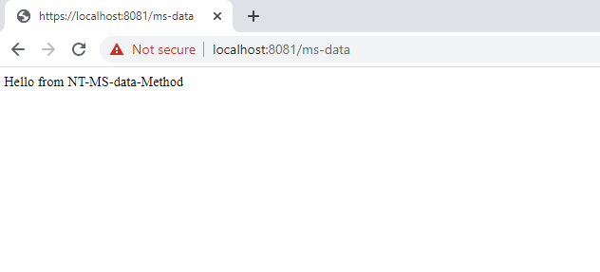
IMPORT CERTIFICATE to browser
Add it in trusted root certificates .
Connection established…

