Slide 1
WebSocket, a faster way for vehicle commands
Geng & Jitendra

Slide 2


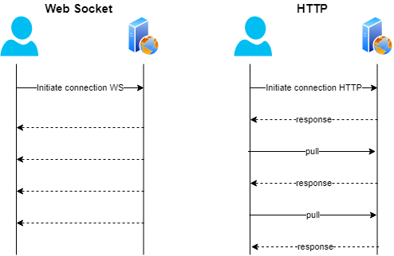
What is WebSocket?
response
response
response
response
Close connection

Slide 3
Differences between HTTP and Websocket
HTTP (https://) | WebSocket (wss://)
Half Duplex | Full Duplex
Consumes time to establishing new TCP connection every time. | Establishes connection only once
Connection closes after request is completed. | Connection stays open.
Client/Server don’t listen to events over TCP connection. | Both client and server are simultaneously listening to change in events.

Slide 4

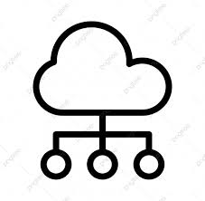
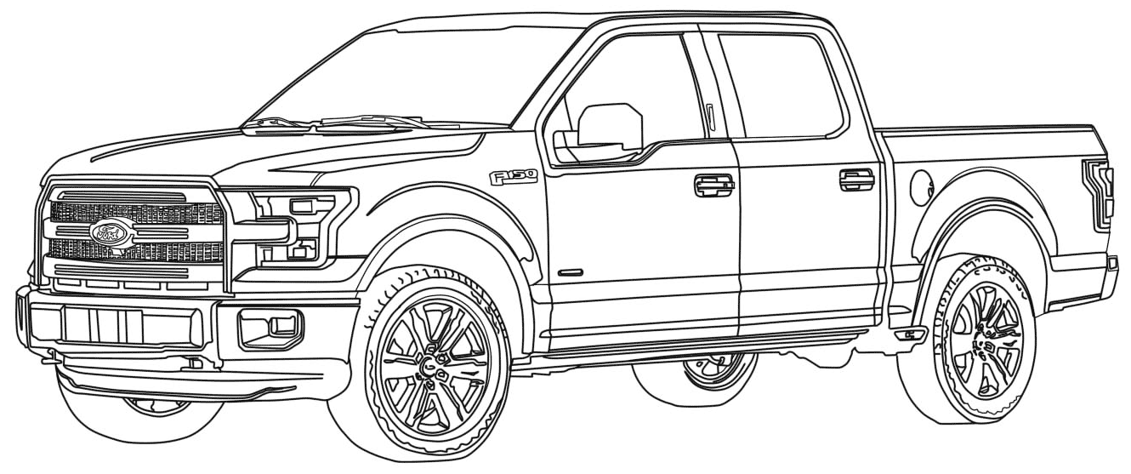
Current Architecture (HTTP - Polling)
FP/LW
1. HTTP Request - Send command API (REMOTE_START, LOCK)
VSDN/
TMC
Command Polling Architecture
Requires Polling
Multiple Calls
Increased Complexity
Slow end-to-end response time
2. HTTP Response - Receives correlation Id for the command
3. HTTP Request/Response Polling
4. HTTP Request/Response Polling - SUCCESS response

Slide 5
New Architecture (WebSocket)
1. WebSocket Open Connection to Telemetry API
FP/LW
TMC
2. HTTP Request - Send command to Vehicle API
WebSockets Architecture
Eliminates Polling
Improves Performance
Reduces Complexity
Fast response time
3. HTTP Response - Receives correlation Id for the command
gPRC
1.a WebSocket Telemetry API – Latest Telemetry Data
1.b WebSocket Telemetry API - SUCCESS
4. WebSocket Close Connection to Telemetry API
* All traffic is through secure port 443 (https)

Slide 6
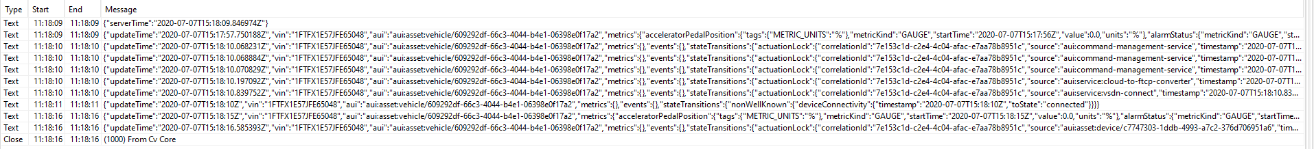
Vehicle Commands using Websocket
Telemetry over websocket connection
Sending command over HTTP
Telemetry websocket stream:

Slide 7
Vehicle Commands using Websocket
{
"updateTime": "2020-07-07T15:22:51.621364Z",
"vin": "1FTFX1E57JFE65048",
"aui": "aui:asset:vehicle/609292df-66c3-4044-b4e1-06398e0f17a2",
"metrics": {},
"events": {},
"stateTransitions": {
"actuationLock": {
"correlationId": "d9bfbeba-0d2b-4c25-ba10-53d2c209605e",
"source": "aui:command-management-service",
"timestamp": "2020-07-07T15:22:51.621364Z",
"message": "Command has been queued for delivery",
"fromState": "requested",
"toState": "request_delivery_queued"
}
}
}

Slide 8
Current Command Response Time Distribution
 | Lock - TMC Polling | Lock - TMC WebSockets
TCU VIN | 13 sec | 8 sec
India - IWID | 10 sec | 7 sec
Mexico - ePID | 6 sec | 3 sec
Disclaimer: Sample data size is less. Tests have been performed only on few vehicles.

Slide 9
Pros
Better response time is observed.
Reduced mobile app complexity & eliminating polling.
Cons
Increased complexity in model classes.
Telemetry can come before or after success state.
iOS - native WebSocket support is not available for iOS 12 and below.

Slide 10
WebSockets with RxJava
Observable.create { emitter ->
val websocket = object : WebSocketListener() {…………}
}.let { listener ->
httpClient.newWebSocket(request(vin), listener)
}

Slide 11
WebSocketListener() {
override fun onOpen() { }
override fun onMessage(websocket: WebSocket, message: String) {
emitter.onNext(message)
}
override fun onClosed() { emitter.onComplete() }
}

Slide 12

Processing websocket data
CV Core
CV Core
FordPass
map (response -> Gson().fromJson(response, VehicleStatusResponse))
Filter (Message length > 2)
filter (isResponseSuccess || isResponseFailure)
TMC
map (response -> populateFinalResponse())
filter (response -> response.correlationId == commandId)
{
"metrics": {
"doorStatus": [
{
"metricKind": "GAUGE",
"startTime": "2020-07-07T15:18:15Z",
"value": “AJAR",
"vehicleDoor": "REAR_LEFT",
"vehicleOccupantRole": "PASSENGER"
}]},
"stateTransitions": {},
}
{
"metrics": {},
"stateTransitions": {
"actuationLock": {
"correlationId": "7e153c1d-c2e4-4c04-afac-e7aa78b8951c",
"fromState": "request_delivery_queued",
"toState": "success"
}
}
}
{
"metrics": {},
"stateTransitions": {
"actuationLock": {
"correlationId": "7e153c1d-c2e4-4c04-afac-e7aa78b8951c",
"fromState": "requested",
"toState": "requested"
}
}
}
{
"metrics": {},
"stateTransitions": {
"actuationLock": {
"correlationId": "7e153c1d-c2e4-4c04-afac-e7aa78b8951c",
"fromState": "requested",
"toState": "request_delivery_queued"
}
}
}
Contains metrics and success state?
Contains failure state / timeout?

Slide 13
Scalability?
Customize our own command process implementation.

Slide 14
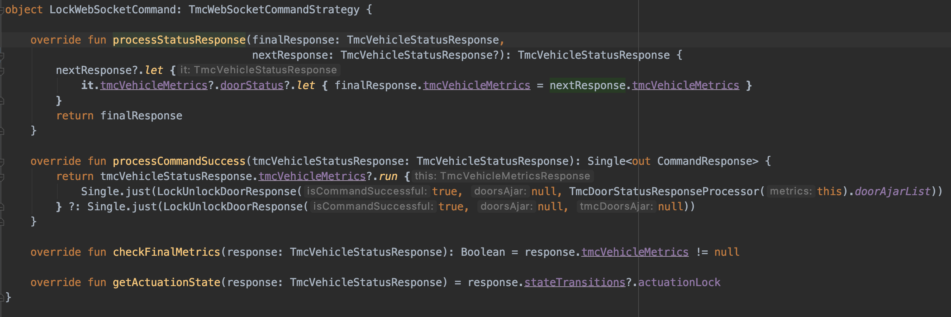

Slide 15
Thank you

