Slide 1
Introduction to OpenNMS
v1.1

Slide 2




What is OpenNMS?
Vision: A world where monitoring just happens
Scalable
Extensible
Open Source
Supported
​Monitors tens of thousands of devices while processing terabytes of data from a single instance.
Extensible platform enabling adaptation and integration into core business processes.
Published under the AGPLv3 license, OpenNMS is a fully open source solution.
Sustained by a large community of users and supported commercially by The OpenNMS Group
OpenNMS is a scalable and highly configurable open-source network management platform with comprehensive fault, performance, and traffic monitoring.
It easily integrates with your core business applications and workflows to monitor and visualize everything in your network.

Slide 3
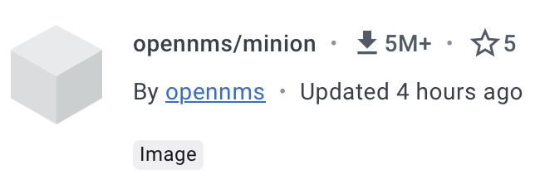
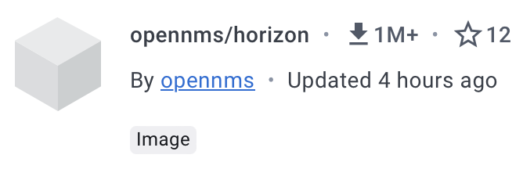
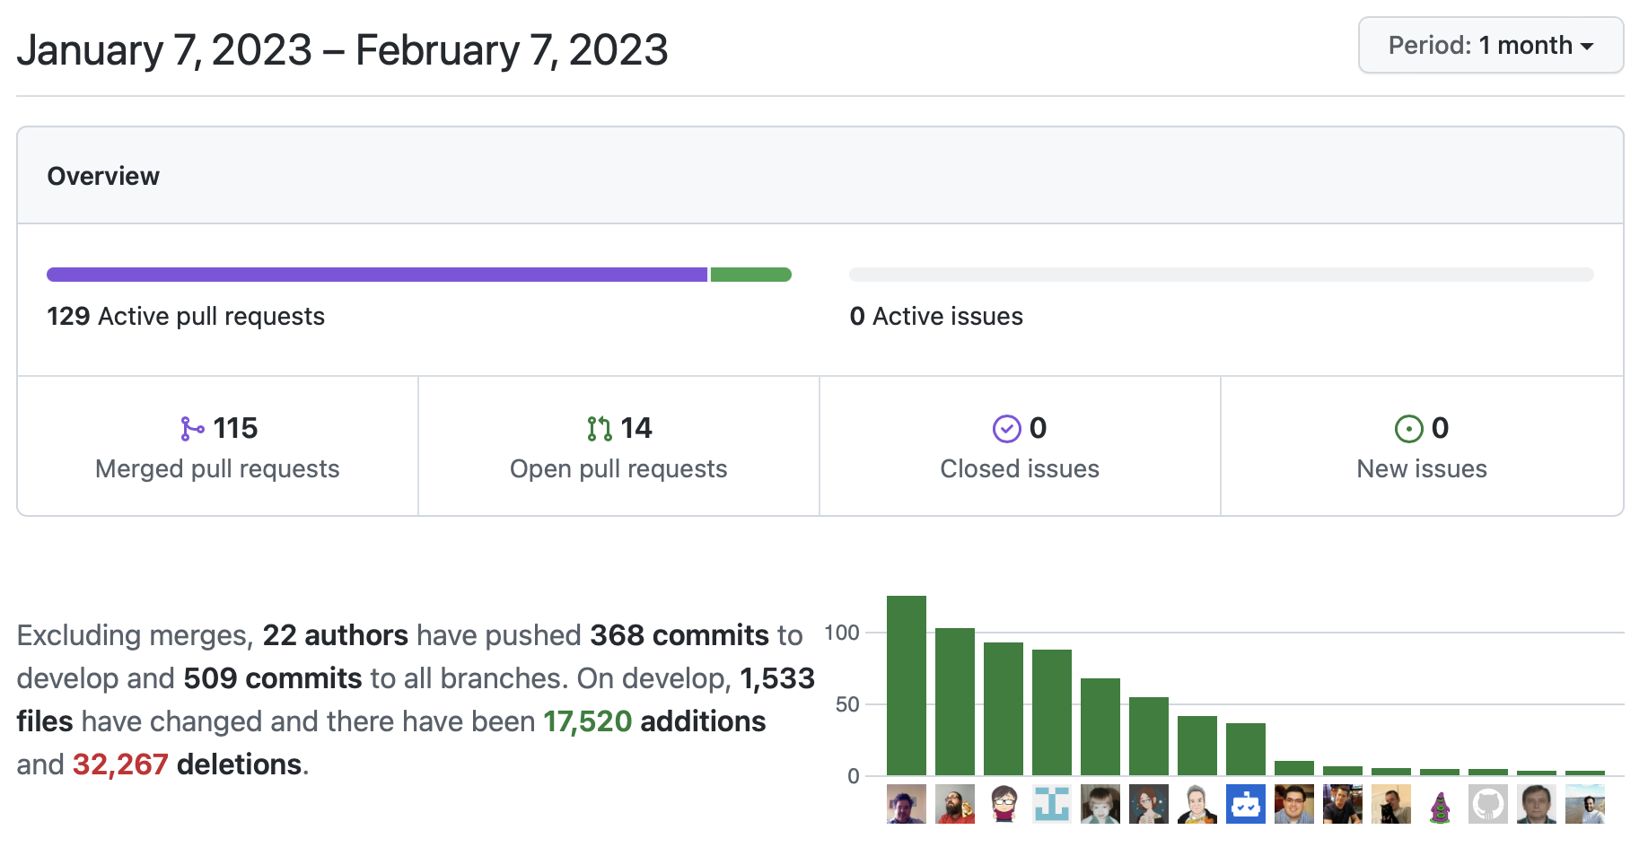
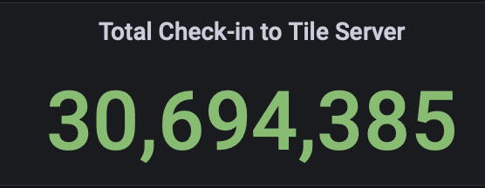
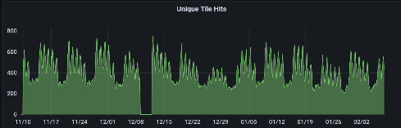
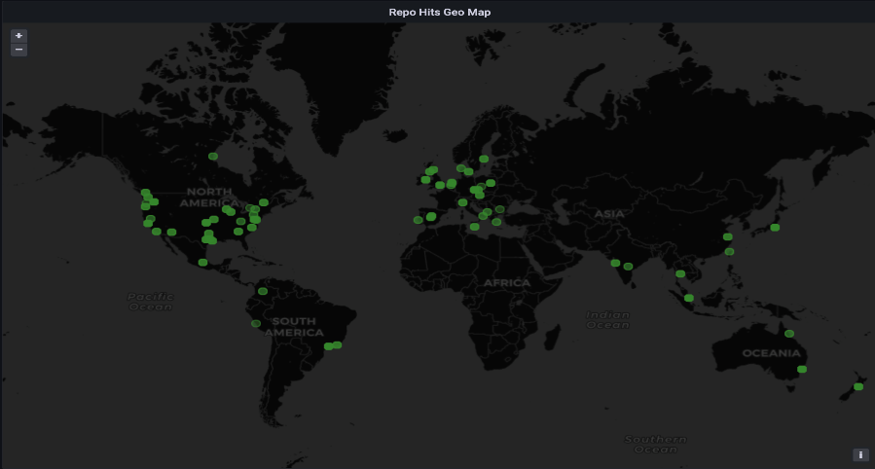
OpenNMS Open Source Community
9M Minion
Container
Downloads!
DockerHub Stats
GitHub Stats
Web Stats (90 Days)

Slide 4
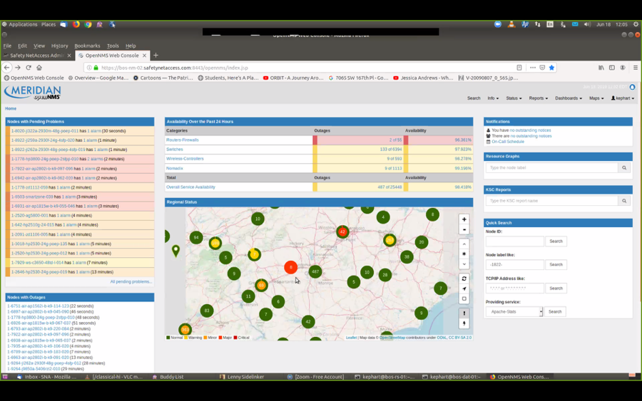
The OpenNMS Solution
Event Management
Fault / Alarm Management
Performance Management
Network Traffic Management
Network Inventory Management
AI Correlation

Slide 5











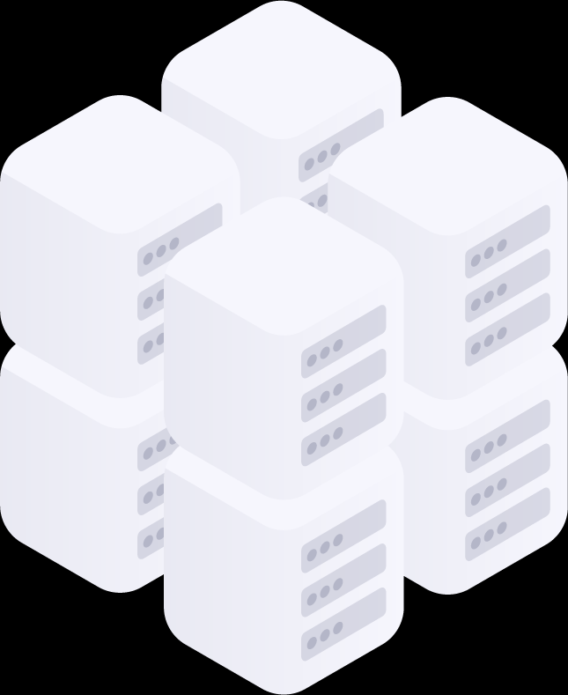



OpenNMS Architecture
Sentinel can optionally scale persistence using local shards
Kafka based secure data pipeline
ES plugin
Elasticsearch
Other OSS Systems
Trouble ticket / CMDB etc
Grafana
Grafana plugin
Time Series DB
Sentinel
Kafka
Forwarder
ReST API
ReST API
OpenNMS Core
Apache Kafka
Cluster
Cassandra
Distributed minions or appliances monitor remote network segments
PostgreSQL
Cassandra
ES plugin
Elasticsearch
SNMP
Logs
Flows
Telemetry
etc.
configuration, inventory and current alarms in PostgreSQL
Alarm and flows archived in Elastic Search
can also use ActiveMQ
Time Series DB
Time Series date stored in Cloud Time Series db, Cassandra or RRD files
Minion
can also use gRPC

Slide 6
Plugin Architecture
Key Features
OpenNMS Integration API
Lifecycle Independent of core OpenNMS
Based on OSGi (Apache Karaf)
Class path / feature / bundle isolation
Reuse of code ‘bundles’ across plugins
Plugin Capabilities
UI components which automatically register and extend the core dashboard
Configuration Components which add definitions for events / alarms / data collection / Correlation Rules
Topology Provider components which show up as domain specific topologies and can be used by ALEC
Interface components which provide new external API’s (Data collection Protocols and Integration Protocols)
Benefits
Allows new and complex functionality to be incrementally developed, tested and safely deployed in a production system
Core / Minion / Sentinel
Plugin features
core features
OpenNMS Integration API
OSGi / karaf
.m2 / system
JVM/JDK
OS

Slide 7
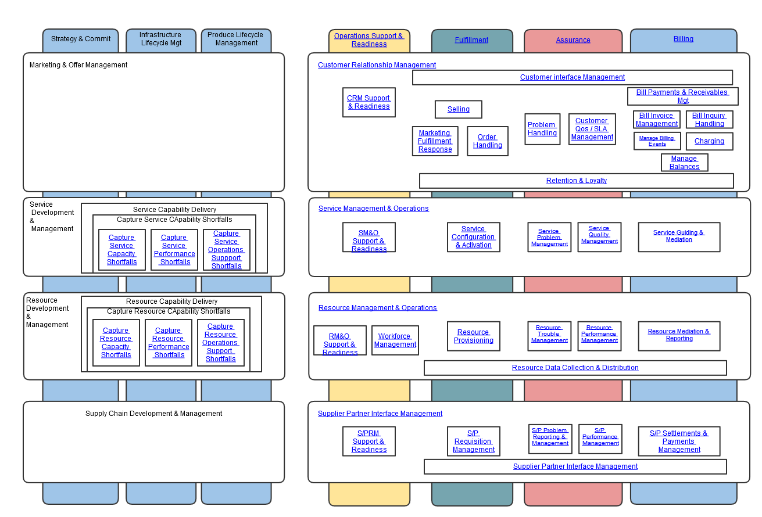
Problem Handling Touch Points
TM Forum Business Process Framework (eTOM)

Slide 8
Performance Management Touch Points
TM Forum Business Process Framework (eTOM)

Slide 9




Resource Data Collection at All Layers
Remote Minions
Remotely monitor services from multiple locations
minion
minion
minion
Application
Space
Synthetic Transactions / Data Collection
ICMP / HTTP / HTTPS
ReST / WS / XML
DHCP / DNS / FTP / LDAP Radius
IMAP / POP3 /SMTP / NTP
JDBC / JSR160 (JMX) / WMS / WBEM
NSClient (Nagios Agent) / NRPE (Nagios Remote Plugin Executor)
SMB / Citrix
SNMP / SSH TCP
Virtualisation
VMware integration
Open Stack (being developed)
Service & Network discovery
VMware integration
Policy driven Layer 2 network discovery
Access Network Cloud
URI
URI
URI
Service 1
Virtualised
Infrastructure
And applications
Service 3
Service 2
VM
VM
VM
VM
VM
VM
VM
VM
VM
VM
VM
VM
Physical
Infrastructure
Core Network Cloud

Slide 10
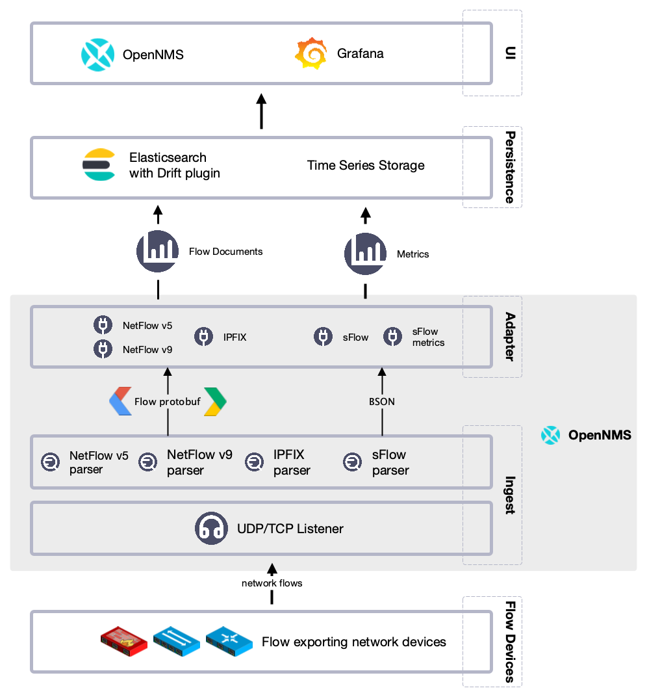
Flow Data Collection

Slide 11
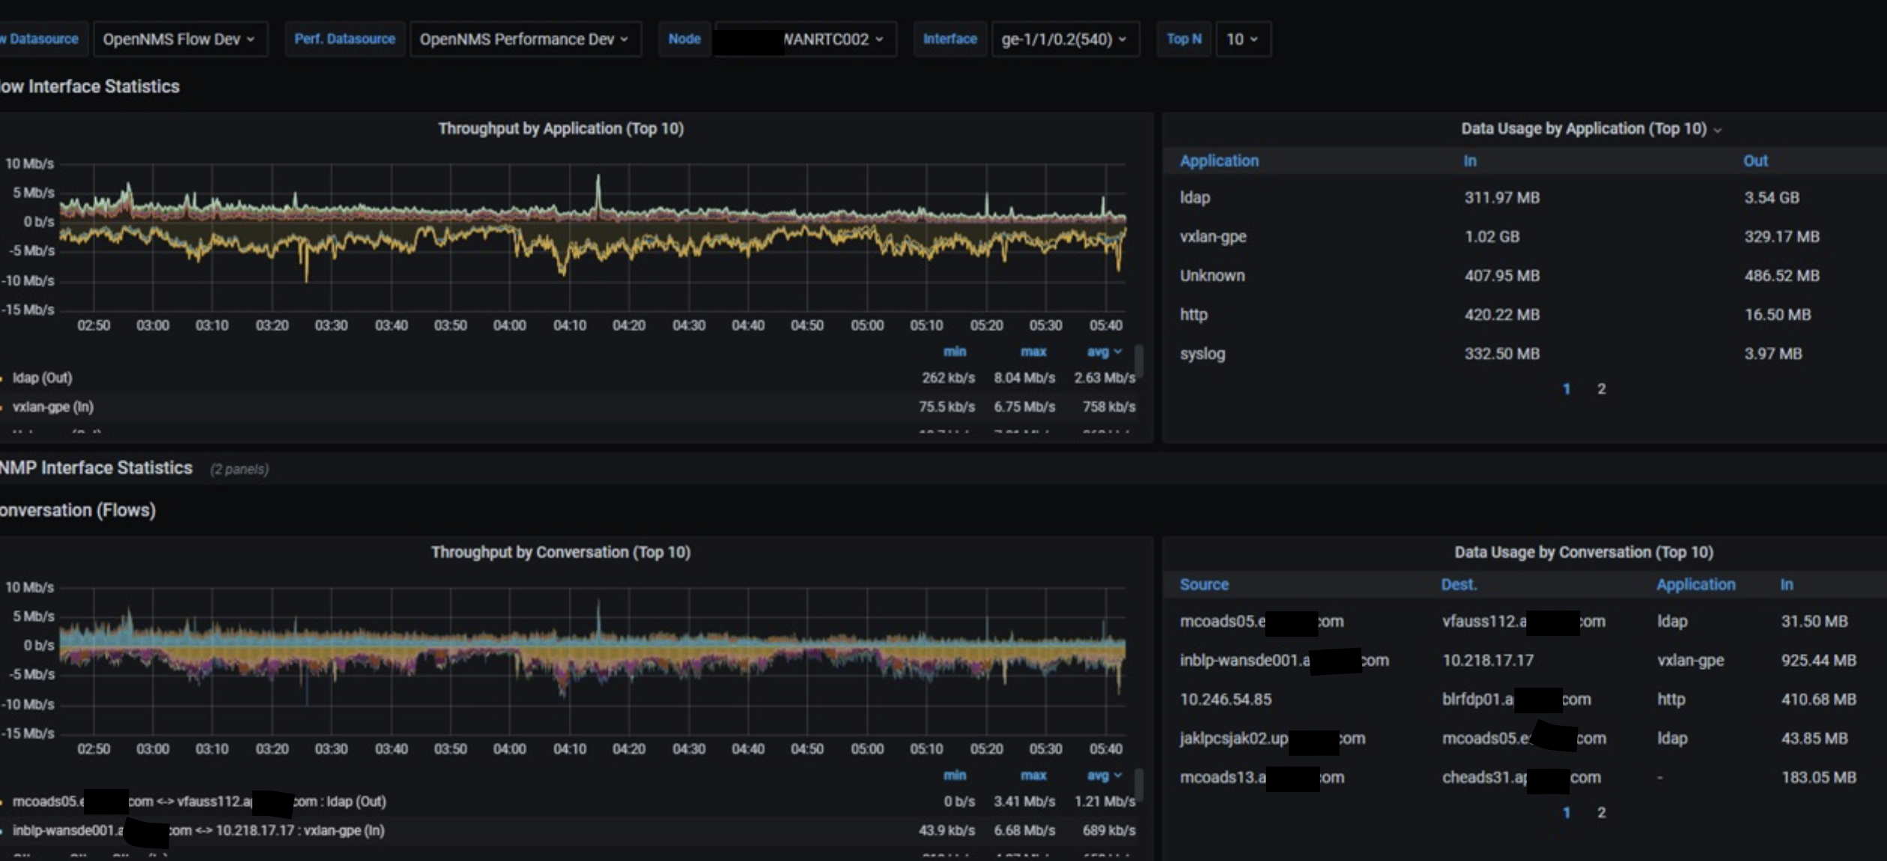


Traffic Analysis (NetFlow)
Who’s using all the bandwidth?
Single source of truth
Be the hero when a security incident response team asks, “Do you have flows?”
Who’s talking to whom?
What are they talking about?
Network flow: data lake

Slide 12
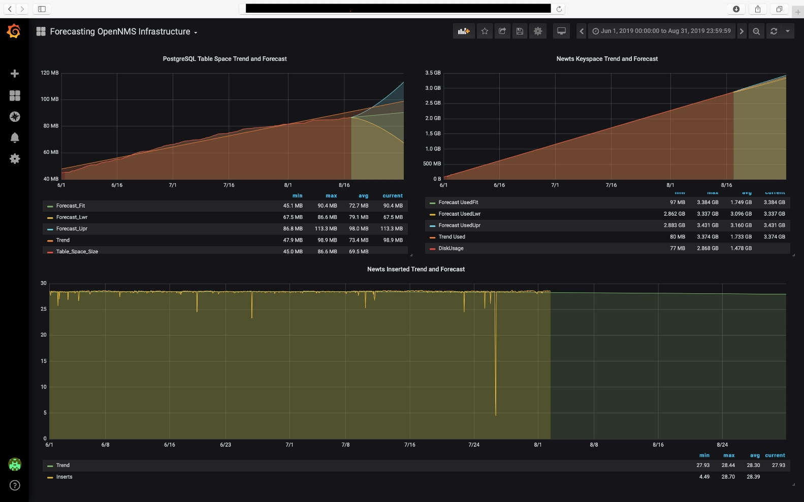
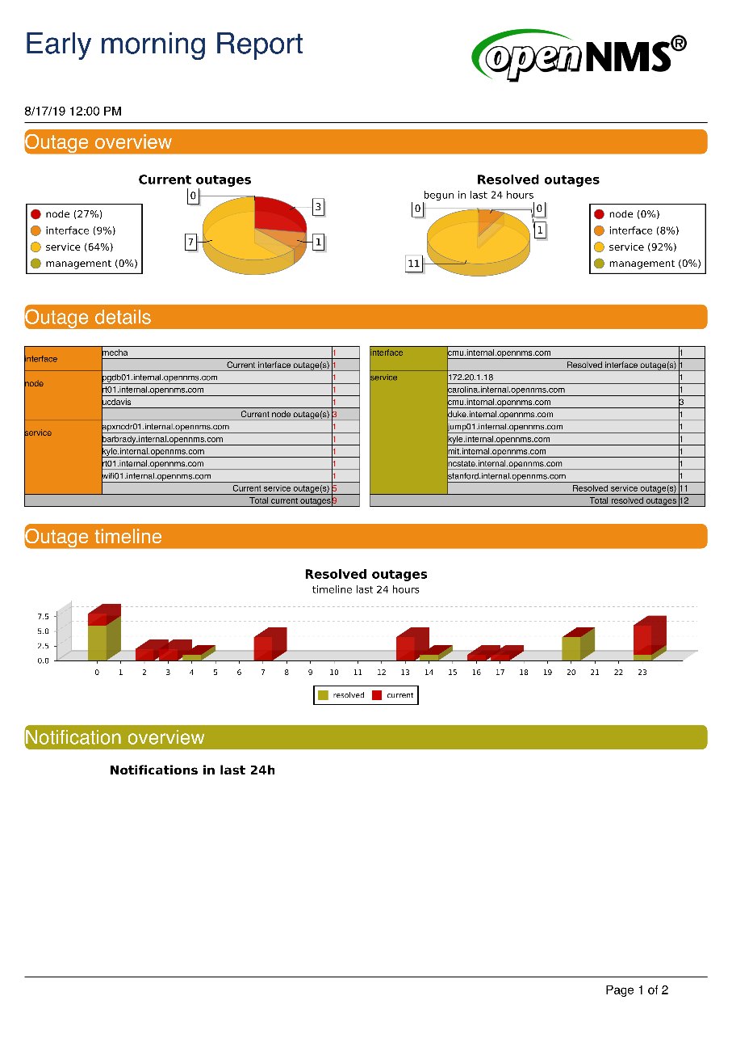
Enterprise Reporting
Run *any* Grafana Dashboard
as an Enterprise Report

Slide 13
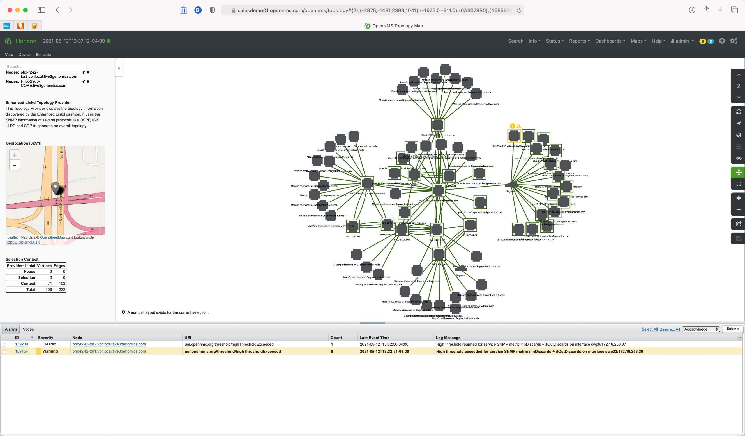
Network Topology
Focal Point Driven Context
Enhanced Linkd Discovery
ospf (layer 3)
is-is
cdp
lldp
bridge
other (graph-ml)

Slide 14
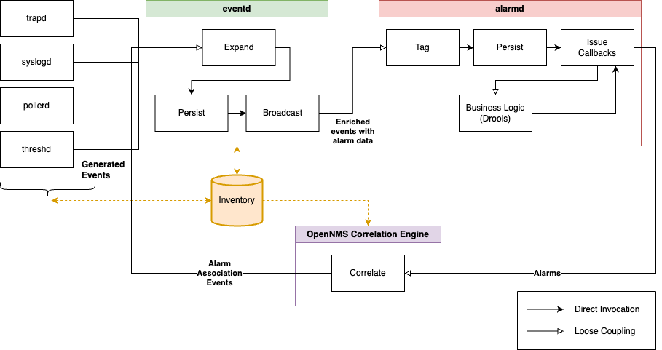
Event and Alarm Corelation

Slide 15
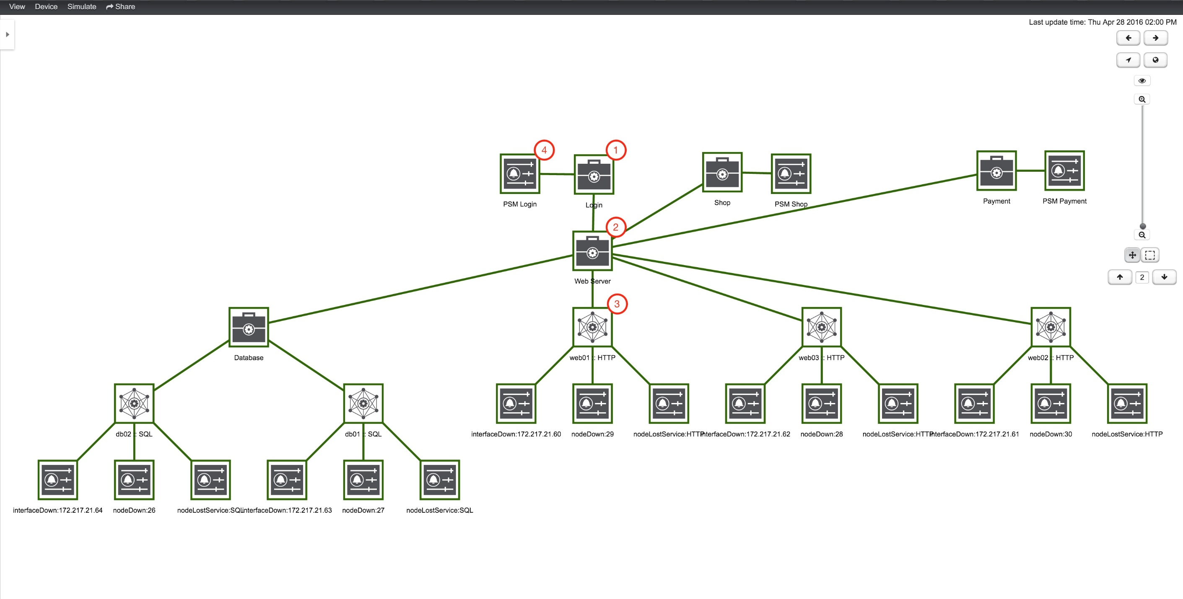
Business Service Monitoring

