Slide 1

TEAM MEMEBERS
KARISHMA M
KAMALI G
JANANI B
DESIGN AND IMPLEMENTATION OF INTELLIGENT VEHICLE HEADLIGHT DIMMER

Slide 2

OVERVIEW
  Introduction
  Key Features
  Objective
  Components Used
  Circuit Diagram
  Working Principle
  Application
  Innovation-Benefits-Impact
  Key Points

Slide 3

INTRODUCTION
The Intelligent Vehicle Headlight Dimmer represents a ground breaking advancement in automotive safety technology, designed to automatically regulate headlight intensity based on real-time traffic conditions. This sophisticated system seamlessly transitions vehicle headlights from high beam to low beam when detecting approaching vehicles, significantly reducing the risk of glare-related accidents during night time driving.

Slide 4




KEY FEATURES
Much longer
recovery period
Increased time
value of money
Improved risk
taking ability
Time to recover the project cost from savings.
The benefits or savings from your headlight dimmer grow over time, making money spent today more valuable in the future due to energy savings and reduced maintenance.
Helps drivers make safer decisions at night by reducing glare and boosting confidence on the road.

Slide 5

OBJECTIVE
The objective of the Intelligent Vehicle Headlight Dimmer is to enhance road safety by preventing accidents caused by high-beam glare during night driving. This system is designed to automatically switch headlights from high beam to low beam without requiring any driver intervention, thereby reducing discomfort, distraction, and eye strain for both drivers. It also helps in extending the lifespan of headlights and relay components by minimizing unnecessary usage. With its low-cost and reliable design, the system ensures improved driving comfort and safety, especially on rural and poorly lit roads.

Slide 6
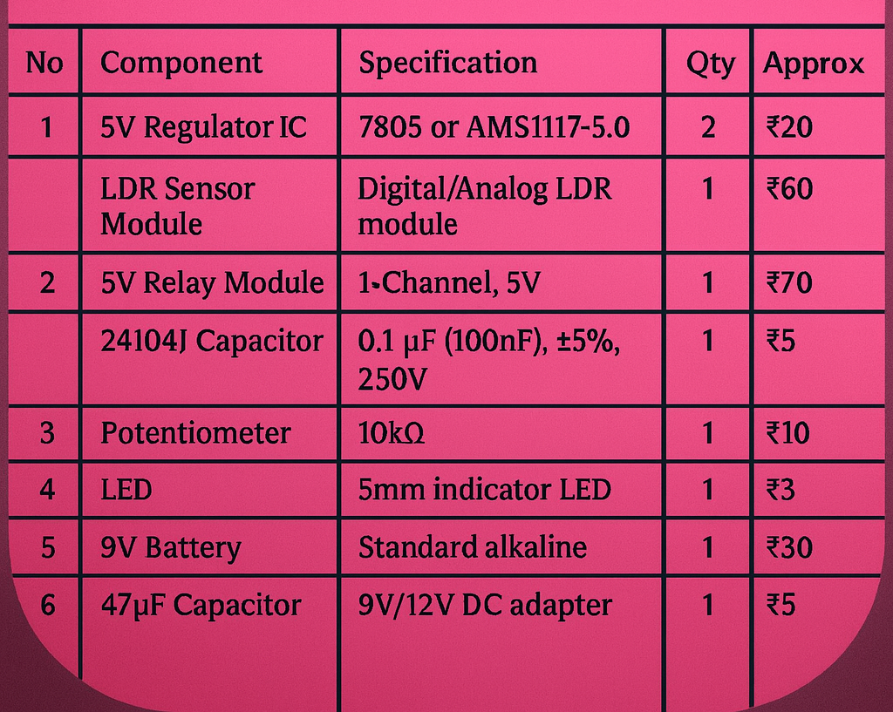
COMPONENTS USED

Slide 7
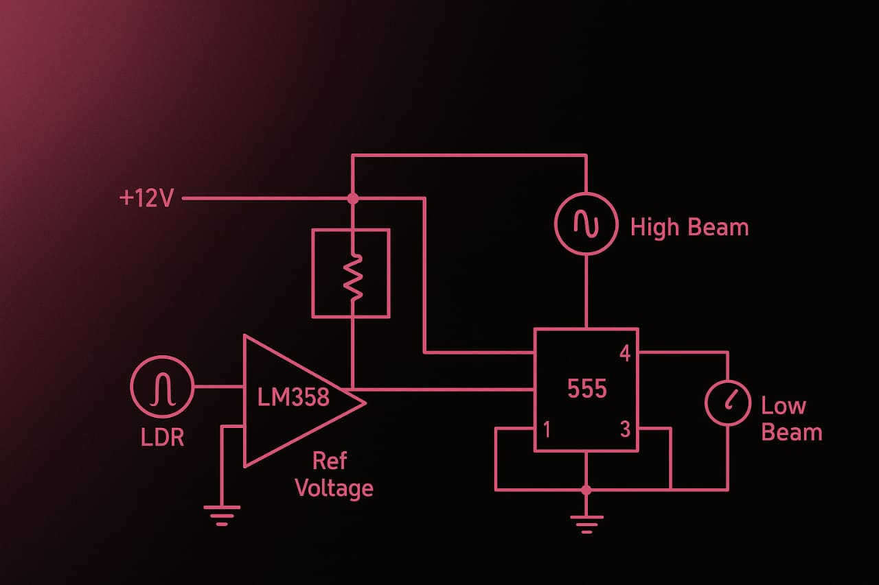
CIRCUIT DIAGRAM
The Intelligent Headlight Dimmer circuit uses an LDR with an LM358 comparator to detect glare from oncoming vehicles. A 555 timer prevents flicker, and a relay automatically switches headlights from high beam to low beam, ensuring safer night driving.
Amount
Number of years

Slide 8
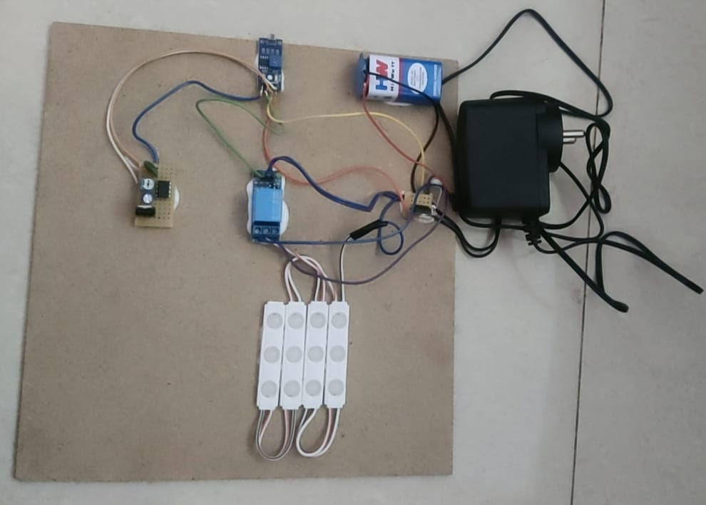
PROTOTYPE
The prototype of the Intelligent Vehicle Headlight Dimmer is a small-scale working model that automatically adjusts a vehicle’s headlight from high beam to low beam using an LDR sensor and a microcontroller.
Amount
Number of years

Slide 9
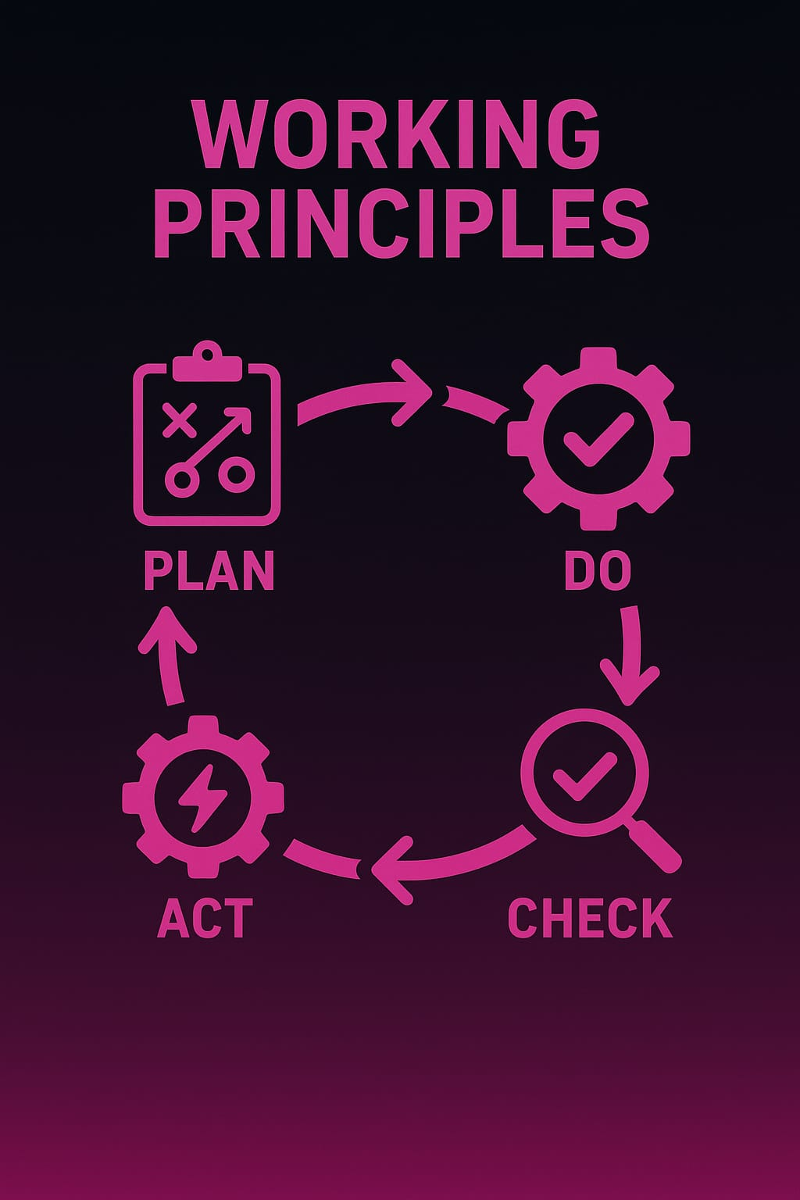
WORKING PRINCIPLE
The Intelligent Headlight Dimmer automatically adjusts headlight brightness based on ambient light or oncoming vehicles using sensors and a control circuit.

Slide 10
WORKING
DEMO
The working demo shows an LDR sensing bright light from an oncoming vehicle and sending the signal to a microcontroller, which instantly switches the headlight from high beam to low beam. When the light reduces, the system restores the high beam. This prototype effectively demonstrates automatic glare-free night driving.

Slide 11

APPLICATION AND FUTURE SCOPE
Used in vehicles to automatically adjust headlight brightness, enhancing safety and energy efficiency.
It can be integrated with smart sensors, AI, and IoT for fully adaptive lighting systems, improving safety, efficiency, and automation in vehicles.
APPLICATIONS
FUTURE SCOPE

Slide 12
INN0VATION - BENEFITS -IMPACT
It saves energy by adjusting brightness according to ambient light, reduces maintenance costs, and extends the lifespan of headlights.
Reducing glare and improving visibility. It also saves energy, lowers maintenance costs, and promotes innovative automotive with more efficient vehicles.
Automatically dims or brightens headlights based on real-time light conditions, improving safety and saving energy.

Slide 13

KEY POINTS
  Automatically adjusts headlight brightness.
  Uses light sensors for detection.
  Saves energy and reduces maintenance.
  Enhances night driving safety.
  Investment recovers over time through savings.

Slide 14

ANY QUERIES ?

Slide 15
THANK YOU !

