Slide 4
BACKGROUND & LITERATURE
04 / 11
Related Work & State-of-the-Art Baseline Comparison
Architecture / Paradigm | Core Technical Mechanism | Inherent Engineering Bottleneck | Our Proposed Framework
Traditional SIEM (Chen et al., 2024) | Log aggregation, ingestion indexing, and static threshold correlation rules. | Detection-only paradigm; zero endpoint volatile memory capture or active containment. | Synchronous OS-level trigger acquiring volatile telemetry at T0.
Monolithic SOAR (Islam et al., 2025) | Cloud-hosted playbooks with extensive multi-vendor API connectors. | Prohibitive operational cost, closed-source lock-in, and high cold-start latency. | Lightweight asynchronous REST pipeline (FastAPI + SQLite), zero external fees.
Manual DFIR Scripts (NIST SP 800-61) | Ad-hoc CLI command execution during scheduled post-incident analysis. | Volatile sockets wiped by attackers prior to analyst login; custody challenges. | Atomic SHA-256 generation concurrent with OS process execution.

Slide 5
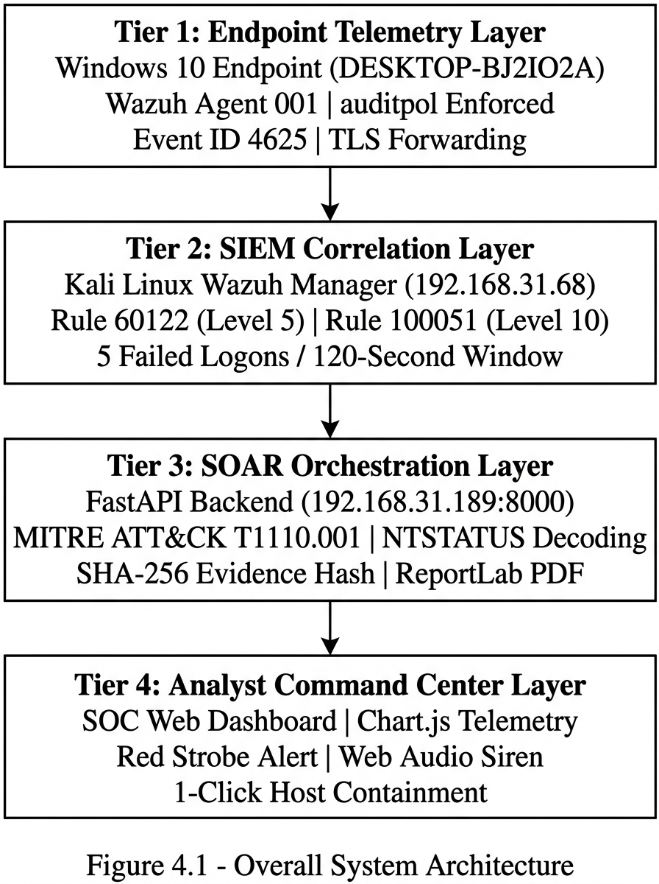

Slide 6
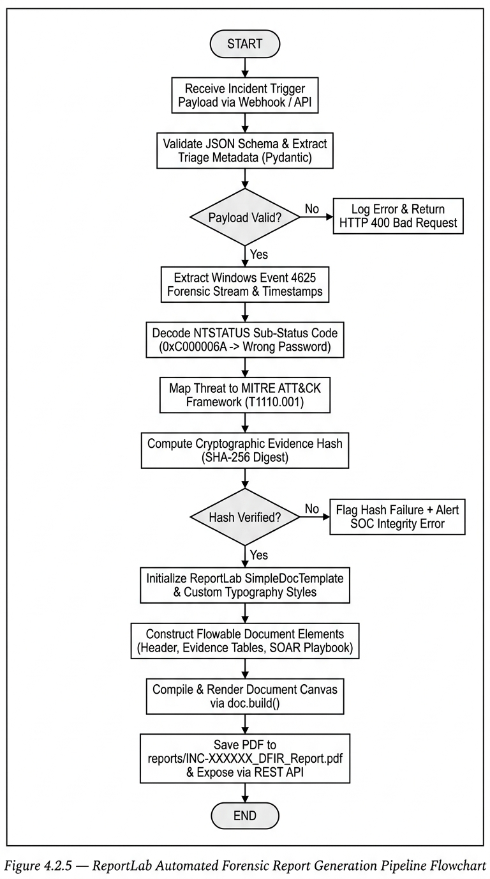

Slide 7
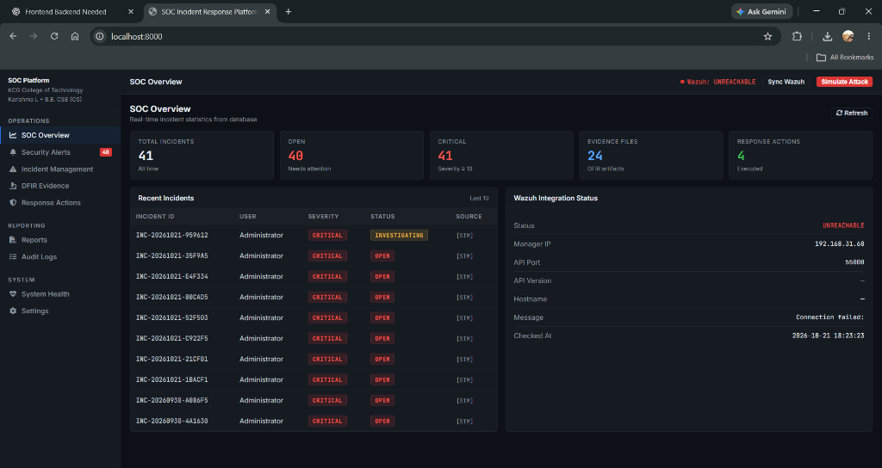

Slide 8
