Slide 1
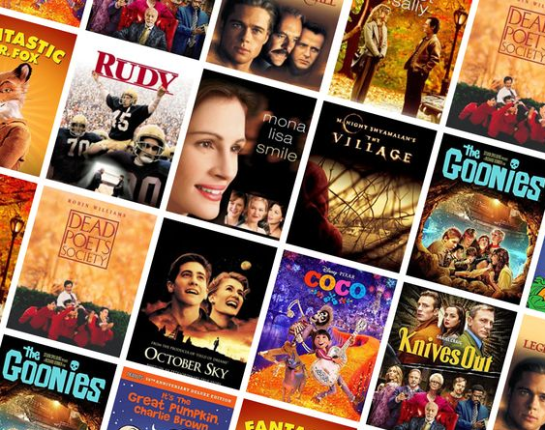
Recommendation Engine Using Movie Plots
Group 2
Gerry CHNG Kian Woon
Karishma YADAV
Mayurapriyann ARULMOZHI BASKARAN
SYED Ahmad Zaki Bin Syed Sakaf Al-Attas
Vertika PODDAR

Slide 2
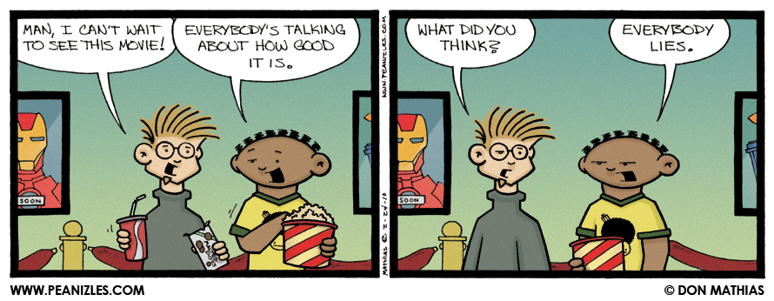
A PERENNIAL WEEKEND QUESTION…
“How can we find movies we know we’ll like?”

Slide 3


WHAT WE KNOW….
?
We Know What We Like.
We remembered those movies that captured our imagination, as we grew up from our young innocent selves to who we are today.
We Know Why We Like Them.
We remember vividly the themes, the plots and the reasons why these movies are so endearing to us.

Slide 4
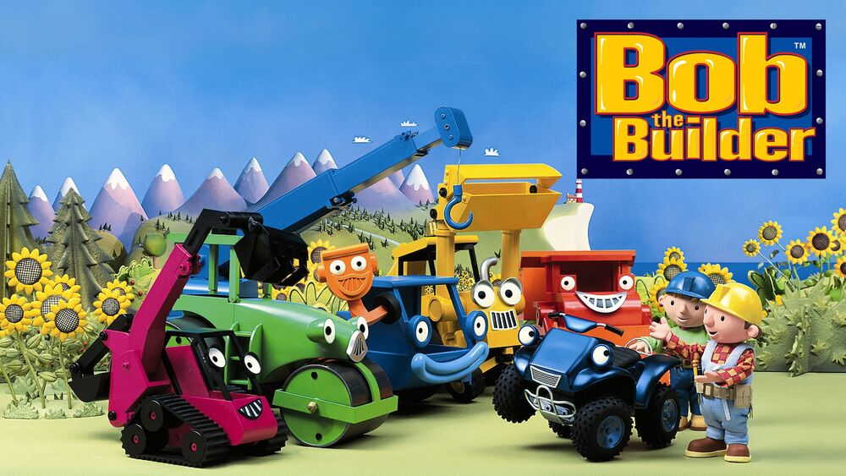
CAN WE BUILD A RECOMMENDATION ENGINE USING MOVIE SUMMARIES?
YES, WE CAN!
Picture taken from Bob The Builder (PBS Kids Wiki)

Slide 5





OUR APPROACH FOR TODAY
Raw Data
Cleaned Data
Trial-and-Error
Final Output
Demonstration

Slide 6




UNDERSTANDING THE RAW DATA USED
UNDERSTANDING ITS CHALLENGES
Movie Metadata (n = 81,741 movies)
Wikipedia movie ID
Freebase movie ID
Movie name
Movie release date
Movie box office revenue
Movie runtime
Movie languages (Freebase ID: name tuples)
Movie countries (Freebase ID: name tuples)
Movie genres (Freebase ID: name tuples)
Plot Summaries (n = 42,306)
Computationally Intensive
CPU-bound and memory-bound problem
High User Expectations
Users may expect a quick search result
Finding Complementary Datasets
Difficulty in web scraping an open data site in a working format
Fronting Our Model
Creating a user-friendly interface

Slide 7



OUR DATA CLEANING CONSIDERATIONS
Merge Data
Combine
Movie Metadata
with Plot Summaries
spaCy Processing
Tokenize,
POS Tagging,
Lemmatize,
Remove Stop-words
Raw Data
Movie Metadata
Plot Summaries
Filter
Kept only English movies,
released on or after 1980
(n = 14,000)
Cleaned Data
Lemmatized in
pickle format

Slide 8
FINDING SIMILAR DOCS USING A FEW KEY WORDS
CHOOSING VECTOR SPACE OVER TFIDF
MATCHING KEY WORDS AGAINST MAX AND TOTAL
WHY NOT TFIDF?
COSINE SIMILARITY CALCULATED AGAINST VECTOR SPACE
“If user types words that are not found in vocabulary, key films will not be highlighted.”
Plot_no. | “Cartoon” | “Babies” | “Unicorn” | “Fantasy” | Max | Total
3395527 | 0.602133 | 0.401775 | 0.473325 | 0.445883 | 0.602133 | 1.923115
23983916 | 0.368188 | 0.600923 | 0.323452 | 0.406480 | 0.600923 | 1.699044
18225554 | 0.376839 | 0.611129 | 0.341574 | 0.350316 | 0.611129 | 1.679859
18341506 | 0.362794 | 0.620921 | 0.298837 | 0.377428 | 0.620921 | 1.659980
21509421 | 0.342617 | 0.610400 | 0.315247 | 0.369882 | 0.610400 | 1.638146
24642297 | 0.341580 | 0.600720 | 0.273245 | 0.348008 | 0.600720 | 1.563553
WHY VECTOR SPACE?
“Each word or string is considered as a word vector with 300 dimensions. Even though the user types in words that are not found in the vocabulary, similar words that are close to the query term in the vector space is returned.”

Slide 9
ABSTRACTIVE SUMMARISATION, USING PEGASUS, MADE THE MOST SENSE
Example of A Full Plot Summary
The film opens with Madhav and Sreenu playing a football cup final in Kolkata. Madhav and Sreenu are best friends, football players, and neighbours. Subsequently, the team wins the cup. A mishap happens when Sreenu tries to save Madhav from an accident. Madhav escapes with minor injuries, but Sreenu loses his leg. This puts an end to his football career. Sreenu, recovering from the incident, convinces Madhav not to tell anyone about the cause of Sreenu's accident. He does this to save the two families from drifting apart. Remembering his sacrifice, Madhav works hard and becomes the captain of the team, a post once held by Sreenu. Once, while visiting Goa for a match, Madhav sees Amrutha and falls in love with her. When Amrutha returns to her house, she finds her grandparents fixing her marriage with an NRI. The marriage breaks apart when the father of the groom gets to know about Madhav's love for Amrutha. Her heartbroken grandfather dies a few days later, and Amrutha holds Madhav responsible for all these incidents and starts hating him. Madhav tries to change her life by anonymously sending her gifts and money during her hardships. Amrutha desperately tries to find the person who was sending these to her. A few days later, during the festival of Holi, Amrutha mistakenly thinks Sreenu to be the sender of all the gifts and proposes him for marriage. Sreenu, not knowing about Madhav's love, agrees to the proposal. Madhav rushes to Sreenu's house, where he realises that the bride is no one else but Amrutha. Madhav sacrifices his love for his best friend's happiness. He tries to burn the photos of him and Amrutha in Goa, but he is seen by his father. His father gets to know the truth but Madhav convinces him not to tell anyone. Madhav decides to leave the town so that the marriage goes on smoothly. He fakes a letter asking him to report to Delhi for national football team selection. Sreenu asks him to leave immediately and to fulfill both of their dreams. Madhav, instead of going to Delhi, flies to Mumbai. Meanwhile, Sreenu's father learns about the photograph and Amrutha is questioned about their relationship. Amrutha realises that it was Madhav, and not Sreenu, who helped her. Sreenu and Amrutha leave for Mumbai. The film ends with Amrutha and Madhav getting together and Sreenu walking away with satisfaction.
Extractive Summarisation Results
Abstractive Summarisation Results
spaCy
TextRank
T5
BART
Pegasus
The marriage breaks apart when the father of the groom gets to know about Madhav’s love for Amrutha. The fil opens with Madhav and Sreenu playing a football cup final in Kolkata. A few days later, during the festival of Holi, Amrutha mistakenly thinks Sreenu to be the sender of all the gifts and proposes him for marriage. Madhav tried to change her life by anonymously sending her gifts and money during her hardships. His father gets to know the truth but Madhav convinces him not to tell anyone.
The marriage breaks apart when the father of the groom gets to know about Madhav’s love for Amrutha. Sreenu and Amrutha leave for Mumbai. His father gets to know the truth but Madhav convinces him not to tell anyone.
A mishap happens when Sreenu tries to save Madhav from an accident. He convinces Madhav not to tell anyone about the cause of the accident, which puts an end to his football career.
Madhav and Sreenu are best friends, football players and neighbours. While visiting Goa for a match, Madhav sees Amrutha and falls in love with her. Her grandparents fix her marriage with an NRI. The marriage breaks apart when the father of the groom gets to know.
Madhav and Sreenu are best friends, football players and neighbours. Once, while visiting Goa for a match, Madhav sees Amrutha and falls in love with her. The marriage breaks apart when the father of the groom gets to know about Madhav’s love for Amrutha.
Incomplete
Incomplete
Choosing Only Selected Sentences
Reduces The Overall Plot.

Slide 10
HOW WOULD THE FINAL SOLUTION LOOK LIKE?
User
“Like” movies
that meet
criteria
Final Top 20 movies shown with abstractive summaries
WHAT
USER SEES
User enters
key words
Initial Top 20 movies shown
WHAT
HAPPENS IN
BACKEND
Key words are treated as a word vector, and used in cosine similarity calculations with the rest of the corpus
Plot summaries are ranked in order of the highest cosine similarity to the selected movies
Pre-Processing Step:
Abstractive summarisation on plot summaries
Cosine similarity between all plot summaries
Display
Action
Backend

Slide 11




POSSIBLE FUTURE WORK SCOPE
Include
cast and character names
as part of
initial search words
Human annotators as a comparison to our generated abstractive summaries
Adapting recommendation model on academic journals with formulaes and equations
Model evaluation against publicly accessible movie databases (IMDb movie recommendations)

Slide 12
DEMO TIME

Slide 13
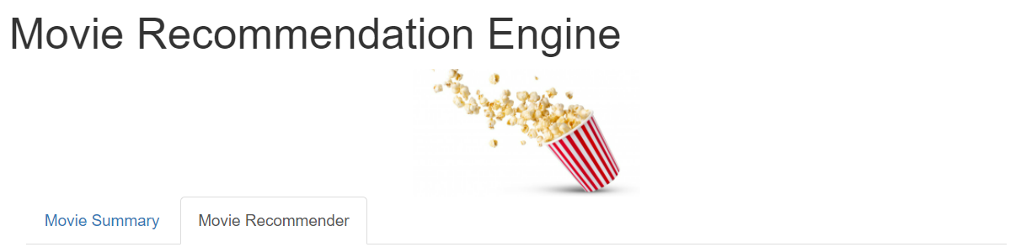
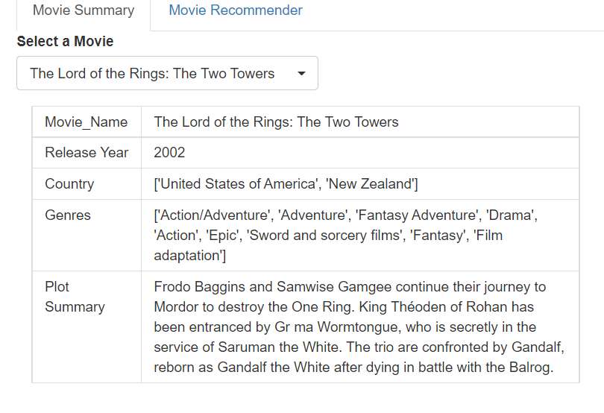
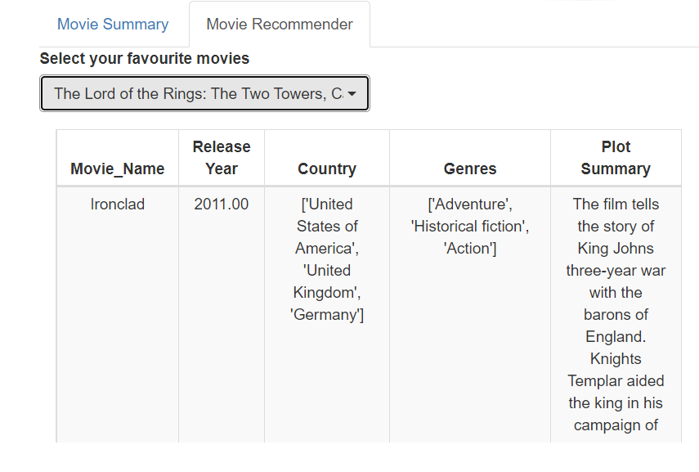
R SHINY USER INTERFACE
Home Page
Tab for the users to check plot summary for a movie of their choice
Tab for the users to get top 20 movie recommendations based on their ‘Liked’ movies based on a similarity matrix

Slide 14
THANK YOU

Slide 15
WHAT WERE OUR LEARNINGS & CONTRIBUTIONS?
Karishma
Worked along with Vertika to design the user interface for our project. We deployed the python models into RShiny using the reticulate package in R.
Learnt from our discussions during the project meeting how the models were built by my fellow teammates and understood the python codes while deploying the models in R.
Vertika
Teamed up with Karishma to design the user interface using RShiny to showcase our work. For this we deployed the Python models using the reticulate package in R, and in the process understood the rationale and the logic of the codes used.
From team discussions, gained an in depth understanding of the models built by the fellow team members and the practical challenges encountered.
Gerry
It is important to understand the inner workings to be able to identify and choose an approach suited to your use case. NLP is also not just about the models, but the entire MLOps process from obtaining data (either dataset or scrapped), cleaning, operational pipelining, and interfacing to user.
Handled the coding of the algorithm and providing a shared compute platform for the team.
Mayur
Understood the process and complexities involved in building a fully functional recommender system. Explored various extractive and abstractive text summarization techniques and finalized on ideal summarization technique that suited our dataset by trial-and-error approach.
Zaki
Text analytics coding is complex. Glad to stand on the shoulders of giants within my team!! Did up slides and presentation.

Slide 16
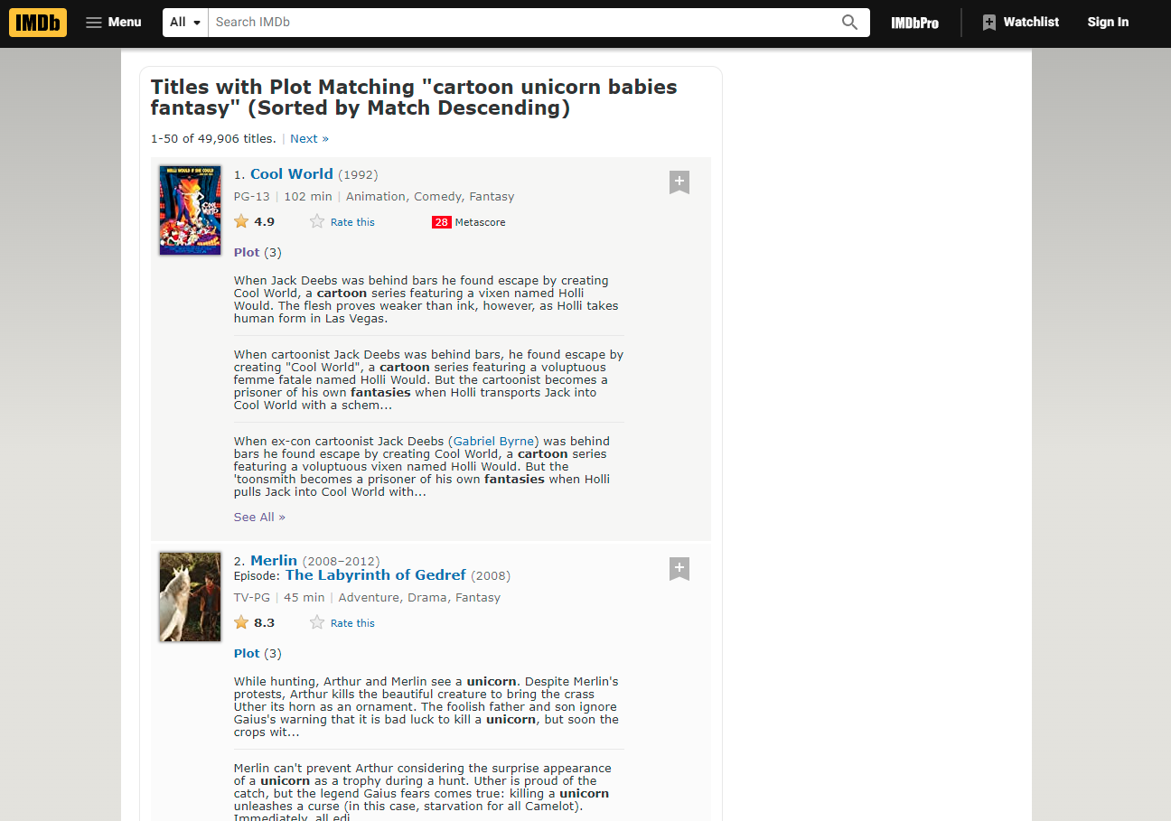
IMDB APPEARED TO USE A TERM COMPARISON FOR ITS SEARCH

