Slide 1


CMPT-732: Programming in Big Data Project Datastorm
Crystal Dias
Karishma Damania
Jeanne Helm
M.Sc. in Professional Computer Science
9th December 2022
Notes:
Introduction: Crystal

Slide 2
Problem Definition

Slide 3
Problem Statement Study about weather across Canada to help in identifying habitable places with favourable climatic conditions.
Dataset GHCN (Global Historical Climatology Network) daily with records of 175+ years for 100k stations around the world
Proposed Methodology Scalable solution adhering to the 4 Vs - volume, velocity, variety and veracity of Big Data
Notes:
Crystal
write out GHCN

Slide 4
Methodology

Slide 5
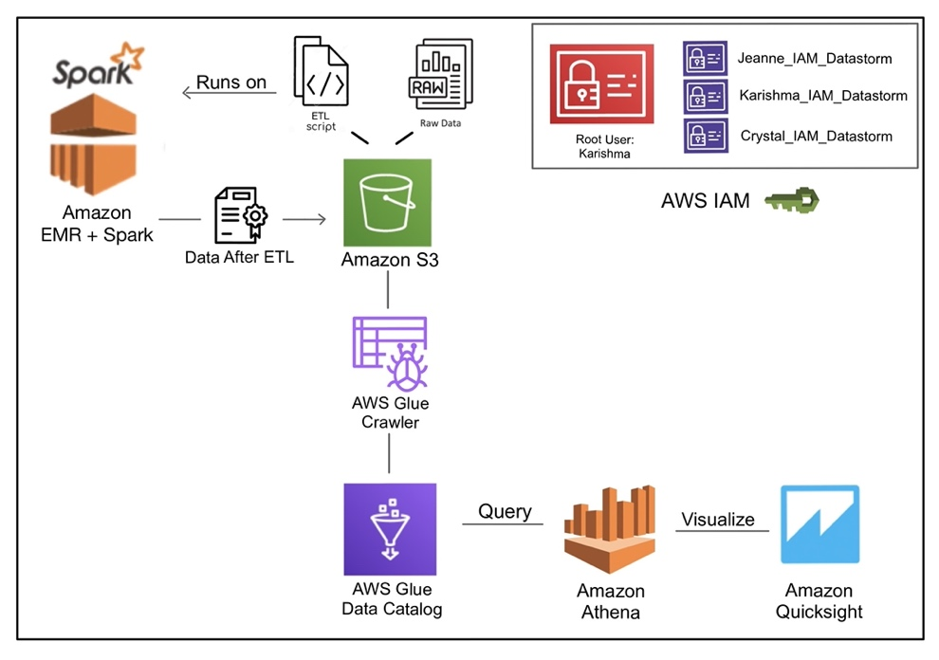
Architecture
ETL
Apache Spark
Amazon EMR
Storage
Amazon S3
Analysis
AWS Glue
Amazon Athena
Visualization
Amazon QuickSight
Security
Amazon IAM Access
Notes:
We’ll talk about the technology on the video
Karishma: introduce what we’ll demonstrate
Jeanne: do the demo, problems
163431423073

Slide 6
Problems and Results
Notes:
Switch to the browser:
Log in
Talk about IAM
Go to EMR
Show S3
Move on to Glue
Go to Athena (sample query)
Go to the Github Project – Show what can be found where (e. g. sample queries?)
Results
Go to QuickSight
Show data sources
Show Analysis
Show Dashboards
Shared Folder
Talk about the results – all 3 of us
WIND
PRCP Kari
SNOW you
draw a conclusion ?? Kari or crystal

Slide 7

Thank you

