Slide 1


CMPT-732: Programming in Big Data Project Datastorm
Crystal Dias
Karishma Damania
Jeanne Helm
M.Sc. in Professional Computer Science
9th December 2022

Slide 2
Problem Definition

Slide 3
Problem Statement Study about weather across Canada to help in identifying habitable places with favourable climatic conditions.
Dataset GHCN daily with records of 175+ years for 100k stations around the world
Proposed Methodology Scalable solution adhering to the 4 Vs - volume, velocity, variety and veracity of Big Data
Notes:
On-brand bullet points
* copy and paste to reuse *
FONT: Header:
Impact, uppercase Subheads and Table: Trebuchet MS, bold, uppercase Body: Times, sentence-case

Slide 4
Methodology

Slide 5
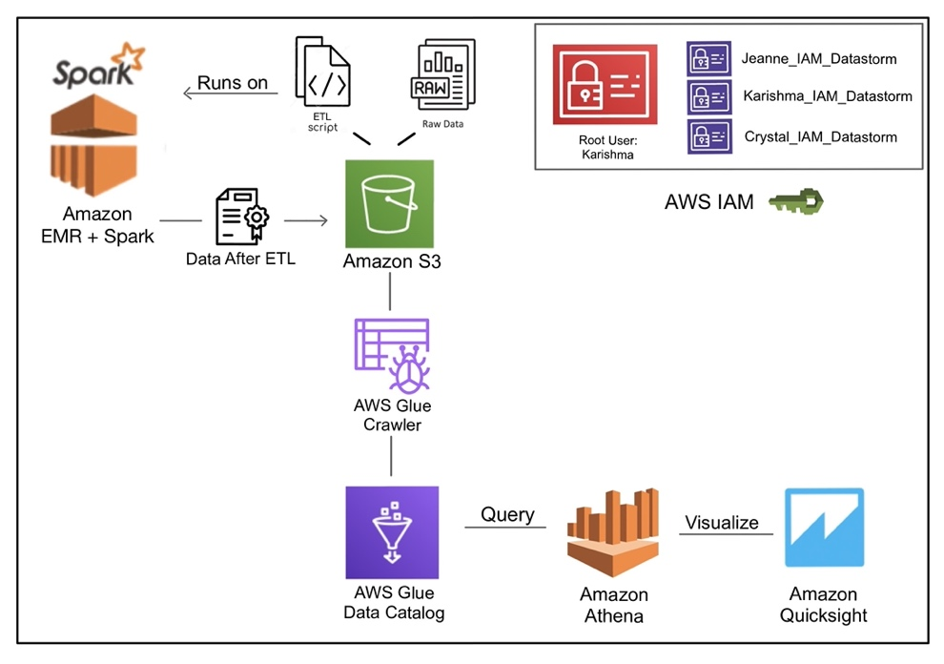
Architecture
ETL Apache Spark Amazon EMR
Storage Amazon S3
Analysis AWS Glue Amazon Athena
Visualization
Amazon QuickSight
Security
Amazon IAM Access
Notes:
TODO: FORMATTING
We’ll talk about the technology on the video

Slide 6
Problems and Results
Notes:
Switch to the browser:
Log in
Talk about IAM
Go to EMR
Show S3
Move on to Glue
Go to Athena (sample query)
Go to the Github Project – Show what can be found where (e. g. sample queries?)
Results
Go to QuickSight
Show data sources
Show Analysis
Show Dashboards
Shared Folder
Talk about the results
PRCP
SNOW
WIND
draw a conclusion

Slide 7

Notes:
HOW TO CHANGE IMAGE:
Click on image box.
Go to “Picture Format” tab
Click “Change Picture”

