Slide 1
Project proposal
on
Jumbled Word Game
Submitted To:
Shagun Sharma
Tushar Khitoliya
Submitted by :
Karishma Dhawan
2210990483
Chitkara University Institute of Engineering and Technology (CUIET)
Chitkara University, Punjab

Slide 2
Outline
Introduction
Motivation
Justification for Project
Problem Statement
Objective
Methodology
Expected Outcomes
References

Slide 3
Introduction
This is a jumbled word game designed for kids to improve their vocabulary, boost their memory and develop thinking skills.
In this we have used tkinter library, random module, lists, functions and conditional statements.
It’s a small project to test our programming skills in python basics.

Slide 4

Motivation
The primary motivation for this project is to develop a simply designed and physically engaging fun game for kids to develop their interest more in vocabulary.
Personalizing gaming experience for the user.

Slide 5
Justification for project
Implementing user friendly interfaces to allow better understanding and workflows.
Allows user to check their answer.
And shows them applause message if their answer is correct.
Wishes them better luck for next time if their answer is wrong.
Only requires buttons to play which make it simple to run.

Slide 6
Problem Statement
Create a game window using tkinter library.
Use lists to represent all jumbled and correct words used in game.
Create buttons to give word, write answer,
check answer and to reset word.
Create message box to show message to user.

Slide 7
Objective
Used geometry(), title() to give the size and appropriate title for the game’s window.
Importing random module for generating random numbers.
Importing module messagebox to print result for user.
Defined user built functions.
Used two lists, first for writing correct words and second for writing jumbled words.

Slide 8
Objective
Used randrange() function to select any random element from the given range.
Used showinfo() attribute to show the message after user checks his answer.
Made buttons for checking answer and to reset the word.

Slide 9
Methodology
Code is written in visual studio code platform.
Inbuilt functions of tkinter are used.
Modules like random, messagebox are used.
Lists, inbuilt and user built functions and simple conditional statements are used.

Slide 10
Expected Outcomes
Tkinter window will be made.
User answer will be checked .
Message box will be shown.
Reset button will be shown to reset the word.

Slide 11
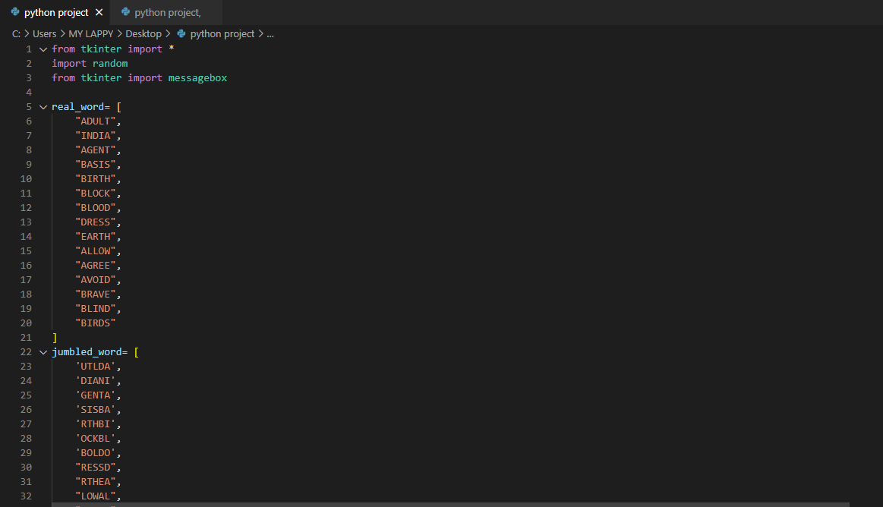
Code of project

Slide 12
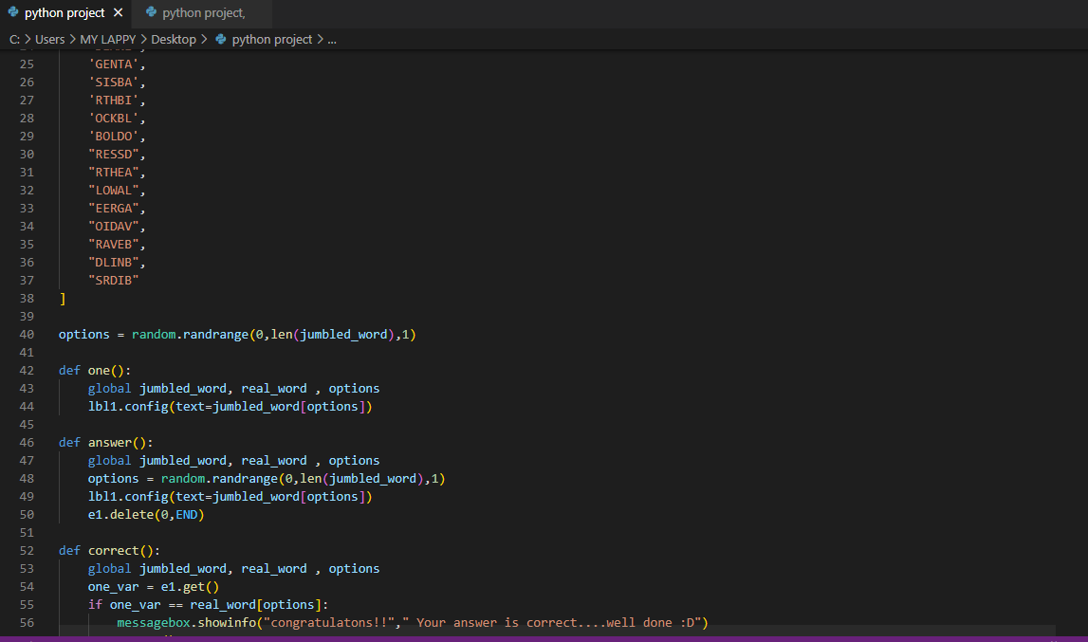
Code of project

Slide 13
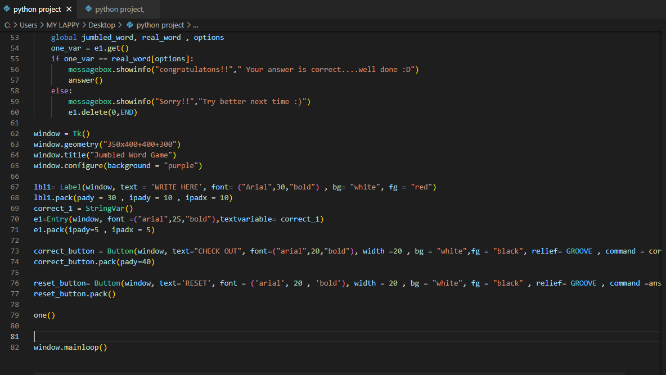
Code of project

Slide 14
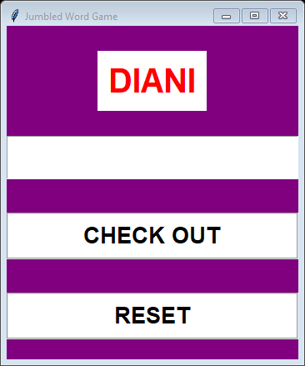
Output
This window will be open after running the code.
Firstly it will show the button for jumbled word, then second button to write answer, then third to check the answer, and at last to reset the word.

Slide 15
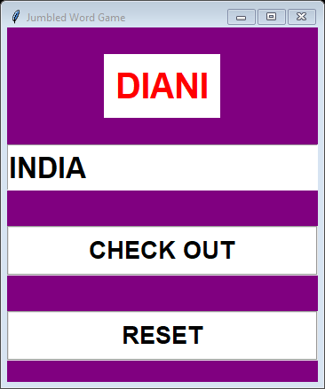
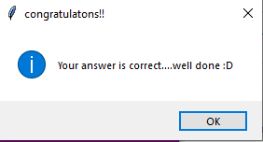
Output
1. Writing correct answer in answer button.
After checking answer this
this message box appears.

Slide 16

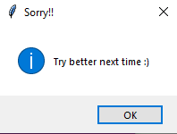
Output
2. Writing wrong answer in the answer button.
After checking answer this
message box appears.

Slide 17
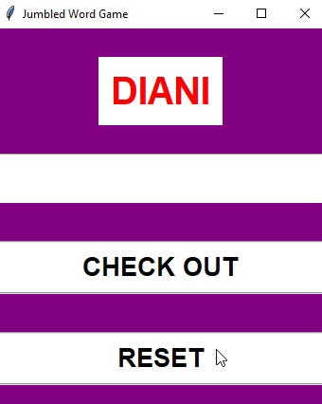
3. Reset jumbled word.
The words will be reset according to the words provided in the code only .

Slide 18
Referances
Python Documentation
Geeksforgeeks
Freecodecamp
tkinter Documentation

Slide 19
Thank You

