Slide 1
Sentiment analysis of Amazon-Fine-Food Reviews
Karishma Ghiya
Anushka Kher

Slide 2
Dataset
Data Source: https://www.kaggle.com/snap/amazon-fine-food-reviews
Data columns:
Id
ProductId → Unique product identifier
UserId
ProfileName
HelpfulnessNumerator
HelpfulnessDenominator → number of users who indicated whether they found review helpful or not
Score → product ratings between 1 to 5
Time
Summary → brief summary of text
Text → review

Slide 3
Objective
Perform sentiment analysis on amazon fine food reviews
Generate polarity for each review and corresponding summary
Extracting the product title and description using Amazon API
Creating visualizations to find interesting patterns among dataset variables
Building a prediction model to predict if a review is positive or negative

Slide 4
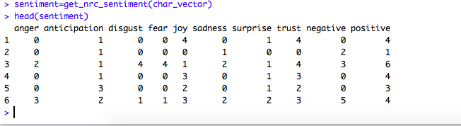
Syuzhet Package
Used CRAN syuzhet package to calculate sentiments associated with each review.
Arguments: character vector
Return value: a data frame where each row represents a review and columns indicate value of each emotion type for the review

Slide 5

Syuzhet Package(contd.)
Arguments: a character vector. a string indicating the sentiment method
Return value: a numeric vector of sentiment value for each review

Slide 6
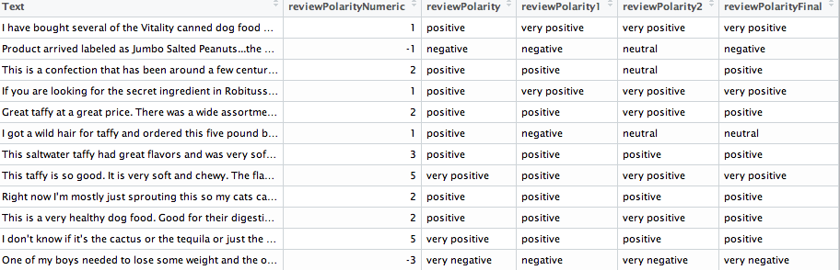
Generating polarity
First prediction: using get_sentiment() value
Second Prediction: using positive and negative sentiments from get_nrc_sentiment() vector
Third prediction: using different sentiments from get_nrc_sentiment() vector
Final prediction: calculated based on previous three predictions

Slide 7
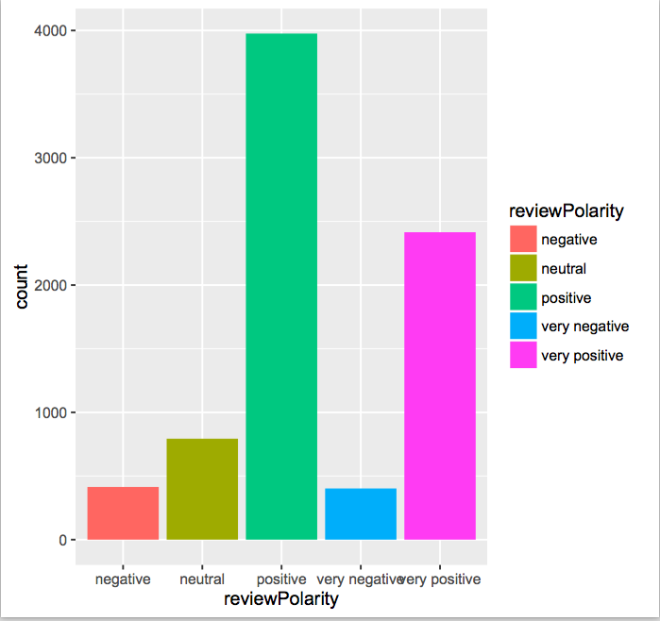
Data exploration
Count of reviews based on their polarity

Slide 8
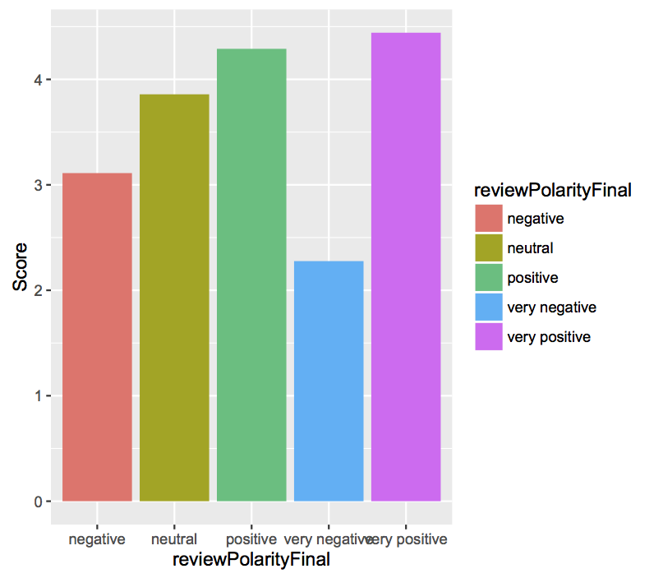
Data exploration(contd.)
Ggplot of polarity against score

Slide 9
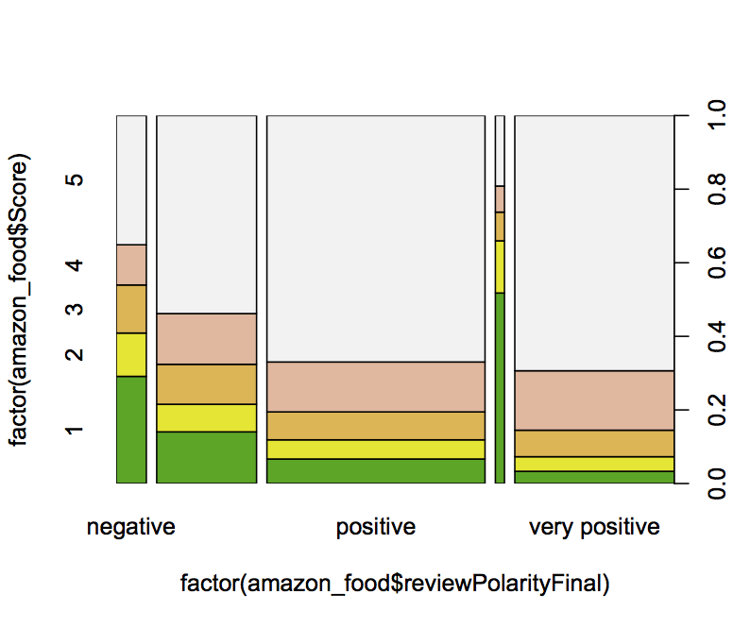
Data exploration(contd.)
Spine plot of polarity against score

Slide 10
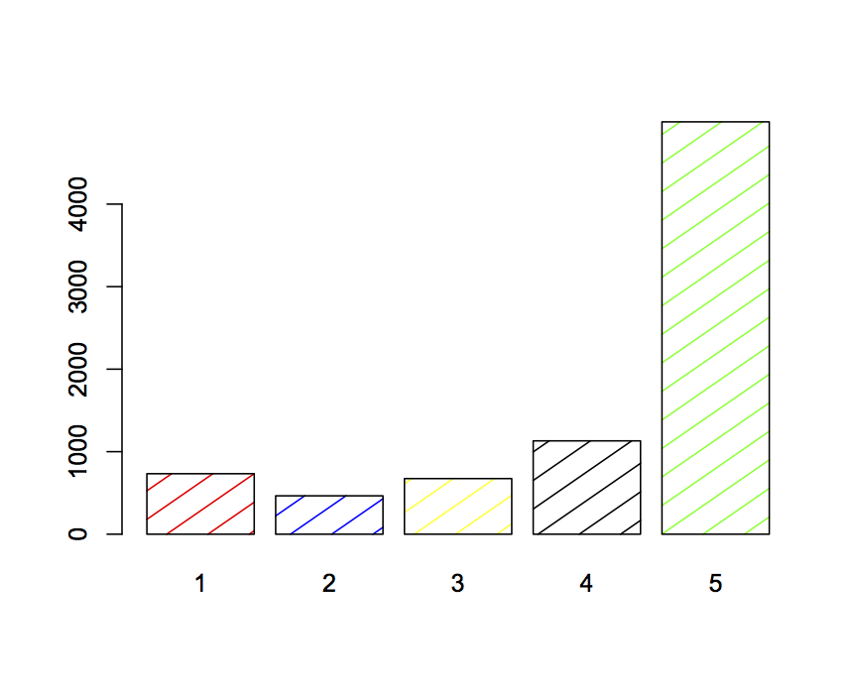
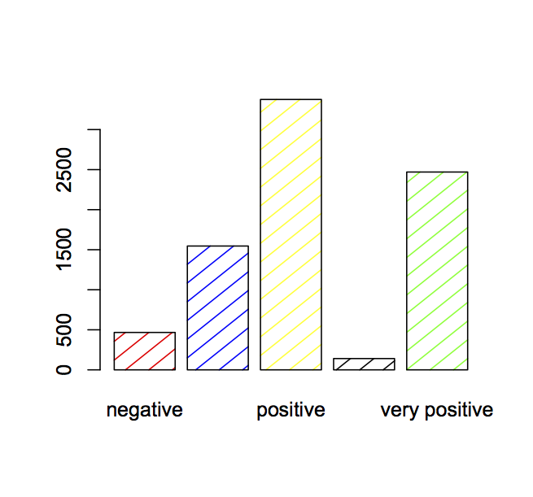
Data exploration(contd.)
Count of polarity
Count of score

Slide 11
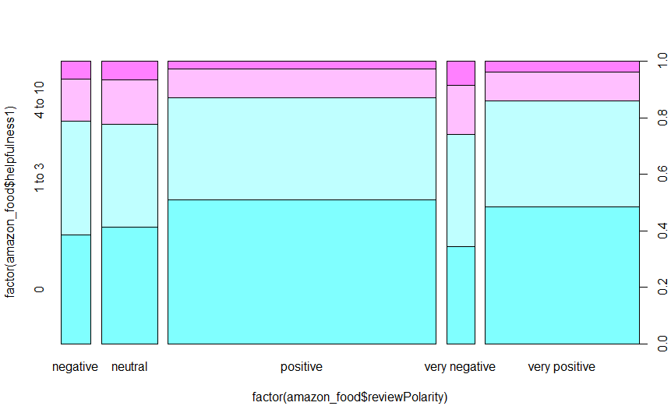
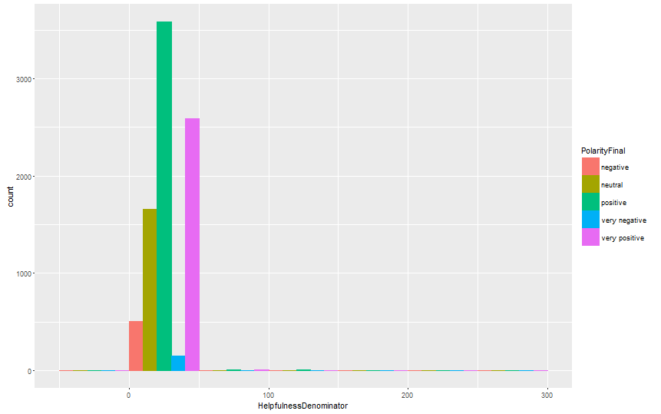
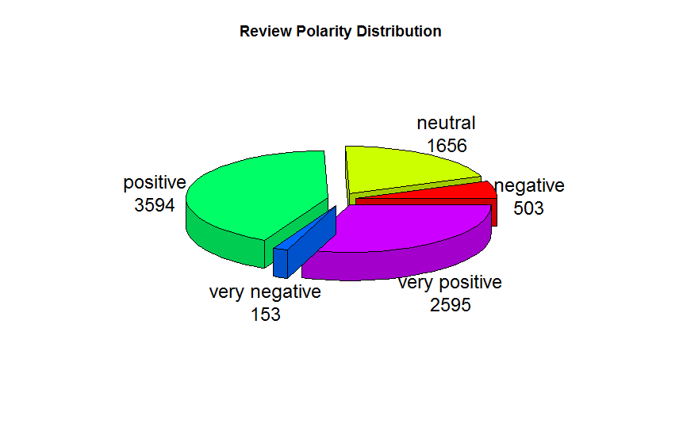
Data exploration(contd.)
Polarity vs Helpfulness

Slide 12
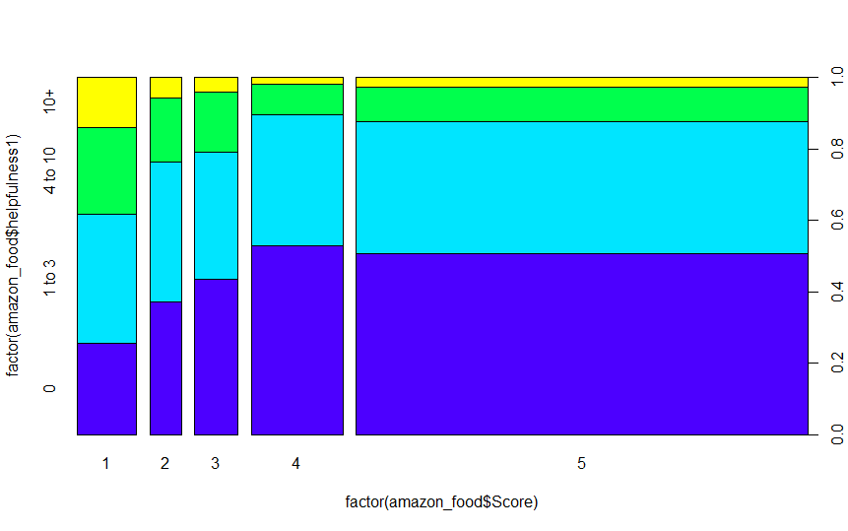
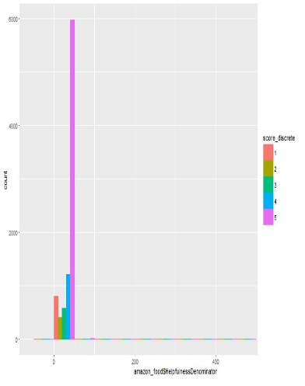
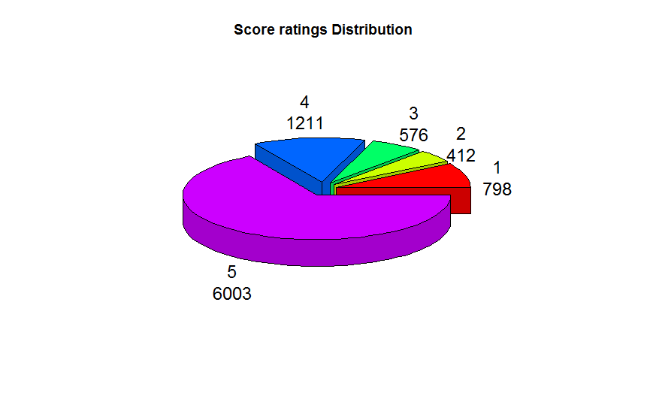
Data Exploration(contd.)
Score vs Helpfulness

Slide 13
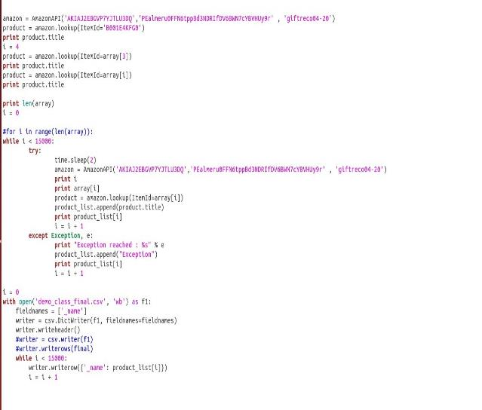
Amazon’s Product Advertising API
Use of API to extract product title of the given product ID for all reviews in the dataset.
Amazon Product Advertising API: ItemLookup() function
Necessary parameters to use API:
AWS Access Key ID
Amazon Secret Key
Associate Tag

Slide 14
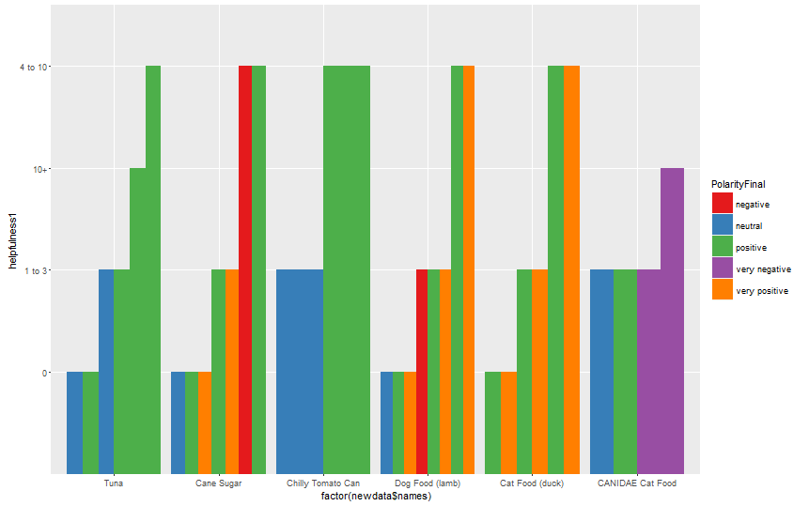
Data Exploration(contd.)
Pet Food:
Dog Food(Lamb)
Cat Food (Duck)
CANIDAE Cat Food
Human Food:
Tuna
Cane Sugar
Chilly Tomato Can

Slide 15
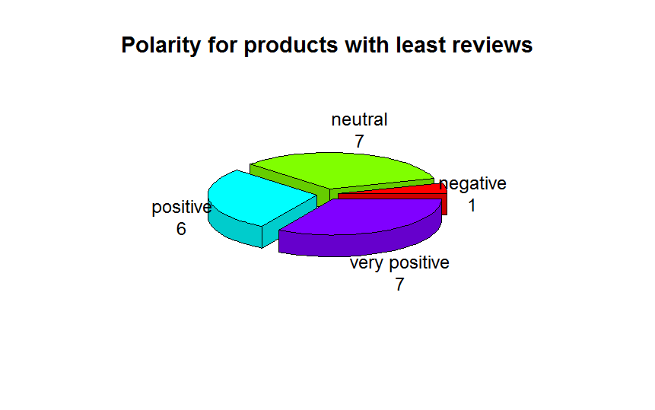
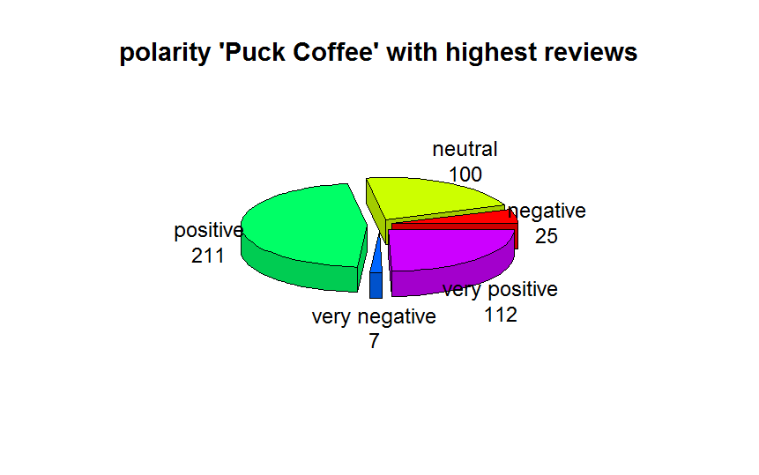
Data Exploration(contd.)
Products with least reviews (1 to 3 reviews):
Vanilla extract
Chocolate Bar
Pasta
Popchips
Skyflakes Crackers
Spectrum Shortening
Berries
Cocoa Bar
455 reviews for Puck Coffee, highest number in the dataset

Slide 16
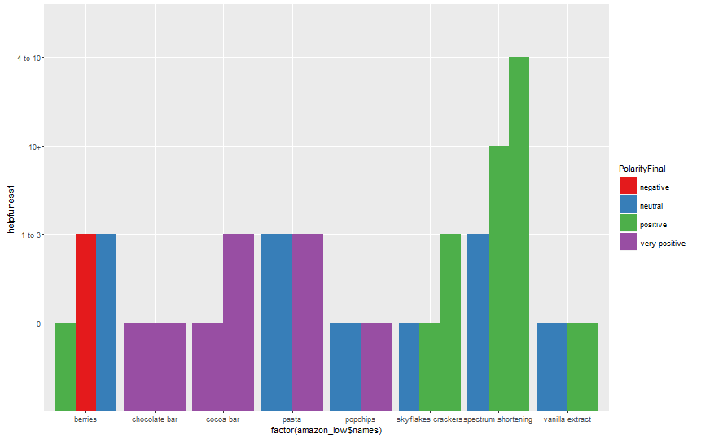
Data Exploration(contd.)
Helpfulness comparison across products with least reviews

Slide 17
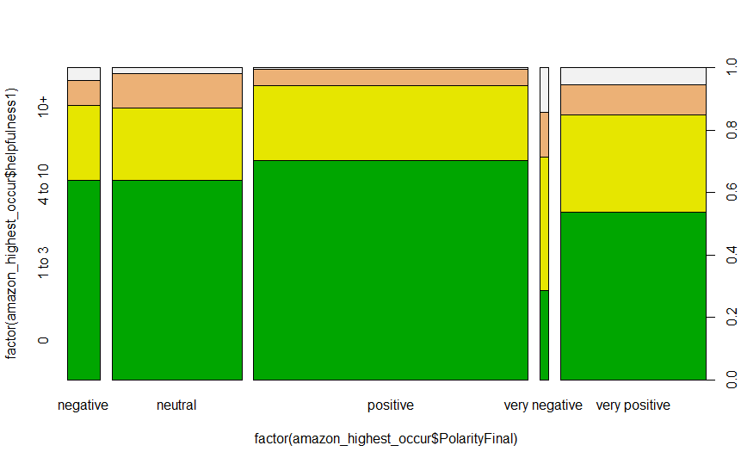
Data Exploration(contd.)
Helpfulness comparison for product with highest reviews
Product: PUCK COFFEE
No of Reviews: 455

Slide 18
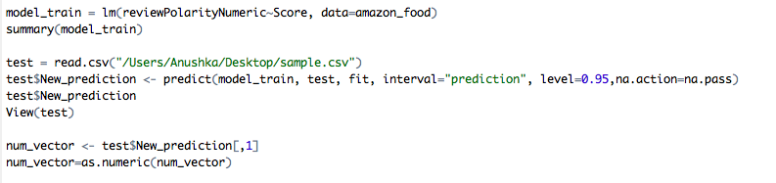
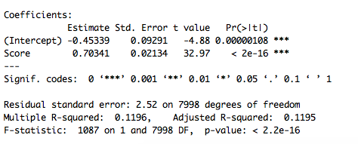
Prediction model
Built a linear regression model considering
IV: Score and DV: sentiment value

Slide 19
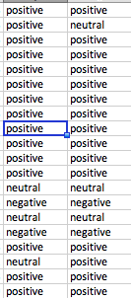
Prediction Model(contd.)
Sample of predicted polarity against original polarity
While making final predictions, only three main categories were considered: positive, negative and neutral.

Slide 20
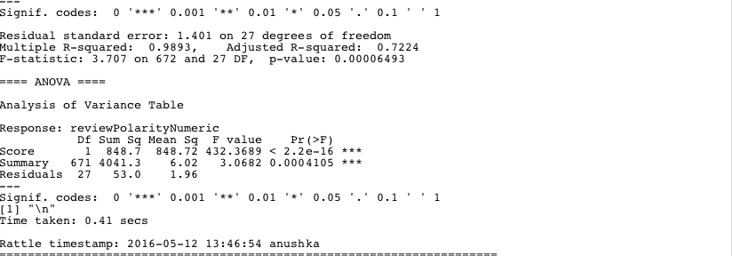
Prediction Model(contd.)
DV: sentiment value
IV: Score and summary of text

Slide 21
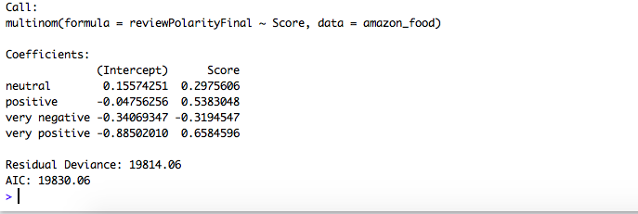
Multinomial Regression
Is used as an extension of binomial logistic regression, to predict different outcomes of a categorical DV. (categories > 2).

Slide 22
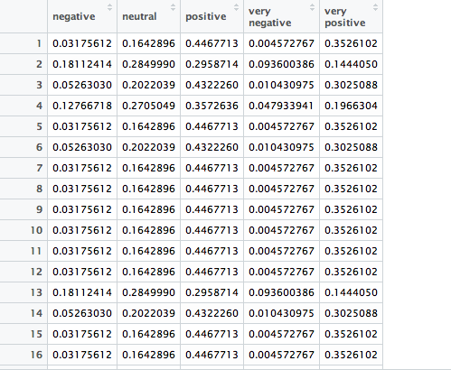
Multinomial Regression(contd.)
Builds a prediction model
and predicts the probabilities
of each category of polarity

Slide 23
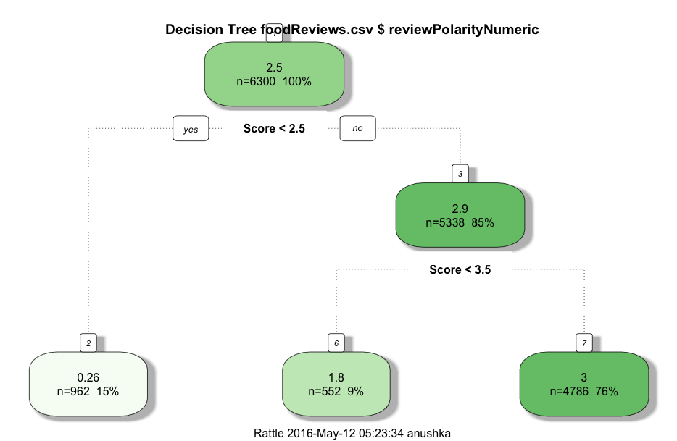
Prediction Model(contd.)
Decision Tree

Slide 24
Limitations and future work
Limitations
The data consists of reviews until October 2012.
Helpfulness, product description, review text was not used to build a prediction model
Entire dataset was not used to perform sentiment analysis
Future Work
Text of review can be used directly to make predictions instead of generating a sentiment value
Some more analysis can be shown between product description and other features of the dataset.

Slide 25
Thank You!

