Slide 1

Autism Spectrum Disorder Detection in toddlers
By- Karishma Padale

Slide 2

Few clinics for Autism Spectrum Disorder(ASD) detection
Lot of money and time needed.
Child may or may not have it.
Prescreening required to save time

Slide 3

Project Definition
To predict if a toddler needs to go to ASD Diagnosis clinic based on the pre-screening process.
The prevalence is 69.1% of toddlers show traits of ASD in the pre-screening process and should be sent to ASD diagnosis clinic.

Slide 4

Dataset
The data is from Kaggle.
Link of the data :(https://www.kaggle.com/fabdelja/autism-screening-for-toddlers#Toddler%20Autism%20dataset%20July%202018.csv).
The data consists of around 1054 observations of toddlers from ASD screening centers for Autism.
There are 1054 rows and 19 columns.

Slide 5
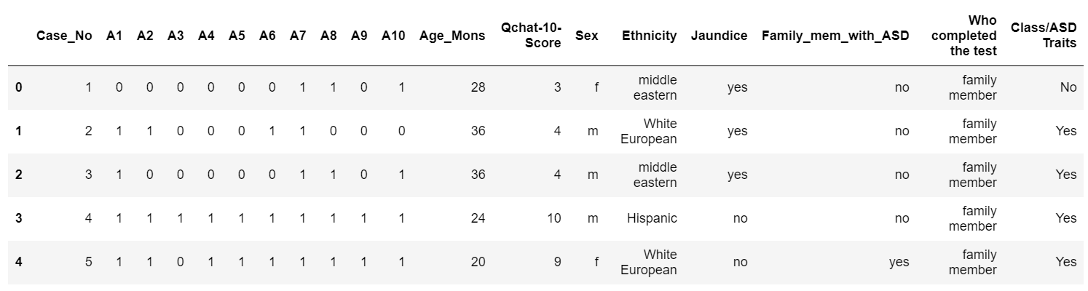
Feature Engineering
There are 11 Numerical features and 7 Categorial features.
One- hot encoding has been done on 1 feature ‘Ethnicity’.
There are 2 identifiers.

Slide 6
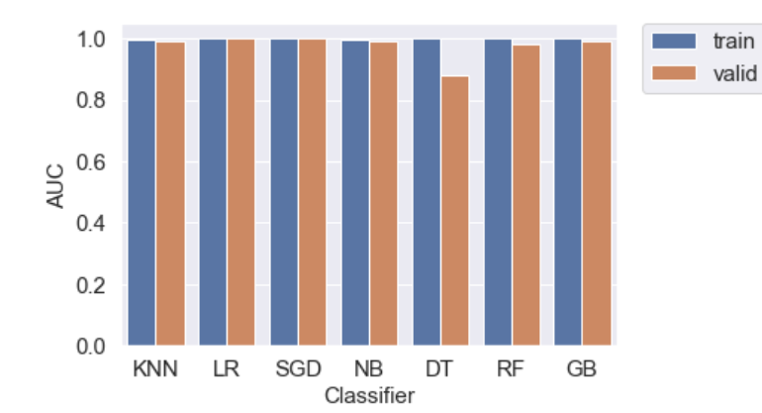
Best Baseline Model
Random Forest
It is a supervised machine learning algorithm.
It is easy to use and is flexible.
It is used for both classification and regression methods.
It creates random forests which is obtained from merging of decision trees for more accurate and stable predictions.
Random Forest adds extra arbitrariness to the model, while developing the trees.
Rather than looking for the most significant component while part a node, it scans for the best element among a random subset of features.
This outcomes in a wide assorted variety that by and large outcomes in a superior model.
It uses only random subset of features to split the node.

Slide 7
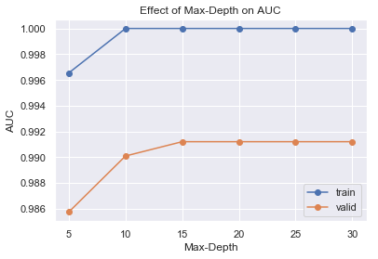
Effect of Hyperparameter
Max-Depth = 5 is the hyperparameter used.

Slide 8
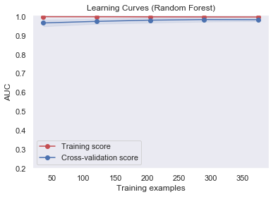
Improving model
The model is a high bias which is also known as underfitting.
It means that the model is not capturing all the signals as it would from data.
It is a measure of model rigidity and inflexibility.
To improve this model the techniques we can use is to add more features, Regularization, Change model architecture.

Slide 9
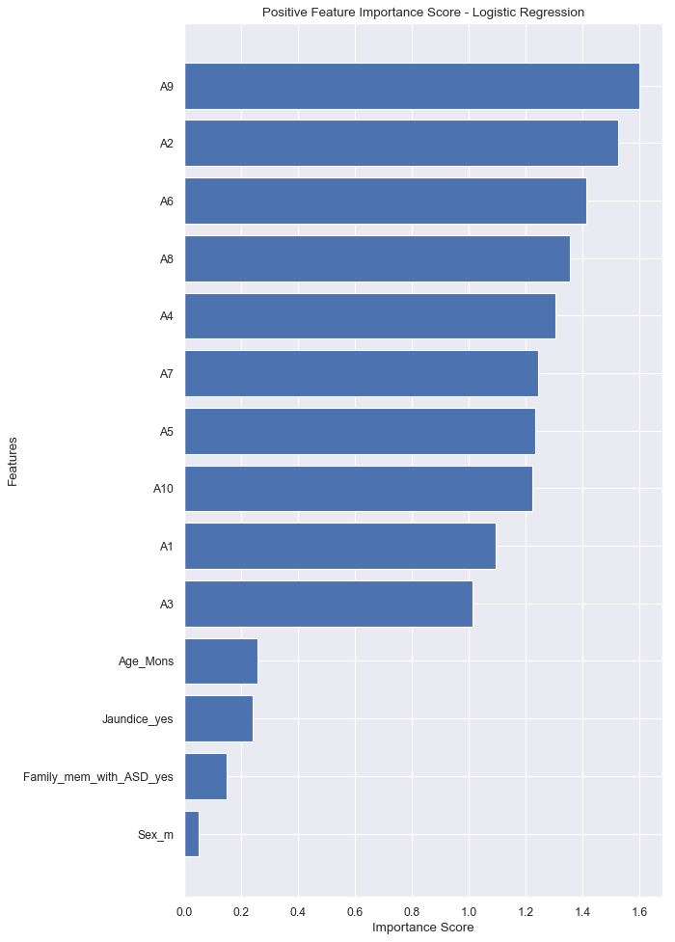
Selection of best model
Feature Importance

Slide 10
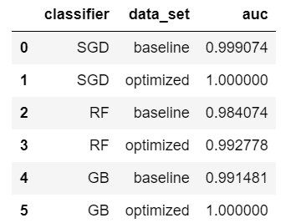
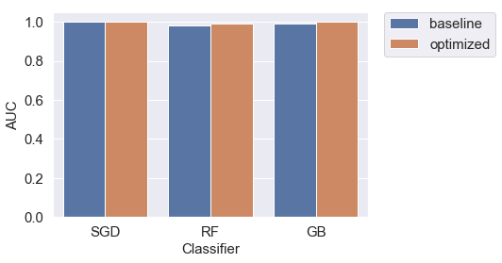
Selection of best model
Hyper tuning method : Random Forest

Slide 11
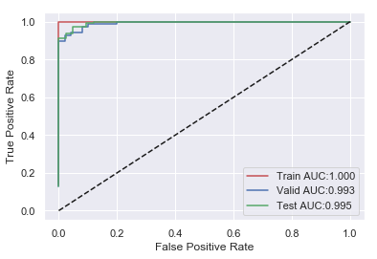
Model Evaluation
Training:
AUC:1.000
accuracy:1.000
recall:1.000
precision:1.000
specificity:1.000
prevalence:0.500
Validation:
AUC:0.993
accuracy:0.949
recall:0.944
precision:0.981
specificity:0.960
prevalence:0.684
Test:
AUC:0.995
accuracy:0.943
recall:0.931
precision:0.991
specificity:0.976
prevalence:0.734
Random Forest

